Slide 1
Lecture 7:
Generative Models

Slide 2
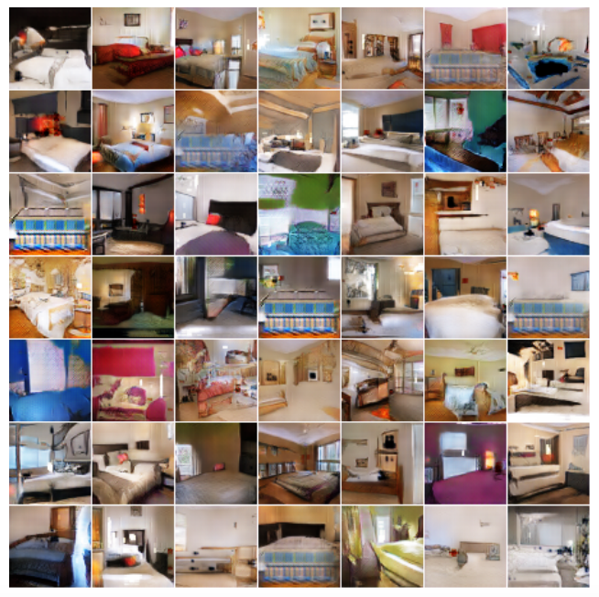
Generative modeling tasks
Generation: learn to sample from the distribution represented by the training set

Slide 3
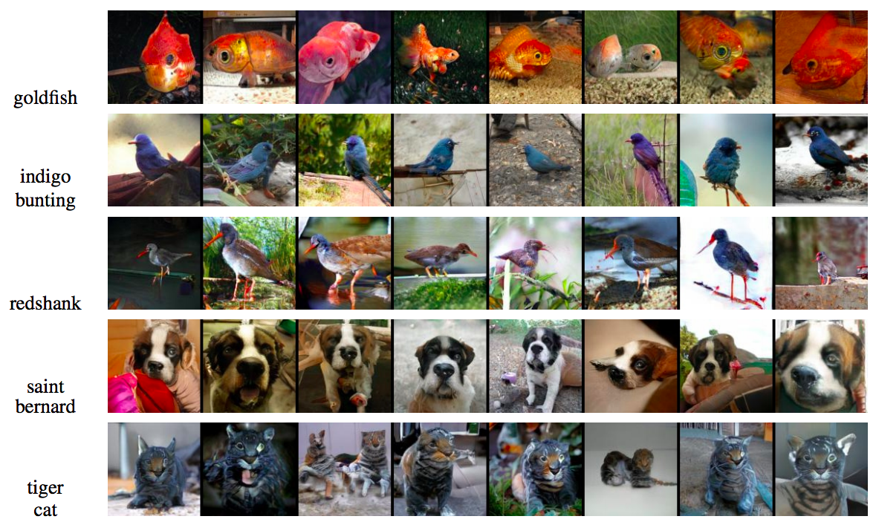
Generative modeling tasks
Generation conditioned on class label or text prompt
Figure source

Slide 4
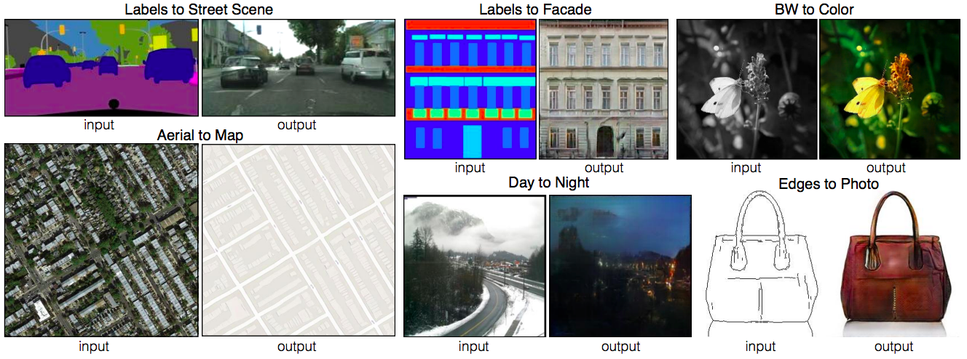
Generative modeling tasks
Generation conditioned on image (image-to-image translation)
P. Isola, J.-Y. Zhu, T. Zhou, A. Efros, Image-to-Image Translation with Conditional Adversarial Networks, CVPR 2017

Slide 5
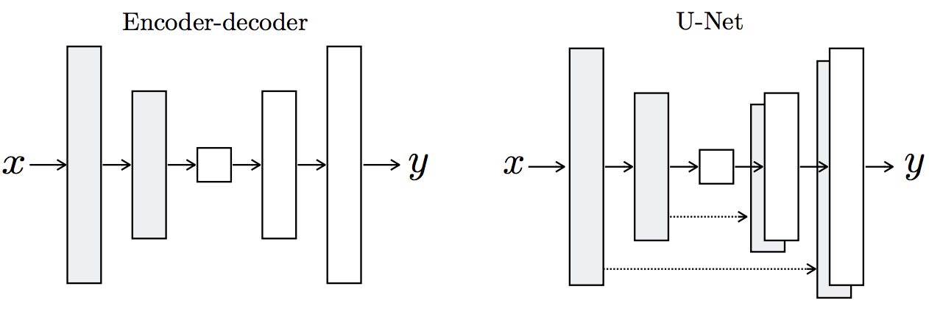
Designing a network for generative tasks
We need an architecture that can generate an image
Random seed or latent code
Unconditional generation

Slide 6
Designing a network for generative tasks
We need an architecture that can generate an image
Image-to-image translation

Slide 7
Designing a network for generative tasks
We need an architecture that can generate an image
We need to design the right loss function and training framework

Slide 8
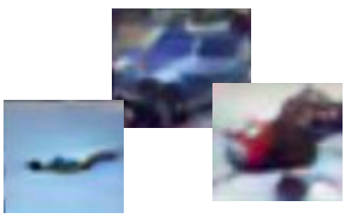
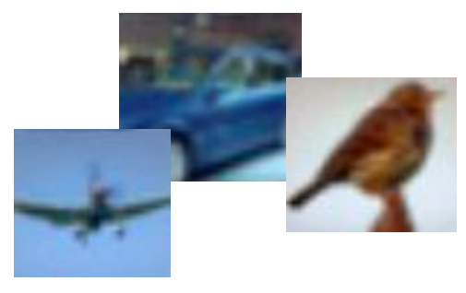
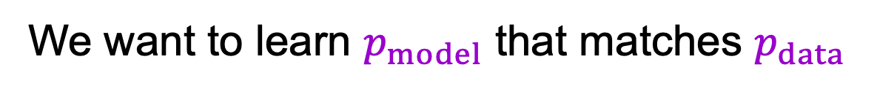
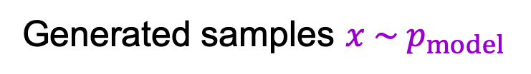
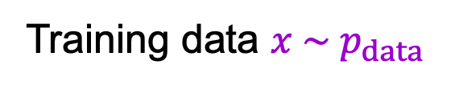
Learning to sample
Training data $x \sim p_{data}$
Generated samples $x \sim p_{model}$
We want to learn $p_{model}$ that matches $p_{data}$
Adapted from Stanford CS231n

Slide 9



Generative adversarial networks
Train two networks with opposing objectives:
  Generator: learns to generate samples
  Discriminator: learns to distinguish between generated and real samples
$$G$$
$$D$$
Random noise $z$
“Fake”
$$D$$
“Real”
Figure adapted from F. Fleuret
I. Goodfellow et al. Generative adversarial nets. NeurIPS 2014

Slide 10
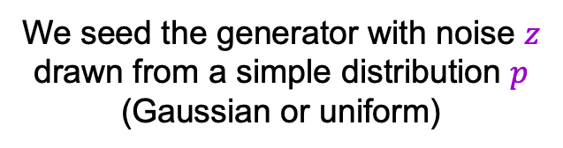
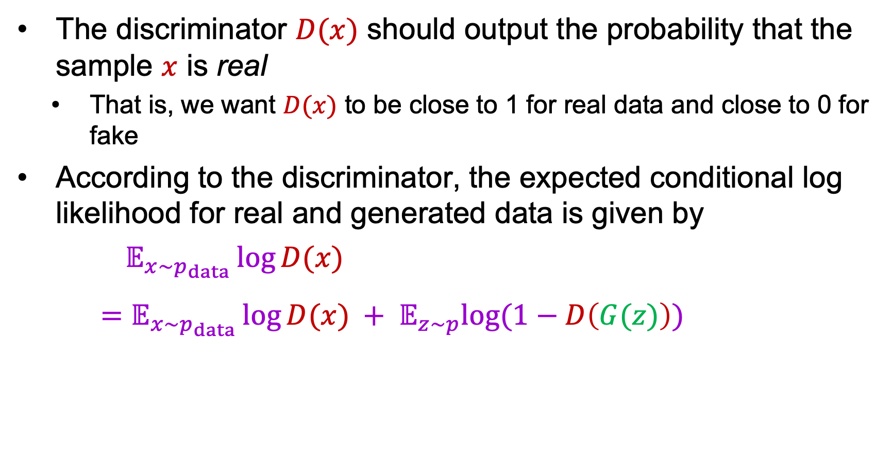
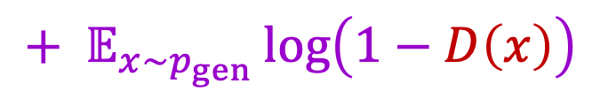
GAN objective
The discriminator $D(x)$ should output the probability that the sample $x$ is real
  That is, we want $D(x)$ to be close to 1 for real data and close to 0 for fake
According to the discriminator, the expected conditional log likelihood for real and generated data is given by
$𝔼_{x\sim p_{data}}\log{D(x)}$
$=𝔼_{x\sim p_{data}}\log{D(x)} + 𝔼_{z\sim p}log⁡(1−D\left(G(z)\right))$
$$+ 𝔼_{x\sim p_{gen}}\log\left(1−D\left(x\right)\right)$$
We seed the generator with noise $z$ drawn from a simple distribution $p$ (Gaussian or uniform)

Slide 11

Non-saturating GAN loss (NSGAN)
  $\min_{w_{G}}𝔼_{z\sim p} log⁡(1−D\left(G(z)\right))$ vs. $\max_{w_{G}}𝔼_{z\sim p} log⁡(D\left(G(z)\right))$
Minimize log-probability of generator samples labeled “fake”
Maximize log-probability of generator samples labeled “real”

Slide 12
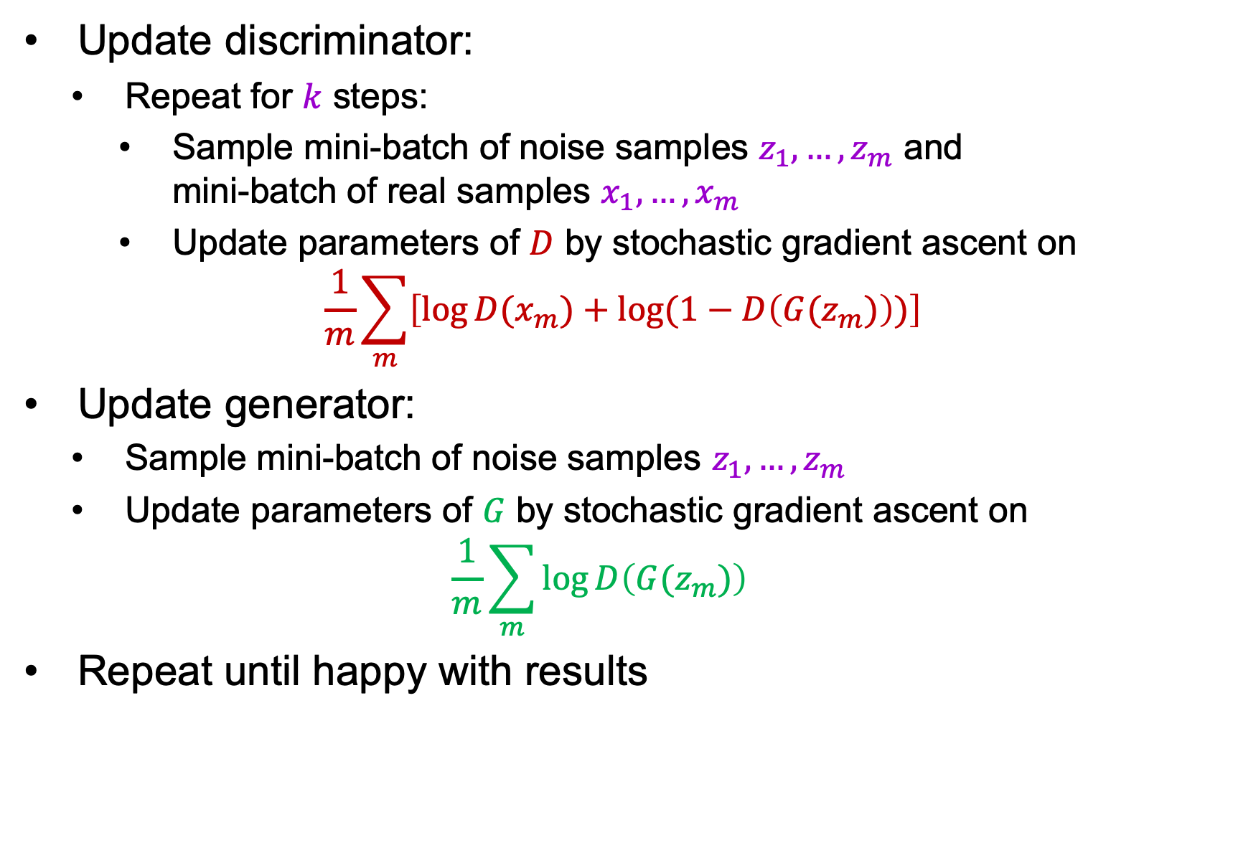
GAN training in practice
Update discriminator:
  Repeat for $k$ steps:
    Sample mini-batch of noise samples $z_{1},…, z_{m}$ and
    mini-batch of real samples $x_{1},…, x_{m}$
    Update parameters of $D$ by stochastic gradient ascent on
$$\frac{1}{m}\sum_{m}{\left[\log{D(x_{m})}+log⁡(1−D\left(G(z_{m})\right))\right]}$$
Update generator:
  Sample mini-batch of noise samples $z_{1},…, z_{m}$
  Update parameters of $G$ by stochastic gradient ascent on
  $$\frac{1}{m}\sum_{m}{\log{D\left(G(z_{m})\right)}}$$
Repeat until happy with results
Notes:
From the paper: Optimizing D to completion in the inner loop of training is computationally prohibitive, and on finite datasets would result in overfitting. Instead, we alternate between k steps of optimizing D and one step of optimizing G. This results in D being maintained near its optimal solution, so long as G changes slowly enough

Slide 13








GAN: Schematic picture
Update discriminator: push $D(x_{data})$ close to 1 and $D\left(G(z)\right)$ close to 0
  The generator is a “black box” to the discriminator
$$G(z)$$
$$z$$
$$G$$
$$D$$
$$D\left(G(z)\right)$$
$$D(x_{data})$$
$$x_{data}$$

Slide 14


GAN: Schematic picture
Update generator: increase $D\left(G(z)\right)$
  Requires back-propagating through the composed generator-discriminator network (i.e., the discriminator cannot be a black box)
  The generator is exposed to real data only via the output of the discriminator and its gradients
$$G(z)$$
$$z$$
$$G$$
$$D$$
$$D\left(G(z)\right)$$

Slide 15

GAN: Schematic picture
Test time – the discriminator is discarded
$$z$$
$$G$$
$$G(z)$$

Slide 16
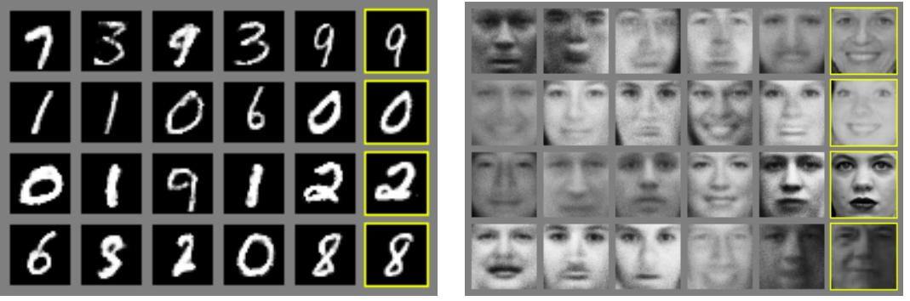
Original GAN results
MNIST digits
Toronto Face Dataset
Nearest real image for sample to the left
I. Goodfellow et al. Generative adversarial nets. NeurIPS 2014

Slide 17
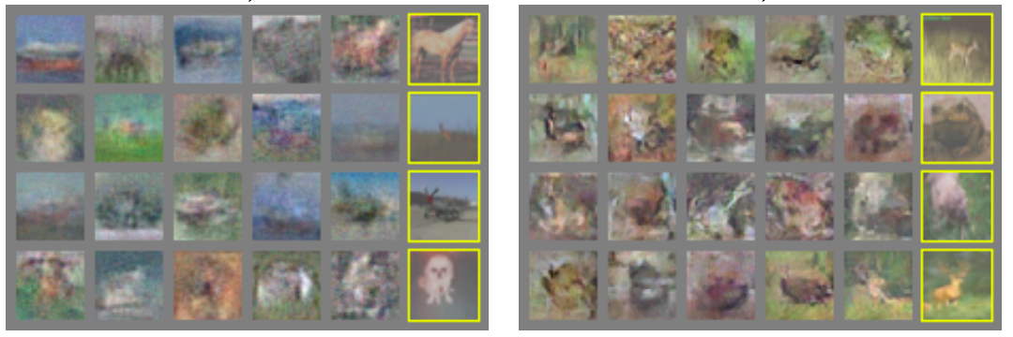
Original GAN results
CIFAR-10 (FC networks)
CIFAR-10 (conv networks)
I. Goodfellow et al. Generative adversarial nets. NeurIPS 2014

Slide 18
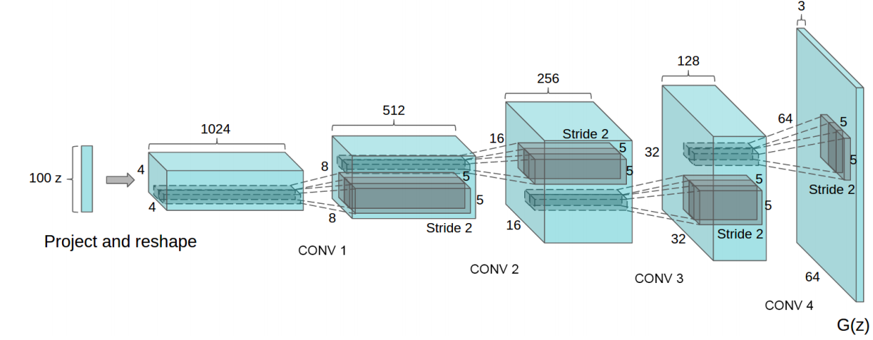
DCGAN
Early, influential convolutional architecture for generator
Uniformly distributed input
Linear transformation
Four transposed convolution layers with output stride of 2 for upsampling, followed by ReLU activations
Tanh activations in the last layer
A. Radford, L. Metz, S. Chintala, Unsupervised representation learning with deep convolutional generative adversarial networks, ICLR 2016

Slide 19
DCGAN
Early, influential convolutional architecture for generator
Discriminator architecture (empirically determined to give best training stability):
  Don’t use pooling, only strided convolutions
  Use Leaky ReLU activations (sparse gradients cause problems for training)
  Use only one FC layer before the softmax output
  Use batch normalization after most layers (in the generator also)
A. Radford, L. Metz, S. Chintala, Unsupervised representation learning with deep convolutional generative adversarial networks, ICLR 2016

Slide 20
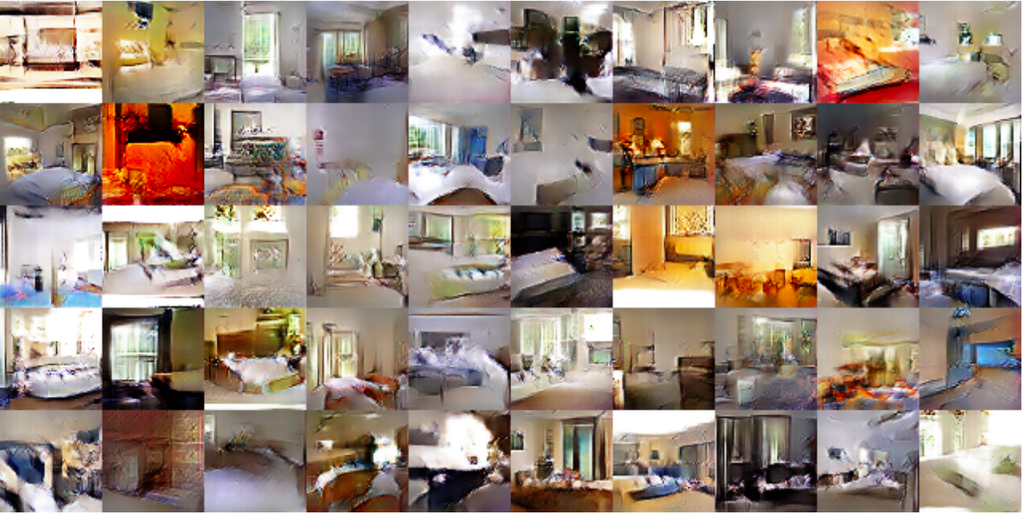
DCGAN results
Generated bedrooms after one epoch

Slide 21
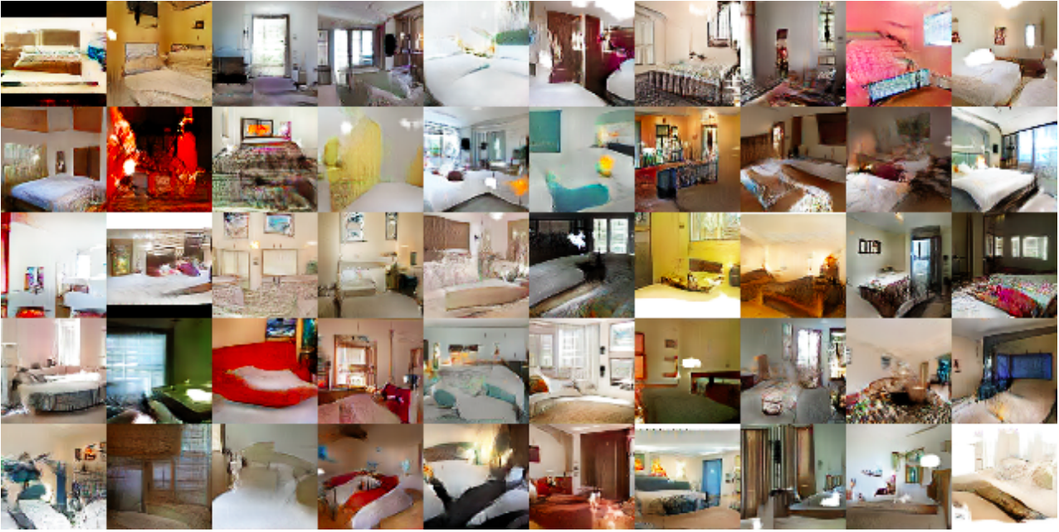
DCGAN results
Generated bedrooms after five epochs

Slide 22
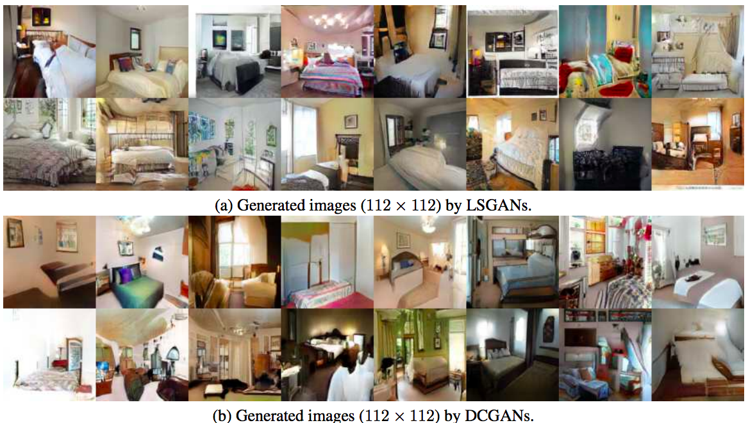
Least Squares GAN (LSGAN)
Benefits (claimed)
  Higher-quality images
X. Mao et al. Least squares generative adversarial networks. ICCV 2017

Slide 23
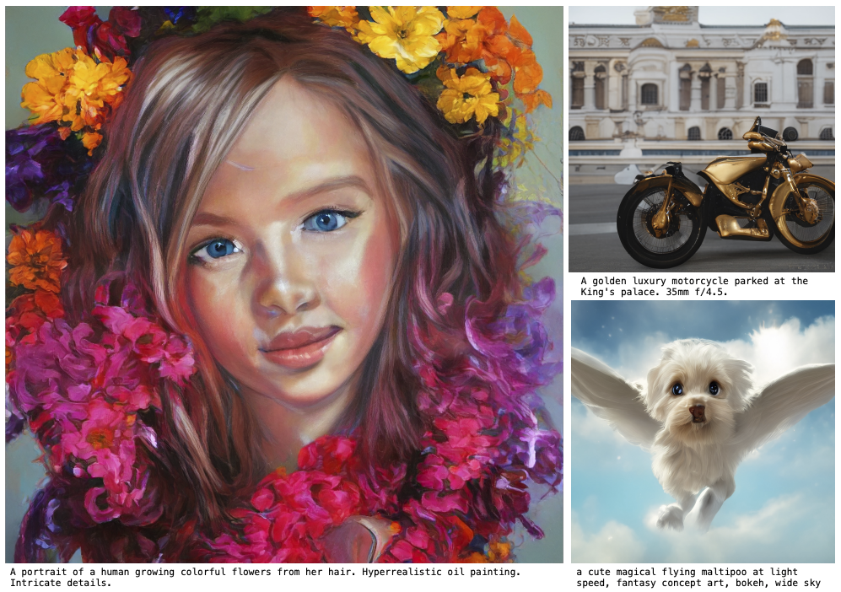
The rise (and fall?) of GANs
M. Kang et al. Scaling up GANs for Text-to-Image Synthesis. CVPR 2023

Slide 24
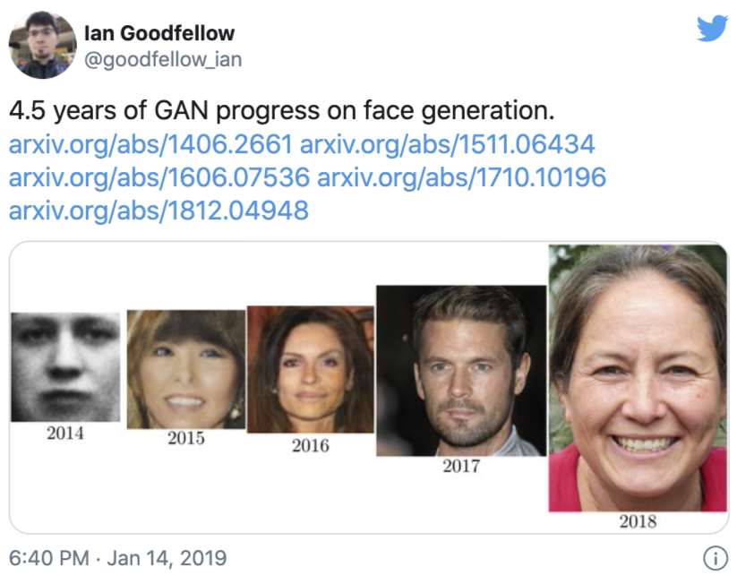
The rise of GANs

Slide 25
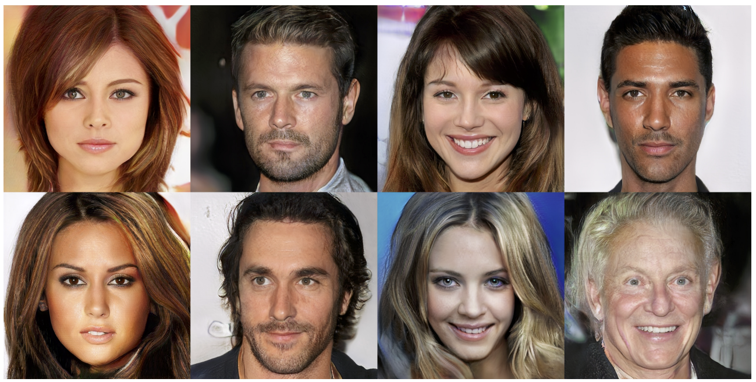
Progressive GANs
Realistic face images up to 1024 x 1024 resolution
T. Karras, T. Aila, S. Laine, J. Lehtinen. Progressive Growing of GANs for Improved Quality, Stability, and Variation. ICLR 2018

Slide 26
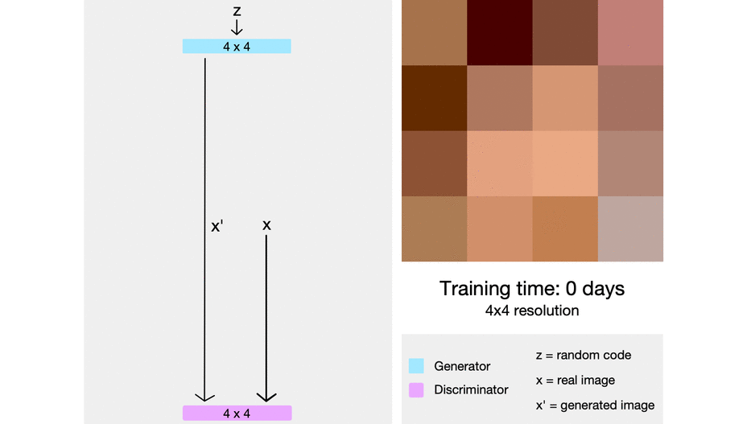
Progressive GANs
Key idea: train lower-resolution models, gradually add layers corresponding to higher-resolution outputs
Source
T. Karras, T. Aila, S. Laine, J. Lehtinen. Progressive Growing of GANs for Improved Quality, Stability, and Variation. ICLR 2018

Slide 27
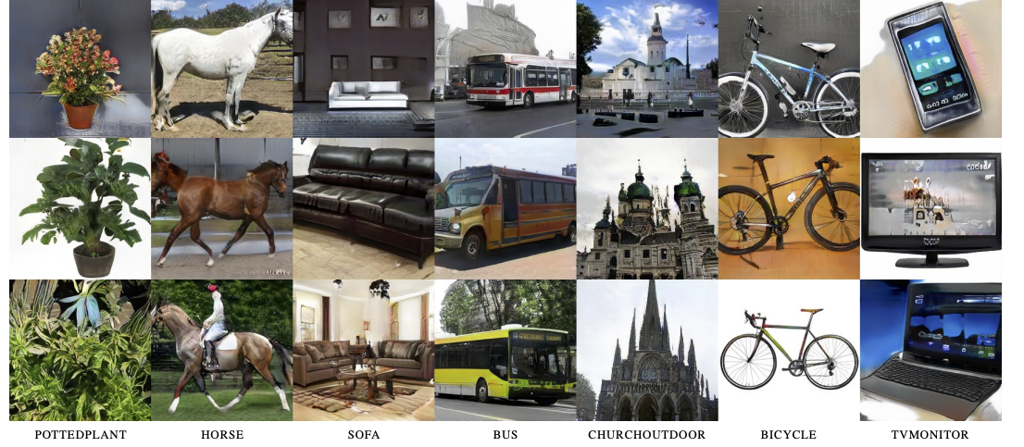
Progressive GANs: Results
256 x 256 results for LSUN categories

Slide 28
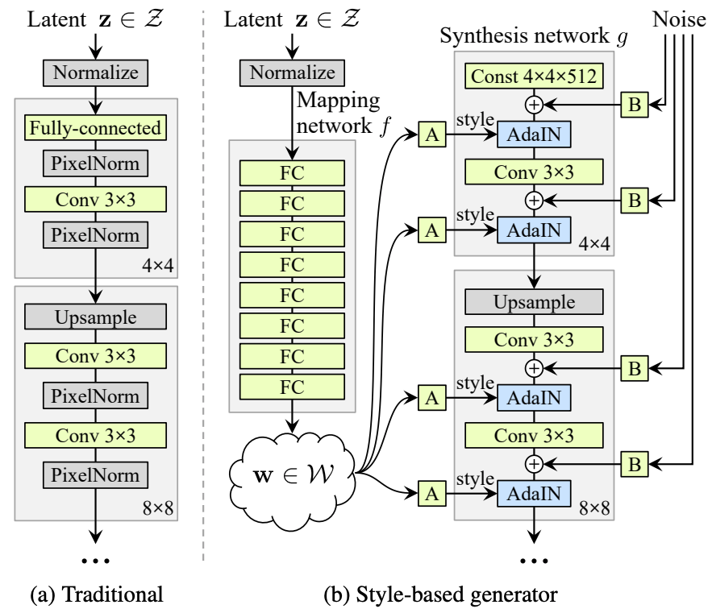
StyleGAN
Built on top of Progressive GAN
T. Karras, S. Laine, T. Aila. A Style-Based Generator Architecture for Generative Adversarial Networks. CVPR 2019

Slide 29
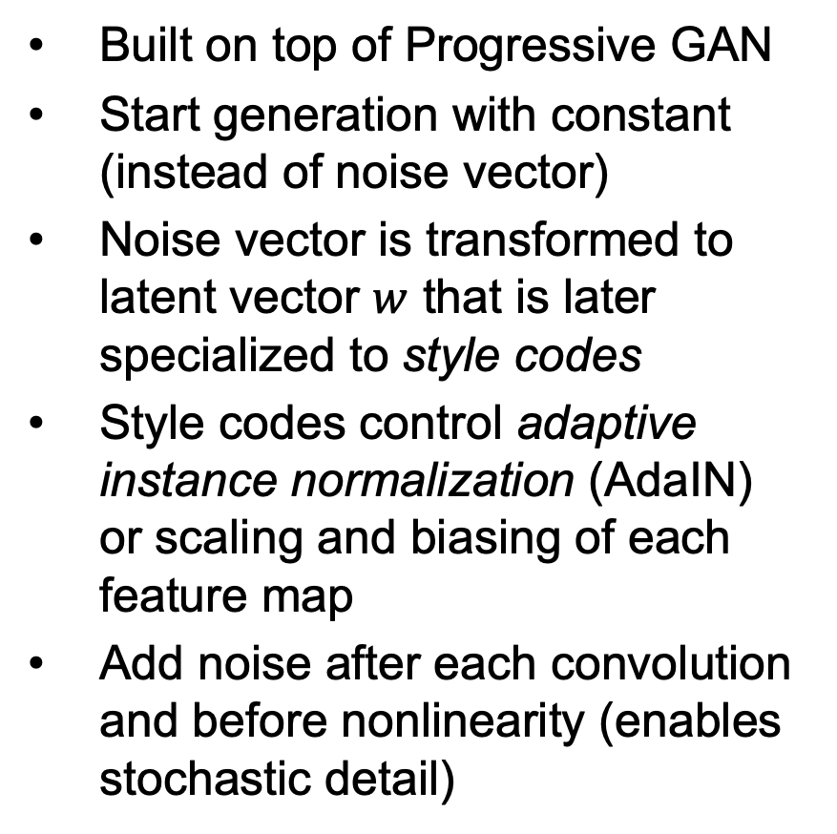
StyleGAN
Built on top of Progressive GAN
Start generation with constant (instead of noise vector)
Noise vector is transformed to latent vector $w$ that is later specialized to style codes
Style codes control adaptive instance normalization (AdaIN) or scaling and biasing of each feature map
Add noise after each convolution and before nonlinearity (enables stochastic detail)
T. Karras, S. Laine, T. Aila. A Style-Based Generator Architecture for Generative Adversarial Networks. CVPR 2019

Slide 30
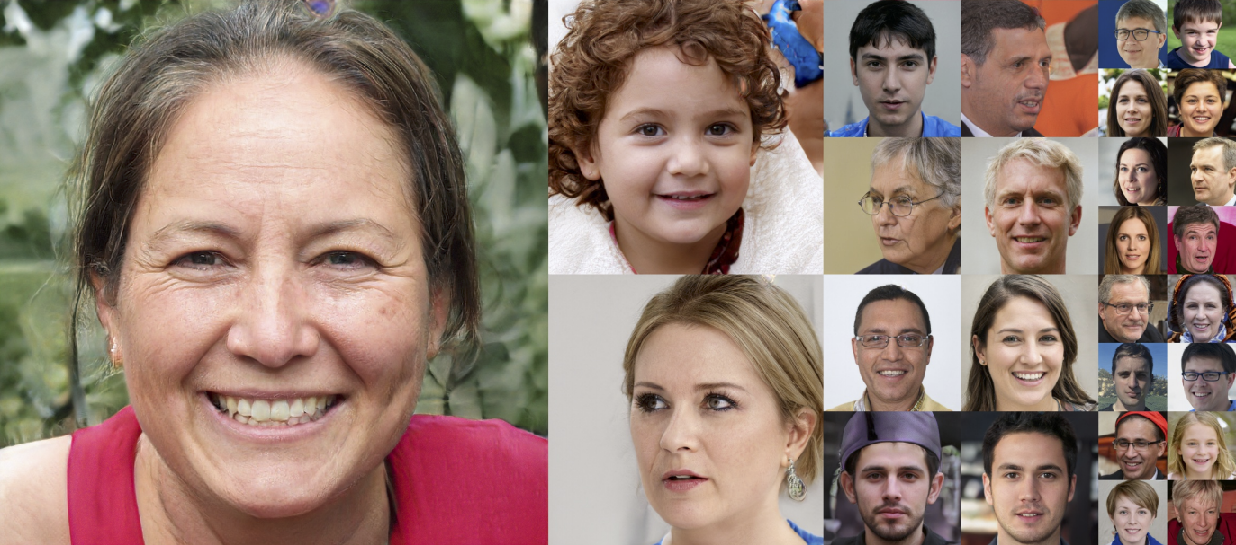
StyleGAN: Results
T. Karras, S. Laine, T. Aila. A Style-Based Generator Architecture for Generative Adversarial Networks. CVPR 2019

Slide 31
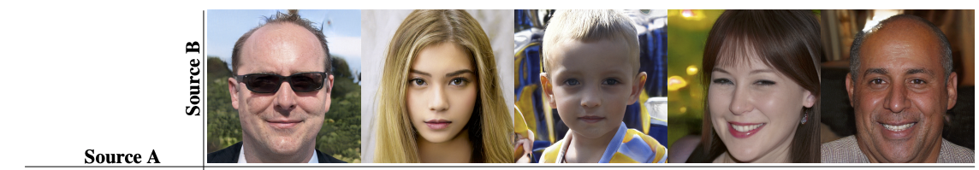
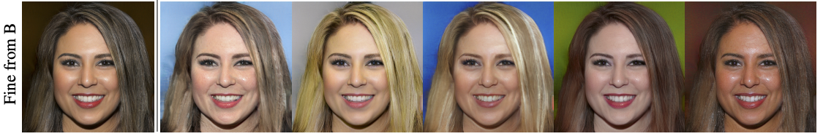
Mixing styles
“Two sets of images were generated from their respective latent codes (sources A and B); the rest of the images were generated by copying a specified subset of styles from source B and taking the rest from source A.”
Notes:
Two sets of images were generated from their respective latent codes (sources A and B); the rest of the images were generated by copying a specified subset of styles from source B and taking the rest from source A. Copying the styles corresponding to coarse spatial resolutions (4 2 – 8 2 ) brings high-level aspects such as pose, general hair style, face shape, and eyeglasses from source B, while all colors (eyes, hair, lighting) and finer facial features resemble A. If we instead copy the styles of middle resolutions (162 – 322 ) from B, we inherit smaller scale facial features, hair style, eyes open/closed from B, while the pose, general face shape, and eyeglasses from A are preserved. Finally, copying the fine styles (642 – 10242 ) from B brings mainly the color scheme and microstructure.

Slide 32
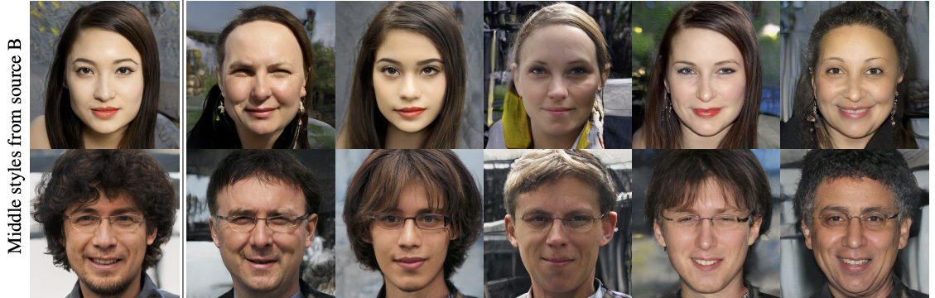
Mixing styles
Notes:
Two sets of images were generated from their respective latent codes (sources A and B); the rest of the images were generated by copying a specified subset of styles from source B and taking the rest from source A. Copying the styles corresponding to coarse spatial resolutions (4 2 – 8 2 ) brings high-level aspects such as pose, general hair style, face shape, and eyeglasses from source B, while all colors (eyes, hair, lighting) and finer facial features resemble A. If we instead copy the styles of middle resolutions (162 – 322 ) from B, we inherit smaller scale facial features, hair style, eyes open/closed from B, while the pose, general face shape, and eyeglasses from A are preserved. Finally, copying the fine styles (642 – 10242 ) from B brings mainly the color scheme and microstructure.

