Slide 1
Lecture 6:
Segmentation

Slide 2
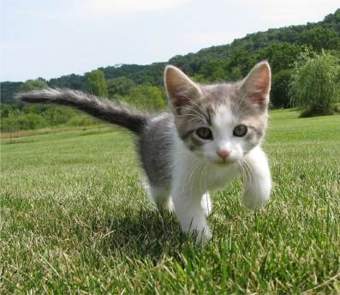
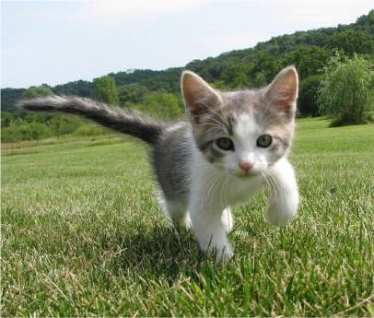
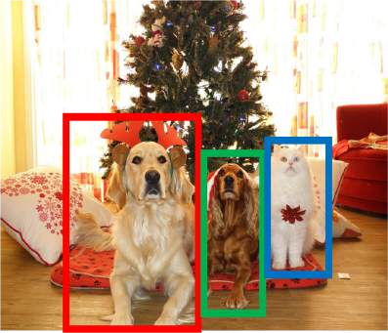
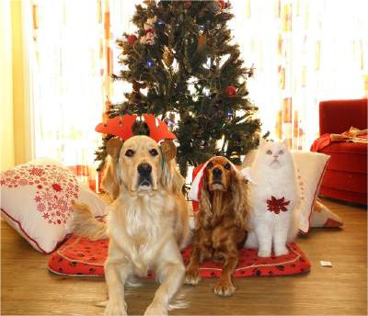
Computer Vision Tasks: Object Detection
Semantic Segmentation
Object Detection
Instance Segmentation
Classification
CAT
GRASS, CAT, TREE, SKY
DOG, DOG, CAT
DOG, DOG, CAT
No spatial extent
No objects, just pixels
Multiple Objects

Slide 3
Computer Vision Tasks: Semantic Segmentation
Semantic Segmentation
Object Detection
Instance Segmentation
Classification
CAT
GRASS, CAT, TREE, SKY
DOG, DOG, CAT
DOG, DOG, CAT
No spatial extent
No objects, just pixels
Multiple Objects

Slide 4
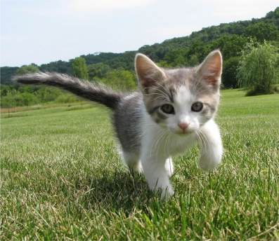
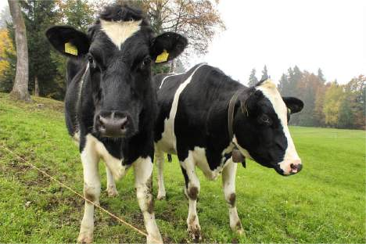
Semantic Segmentation
This image is CC0 public domain
Label each pixel in the image with a category label
Sky
Sky
Cow
Grass
Don’t differentiate instances, only care about pixels
Trees
Trees
Cat
Grass

Slide 5
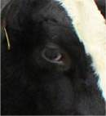
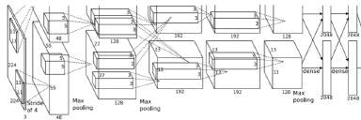
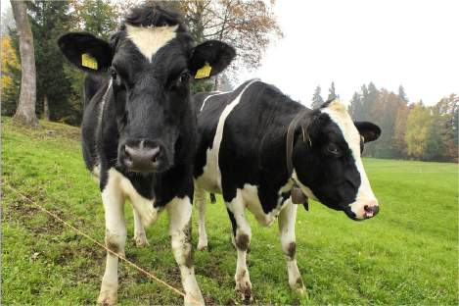
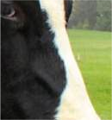
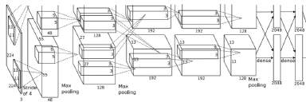
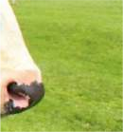
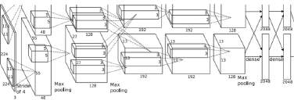
Semantic Segmentation Idea: Sliding Window
Extract patch
Classify center pixel with CNN
Full image
Cow
Cow
Grass
Farabet et al, “Learning Hierarchical Features for Scene Labeling,” TPAMI 2013
Pinheiro and Collobert, “Recurrent Convolutional Neural Networks for Scene Labeling”, ICML 2014

Slide 6
Semantic Segmentation Idea: Sliding Window
Extract patch
Classify center pixel with CNN
Full image
Cow
Cow
Grass
Problem: Very inefficient! Not reusing shared features between overlapping patches
Farabet et al, “Learning Hierarchical Features for Scene Labeling,” TPAMI 2013
Pinheiro and Collobert, “Recurrent Convolutional Neural Networks for Scene Labeling”, ICML 2014

Slide 7
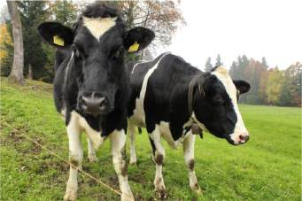
Semantic Segmentation: Fully Convolutional Network
Design a network as a bunch of convolutional layers to make predictions for pixels all at once!
Conv
Conv
Conv
Conv
argmax
Input: 3 x H x W
Scores: C x H x W
Predictions: H x W
Convolutions: D x H x W
Loss function: Per-Pixel cross-entropy
Long et al, “Fully convolutional networks for semantic segmentation”, CVPR 2015

Slide 8
Semantic Segmentation: Fully Convolutional Network
Design a network as a bunch of convolutional layers to make predictions for pixels all at once!
Conv
Conv
Conv
Conv
argmax
Input: 3 x H x W
Problem #1: Effective receptive field size is linear in number of conv layers: With L 3x3 conv layers, receptive field is 1+2L
Long et al, “Fully convolutional networks for semantic segmentation”, CVPR 2015

Slide 9
Semantic Segmentation: Fully Convolutional Network
Design a network as a bunch of convolutional layers to make predictions for pixels all at once!
Conv
Conv
Conv
Conv
argmax
Input: 3 x H x W
Problem #1: Effective receptive field size is linear in number of conv layers: With L 3x3 conv
Problem #2: Convolution on high res images is expensive! Recall ResNet stem aggressively
layers, receptive field is 1+2L
Long et al, “Fully convolutional networks for semantic segmentation”, CVPR 2015
downsamples

Slide 10
Semantic Segmentation: Fully Convolutional Network
Design network as a bunch of convolutional layers, with
downsampling and upsampling inside the network!
Med-res: D₂ x H/4 x W/4
Med-res: D₂ x H/4 x W/4
Low-res:
D₃ x H/4 x W/4
Input: 3 x H x W
High-res: D₁ x H/2 x W/2
High-res: D₁ x H/2 x W/2
Predictions: H x W
Long, Shelhamer, and Darrell, “Fully Convolutional Networks for Semantic Segmentation”, CVPR 2015
Noh et al, “Learning Deconvolution Network for Semantic Segmentation”, ICCV 2015

Slide 11
Semantic Segmentation: Fully Convolutional Network
Downsampling: Pooling, strided convolution
Design network as a bunch of convolutional layers, with
Upsampling:
???
downsampling and upsampling inside the network!
Med-res: D₂ x H/4 x W/4
Med-res: D₂ x H/4 x W/4
Low-res:
D₃ x H/4 x W/4
Input: 3 x H x W
High-res: D₁ x H/2 x W/2
High-res: D₁ x H/2 x W/2
Predictions: H x W
Long, Shelhamer, and Darrell, “Fully Convolutional Networks for Semantic Segmentation”, CVPR 2015
Noh et al, “Learning Deconvolution Network for Semantic Segmentation”, ICCV 2015

Slide 12
In-Network Upsampling: “Unpooling”
Bed of Nails
1 | 0 | 2 | 0
0 | 0 | 0 | 0
3 | 0 | 4 | 0
0 | 0 | 0 | 0
1 | 2
3 | 4
Input C x 2 x 2
Output C x 4 x 4

Slide 13
In-Network Upsampling: “Unpooling”
Bed of Nails Nearest Neighbor
1 | 0 | 2 | 0
0 | 0 | 0 | 0
3 | 0 | 4 | 0
0 | 0 | 0 | 0
1 | 1 | 2 | 2
1 | 1 | 2 | 2
3 | 3 | 4 | 4
3 | 3 | 4 | 4
1 | 2
3 | 4
1 | 2
3 | 4
Input C x 2 x 2
Output C x 4 x 4
Input C x 2 x 2
Output C x 4 x 4

Slide 14
In-Network Upsampling: Bilinear Interpolation
1.00 | 1.25 | 1.75 | 2.00
1.50 | 1.75 | 2.25 | 2.50
2.50 | 2.75 | 3.25 | 3.50
3.00 | 3.25 | 3.75 | 4.00
1 | 2
3 | 4
Input: C x 2 x 2
Output: C x 4 x 4
Use two closest neighbors in x and y to construct linear approximations

Slide 15
In-Network Upsampling: Bicubic Interpolation
0.68 | 1.02 | 1.56 | 1.89
1.35 | 1.68 | 2.23 | 2.56
2.44 | 2.77 | 3.32 | 3.65
3.11 | 3.44 | 3.98 | 4.32
1 | 2
3 | 4
Input: C x 2 x 2 Output: C x 4 x 4
Use three closest neighbors in x and y to construct cubic approximations
(This is how we normally resize images!)

Slide 16
In-Network Upsampling: “Max Unpooling”
Max Pooling: Remember which position had the max
Max Unpooling: Place into remembered positions
1 | 2 | 6 | 3
3 | 5 | 2 | 1
1 | 2 | 2 | 1
7 | 3 | 4 | 8
0 | 0 | 2 | 0
0 | 1 | 0 | 0
0 | 0 | 0 | 0
3 | 0 | 0 | 4
5 | 6
7 | 8
Rest of net
Pair each downsampling layer with an upsampling layer
1 | 2
3 | 4
Noh et al, “Learning Deconvolution Network for Semantic Segmentation”, ICCV 2015

Slide 17
Learnable Upsampling: Transposed Convolution
Recall: Normal 3 x 3 convolution, stride 1, pad 1
Input: 4 x 4
Output: 4 x 4

Slide 18
Learnable Upsampling: Transposed Convolution
Recall: Normal 3 x 3 convolution, stride 1, pad 1
Dot product between input and filter
Input: 4 x 4
Output: 4 x 4

Slide 19
Learnable Upsampling: Transposed Convolution
Recall: Normal 3 x 3 convolution, stride 1, pad 1
Dot product between input and filter
Input: 4 x 4
Output: 4 x 4

Slide 20
Learnable Upsampling: Transposed Convolution
Recall: Normal 3 x 3 convolution, stride 2, pad 1
Input: 4 x 4
Output: 2 x 2

Slide 21
Learnable Upsampling: Transposed Convolution
Recall: Normal 3 x 3 convolution, stride 2, pad 1
Dot product between input and filter
Input: 4 x 4
Output: 2 x 2

Slide 22
Learnable Upsampling: Transposed Convolution
Recall: Normal 3 x 3 convolution, stride 2, pad 1
Dot product between input and filter
Input: 4 x 4
Output: 2 x 2

Slide 23
Learnable Upsampling: Transposed Convolution
Recall: Normal 3 x 3 convolution, stride 2, pad 1
Convolution with stride > 1 is “Learnable Downsampling” Can we use stride < 1 for “Learnable Upsampling”?
Dot product between input and filter
Input: 4 x 4
Output: 2 x 2

Slide 24
Learnable Upsampling: Transposed Convolution
3 x 3 convolution transpose, stride 2
Input: 2 x 2
Output: 4 x 4

Slide 25
Learnable Upsampling: Transposed Convolution
3 x 3 convolution transpose, stride 2
Weight filter by input value and copy to output
Input: 2 x 2
Output: 4 x 4

Slide 26
Learnable Upsampling: Transposed Convolution
3 x 3 convolution transpose, stride 2
Filter moves 2 pixels in output for every 1 pixel in input
Weight filter by input value and copy to output
Input: 2 x 2
Output: 4 x 4

Slide 27
Learnable Upsampling: Transposed Convolution
Sum where
3 x 3 convolution transpose, stride 2
output overlaps
Filter moves 2 pixels in output for every 1 pixel in input
Weight filter by input value and copy to output
Input: 2 x 2
Output: 4 x 4

Slide 28
Learnable Upsampling: Transposed Convolution
Sum where
3 x 3 convolution transpose, stride 2
output overlaps
This gives 5x5 output – need to trim one pixel from top and left to give 4x4 output
Weight filter by input value and copy to output
Input: 2 x 2
Output: 4 x 4

Slide 29
Transposed Convolution: 1D example
Input Filter Output
Output has copies of filter weighted by input
ax
ay
az
 | + | bx
 |  | by
 |  | bz
x
y
z
a
Stride 2: Move 2 pixels output for each pixel in input
b
Sum at overlaps

Slide 30
Transposed Convolution: 1D example
Input Filter Output
This has many names:
ax
ay
az
 | + | bx
 |  | by
 |  | bz
Deconvolution (bad)!
Upconvolution
Fractionally strided convolution
Backward strided convolution
Transposed Convolution (best name)
x
y
z
a
b

Slide 31
Semantic Segmentation: Fully Convolutional Network
Design network as a bunch of convolutional layers, with
downsampling and upsampling inside the network!
Upsampling: Iinterpolation, transposed conv
Downsampling: Pooling, strided convolution
Med-res: D₂ x H/4 x W/4
Med-res: D₂ x H/4 x W/4
Low-res:
D₃ x H/4 x W/4
Input: 3 x H x W
High-res: D₁ x H/2 x W/2
High-res: D₁ x H/2 x W/2
Predictions: H x W
Loss function: Per-Pixel cross-entropy
Long, Shelhamer, and Darrell, “Fully Convolutional Networks for Semantic Segmentation”, CVPR 2015 Noh et al, “Learning Deconvolution Network for Semantic Segmentation”, ICCV 2015

Slide 32
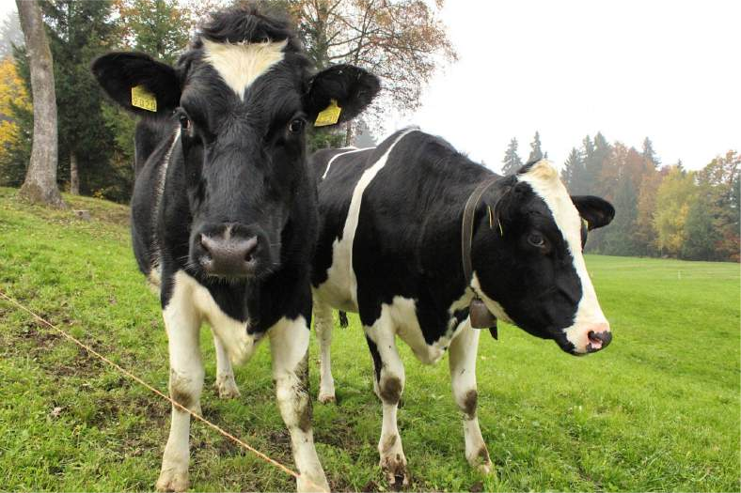
Computer Vision Tasks
Object Detection: Detects individual object instances, but only gives box
Semantic Segmentation: Gives per- pixel labels, but merges instances
Sky
Cow
Grass
Trees

Slide 33
Things and Stuff
This image is CC0 public domain
Things: Object categories that can be separated into object instances
(e.g. cats, cars, person)
Stuff: Object categories that cannot be separated into instances
(e.g. sky, grass, water, trees)
Sky
Sky
Cow
Grass
Trees
Trees
Cat
Grass

Slide 34
Computer Vision Tasks
Object Detection: Detects individual object instances, but only gives box (Only things!)
Semantic Segmentation: Gives per- pixel labels, but merges instances (Both things and stuff)
Sky
Cow
Grass
Trees

Slide 35
Computer Vision Tasks: Instance Segmentation
Semantic Segmentation
Object Detection
Instance Segmentation
Classification
CAT
GRASS, CAT, TREE, SKY
DOG, DOG, CAT
DOG, DOG, CAT
No spatial extent
No objects, just pixels
Multiple Objects

Slide 36
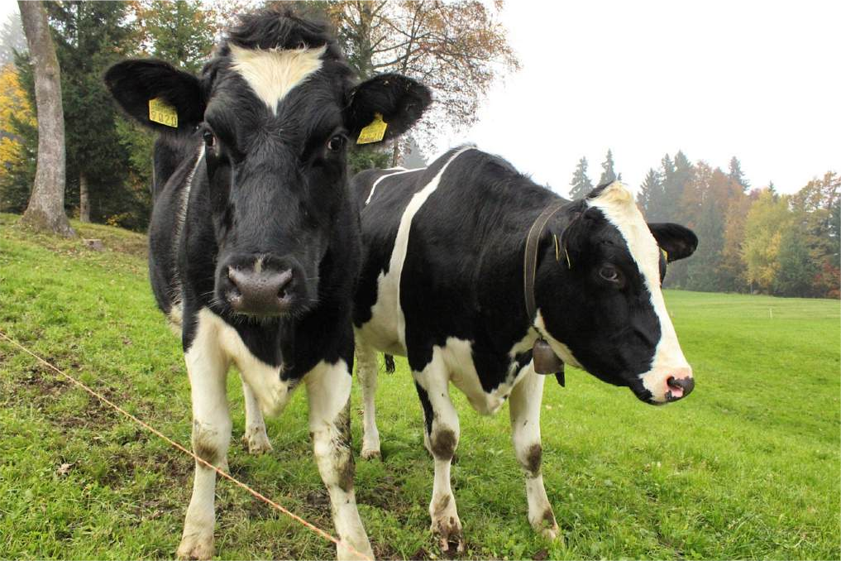
Computer Vision Tasks: Instance Segmentation
Instance Segmentation:
Cow
Detect all objects in the image, and identify the pixels that belong to each object (Only things!)
Cow
This image is CC0 public domain

Slide 37
Computer Vision Tasks: Instance Segmentation
Instance Segmentation:
Cow
Detect all objects in the image, and identify the pixels that belong to each object (Only things!)
Cow
Approach: Perform object detection, then predict a segmentation mask for each object!
This image is CC0 public domain

Slide 38
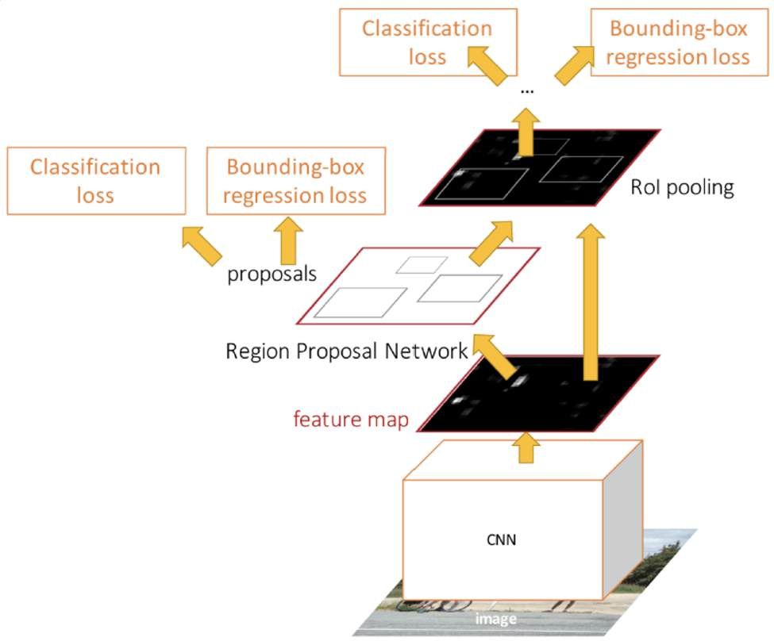
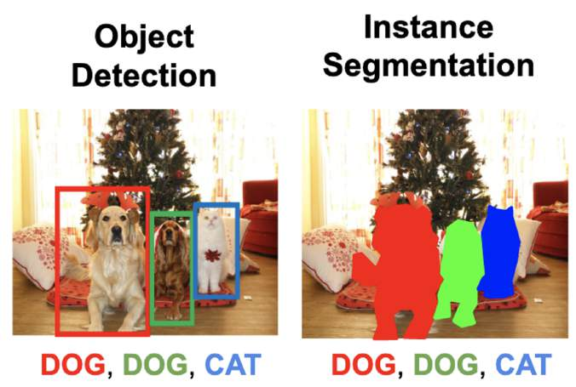
Object Detection: Faster R-CNN
Ren et al, “Faster R-CNN: Towards Real-Time Object Detection with Region Proposal Networks”, NeurIPS 2015

Slide 39
Instance Segmentation:
Mask R-CNN
Mask Prediction
He et al, “Mask R-CNN”, ICCV 2017

Slide 40
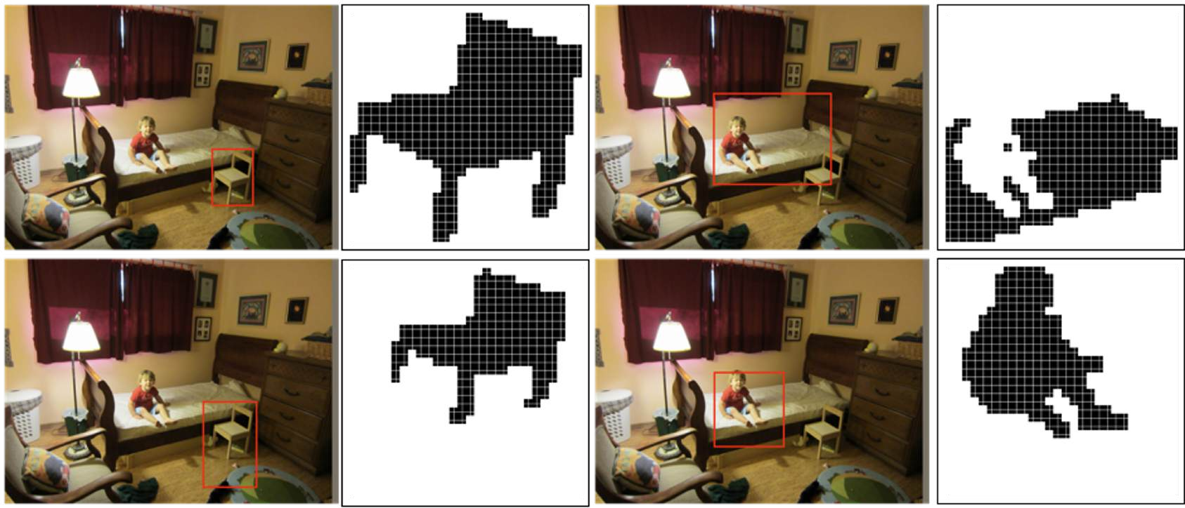
Mask R-CNN: Example Training Targets

Slide 41
Mask R-CNN: Example Training Targets

Slide 42
Mask R-CNN: Example Training Targets

Slide 43
Mask R-CNN: Example Training Targets

Slide 44
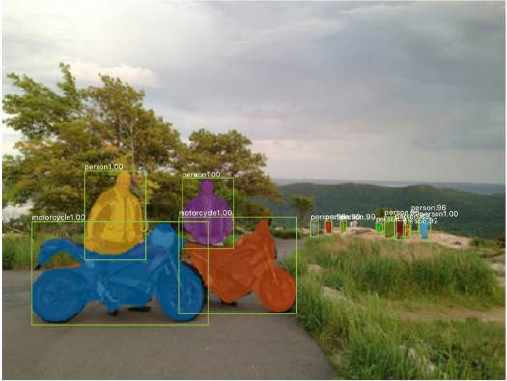
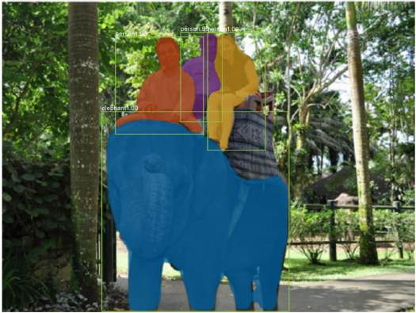
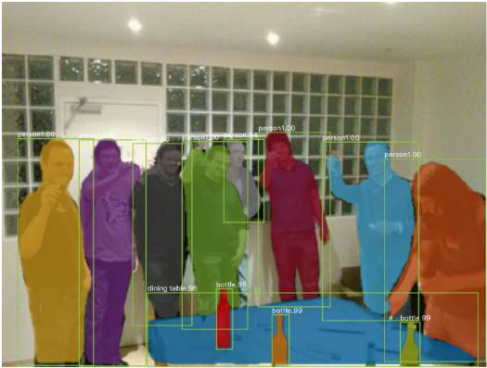
Mask R-CNN: Very Good Results!

Slide 45
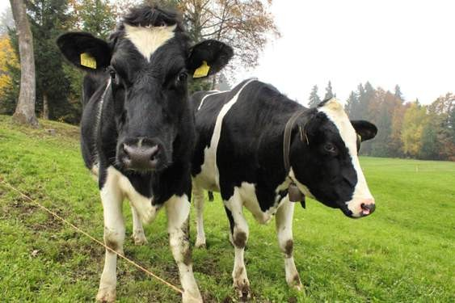
Beyond Instance Segmentation
Instance Segmentation: Separate object instances, but only things
Semantic Segmentation: Identify both things and stuff, but doesn’t separate instances
Sky
Cow
Grass
Cow
Trees
Cow

Slide 46
Beyond Instance Segmentation: Human Keypoints
Represent the pose of a human by locating a set of keypoints
e.g. 17 keypoints:
Nose
Left / Right eye
Left / Right ear
Left / Right shoulder
Left / Right elbow
Left / Right wrist
Left / Right hip
Left / Right knee
Left / Right ankle
Person image is CC0 public domain

Slide 47
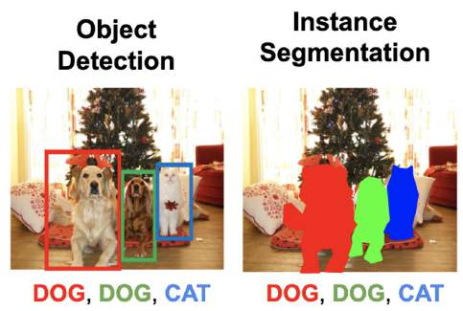
Mask R-CNN:
Instance Segmentation
Mask Prediction
Keypoint estimation
He et al, “Mask R-CNN”, ICCV 2017

Slide 48
Mask R-CNN: Keypoint Estimation
Mask Prediction
Keypoint prediction
Keypoint estimation
He et al, “Mask R-CNN”, ICCV 2017

Slide 49
Mask R-CNN: Keypoint Estimation
Mask Prediction
Keypoint prediction
Keypoint estimation
He et al, “Mask R-CNN”, ICCV 2017

Slide 50
Dense Captioning: Predict a caption per region!
Caption prediction
(LSTM)
Per-Region Heads:
Each receives the features after
RoI Pool / RoI Align, makes some prediction per-region
Johnson, Karpathy, and Fei-Fei, “DenseCap: Fully Convolutional
Localization Networks for Dense Captioning”, CVPR 2016

Slide 51
Dense Captioning
Johnson, Karpathy, and Fei-Fei, “DenseCap: Fully Convolutional Localization Networks for Dense Captioning”, CVPR 2016

Slide 52
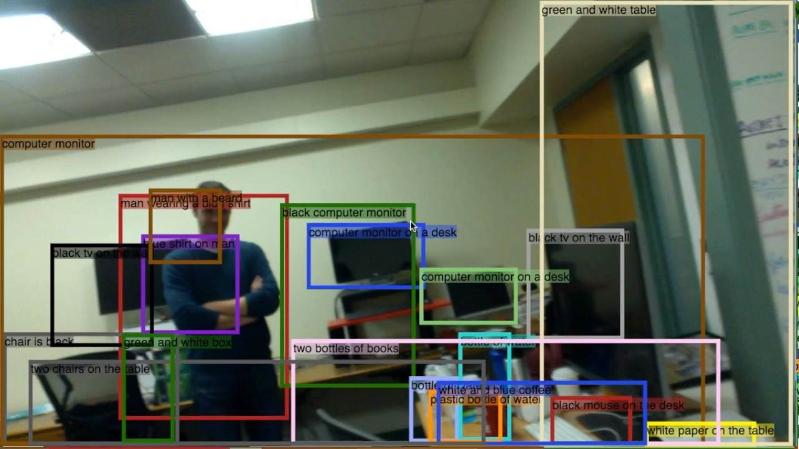
Dense Captioning
Johnson, Karpathy, and Fei-Fei, “DenseCap: Fully Convolutional Localization Networks for Dense Captioning”, CVPR 2016

Slide 53
Summary: Many Computer Vision Tasks!
Semantic Segmentation
Object Detection
Instance Segmentation
Classification
CAT
GRASS, CAT, TREE, SKY
DOG, DOG, CAT
DOG, DOG, CAT
No spatial extent
No objects, just pixels
Multiple Objects
This image is CC0 public domain

