Slide 1
Lecture 5: Object Detection

Slide 2
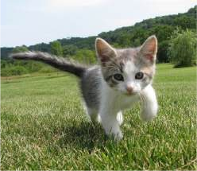
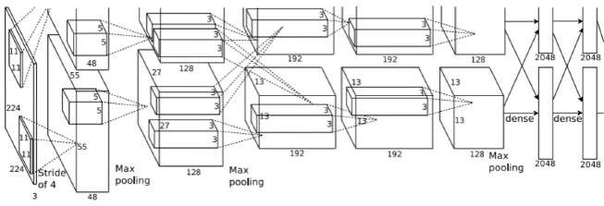
So far: Image Classification
Class Scores
Cat: 0.9
Dog: 0.05
Car: 0.01
...
Fully-Connected: 4096 to 1000
Vector:
4096
This image is CC0 public domain
Figure copyright Alex Krizhevsky, Ilya Sutskever, and Geoffrey Hinton, 2012. Reproduced with permission.

Slide 3
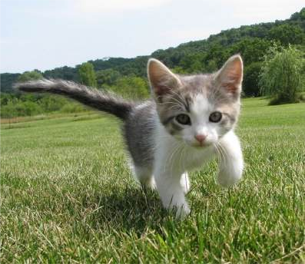
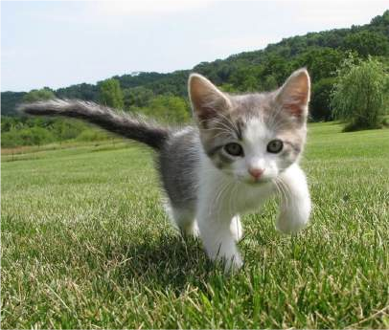
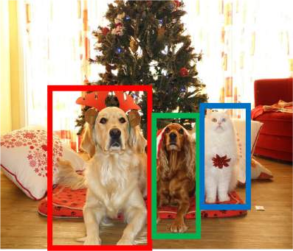
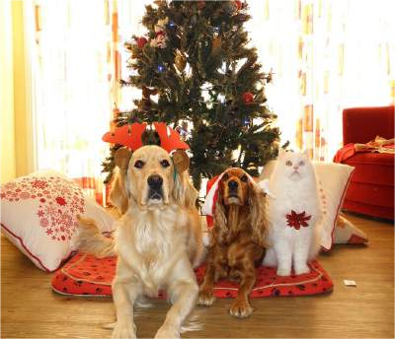
Computer Vision Tasks
Semantic
Object Detection
Instance Segmentation
Classification
Segmentation
CAT
GRASS, CAT, TREE, SKY
DOG, DOG, CAT
DOG, DOG, CAT
No spatial extent
Multiple Objects
This image is CC0 public domain

Slide 4
Today: Object Detection
Semantic Segmentation
Object Detection
Instance Segmentation
Classification
CAT
GRASS, CAT, TREE, SKY
DOG, DOG, CAT
DOG, DOG, CAT
No spatial extent
Multiple Objects
This image is CC0 public domain

Slide 5
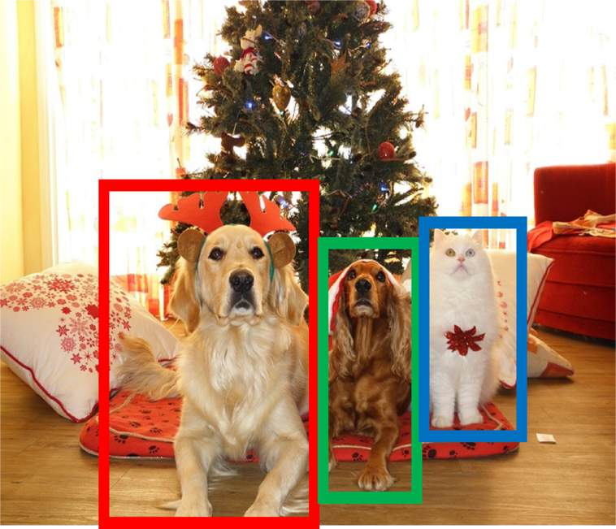
Object Detection: Task Definition
Input: Single RGB Image
Output: A set of detected objects; For each object predict:
Category label (from fixed, known set of categories)
Bounding box (four numbers: x, y, width, height)

Slide 6
Object Detection: Challenges
Multiple outputs: Need to output variable numbers of objects per image
Multiple types of output: Need to
predict ”what” (category label) as well as “where” (bounding box)
Large images: Classification works at
224x224; need higher resolution for detection, often ~800x600

Slide 7
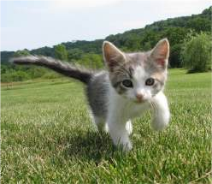
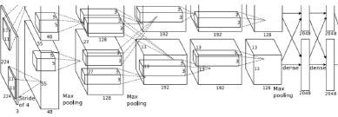
Detecting a single object
Vector:
4096
This image is CC0 public domain

Slide 8
Detecting a single object
“What”
Class Scores
Cat: 0.9
Dog: 0.05
Car: 0.01
...
Correct label:
Cat
Softmax Loss
Fully Connected: 4096 to 1000
Vector:
4096
This image is CC0 public domain

Slide 9
Detecting a single object
“What”
Class Scores
Cat: 0.9
Dog: 0.05
Car: 0.01
...
Correct label:
Cat
Softmax Loss
Fully Connected: 4096 to 1000
Vector:
4096
This image is CC0 public domain
Fully Connected: 4096 to 4
Treat localization as a regression problem!
Box Coordinates (x, y, w, h)
L2 Loss
“Where”
Correct box: (x’, y’, w’, h’)

Slide 10
Detecting a single object
“What”
Class Scores
Cat: 0.9
Dog: 0.05
Car: 0.01
...
Correct label:
Cat
Softmax Loss
Fully Connected: 4096 to 1000
Weighted Sum
Loss
Vector:
4096
This image is CC0 public domain
Fully Connected: 4096 to 4
Treat localization as a regression problem!
Box Coordinates (x, y, w, h)
L2 Loss
“Where”
Correct box: (x’, y’, w’, h’)

Slide 11
Detecting a single object
“What”
Class Scores
Cat: 0.9
Dog: 0.05
Car: 0.01
...
Correct label:
Cat
Softmax
Fully Connected: 4096 to 1000
Loss
Multitask Loss
Loss
Weighted Sum
Vector:
4096
This image is CC0 public domain
Fully Connected: 4096 to 4
Treat localization as a regression problem!
Box Coordinates (x, y, w, h)
L2 Loss
“Where”
Correct box: (x’, y’, w’, h’)

Slide 12
Detecting a single object
“What”
Class Scores
Cat: 0.9
Dog: 0.05
Car: 0.01
...
Correct label:
Cat
Softmax
Often pretrained on ImageNet (Transfer learning)
Fully Connected: 4096 to 1000
Loss
Multitask Loss
Loss
Weighted Sum
Vector:
4096
This image is CC0 public domain
Fully Connected: 4096 to 4
Treat localization as a regression problem!
Box Coordinates (x, y, w, h)
L2 Loss
“Where”
Correct box: (x’, y’, w’, h’)

Slide 13
Detecting a single object
“What”
Class Scores
Cat: 0.9
Dog: 0.05
Car: 0.01
...
Correct label:
Cat
Softmax
Often pretrained on ImageNet (Transfer learning)
Fully Connected: 4096 to 1000
Loss
Multitask Loss
Loss
Weighted Sum
Vector:
4096
This image is CC0 public domain
Fully Connected: 4096 to 4
Treat localization as a regression problem!
Box Coordinates (x, y, w, h)
L2 Loss
Problem: Images can have more than one object!
“Where”
Correct box: (x’, y’, w’, h’)

Slide 14

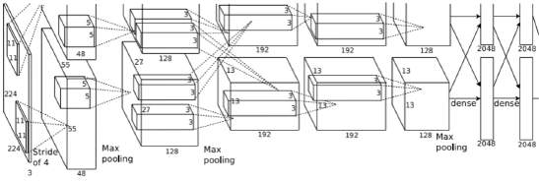
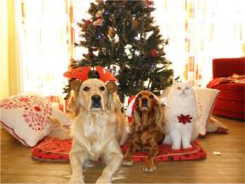
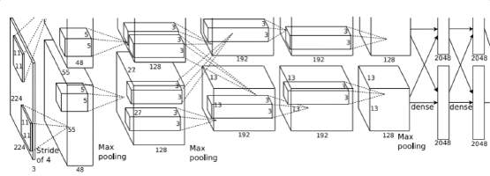
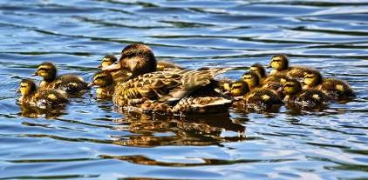
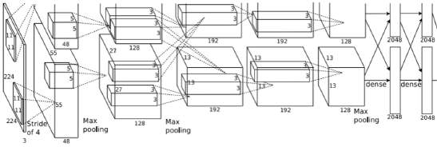
Need different numbers of outputs per image
Detecting Multiple Objects
CAT: (x, y, w, h)
4 numbers
DOG: (x, y, w, h)
DOG: (x, y, w, h)
CAT: (x, y, w, h)
16 numbers
DUCK: (x, y, w, h)
DUCK: (x, y, w, h)
….
Many numbers!
Duck image is free to use under the Pixabay license

Slide 15
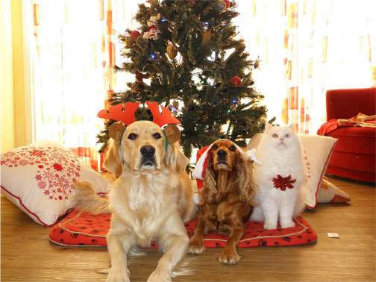
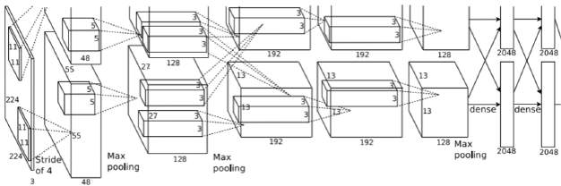
Detecting Multiple Objects: Sliding Window
Apply a CNN to many different crops of the image, CNN classifies each crop as object or background
Dog? NO Cat? NO
Background? YES

Slide 16
Detecting Multiple Objects: Sliding Window
Apply a CNN to many different crops of the image, CNN classifies each crop as object or background
Dog? YES
Cat? NO Background? NO

Slide 17
Detecting Multiple Objects: Sliding Window
Apply a CNN to many different crops of the image, CNN classifies each crop as object or background
Dog? YES
Cat? NO Background? NO

Slide 18
Detecting Multiple Objects: Sliding Window
Apply a CNN to many different crops of the image, CNN classifies each crop as object or background
Dog? NO Cat? YES
Background? NO

Slide 19
Detecting Multiple Objects: Sliding Window
Apply a CNN to many different crops of the image, CNN classifies each crop as object or background
Question: How many possible boxes are there in an image of size H x W?

Slide 20
Detecting Multiple Objects: Sliding Window
Apply a CNN to many different crops of the image, CNN classifies each crop as object or background
Question: How many possible boxes are there in an image of size H x W?
Consider a box of size h x w: Possible x positions: W – w + 1 Possible y positions: H – h + 1 Possible positions:
(W – w + 1) * (H – h + 1)

Slide 21
Detecting Multiple Objects: Sliding Window
Apply a CNN to many different crops of the image, CNN classifies each crop as object or background
Question: How many possible boxes are there in an image of size H x W?
Total possible boxes:
𝐻 𝖶
! !(𝑊 − 𝑤 + 1)(𝐻 − ℎ + 1)
ℎ=1 w=1
Consider a box of size h x w: Possible x positions: W – w + 1 Possible y positions: H – h + 1 Possible positions:
(W – w + 1) * (H – h + 1)
𝐻(𝐻 + 1) 𝑊(𝑊 + 1)
2 2
=

Slide 22
Detecting Multiple Objects: Sliding Window
800 x 600 image has ~58M boxes! No way we can evaluate them all
Apply a CNN to many different crops of the image, CNN classifies each crop as object or background
Question: How many possible boxes are there in an image of size H x W?
Total possible boxes:
𝐻 𝖶
! !(𝑊 − 𝑤 + 1)(𝐻 − ℎ + 1)
ℎ=1 w=1
Consider a box of size h x w: Possible x positions: W – w + 1 Possible y positions: H – h + 1 Possible positions:
(W – w + 1) * (H – h + 1)
𝐻(𝐻 + 1) 𝑊(𝑊 + 1)
2 2
=

Slide 23
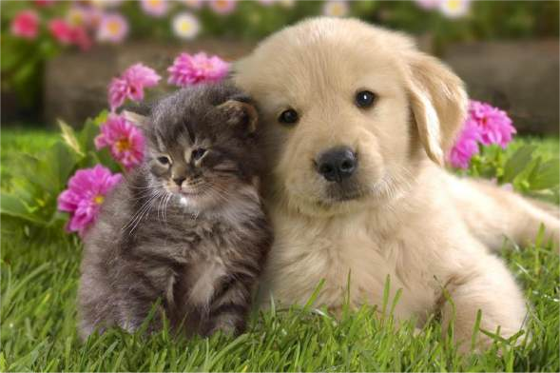

Region Proposals
Find a small set of boxes that are likely to cover all objects
Often based on heuristics: e.g. look for “blob-like” image regions
Relatively fast to run; e.g. Selective Search gives 2000 region proposals in a few seconds on CPU
Alexe et al, “Measuring the objectness of image windows”, TPAMI 2012 Uijlings et al, “Selective Search for Object Recognition”, IJCV 2013
Cheng et al, “BING: Binarized normed gradients for objectness estimation at 300fps”, CVPR 2014 Zitnick and Dollar, “Edge boxes: Locating object proposals from edges”, ECCV 2014

Slide 24
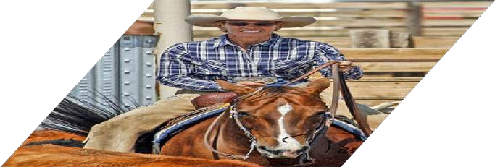
R-CNN: Region-Based CNN
Input image
Girshick et al, “Rich feature hierarchies for accurate object detection and semantic segmentation”, CVPR 2014.
Figure copyright Ross Girshick, 2015; source. Reproduced with permission.

Slide 25
R-CNN: Region-Based CNN
Regions of Interest (RoI) from a proposal method (~2k)
Input image
Girshick et al, “Rich feature hierarchies for accurate object detection and semantic segmentation”, CVPR 2014.
Figure copyright Ross Girshick, 2015; source. Reproduced with permission.

Slide 26

R-CNN: Region-Based CNN
Warped image regions (224x224)
Input image
Girshick et al, “Rich feature hierarchies for accurate object detection and semantic segmentation”, CVPR 2014.
Figure copyright Ross Girshick, 2015; source. Reproduced with permission.

Slide 27
R-CNN: Region-Based CNN
Conv Net
Forward each region through ConvNet
Warped image regions (224x224)
Conv Net
Conv Net
Input image
Girshick et al, “Rich feature hierarchies for accurate object detection and semantic segmentation”, CVPR 2014.
Figure copyright Ross Girshick, 2015; source. Reproduced with permission.

Slide 28
R-CNN: Region-Based CNN
Classify each region
Class
Class
Class
Forward each region through ConvNet
Warped image regions (224x224)
Conv Net
Conv Net
Conv Net
Input image
Girshick et al, “Rich feature hierarchies for accurate object detection and semantic segmentation”, CVPR 2014.
Figure copyright Ross Girshick, 2015; source. Reproduced with permission.

Slide 29
R-CNN: Region-Based CNN
Classify each region
Bounding box regression:
Predict “transform” to correct the RoI: 4 numbers (t_{x}, t_{y}, t_{h}, t_{w})
Bbox
Class
Bbox
Class
Bbox
Class
Forward each region through ConvNet
Warped image regions (224x224)
Conv Net
Conv Net
Conv Net
Input image
Girshick et al, “Rich feature hierarchies for accurate object detection and semantic segmentation”, CVPR 2014.
Figure copyright Ross Girshick, 2015; source. Reproduced with permission.

Slide 30
R-CNN: Region-Based CNN
Classify each region
Bounding box regression:
Predict “transform” to correct the RoI: 4 numbers (t_{x}, t_{y}, t_{h}, t_{w})
Bbox
Class
Bbox
Class
Bbox
Class
Forward each region through ConvNet
Warped image regions (224x224)
Conv Net
Region proposal: (p_{x}, p_{y}, p_{h}, p_{w}) Transform: (t_{x}, t_{y}, t_{h}, t_{w})
Output box: (b_{x}, b_{y}, b_{h}, b_{w})
Translate relative to box size: b_{x} = p_{x} + p_{w}t_{x} b_{y} = p_{y} + p_{h}t_{y}
Log-space scale transform:
b_{w} = p_{w}exp(t_{w}) b_{h} = p_{h}exp(t_{h})
Conv Net
Conv Net
Regions of Interest (RoI) from a proposal method (~2k)
Input image
Girshick et al, “Rich feature hierarchies for accurate object detection and semantic segmentation”, CVPR 2014.
Figure copyright Ross Girshick, 2015; source. Reproduced with permission.

Slide 31

R-CNN: Test-time
Input: Single RGB Image
Bbox
Class
Run region proposal method to compute ~2000 region proposals
Resize each region to 224x224 and run independently through CNN to predict class scores and bbox transform
Use scores to select a subset of region proposals to output
(Many choices here: threshold on background, or per-category? Or take top K proposals per image?)
Compare with ground-truth boxes
Bbox
Class
Bbox
Class
Conv Net
Conv Net
Conv Net
Input image
Girshick et al, “Rich feature hierarchies for accurate object detection and semantic segmentation”, CVPR 2014.
Figure copyright Ross Girshick, 2015; source. Reproduced with permission.

Slide 32
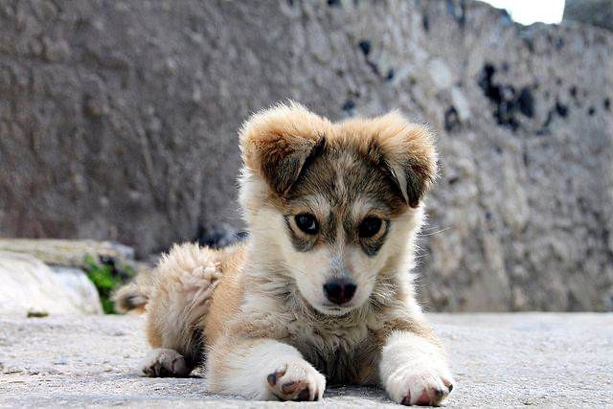
Comparing Boxes: Intersection over Union (IoU)
How can we compare our
Our Prediction
prediction to the ground-truth box?
Ground Truth
Puppy image is licensed under CC-A 2.0 Generic license. Bounding boxes and text added by .

Slide 33
Comparing Boxes: Intersection over Union (IoU)
How can we compare our
Our Prediction
prediction to the ground-truth box?
Ground Truth
Intersection over Union (IoU) (Also called “Jaccard similarity” or “Jaccard index”):
𝑨𝒓𝒆𝒂 𝒐𝒇 𝑰𝒏𝒕𝒆𝒓𝒔𝒆𝒄𝒕𝒊𝒐𝒏
𝑨𝒓𝒆𝒂 𝒐𝒇 𝑼𝒏𝒊𝒐𝒏
Puppy image is licensed under CC-A 2.0 Generic license. Bounding boxes and text added by .

Slide 34
Comparing Boxes: Intersection over Union (IoU)
How can we compare our
Our Prediction
prediction to the ground-truth box?
Ground Truth
Intersection over Union (IoU) (Also called “Jaccard similarity” or “Jaccard index”):
𝑨𝒓𝒆𝒂 𝒐𝒇 𝑰𝒏𝒕𝒆𝒓𝒔𝒆𝒄𝒕𝒊𝒐𝒏
𝑨𝒓𝒆𝒂 𝒐𝒇 𝑼𝒏𝒊𝒐𝒏
Puppy image is licensed under CC-A 2.0 Generic license. Bounding boxes and text added by .

Slide 35
Comparing Boxes: Intersection over Union (IoU)
How can we compare our
Our Prediction
prediction to the ground-truth box?
Ground Truth
Intersection over Union (IoU) (Also called “Jaccard similarity” or “Jaccard index”):
𝑨𝒓𝒆𝒂 𝒐𝒇 𝑰𝒏𝒕𝒆𝒓𝒔𝒆𝒄𝒕𝒊𝒐𝒏
IoU = 0.51
𝑨𝒓𝒆𝒂 𝒐𝒇 𝑼𝒏𝒊𝒐𝒏
IoU > 0.5 is “decent”
Puppy image is licensed under CC-A 2.0 Generic license. Bounding boxes and text added by .

Slide 36
Comparing Boxes: Intersection over Union (IoU)
How can we compare our
Our Prediction
prediction to the ground-truth box?
Ground Truth
Intersection over Union (IoU) (Also called “Jaccard similarity” or “Jaccard index”):
𝑨𝒓𝒆𝒂 𝒐𝒇 𝑰𝒏𝒕𝒆𝒓𝒔𝒆𝒄𝒕𝒊𝒐𝒏
IoU = 0.72
𝑨𝒓𝒆𝒂 𝒐𝒇 𝑼𝒏𝒊𝒐𝒏
IoU > 0.5 is “decent”,
IoU > 0.7 is “pretty good”,
Puppy image is licensed under CC-A 2.0 Generic license. Bounding boxes and text added by .

Slide 37
Comparing Boxes: Intersection over Union (IoU)
How can we compare our
Our Prediction
prediction to the ground-truth box?
Ground Truth
Intersection over Union (IoU) (Also called “Jaccard similarity” or “Jaccard index”):
𝑨𝒓𝒆𝒂 𝒐𝒇 𝑰𝒏𝒕𝒆𝒓𝒔𝒆𝒄𝒕𝒊𝒐𝒏
IoU = 0.91
𝑨𝒓𝒆𝒂 𝒐𝒇 𝑼𝒏𝒊𝒐𝒏
IoU > 0.5 is “decent”,
IoU > 0.7 is “pretty good”, IoU > 0.9 is “almost perfect”
Puppy image is licensed under CC-A 2.0 Generic license. Bounding boxes and text added by .

Slide 38
Overlapping Boxes
Problem: Object detectors often output many overlapping detections:
P(dog) = 0.75
P(dog) = 0.9
P(dog) = 0.7
P(dog) = 0.8
Puppy image is CC0 Public Domain

Slide 39
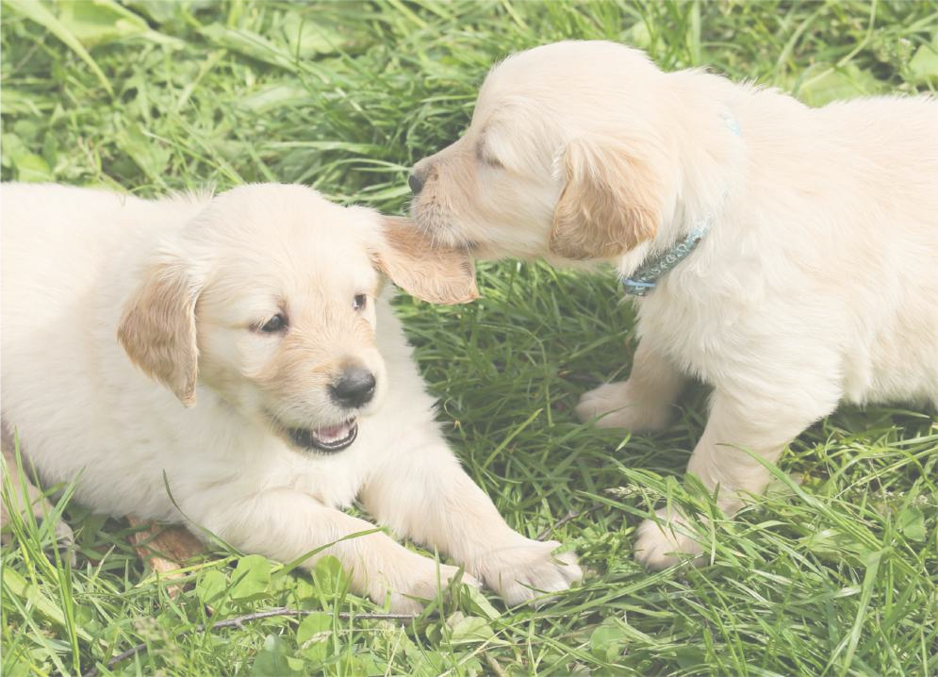
Overlapping Boxes: Non-Max Suppression (NMS)
Problem: Object detectors often output many overlapping detections:
P(dog) = 0.75
P(dog) = 0.9
Solution: Post-process raw detections using Non-Max Suppression (NMS)
Select next highest-scoring box
Eliminate lower-scoring boxes with IoU > threshold (e.g. 0.7)
If any boxes remain, GOTO 1
P(dog) = 0.7
P(dog) = 0.8
Puppy image is CC0 Public Domain

Slide 40
Overlapping Boxes: Non-Max Suppression (NMS)
Problem: Object detectors often output many overlapping detections:
P(dog) = 0.9
P(dog) = 0.75
Solution: Post-process raw detections using Non-Max Suppression (NMS)
Select next highest-scoring box
Eliminate lower-scoring boxes with IoU > threshold (e.g. 0.7)
If any boxes remain, GOTO 1
IoU(■, ■) = 0.78
IoU(■, ■) = 0.05
IoU(■, ■) = 0.07
P(dog) = 0.7
P(dog) = 0.8
Puppy image is CC0 Public Domain

Slide 41
Overlapping Boxes: Non-Max Suppression (NMS)
Problem: Object detectors often output many overlapping detections:
P(dog) = 0.75
P(dog) = 0.9
Solution: Post-process raw detections using Non-Max Suppression (NMS)
Select next highest-scoring box
Eliminate lower-scoring boxes with IoU > threshold (e.g. 0.7)
If any boxes remain, GOTO 1
P(dog) = 0.7
IoU(■, ■) = 0.74
Puppy image is CC0 Public Domain

Slide 42
Overlapping Boxes: Non-Max Suppression (NMS)
Problem: Object detectors often output many overlapping detections:
P(dog) = 0.75
P(dog) = 0.9
Solution: Post-process raw detections using Non-Max Suppression (NMS)
Select next highest-scoring box
Eliminate lower-scoring boxes with IoU > threshold (e.g. 0.7)
If any boxes remain, GOTO 1
Puppy image is CC0 Public Domain

Slide 43

Overlapping Boxes: Non-Max Suppression (NMS)
Problem: Object detectors often output many overlapping detections:
Solution: Post-process raw detections using Non-Max Suppression (NMS)
Select next highest-scoring box
Eliminate lower-scoring boxes with IoU > threshold (e.g. 0.7)
If any boxes remain, GOTO 1
Problem: NMS may eliminate ”good” boxes when objects are highly overlapping… no good solution =(
Crowd image is free for commercial use under the Pixabay license

Slide 44
Evaluating Object Detectors: Mean Average Precision (mAP)
Run object detector on all test images (with NMS)
For each category, compute Average Precision (AP) = area under Precision vs Recall Curve

Slide 45
Evaluating Object Detectors: Mean Average Precision (mAP)
All dog detections sorted by score
0.99
0.95
0.90
0.5
0.10
Run object detector on all test images (with NMS)
For each category, compute Average Precision (AP) = area under Precision vs Recall Curve
  For each detection (highest score to lowest score)
All ground-truth dog boxes

Slide 46
Evaluating Object Detectors: Mean Average Precision (mAP)
All dog detections sorted by score
0.99
0.95
0.90
0.5
0.10
Match: IoU > 0.5
Run object detector on all test images (with NMS)
For each category, compute Average Precision (AP) = area under Precision vs Recall Curve
  For each detection (highest score to lowest score)
    If it matches some GT box with IoU > 0.5, mark it as positive and eliminate the GT
    Otherwise mark it as negative
All ground-truth dog boxes

Slide 47

Evaluating Object Detectors: Mean Average Precision (mAP)
All dog detections sorted by score
0.99
0.95
0.90
0.5
0.10
Match: IoU > 0.5
Run object detector on all test images (with NMS)
For each category, compute Average Precision (AP) = area under Precision vs Recall Curve
  For each detection (highest score to lowest score)
    If it matches some GT box with IoU > 0.5, mark it as positive and eliminate the GT
    Otherwise mark it as negative
    Plot a point on PR Curve
All ground-truth dog boxes
Precision = 1/1 = 1.0 Recall = 1/3 = 0.33
Precision
Recall
1.0

Slide 48

Evaluating Object Detectors: Mean Average Precision (mAP)
All dog detections sorted by score
0.99
0.95
0.90
0.5
0.10
Match: IoU > 0.5
Run object detector on all test images (with NMS)
For each category, compute Average Precision (AP) = area under Precision vs Recall Curve
  For each detection (highest score to lowest score)
    If it matches some GT box with IoU > 0.5, mark it as positive and eliminate the GT
    Otherwise mark it as negative
    Plot a point on PR Curve
All ground-truth dog boxes
Precision = 2/2 = 1.0 Recall = 2/3 = 0.67
Precision
Recall
1.0

Slide 49
Evaluating Object Detectors: Mean Average Precision (mAP)
All dog detections sorted by score
0.99
0.95
0.90
0.5
0.10
No match > 0.5 IoU with GT
Run object detector on all test images (with NMS)
For each category, compute Average Precision (AP) = area under Precision vs Recall Curve
  For each detection (highest score to lowest score)
    If it matches some GT box with IoU > 0.5, mark it as positive and eliminate the GT
    Otherwise mark it as negative
    Plot a point on PR Curve
All ground-truth dog boxes
Precision = 2/3 = 0.67 Recall = 2/3 = 0.67
Precision
Recall
1.0

Slide 50
Evaluating Object Detectors: Mean Average Precision (mAP)
All dog detections sorted by score
0.99
0.95
0.90
0.5
0.10
No match > 0.5 IoU with GT
Run object detector on all test images (with NMS)
For each category, compute Average Precision (AP) = area under Precision vs Recall Curve
  For each detection (highest score to lowest score)
    If it matches some GT box with IoU > 0.5, mark it as positive and eliminate the GT
    Otherwise mark it as negative
    Plot a point on PR Curve
All ground-truth dog boxes
Precision = 2/4 = 0.5 Recall = 2/3 = 0.67
Precision
Recall
1.0

Slide 51

Evaluating Object Detectors: Mean Average Precision (mAP)
All dog detections sorted by score
0.99
0.95
0.90
0.5
0.10
Match: > 0.5 IoU
Run object detector on all test images (with NMS)
For each category, compute Average Precision (AP) = area under Precision vs Recall Curve
  For each detection (highest score to lowest score)
    If it matches some GT box with IoU > 0.5, mark it as positive and eliminate the GT
    Otherwise mark it as negative
    Plot a point on PR Curve
All ground-truth dog boxes
Precision = 3/5 = 0.6 Recall = 3/3 = 1.0
Precision
Recall
1.0

Slide 52
Evaluating Object Detectors: Mean Average Precision (mAP)
All dog detections sorted by score
0.99
0.95
0.90
0.5
0.10
Run object detector on all test images (with NMS)
For each category, compute Average Precision (AP) = area under Precision vs Recall Curve
  For each detection (highest score to lowest score)
    If it matches some GT box with IoU > 0.5, mark it as positive and eliminate the GT
    Otherwise mark it as negative
    Plot a point on PR Curve
  Average Precision (AP) = area under PR curve
All ground-truth dog boxes
Precision
Dog AP = 0.86
Recall
1.0

Slide 53
Evaluating Object Detectors: Mean Average Precision (mAP)
All dog detections sorted by score
0.99
0.95
0.90
0.5
0.10
Run object detector on all test images (with NMS)
For each category, compute Average Precision (AP) = area under Precision vs Recall Curve
  For each detection (highest score to lowest score)
    If it matches some GT box with IoU > 0.5, mark it as positive and eliminate the GT
    Otherwise mark it as negative
    Plot a point on PR Curve
  Average Precision (AP) = area under PR curve
How to get AP = 1.0: Hit all GT boxes with IoU > 0.5, and have no “false positive” detections ranked above any “true positives”
All ground-truth dog boxes
Precision
Dog AP = 0.86
Recall
1.0

Slide 54
Evaluating Object Detectors: Mean Average Precision (mAP)
Run object detector on all test images (with NMS)
For each category, compute Average Precision (AP) = area under Precision vs Recall Curve
  For each detection (highest score to lowest score)
    If it matches some GT box with IoU > 0.5, mark it as positive and eliminate the GT
    Otherwise mark it as negative
    Plot a point on PR Curve
  Average Precision (AP) = area under PR curve
  Mean Average Precision (mAP) = average of AP for each category
Car AP = 0.65 Cat AP = 0.80 Dog AP = 0.86
mAP@0.5 = 0.77

Slide 55
Evaluating Object Detectors: Mean Average Precision (mAP)
Run object detector on all test images (with NMS)
For each category, compute Average Precision (AP) = area under Precision vs Recall Curve
  For each detection (highest score to lowest score)
    If it matches some GT box with IoU > 0.5, mark it as positive and eliminate the GT
    Otherwise mark it as negative
    Plot a point on PR Curve
  Average Precision (AP) = area under PR curve
  Mean Average Precision (mAP) = average of AP for each category
  For “COCO mAP”: Compute mAP@thresh for each IoU threshold (0.5, 0.55, 0.6, …, 0.95) and take average
mAP@0.5 = 0.77
mAP@0.55 = 0.71
mAP@0.60 = 0.65
…
mAP@0.95 = 0.2
COCO mAP = 0.4

Slide 56
R-CNN: Region-Based CNN
Classify each region
Bounding box regression:
Predict “transform” to correct the RoI: 4 numbers (t_{x}, t_{y}, t_{h}, t_{w})
Bbox
Class
Bbox
Class
Bbox
Class
Forward each region through ConvNet
Warped image regions (224x224)
Conv Net
Conv Net
Conv Net
Regions of Interest (RoI) from a proposal method (~2k)
Input image
Girshick et al, “Rich feature hierarchies for accurate object detection and semantic segmentation”, CVPR 2014.
Figure copyright Ross Girshick, 2015; source. Reproduced with permission.

Slide 57
R-CNN: Region-Based CNN
Classify each region
Bounding box regression:
Predict “transform” to correct the RoI: 4 numbers (t_{x}, t_{y}, t_{h}, t_{w})
Bbox
Class
Bbox
Class
Bbox
Class
Forward each region through ConvNet
Warped image regions (224x224)
Conv Net
Problem: Very slow! Need to do ~2k forward passes for each image!
Conv Net
Conv Net
Regions of Interest (RoI)
Input
image
Girshick et al, “Rich feature hierarchies for accurate object detection and semantic segmentation”, CVPR 2014.
Figure copyright Ross Girshick, 2015; source. Reproduced with permission.

Slide 58
R-CNN: Region-Based CNN
Classify each region
Bounding box regression:
Predict “transform” to correct the RoI: 4 numbers (t_{x}, t_{y}, t_{h}, t_{w})
Bbox
Class
Bbox
Class
Bbox
Class
Forward each region through ConvNet
Warped image regions (224x224)
Conv Net
Problem: Very slow! Need to do ~2k forward passes for each image!
Conv Net
Conv Net
Solution: Run CNN
*before* warping!
Regions of Interest (RoI) from a proposal method (~2k)
Input image
Girshick et al, “Rich feature hierarchies for accurate object detection and semantic segmentation”, CVPR 2014.
Figure copyright Ross Girshick, 2015; source. Reproduced with permission.

Slide 59






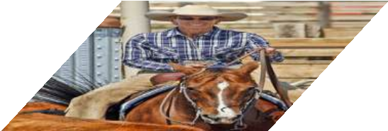
“Slow” R-CNN
Process each region independently
Bbox
Class
Bbox
Class
Bbox
Class
Conv Net
Conv Net
Conv Net
Input image

Slide 60
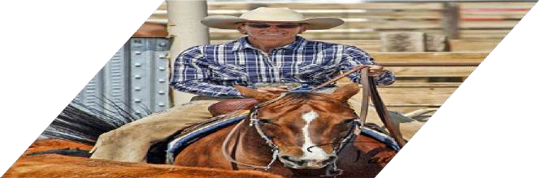
Fast R-CNN
“Slow” R-CNN
Process each region independently
Bbox
Class
Bbox
Class
Bbox
Class
Conv Net
Conv Net
Conv Net
Input image
Input image
Girshick, “Fast R-CNN”, ICCV 2015. Figure copyright Ross Girshick, 2015; source. Reproduced with permission.

Slide 61

Fast R-CNN
“Slow” R-CNN
Process each region independently
Bbox
Class
Bbox
Class
Image features
Run whole image through ConvNet
Bbox
Class
Conv Net
Conv Net
“Backbone” network: AlexNet, VGG,
Conv Net
ConvNet
ResNet, etc
Input image
Input image
Girshick, “Fast R-CNN”, ICCV 2015. Figure copyright Ross Girshick, 2015; source. Reproduced with permission.

Slide 62
Fast R-CNN
“Slow” R-CNN
Process each region independently
Regions of Interest (RoIs) from a proposal method
Bbox
Class
Bbox
Class
Image features
Run whole image through ConvNet
Bbox
Class
Conv Net
Conv Net
“Backbone” network: AlexNet, VGG, ResNet, etc
Conv Net
ConvNet
Input image
Input image
Girshick, “Fast R-CNN”, ICCV 2015. Figure copyright Ross Girshick, 2015; source. Reproduced with permission.
Lecture 5 - 65

Slide 63
Fast R-CNN
“Slow” R-CNN
Process each region independently
Regions of Interest (RoIs) from a proposal method
Bbox
Class
Crop + Resize features Image features
Run whole image through ConvNet
Bbox
Class
Bbox
Class
Conv Net
Conv Net
“Backbone” network: AlexNet, VGG, ResNet, etc
Conv Net
ConvNet
Input image
Input image
Girshick, “Fast R-CNN”, ICCV 2015. Figure copyright Ross Girshick, 2015; source. Reproduced with permission.
Lecture 5 - 66

Slide 64
Fast R-CNN
“Slow” R-CNN
Process each region independently
Regions of Interest (RoIs) from a proposal method
Per-Region Network
Crop + Resize features Image features
Run whole image through ConvNet
CNN
CNN
CNN
Bbox
Class
Bbox
Class
Bbox
Class
Conv Net
Conv Net
“Backbone” network: AlexNet, VGG, ResNet, etc
Conv Net
ConvNet
Input image
Input image
Girshick, “Fast R-CNN”, ICCV 2015. Figure copyright Ross Girshick, 2015; source. Reproduced with permission.
Lecture 5 - 67

Slide 65
Fast R-CNN
Bbox
Bbox
Bbox
Category and box transform per region
“Slow” R-CNN
Process each region independently
Class
Class
Class
Regions of Interest (RoIs) from a proposal method
Per-Region Network
Crop + Resize features Image features
Run whole image through ConvNet
CNN
CNN
CNN
Bbox
Class
Bbox
Class
Bbox
Class
Conv Net
Conv Net
“Backbone” network: AlexNet, VGG, ResNet, etc
Conv Net
ConvNet
Input image
Input image
Girshick, “Fast R-CNN”, ICCV 2015. Figure copyright Ross Girshick, 2015; source. Reproduced with permission.

Slide 66
Fast R-CNN
Bbox
Bbox
Bbox
Category and box transform per region
Class
Class
Class
Per-Region network is relatively lightweight
Regions of Interest (RoIs) from a proposal method
Per-Region Network
Crop + Resize features Image features
Run whole image through ConvNet
CNN
CNN
CNN
“Backbone” network: AlexNet, VGG, ResNet, etc
Most of the computation happens in backbone network; this saves work for overlapping region proposals
ConvNet
Input image
Girshick, “Fast R-CNN”, ICCV 2015. Figure copyright Ross Girshick, 2015; source. Reproduced with permission.

Slide 67
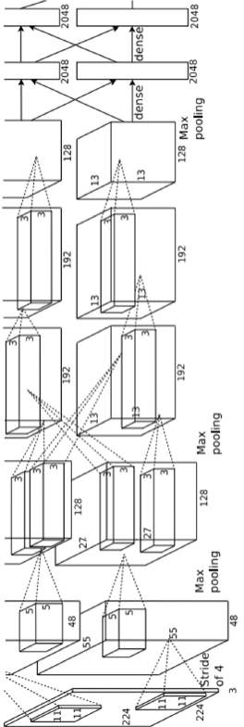
Fast R-CNN
Bbox
Bbox
Bbox
Category and box transform per region
Example: When using AlexNet for detection, five conv layers are used for backbone and
two FC layers are used for per- region network
Class
Class
Class
Regions of Interest (RoIs) from a proposal method
Per-Region Network
Crop + Resize features Image features
CNN
CNN
CNN
“Backbone” network: AlexNet, VGG, ResNet, etc
Run whole image through ConvNet
ConvNet
Input image
Girshick, “Fast R-CNN”, ICCV 2015. Figure copyright Ross Girshick, 2015; source. Reproduced with permission.

Slide 68
Fast R-CNN
3x3 conv, 512
3x3 conv, 512
3x3 conv, 512
3x3 conv, 512
3x3 conv, 512 3x3 conv, 512, /2
Softmax
FC 1000
Pool
Bbox
Bbox
Bbox
Category and box transform per region
Example:
For ResNet, last stage is used as per-region network; the rest of the network is used as backbone
Class
Class
Class
Regions of Interest (RoIs) from a proposal method
Per-Region Network
Crop + Resize features Image features
CNN
CNN
CNN
..
.
3x3 conv, 128
3x3 conv, 128
3x3 conv, 128
3x3 conv, 128
“Backbone” network: AlexNet, VGG, ResNet, etc
Run whole image through ConvNet
3x3 conv, 128
3x3 conv, 128, / 2
3x3 conv, 64
3x3 conv, 64
ConvNet
3x3 conv, 64
3x3 conv, 64
3x3 conv, 64
3x3 conv, 64
Input image
Pool
7x7 conv, 64, / 2
Input
Girshick, “Fast R-CNN”, ICCV 2015. Figure copyright Ross Girshick, 2015; source. Reproduced with permission.

Slide 69
Fast R-CNN
Bbox
Bbox
Bbox
Category and box transform per region
Class
Class
Class
Regions of Interest (RoIs) from a proposal method
Per-Region Network
CNN
CNN
CNN
Crop + Resize features
Image features
How to crop features?
“Backbone” network: AlexNet, VGG, ResNet, etc
Run whole image through ConvNet
ConvNet
Input image
Girshick, “Fast R-CNN”, ICCV 2015. Figure copyright Ross Girshick, 2015; source. Reproduced with permission.

Slide 70















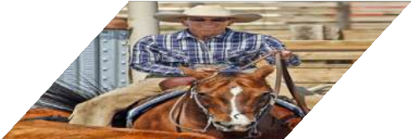
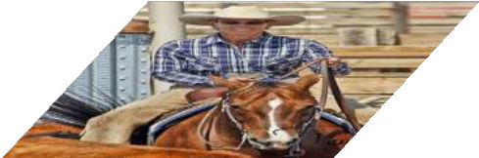
Fast R-CNN vs “Slow” R-CNN
Fast R-CNN: Apply differentiable cropping to shared image features
“Slow” R-CNN: Apply differentiable cropping to shared image features
Bbox
Bbox
Bbox
Category and box transform per region
Bbox
Class
Class
Class
Class
Bbox
Class
Regions of Interest (RoIs) from a proposal method
Per-Region Network
Crop + Resize features Image features
Run whole image through ConvNet
Bbox
Class
Forward each region through ConvNet
Warped image regions (224x224)
CNN
CNN
CNN
Conv Net
Conv Net
Conv Net
“Backbone” network: AlexNet, VGG, ResNet, etc
Regions of Interest (RoI) from a proposal method (~2k)
ConvNet
Input image
Input image

Slide 71
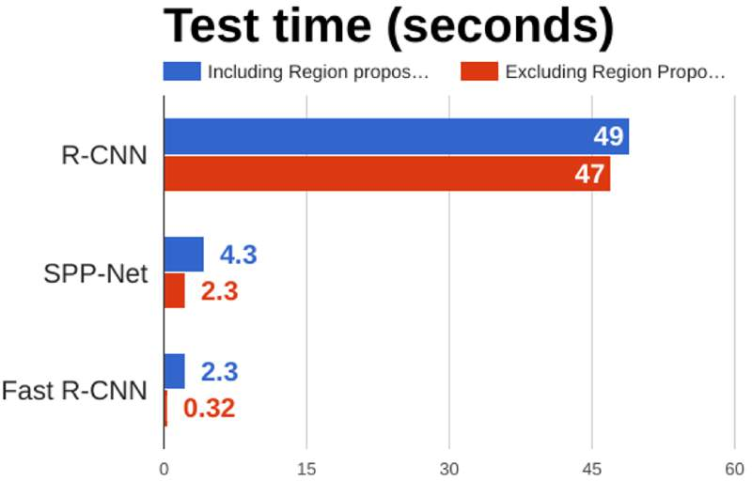
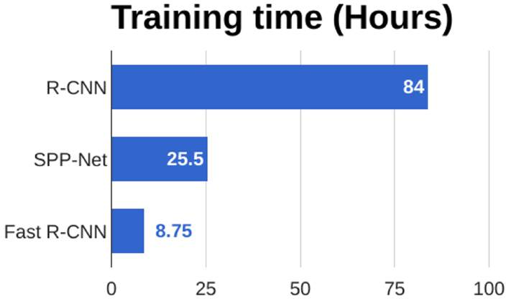
Fast R-CNN vs “Slow” R-CNN
Girshick et al, “Rich feature hierarchies for accurate object detection and semantic segmentation”, CVPR 2014. He et al, “Spatial pyramid pooling in deep convolutional networks for visual recognition”, ECCV 2014
Girshick, “Fast R-CNN”, ICCV 2015

Slide 72
Fast R-CNN vs “Slow” R-CNN
Problem: Runtime dominated by region proposals!
Girshick et al, “Rich feature hierarchies for accurate object detection and semantic segmentation”, CVPR 2014. He et al, “Spatial pyramid pooling in deep convolutional networks for visual recognition”, ECCV 2014
Girshick, “Fast R-CNN”, ICCV 2015

Slide 73
Fast R-CNN vs “Slow” R-CNN
Problem: Runtime dominated by region proposals!
Recall: Region proposals computed by heuristic ”Selective Search” algorithm on CPU -- let’s learn them with a CNN instead!
Girshick et al, “Rich feature hierarchies for accurate object detection and semantic segmentation”, CVPR 2014. He et al, “Spatial pyramid pooling in deep convolutional networks for visual recognition”, ECCV 2014
Girshick, “Fast R-CNN”, ICCV 2015
Lecture 5 - 73

Slide 74
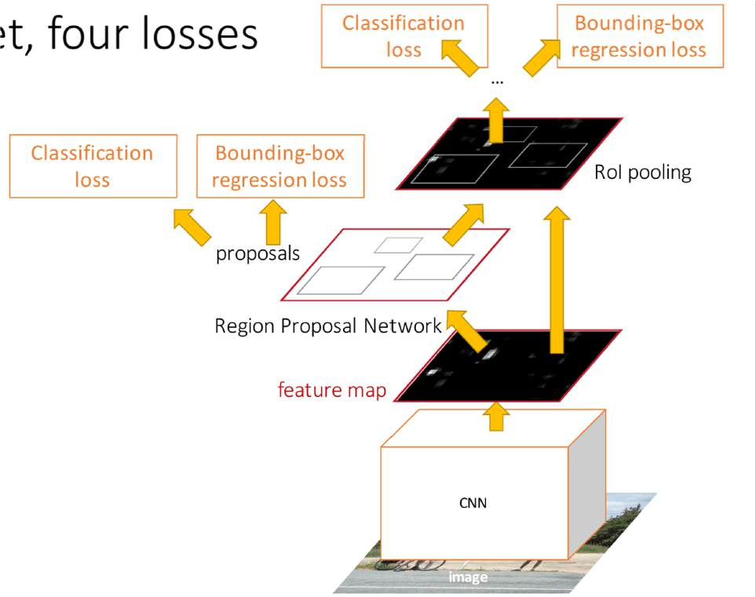
Faster R-CNN: Learnable Region Proposals
Insert Region Proposal Network (RPN) to predict proposals from features
Otherwise same as Fast R-CNN: Crop features for each proposal, classify each one
Ren et al, “Faster R-CNN: Towards Real-Time Object Detection with Region Proposal Networks”, NIPS 2015 Figure copyright 2015, Ross Girshick; reproduced with permission

Slide 75
Faster R-CNN: Learnable Region Proposals
Jointly train with 4 losses:
RPN classification: anchor box is object / not an object
RPN regression: predict transform from anchor box to proposal box
Object classification: classify proposals as background / object class
Object regression: predict transform from proposal box to object box
Ren et al, “Faster R-CNN: Towards Real-Time Object Detection with Region Proposal Networks”, NIPS 2015 Figure copyright 2015, Ross Girshick; reproduced with permission

Slide 76
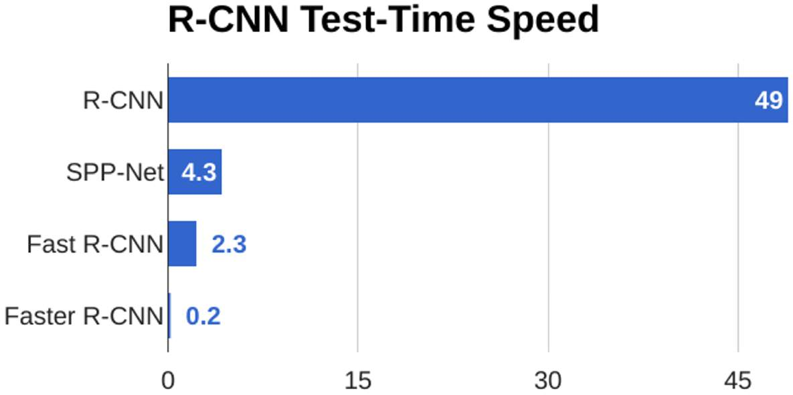
Faster R-CNN: Learnable Region Proposals

Slide 77
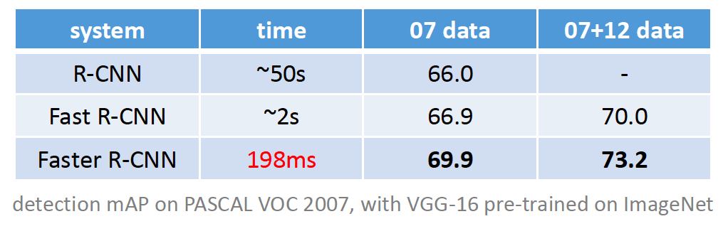
Faster R-CNN results

Slide 78
Object detection progress
Faster R-CNN
Fast R-CNN
Before CNNs
R-CNNv1
After CNNs

Slide 79
Outline
Task definition and evaluation
Two-stage detectors
  R-CNN
  Fast R-CNN
  Faster R-CNN
Single-stage and multi-resolution detectors

Slide 80
Streamlined detection architectures
The Faster R-CNN pipeline separates proposal generation and region classification
Is it possible to do detection in one shot?
Region Proposals
RPN
Classification + Regression
Conv feature map of the entire image
RoI features
Detections
RoI pooling
Classification + Regression
Conv feature map of the entire image
Detections

Slide 81
YOLO
Divide the image into a coarse grid and directly predict class label and a few candidate boxes for each grid cell

Slide 82
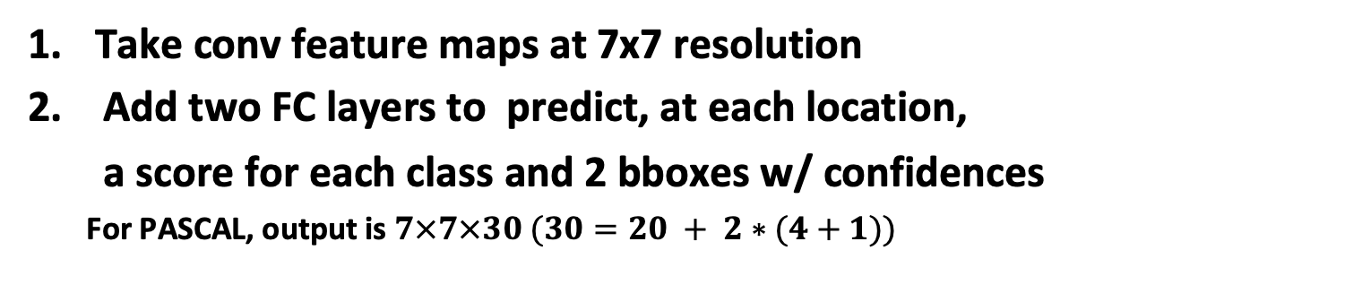
YOLO
Take conv feature maps at 7x7 resolution
Add two FC layers to predict, at each location,
a score for each class and 2 bboxes w/ confidences
  For PASCAL, output is $7×7×30 (30=20 + 2∗(4+1))$

Slide 83
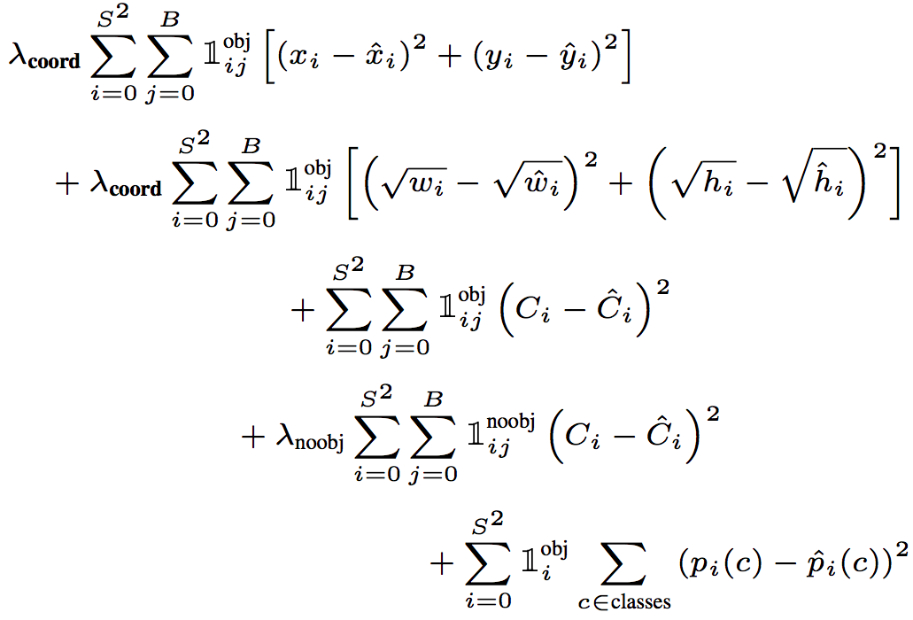
YOLO
Objective function:
Regression
Object/no object confidence
Class prediction
Notes:
At training time we only want one bounding box predictor to be responsible for each object. We assign one predictor to be “responsible” for predicting an object based on which prediction has the highest current IOU with the ground truth.

Slide 84

YOLO
Objective function:
Cell i contains object, predictor j is responsible for it
Small deviations matter less for larger boxes than for smaller boxes
Confidence for object
Confidence for no object
Down-weight loss from boxes that don’t contain objects ($λ_{noobj}=0.5)$
Class probability
Notes:
At training time we only want one bounding box predictor to be responsible for each object. We assign one predictor to be “responsible” for predicting an object based on which prediction has the highest current IOU with the ground truth.

Slide 85
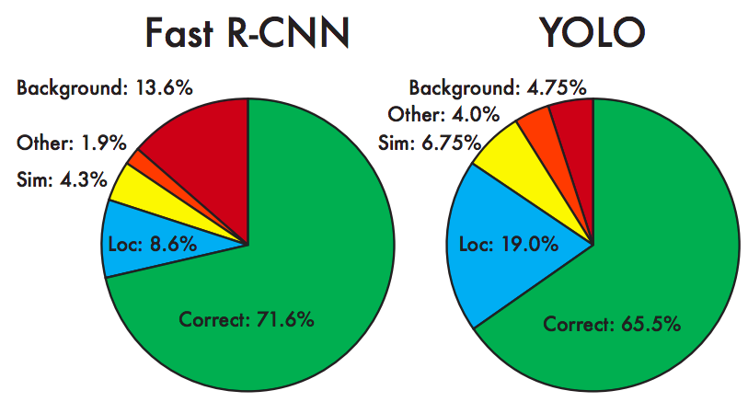
YOLO: Results
Each grid cell predicts only two boxes and can only have one class – this limits the number of nearby objects that can be predicted
Localization accuracy suffers compared to Fast(er) R-CNN due to coarser features, errors on small boxes
7x speedup over Faster R-CNN (45-155 FPS vs. 7-18 FPS)
Performance on PASCAL 2007

