Slide 1
Lecture 4: Convolutional Networks

Slide 2






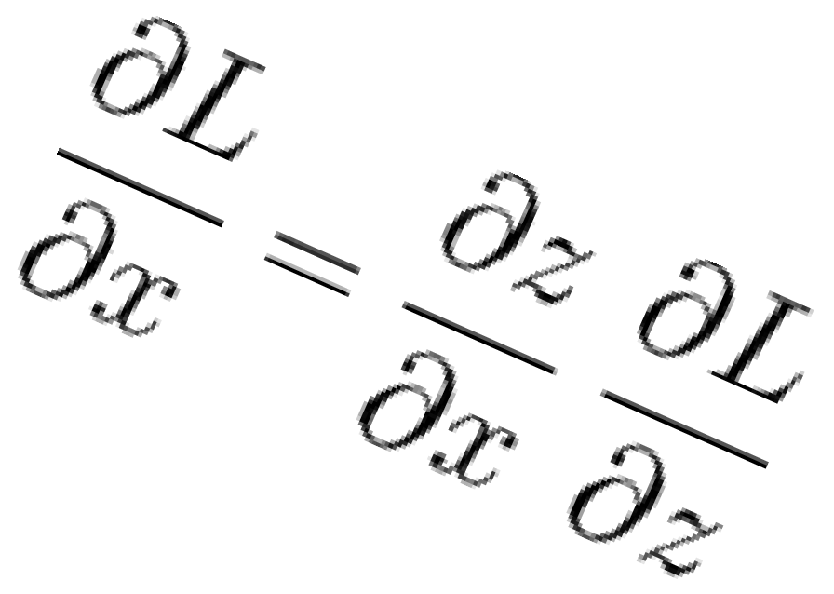





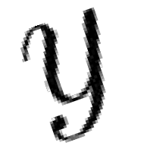


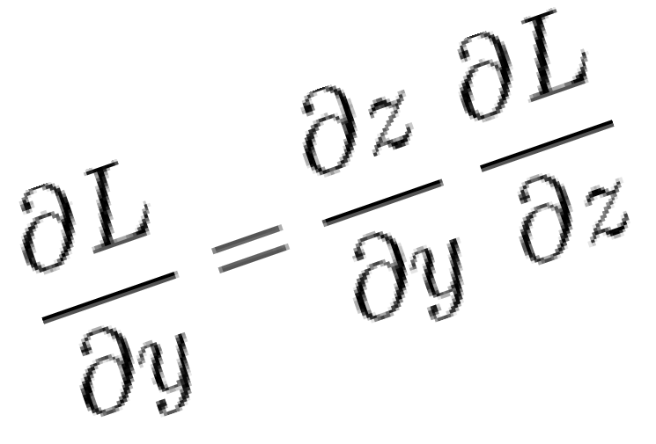

Last Time: Backpropagation
During the backward pass, each node in the graph receives upstream gradients and multiplies them by local gradients to compute downstream gradients
Represent complex expressions as computational graphs
x
*
s (scores)
hinge loss
L
+
W
R
Downstream gradients
f
Local gradients
Forward pass computes outputs
Upstream gradient
Backward pass computes gradients

Slide 3
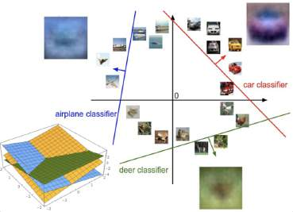


Problem: So far our classifiers don’t respect the spatial structure of images!
f(x,W) = Wx
Stretch pixels into column
56
231
24
2
56 | 231
24 | 2
x
Input: 3072
h
W
1
W
s
2
Input image (2, 2)
Output: 10
Hidden layer: 100
(4,)

Slide 4
Problem: So far our classifiers don’t respect the spatial structure of images!
f(x,W) = Wx
Solution: Define new computational nodes that operate on images!
Stretch pixels into column
56
231
24
2
56 | 231
24 | 2
x
Input: 3072
h
W
1
W
s
2
Input image (2, 2)
Output: 10
Hidden layer: 100
(4,)

Slide 5
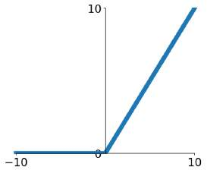
Components of a Fully-Connected Network
Fully-Connected Layers Activation Function
x
h
s

Slide 6
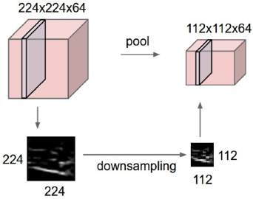

Components of a Convolutional Network
Fully-Connected Layers Activation Function
x
h
s
Convolution Layers
Pooling Layers
Normalization
^{𝑥}𝑖,j ^{− 𝜇}j
𝑥! =
𝑖,j
𝜎² + 𝜀
j

Slide 7
Components of a Convolutional Network
Fully-Connected Layers Activation Function
x
h
s
Convolution Layers
Pooling Layers
Normalization
^{𝑥}𝑖,j ^{− 𝜇}j
𝑥! =
𝑖,j
𝜎² + 𝜀
j

Slide 8


Fully-Connected Layer
32x32x3 image -> stretch to 3072 x 1
Input
Output
1
1
10 x 3072
weights
3072
10

Slide 9
Fully-Connected Layer
32x32x3 image -> stretch to 3072 x 1
Input
Output
1
1
10 x 3072
weights
3072
10
1 number:
the result of taking a dot product between a row of W and the input (a 3072- dimensional dot product)

Slide 10
Convolution Layer
3x32x32 image: preserve spatial structure
32 height
32
width
3
depth / channels

Slide 11
Convolution Layer
3x32x32 image
3x5x5 filter
Convolve the filter with the image
i.e. “slide over the image spatially, computing dot products”
32 height
32
width
3
depth / channels

Slide 12
Convolution Layer
Filters always extend the full depth of the input volume
3x32x32 image
3x5x5 filter
Convolve the filter with the image
i.e. “slide over the image spatially, computing dot products”
32 height
32
width
3
depth / channels

Slide 13
Convolution Layer
3x32x32 image
3x5x5 filter
1 number:
the result of taking a dot product between the filter and a small 3x5x5 chunk of the image
(i.e. 3*5*5 = 75-dimensional dot product + bias)
𝑤^{𝑇}𝑥 + 𝑏
32
32
3

Slide 14
Convolution Layer
1x28x28
activation map
3x32x32 image
3x5x5 filter
28
convolve (slide) over all spatial locations
32
28
32
1
3

Slide 15
Convolution Layer
two 1x28x28 activation map
3x32x32 image
Consider repeating with a second (green) filter:
3x5x5 filter
28 28
convolve (slide) over all spatial locations
32
28
32
1 1
3

Slide 16
Convolution Layer
6 activation maps, each 1x28x28
3x32x32 image
Consider 6 filters, each 3x5x5
Convolution Layer
32
32
6x3x5x5 filters
Stack activations to get a 6x28x28 output image!
3

Slide 17
Convolution Layer
6 activation maps, each 1x28x28
3x32x32 image Also 6-dim bias vector:
Convolution Layer
32
32
6x3x5x5 filters
Stack activations to get a 6x28x28 output image!
3

Slide 18
Convolution Layer
28x28 grid, at each point a 6-dim vector
3x32x32 image Also 6-dim bias vector:
Convolution Layer
32
32
6x3x5x5 filters
Stack activations to get a 6x28x28 output image!
3

Slide 19
Convolution Layer
2x6x28x28 Batch of outputs
2x3x32x32
Also 6-dim bias vector:
Batch of images
Convolution Layer
32
32
6x3x5x5 filters
3

Slide 20
Convolution Layer
N x C_{out} x H’ x W’ Batch of outputs
N x C_{in} x H x W
Also C
-dim bias vector:
Batch of images
out
Convolution Layer
H
W
C_{out} x C_{in}x K_{w} x K_{h} filters
C
out
^{C}in

Slide 21
Stacking Convolutions
32
28
26
….
Conv
Conv
Conv
W₁: 6x3x5x5
₃₂ b₁: 6
W₂: 10x6x3x3 b₂: 10
W₃: 12x10x3x3 b₃: 12
28
26
3
Input:
N x 3 x 32 x 32
6
First hidden layer: N x 6 x 28 x 28
10
Second hidden layer: N x 10 x 26 x 26

Slide 22
Stacking Convolutions
Q: What happens if we stack two convolution layers?
32
28
26
….
Conv
Conv
Conv
W₁: 6x3x5x5
₃₂ b₁: 6
W₂: 10x6x3x3 b₂: 10
W₃: 12x10x3x3 b₃: 12
28
26
3
Input:
N x 3 x 32 x 32
6
First hidden layer: N x 6 x 28 x 28
10
Second hidden layer: N x 10 x 26 x 26

Slide 23
Q: What happens if we stack
(Recall y=W₂W₁x is a linear classifier)
Stacking Convolutions
two convolution layers?
A: We get another convolution!
32
28
26
….
Conv
ReLU
Conv
ReLU
Conv
ReLU
W₁: 6x3x5x5
₃₂ b₁: 6
W₂: 10x6x3x3 b₂: 10
W₃: 12x10x3x3 b₃: 12
28
26
3
Input:
N x 3 x 32 x 32
6
First hidden layer: N x 6 x 28 x 28
10
Second hidden layer: N x 10 x 26 x 26

Slide 24
What do convolutional filters learn?
32
28
26
….
Conv
ReLU
Conv
ReLU
Conv
ReLU
W₁: 6x3x5x5
W₂: 10x6x3x3 b₂: 10
W₃: 12x10x3x3 b₃: 12
₃₂ b₁: 6
28
26
3
Input:
N x 3 x 32 x 32
6
First hidden layer: N x 6 x 28 x 28
10
Second hidden layer: N x 10 x 26 x 26

Slide 25
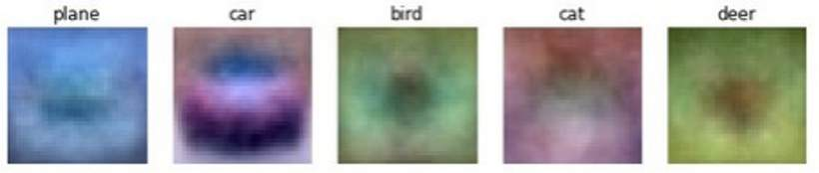
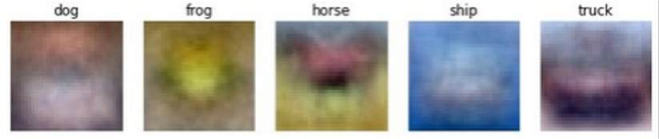
What do convolutional filters learn?
32
28
Linear classifier: One template per class
Conv
ReLU
W₁: 6x3x5x5
₃₂ b₁: 6
28
3
Input:
N x 3 x 32 x 32
6
First hidden layer: N x 6 x 28 x 28

Slide 26
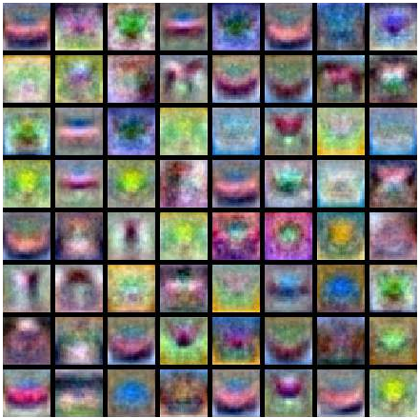
What do convolutional filters learn?
MLP: Bank of whole-image templates
32 28
Conv
ReLU
W₁: 6x3x5x5
₃₂ b₁: 6
28
3
Input:
N x 3 x 32 x 32
6
First hidden layer: N x 6 x 28 x 28

Slide 27
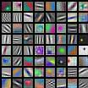
What do convolutional filters learn?
First-layer conv filters: local image templates (Often learns oriented edges, opposing colors)
32 28
Conv
ReLU
W₁: 6x3x5x5
₃₂ b₁: 6
28
3
Input:
N x 3 x 32 x 32
6
First hidden layer: N x 6 x 28 x 28
AlexNet: 64 filters, each 3x11x11

Slide 28
A closer look at spatial dimensions
32
28
Conv
ReLU
W₁: 6x3x5x5
₃₂ b₁: 6
28
3
Input:
N x 3 x 32 x 32
6
First hidden layer: N x 6 x 28 x 28

Slide 29
A closer look at spatial dimensions
Input: 7x7 Filter: 3x3
7
7

Slide 30
A closer look at spatial dimensions
Input: 7x7 Filter: 3x3
7
7

Slide 31
A closer look at spatial dimensions
Input: 7x7 Filter: 3x3
7
7

Slide 32
A closer look at spatial dimensions
Input: 7x7 Filter: 3x3
7
7

Slide 33
A closer look at spatial dimensions
Input: 7x7 Filter: 3x3 Output: 5x5
7
7

Slide 34
A closer look at spatial dimensions
Input: 7x7 Filter: 3x3 Output: 5x5
In general: Input: W
Problem: Feature maps “shrink” with each layer!
7
Filter: K
Output: W – K + 1
7

Slide 35
A closer look at spatial dimensions
0 | 0 | 0 | 0 | 0 | 0 | 0 | 0 | 0
0 |  |  |  |  |  |  |  | 0
0 |  |  |  |  |  |  |  | 0
0 |  |  |  |  |  |  |  | 0
0 |  |  |  |  |  |  |  | 0
0 |  |  |  |  |  |  |  | 0
0 |  |  |  |  |  |  |  | 0
0 |  |  |  |  |  |  |  | 0
0 | 0 | 0 | 0 | 0 | 0 | 0 | 0 | 0
Input: 7x7 Filter: 3x3 Output: 5x5
In general: Input: W
Problem: Feature maps “shrink” with each layer!
Filter: K
Output: W – K + 1
Solution: padding
Add zeros around the input

Slide 36
A closer look at spatial dimensions
0 | 0 | 0 | 0 | 0 | 0 | 0 | 0 | 0
0 |  |  |  |  |  |  |  | 0
0 |  |  |  |  |  |  |  | 0
0 |  |  |  |  |  |  |  | 0
0 |  |  |  |  |  |  |  | 0
0 |  |  |  |  |  |  |  | 0
0 |  |  |  |  |  |  |  | 0
0 |  |  |  |  |  |  |  | 0
0 | 0 | 0 | 0 | 0 | 0 | 0 | 0 | 0
Input: 7x7 Filter: 3x3 Output: 5x5
In general: Input: W Filter: K Padding: P
Very common:
Set P = (K – 1) / 2 to make output have same size as input!
Output: W – K + 1 + 2P

Slide 37
Receptive Fields
For convolution with kernel size K, each element in the output depends on a K x K receptive field in the input
Input
Output

Slide 38
Receptive Fields
Each successive convolution adds K – 1 to the receptive field size With L layers the receptive field size is 1 + L * (K – 1)
Input
Output
Be careful – ”receptive field in the input” vs “receptive field in the previous layer” Hopefully clear from context!

Slide 39
Receptive Fields
Each successive convolution adds K – 1 to the receptive field size With L layers the receptive field size is 1 + L * (K – 1)
Input
Problem: For large images we need many layers for each output to “see” the whole image image
Output

Slide 40
Receptive Fields
Each successive convolution adds K – 1 to the receptive field size With L layers the receptive field size is 1 + L * (K – 1)
Input
Problem: For large images we need many layers for each output to “see” the whole image image
Solution: Downsample inside the network
Output

Slide 41
Strided Convolution
Input: 7x7 Filter: 3x3 Stride: 2

Slide 42
Strided Convolution
Input: 7x7 Filter: 3x3 Stride: 2

Slide 43
Strided Convolution
Input: 7x7 Filter: 3x3 Stride: 2
Output: 3x3

Slide 44
Strided Convolution
Input: 7x7 Filter: 3x3 Stride: 2
In general: Input: W Filter: K Padding: P
Output: 3x3
Stride: S
Output: (W – K + 2P) / S + 1

Slide 45
Convolution Example
Input volume: 3 x 32 x 32
10 5x5 filters with stride 1, pad 2
Output volume size: ?

Slide 46
Convolution Example
Input volume: 3 x 32 x 32
10 5x5 filters with stride 1, pad 2
Output volume size:
(32+2*2-5)/1+1 = 32 spatially, so 10 x 32 x 32

Slide 47
Convolution Example
Input volume: 3 x 32 x 32
10 5x5 filters with stride 1, pad 2
Output volume size: 10 x 32 x 32 Number of learnable parameters: ?

Slide 48
Convolution Example
Input volume: 3 x 32 x 32
10 5x5 filters with stride 1, pad 2
Output volume size: 10 x 32 x 32 Number of learnable parameters: 760
Parameters per filter: 3*5*5 + 1 (for bias) = 76 10 filters, so total is 10 * 76 = 760

Slide 49
Convolution Example
Input volume: 3 x 32 x 32
10 5x5 filters with stride 1, pad 2
Output volume size: 10 x 32 x 32 Number of learnable parameters: 760 Number of multiply-add operations: ?

Slide 50
Convolution Example
Input volume: 3 x 32 x 32
10 5x5 filters with stride 1, pad 2
Output volume size: 10 x 32 x 32
Number of learnable parameters: 760 Number of multiply-add operations: 768,000
10*32*32 = 10,240 outputs; each output is the inner product of two 3x5x5 tensors (75 elems); total = 75*10240 = 768K

Slide 51
Example: 1x1 Convolution
1x1 CONV
with 32 filters
(each filter has size 1x1x64, and performs a 64- dimensional dot product)
56
56
56
56
64
32

Slide 52
Example: 1x1 Convolution
1x1 CONV
with 32 filters
(each filter has size 1x1x64, and performs a 64- dimensional dot product)
Stacking 1x1 conv layers gives MLP operating on
56
56
56
56
64
32
each input position
Lin et al, “Network in Network”, ICLR 2014

Slide 53
Convolution Summary
Input: C_{in} x H x W
Hyperparameters:
Kernel size: K_{H} x K_{W}
Number filters: C_{out}
Padding: P
Stride: S
Weight matrix: C_{out} x C_{in} x K_{H} x K_{W} giving C_{out} filters of size C_{in} x K_{H} x K_{W} Bias vector: C_{out}
Output size: C_{out} x H’ x W’ where:
- H’ = (H – K + 2P) / S + 1
- W’ = (W – K + 2P) / S + 1

Slide 54
Convolution Summary
Input: C_{in} x H x W
Hyperparameters:
Kernel size: K_{H} x K_{W}
Number filters: C_{out}
Padding: P
Stride: S
Weight matrix: C_{out} x C_{in} x K_{H} x K_{W} giving C_{out} filters of size C_{in} x K_{H} x K_{W} Bias vector: C_{out}
Output size: C_{out} x H’ x W’ where:
- H’ = (H – K + 2P) / S + 1
- W’ = (W – K + 2P) / S + 1
Common settings:
K_{H} = K_{W} (Small square filters)
P = (K – 1) / 2 (”Same” padding)
C_{in}, C_{out} = 32, 64, 128, 256 (powers of 2) K = 3, P = 1, S = 1 (3x3 conv)
K = 5, P = 2, S = 1 (5x5 conv) K = 1, P = 0, S = 1 (1x1 conv)
K = 3, P = 1, S = 2 (Downsample by 2)

Slide 55
Other types of convolution
So far: 2D Convolution
Input: C_{in} x H x W Weights: C_{out} x C_{in} x K x K
H
W
^{C}in

Slide 56
Other types of convolution
So far: 2D Convolution
Input: C_{in} x H x W Weights: C_{out} x C_{in} x K x K
1D Convolution
Input: C_{in} x W Weights: C_{out} x C_{in} x K
H
^{C}in
W
^{C}in
W
Lecture 4 - 58

Slide 57
Other types of convolution
So far: 2D Convolution
Input: C_{in} x H x W Weights: C_{out} x C_{in} x K x K
3D Convolution
Input: C_{in} x H x W x D Weights: C_{out} x C_{in} x K x K x K
H
C_{in}-dim vector at each point in the volume
H
D
W
^{C}in
W

Slide 58
Components of a Convolutional Network
Fully-Connected Layers Activation Function
x h s
Convolution Layers
Pooling Layers
Normalization
^{𝑥}𝑖,j ^{− 𝜇}j
𝑥! =
𝑖,j
𝜎² + 𝜀
j

Slide 59
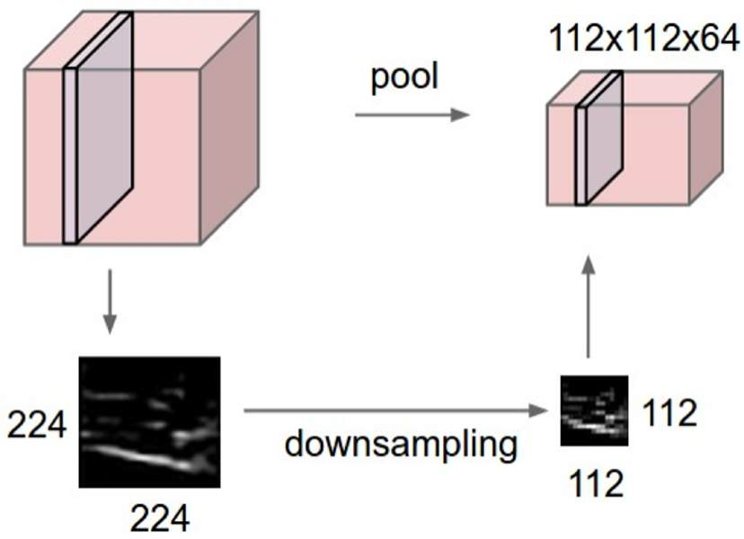
Pooling Layers: Another way to downsample
64 x 224 x 224
64 x 112 x 112
Hyperparameters: Kernel Size
Stride
Pooling function

Slide 60
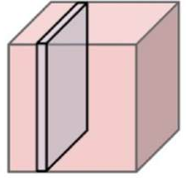
Max Pooling
64 x 224 x 224
Single depth slice
1 | 1 | 2 | 4
5 | 6 | 7 | 8
3 | 2 | 1 | 0
1 | 2 | 3 | 4
x
Max pooling with 2x2 kernel size and stride 2
6 | 8
3 | 4
Introduces invariance to small spatial shifts
y No learnable parameters!

Slide 61
Pooling Summary
Input: C x H x W
Hyperparameters:
Kernel size: K
Stride: S
Pooling function (max, avg)
Output: C x H’ x W’ where
- H’ = (H – K) / S + 1
- W’ = (W – K) / S + 1
Learnable parameters: None!
Common settings: max, K = 2, S = 2
max, K = 3, S = 2 (AlexNet)

Slide 62
Components of a Convolutional Network
Fully-Connected Layers Activation Function
x
h
s
Convolution Layers
Pooling Layers
Normalization
^{𝑥}𝑖,j ^{− 𝜇}j
𝑥! =
𝑖,j
𝜎² + 𝜀
j

Slide 63
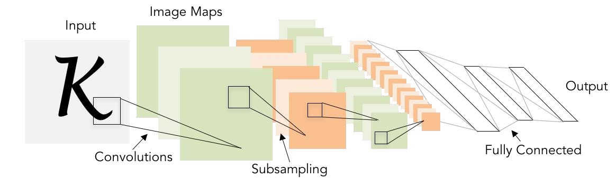
Convolutional Networks
Classic architecture: [Conv, ReLU, Pool] x N, flatten, [FC, ReLU] x N, FC
Example: LeNet-5
Lecun et al, “Gradient-based learning applied to document recognition”, 1998

Slide 64
Example: LeNet-5
Layer | Output Size | Weight Size
Input | 1 x 28 x 28
Conv (C_{out}=20, K=5, P=2, S=1) 20 x 28 x 28 20 x 1 x 5 x 5
ReLU 20 x 28 x 28
MaxPool(K=2, S=2) 20 x 14 x 14
Conv (C_{out}=50, K=5, P=2, S=1) 50 x 14 x 14 50 x 20 x 5 x 5
ReLU 50 x 14 x 14
MaxPool(K=2, S=2) 50 x 7 x 7
Flatten 2450
Linear (2450 -> 500) 500 2450 x 500
ReLU 500
Linear (500 -> 10) 10 500 x 10
Lecun et al, “Gradient-based learning applied to document recognition”, 1998

Slide 65
Example: LeNet-5
Layer | Output Size | Weight Size
Input | 1 x 28 x 28
Conv (C_{out}=20, K=5, P=2, S=1) | 20 x 28 x 28 | 20 x 1 x 5 x 5
ReLU | 20 x 28 x 28
MaxPool(K=2, S=2) 20 x 14 x 14
Conv (C_{out}=50, K=5, P=2, S=1) 50 x 14 x 14 50 x 20 x 5 x 5
ReLU 50 x 14 x 14
MaxPool(K=2, S=2) 50 x 7 x 7
Flatten 2450
Linear (2450 -> 500) 500 2450 x 500
ReLU 500
Linear (500 -> 10) 10 500 x 10
Lecun et al, “Gradient-based learning applied to document recognition”, 1998

Slide 66
Example: LeNet-5
Layer | Output Size | Weight Size
Input | 1 x 28 x 28
Conv (C_{out}=20, K=5, P=2, S=1) | 20 x 28 x 28 | 20 x 1 x 5 x 5
ReLU | 20 x 28 x 28
MaxPool(K=2, S=2) | 20 x 14 x 14
Conv (C_{out}=50, K=5, P=2, S=1) 50 x 14 x 14 50 x 20 x 5 x 5
ReLU 50 x 14 x 14
MaxPool(K=2, S=2) 50 x 7 x 7
Flatten 2450
Linear (2450 -> 500) 500 2450 x 500
ReLU 500
Linear (500 -> 10) 10 500 x 10
Lecun et al, “Gradient-based learning applied to document recognition”, 1998

Slide 67
Example: LeNet-5
Layer | Output Size | Weight Size
Input | 1 x 28 x 28
Conv (C_{out}=20, K=5, P=2, S=1) | 20 x 28 x 28 | 20 x 1 x 5 x 5
ReLU | 20 x 28 x 28
MaxPool(K=2, S=2) | 20 x 14 x 14
Conv (C_{out}=50, K=5, P=2, S=1) | 50 x 14 x 14 | 50 x 20 x 5 x 5
ReLU | 50 x 14 x 14
MaxPool(K=2, S=2) 50 x 7 x 7
Flatten 2450
Linear (2450 -> 500) 500 2450 x 500
ReLU 500
Linear (500 -> 10) 10 500 x 10
Lecun et al, “Gradient-based learning applied to document recognition”, 1998

Slide 68
Example: LeNet-5
Layer | Output Size | Weight Size
Input | 1 x 28 x 28
Conv (C_{out}=20, K=5, P=2, S=1) | 20 x 28 x 28 | 20 x 1 x 5 x 5
ReLU | 20 x 28 x 28
MaxPool(K=2, S=2) | 20 x 14 x 14
Conv (C_{out}=50, K=5, P=2, S=1) | 50 x 14 x 14 | 50 x 20 x 5 x 5
ReLU | 50 x 14 x 14
MaxPool(K=2, S=2) | 50 x 7 x 7
Flatten 2450
Linear (2450 -> 500) 500 2450 x 500
ReLU 500
Linear (500 -> 10) 10 500 x 10
Lecun et al, “Gradient-based learning applied to document recognition”, 1998

Slide 69
Example: LeNet-5
Layer | Output Size | Weight Size
Input | 1 x 28 x 28
Conv (C_{out}=20, K=5, P=2, S=1) | 20 x 28 x 28 | 20 x 1 x 5 x 5
ReLU | 20 x 28 x 28
MaxPool(K=2, S=2) | 20 x 14 x 14
Conv (C_{out}=50, K=5, P=2, S=1) | 50 x 14 x 14 | 50 x 20 x 5 x 5
ReLU | 50 x 14 x 14
MaxPool(K=2, S=2) | 50 x 7 x 7
Flatten | 2450
Linear (2450 -> 500) 500 2450 x 500
ReLU 500
Linear (500 -> 10) 10 500 x 10
Lecun et al, “Gradient-based learning applied to document recognition”, 1998

Slide 70
Example: LeNet-5
Layer | Output Size | Weight Size
Input | 1 x 28 x 28
Conv (C_{out}=20, K=5, P=2, S=1) | 20 x 28 x 28 | 20 x 1 x 5 x 5
ReLU | 20 x 28 x 28
MaxPool(K=2, S=2) | 20 x 14 x 14
Conv (C_{out}=50, K=5, P=2, S=1) | 50 x 14 x 14 | 50 x 20 x 5 x 5
ReLU | 50 x 14 x 14
MaxPool(K=2, S=2) | 50 x 7 x 7
Flatten | 2450
Linear (2450 -> 500) | 500 | 2450 x 500
ReLU | 500
Linear (500 -> 10) 10 500 x 10
Lecun et al, “Gradient-based learning applied to document recognition”, 1998

Slide 71
Example: LeNet-5
Layer | Output Size | Weight Size
Input | 1 x 28 x 28
Conv (C_{out}=20, K=5, P=2, S=1) | 20 x 28 x 28 | 20 x 1 x 5 x 5
ReLU | 20 x 28 x 28
MaxPool(K=2, S=2) | 20 x 14 x 14
Conv (C_{out}=50, K=5, P=2, S=1) | 50 x 14 x 14 | 50 x 20 x 5 x 5
ReLU | 50 x 14 x 14
MaxPool(K=2, S=2) | 50 x 7 x 7
Flatten | 2450
Linear (2450 -> 500) | 500 | 2450 x 500
ReLU | 500
Linear (500 -> 10) | 10 | 500 x 10
Lecun et al, “Gradient-based learning applied to document recognition”, 1998

Slide 72
Example: LeNet-5
Layer | Output Size | Weight Size
Input | 1 x 28 x 28
Conv (C_{out}=20, K=5, P=2, S=1) | 20 x 28 x 28 | 20 x 1 x 5 x 5
ReLU | 20 x 28 x 28
MaxPool(K=2, S=2) | 20 x 14 x 14
Conv (C_{out}=50, K=5, P=2, S=1) | 50 x 14 x 14 | 50 x 20 x 5 x 5
ReLU | 50 x 14 x 14
MaxPool(K=2, S=2) | 50 x 7 x 7
Flatten | 2450
Linear (2450 -> 500) | 500 | 2450 x 500
ReLU | 500
Linear (500 -> 10) | 10 | 500 x 10
As we go through the network:
Spatial size decreases
(using pooling or strided conv)
Number of channels increases
(total “volume” is preserved!)
Lecun et al, “Gradient-based learning applied to document recognition”, 1998

Slide 73
Problem: Deep Networks very hard to train!

Slide 74
Components of a Convolutional Network
Fully-Connected Layers Activation Function
x h s
Convolution Layers Pooling Layers
Normalization
^{𝑥}𝑖,j ^{− 𝜇}j
𝑥! =
𝑖,j
𝜎² + 𝜀
j

Slide 75
Batch Normalization
Idea: “Normalize” the outputs of a layer so they have zero mean and unit variance
Why? Helps reduce “internal covariate shift”, improves optimization We can normalize a batch of activations like this:
_{𝑥! =} 𝑥 − 𝐸 𝑥
This is a differentiable function, so we can use it as an operator in our networks and backprop through it!
𝑉𝑎𝑟 𝑥
Ioffe and Szegedy, “Batch normalization: Accelerating deep network training by reducing internal covariate shift”, ICML 2015

Slide 76
Batch Normalization
𝑁
𝑥 ∈ ℝ
𝑁×𝐷
Per-channel mean, shape is D
Input:
𝜇 = ¹ +
𝑁
^{𝑥}𝑖,j
j
𝑖=1
X
1
𝑁
2
2
Per-channel std, shape is D
𝜎
= _{𝑁} +
^{𝑥}𝑖,j ^{− 𝜇}j
j
𝑖=1
N
^{𝑥}𝑖,j ^{− 𝜇}j
𝑥! =
𝑖,j
Normalized x, Shape is N x D
𝜎² + 𝜀
j
D
Ioffe and Szegedy, “Batch normalization: Accelerating deep network training by reducing internal covariate shift”, ICML 2015

Slide 77
Batch Normalization
𝑁
𝑥 ∈ ℝ
𝑁×𝐷
Per-channel mean, shape is D
Input:
𝜇 = ¹ +
𝑁
^{𝑥}𝑖,j
j
𝑖=1
X
1
𝑁
2
2
Per-channel std, shape is D
𝜎
= _{𝑁} +
^{𝑥}𝑖,j ^{− 𝜇}j
j
𝑖=1
N
^{𝑥}𝑖,j ^{− 𝜇}j
𝑥! =
𝑖,j
Normalized x, Shape is N x D
𝜎² + 𝜀
j
D
Problem: What if zero-mean, unit variance is too hard of a constraint?
Ioffe and Szegedy, “Batch normalization: Accelerating deep network training by reducing internal covariate shift”, ICML 2015

Slide 78
Batch Normalization
𝑁
Input: 𝑥 ∈ ℝ
𝑁×𝐷
Per-channel mean, shape is D
𝜇 = ¹ +
𝑁
^{𝑥}𝑖,j
j
𝑖=1
Learnable scale and shift parameters:
𝛾, 𝛽 ∈ ℝ^{𝐷}
Learning 𝛾 = 𝜎, 𝛽 = 𝜇 will recover the identity function (in expectation)
1
𝑁
2
2
Per-channel std, shape is D
𝜎
= _{𝑁} +
^{𝑥}𝑖,j ^{− 𝜇}j
j
𝑖=1
^{𝑥}𝑖,j ^{− 𝜇}j
𝑥! =
𝑖,j
Normalized x, Shape is N x D
𝜎² + 𝜀
j
𝑦 = 𝛾_{j}𝑥!_{𝑖,j} + 𝛽_{j}
Output, Shape is N x D
𝑖,j

Slide 79
Batch Normalization
Problem: Estimates depend on minibatch; can’t do this at test-time!
𝑁
Input: 𝑥 ∈ ℝ
𝑁×𝐷
Per-channel mean, shape is D
𝜇 = ¹ +
𝑁
^{𝑥}𝑖,j
j
𝑖=1
Learnable scale and shift parameters:
𝛾, 𝛽 ∈ ℝ^{𝐷}
Learning 𝛾 = 𝜎, 𝛽 = 𝜇 will recover the identity function (in expectation)
1
𝑁
2
2
Per-channel std, shape is D
𝜎
= _{𝑁} +
^{𝑥}𝑖,j ^{− 𝜇}j
j
𝑖=1
^{𝑥}𝑖,j ^{− 𝜇}j
𝑥! =
𝑖,j
Normalized x, Shape is N x D
𝜎² + 𝜀
j
𝑦 = 𝛾_{j}𝑥!_{𝑖,j} + 𝛽_{j}
Output, Shape is N x D
𝑖,j

Slide 80
Batch Normalization: Test-Time
₁ 𝑁
_{𝑁} ^{+ 𝑥}𝑖,j
𝑖=1
𝑁×𝐷
(Running) average of
𝜇 =
Per-channel mean, shape is D
Input:
𝑥 ∈ ℝ
j
values seen during training
Learnable scale and shift parameters:
𝛾, 𝛽 ∈ ℝ^{𝐷}
Learning 𝛾 = 𝜎, 𝛽 = 𝜇 will recover the identity function (in expectation)
₁ 𝑁 ₂
_{𝑁} + 𝑥_{𝑖,j} − 𝜇_{j}
𝑖=1
_{𝜎}2 ₌ (Running) average of
Per-channel std, shape is D
j
values seen during training
^{𝑥}𝑖,j ^{− 𝜇}j
𝑥! =
𝑖,j
Normalized x, Shape is N x D
𝜎² + 𝜀
j
𝑦 = 𝛾_{j}𝑥!_{𝑖,j} + 𝛽_{j}
Output, Shape is N x D
𝑖,j

Slide 81
Batch Normalization: Test-Time
₁ 𝑁
_{𝑁} ^{+ 𝑥}𝑖,j
𝑖=1
𝑁×𝐷
(Running) average of
𝜇 =
Per-channel mean, shape is D
Input:
𝑥 ∈ ℝ
j
values seen during training
Learnable scale and shift parameters:
𝛾, 𝛽 ∈ ℝ^{𝐷}
During testing batchnorm
₁ 𝑁 ₂
_{𝑁} + 𝑥_{𝑖,j} − 𝜇_{j}
𝑖=1
_{𝜎}2 ₌ (Running) average of
Per-channel std, shape is D
j
values seen during training
^{𝑥}𝑖,j ^{− 𝜇}j
𝑥! =
𝑖,j
Normalized x, Shape is N x D
𝜎² + 𝜀
j
becomes a linear operator!
Can be fused with the previous _{𝑦𝑖,j = 𝛾j𝑥!𝑖,j + 𝛽j}
Output, Shape is N x D
fully-connected or conv layer

Slide 82
Batch Normalization for ConvNets
Batch Normalization for
Batch Normalization for
fully-connected networks
convolutional networks
(Spatial Batchnorm, BatchNorm2D)
𝑥 ∶ 𝑁 × 𝐶 × 𝐻 × 𝑊
𝑥 ∶ 𝑁 × 𝐷
Normalize
𝜇, 𝜎 ∶ 1 × 𝐷
𝛾, 𝛽 ∶ 1 × 𝐷
Normalize
𝜇, 𝜎 ∶ 1 × 𝐶 × 1 × 1
𝛾, 𝛽 ∶ 1 × 𝐶 × 1 × 1
𝑦 = ^{𝑥 − 𝜇} 𝛾 + 𝛽
𝑦 = ^{𝑥 − 𝜇} 𝛾 + 𝛽
𝜎
𝜎

Slide 83
Batch Normalization
FC
Usually inserted after Fully Connected or Convolutional layers, and before nonlinearity.
BN
tanh
FC
𝑥 − 𝐸 𝑥
BN
𝑥! =
𝑉𝑎𝑟 𝑥
tanh
Ioffe and Szegedy, “Batch normalization: Accelerating deep network training by reducing internal covariate shift”, ICML 2015

Slide 84
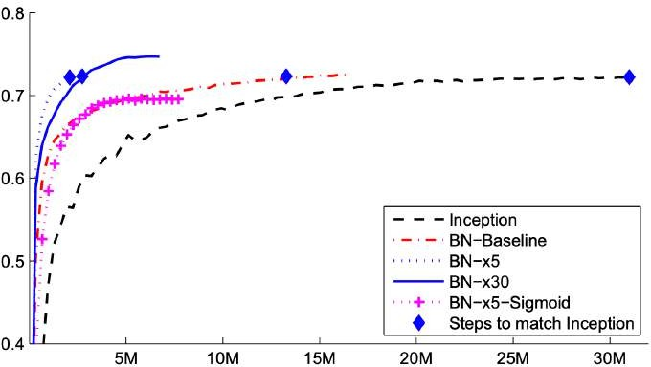
Batch Normalization
Makes deep networks much easier to train!
Allows higher learning rates, faster convergence
Networks become more robust to initialization
Acts as regularization during training
Zero overhead at test-time: can be fused with conv!
FC
BN
tanh
FC
BN
ImageNet accuracy
tanh
Ioffe and Szegedy, “Batch normalization: Accelerating deep network training by reducing internal covariate shift”, ICML 2015
Training iterations

Slide 85
Batch Normalization
Makes deep networks much easier to train!
Allows higher learning rates, faster convergence
Networks become more robust to initialization
Acts as regularization during training
Zero overhead at test-time: can be fused with conv!
Not well-understood theoretically (yet)
Behaves differently during training and testing: this is a very common source of bugs!
FC
BN
tanh
FC
BN
tanh
Ioffe and Szegedy, “Batch normalization: Accelerating deep network training by reducing internal covariate shift”, ICML 2015

Slide 86
Layer Normalization
Layer Normalization for fully- connected networks
Same behavior at train and test! Used in RNNs, Transformers
𝑥 ∶ 𝑁 × 𝐷
Batch Normalization for
fully-connected networks
𝑥 ∶ 𝑁 × 𝐷
Normalize
𝜇, 𝜎 ∶ 1 × 𝐷
Normalize
𝜇, 𝜎 ∶ 𝑁 × 1
𝛾, 𝛽 ∶ 1 × 𝐷
𝛾, 𝛽 ∶ 1 × 𝐷
𝑦 = ^{𝑥 − 𝜇} 𝛾 + 𝛽
𝑦 = ^{𝑥 − 𝜇} 𝛾 + 𝛽
𝜎
𝜎
Lecture 4 - 90

Slide 87
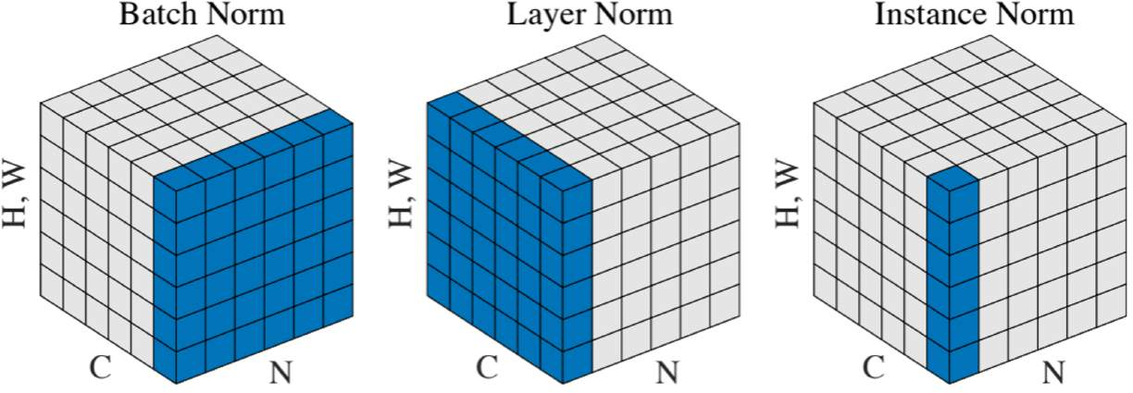
Comparison of Normalization Layers
Wu and He, “Group Normalization”, ECCV 2018

Slide 88
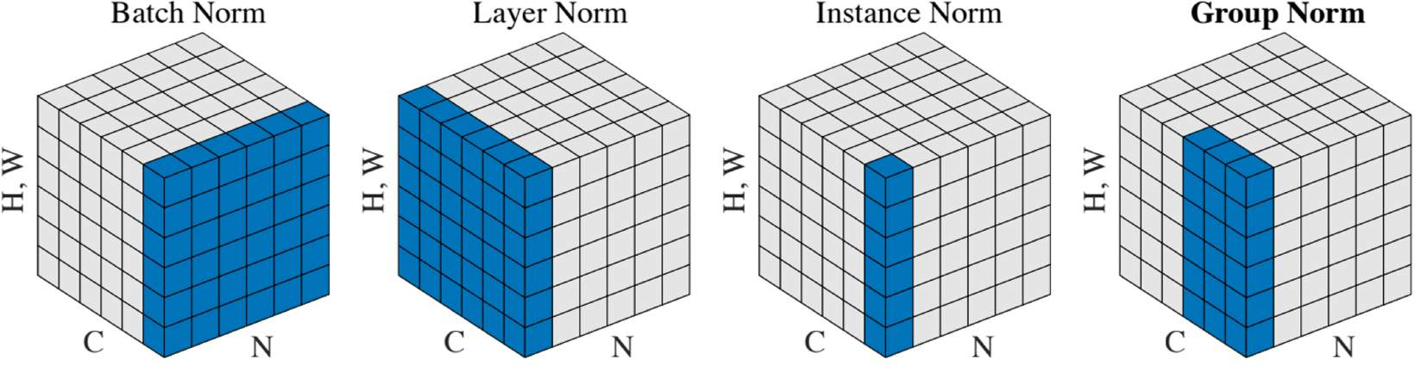
Group Normalization
Wu and He, “Group Normalization”, ECCV 2018

Slide 89



Components of a Convolutional Network
Convolution Layers Fully-Connected Layers
Pooling Layers
x
h
s
Activation Function
Normalization
^{𝑥}𝑖,j ^{− 𝜇}j
𝑥! =
𝑖,j
𝜎² + 𝜀
j

Slide 90
Components of a Convolutional Network
Convolution Layers
Most computationally expensive!
Pooling Layers
Fully-Connected Layers
x
h
s
Activation Function
Normalization
^{𝑥}𝑖,j ^{− 𝜇}j
𝑥! =
𝑖,j
𝜎² + 𝜀
j

Slide 91
Summary: Components of a Convolutional Network
Convolution Layers Fully-Connected Layers
Pooling Layers
x
h
s
Activation Function
Normalization
^{𝑥}𝑖,j ^{− 𝜇}j
𝑥! =
𝑖,j
𝜎² + 𝜀
j

Slide 92
Summary: Components of a Convolutional Network
Problem: What is the right way to combine all these components?

Slide 93
Next time: CNN Architectures

