Slide 1
Lecture 3: Neural Networks

Slide 2

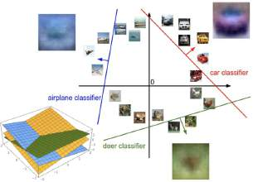
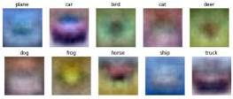



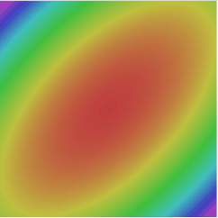
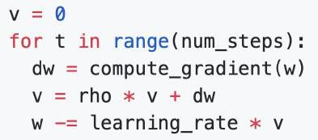
Where we are:
Use Linear Models for image classification problems
Use Loss Functions to express preferences over different
choices of weights
Use Regularization to prevent overfitting to training data
Use Stochastic Gradient Descent to minimize our loss
functions and train the model
Softmax
SVM

Slide 3




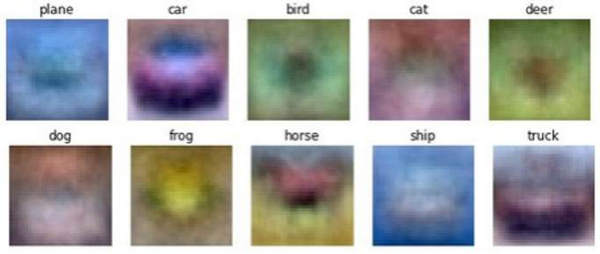



Problem: Linear Classifiers aren’t that powerful
Visual Viewpoint
One template per class: Can’t recognize different modes of a class
Geometric Viewpoint
y
x

Slide 4
One solution: Feature Transforms
Original space
y
r = (x² + y²)^{1/2}
θ = tan⁻¹(y/x)
x
Feature transform

Slide 5




One solution: Feature Transforms
Original space
Feature space
y
θ
r = (x² + y²)^{1/2} θ = tan⁻¹(y/x)
x
r
Feature transform

Slide 6
One solution: Feature Transforms
Original space
Feature space
y
θ
r = (x² + y²)^{1/2} θ = tan⁻¹(y/x)
x
r
Feature transform
Linear classifier in feature space

Slide 7
One solution: Feature Transforms
Original space
Feature space
y
θ
r = (x² + y²)^{1/2} θ = tan⁻¹(y/x)
x
r
Feature transform
Nonlinear classifier in original space!
Linear classifier in feature space

Slide 8


Image Features: Color Histogram
Ignores texture, spatial positions
+1
Frog image is in the public domain

Slide 9

Image Features: Histogram of Oriented Gradients (HoG)
Compute edge direction / strength at each pixel
Divide image into 8x8 regions
Within each region compute a histogram of edge directions weighted by edge strength
Lowe, “Object recognition from local scale-invariant features”, ICCV 1999
Dalal and Triggs, "Histograms of oriented gradients for human detection," CVPR 2005

Slide 10
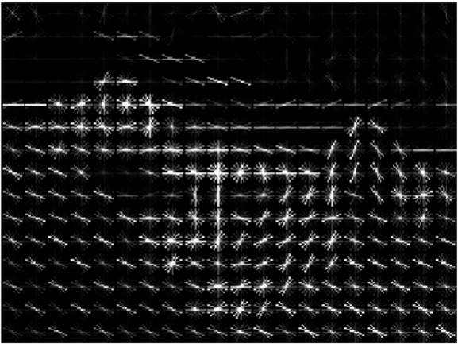
Image Features: Histogram of Oriented Gradients (HoG)
Compute edge direction / strength at each pixel
Divide image into 8x8 regions
Example: 320x240 image gets divided into 40x30 bins; 8 directions per bin; feature vector
3. Within each region compute a histogram of edge directions
weighted by edge strength
has 30*40*9 = 10,800 numbers
Lowe, “Object recognition from local scale-invariant features”, ICCV 1999
Dalal and Triggs, "Histograms of oriented gradients for human detection," CVPR 2005

Slide 11
Image Features: Histogram of Oriented Gradients (HoG)
Weak edges
Strong diagonal edges
Edges in all directions
Compute edge direction / strength at each pixel
Divide image into 8x8 regions
Within each region compute a histogram of edge directions
Example: 320x240 image gets divided into 40x30 bins; 8 directions per bin; feature vector has 30*40*9 = 10,800 numbers
weighted by edge strength
Lowe, “Object recognition from local scale-invariant features”, ICCV 1999
Dalal and Triggs, "Histograms of oriented gradients for human detection," CVPR 2005

Slide 12
Image Features: Histogram of Oriented Gradients (HoG)
Weak edges
Strong diagonal edges
Edges in all directions
Captures texture and position, robust to small image changes
Compute edge direction / strength at each pixel
Divide image into 8x8 regions
Within each region compute a histogram of edge directions
Example: 320x240 image gets divided into 40x30 bins; 8 directions per bin; feature vector has 30*40*9 = 10,800 numbers
weighted by edge strength
Lowe, “Object recognition from local scale-invariant features”, ICCV 1999
Dalal and Triggs, "Histograms of oriented gradients for human detection," CVPR 2005

Slide 13

Image Features

Slide 14

Image Features
f
Feature Extraction
10 numbers giving scores for classes
training

Slide 15

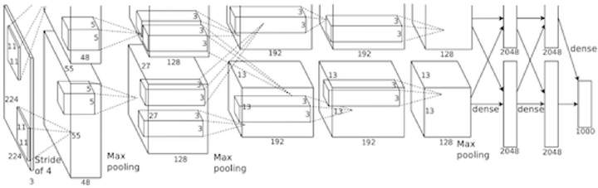
Image Features vs Neural Networks
f
Feature Extraction
10 numbers giving scores for classes
training
Krizhevsky, Sutskever, and Hinton, “Imagenet classification with deep convolutional neural networks”, NIPS 2012.
Figure copyright Krizhevsky, Sutskever, and Hinton, 2012. Reproduced with permission.
10 numbers giving scores for classes
training

Slide 16
Neural Networks
Input: 𝑥 ∈ ℝ^{𝐷} Output: 𝑓 𝑥
Before: Linear Classifier: 𝑓 𝑥
∈ ℝ^𝐶
= 𝑊𝑥 + 𝑏
Learnable parameters: 𝑊 ∈ ℝ^{𝐷×𝐶}, 𝑏 ∈ ℝ^{𝐶}

Slide 17
Neural Networks
Input: 𝑥 ∈ ℝ^{𝐷} Output: 𝑓 𝑥
Before: Linear Classifier: 𝑓 𝑥
∈ ℝ^𝐶
= 𝑊𝑥 + 𝑏
Learnable parameters: 𝑊 ∈ ℝ^{𝐷×𝐶}, 𝑏 ∈ ℝ^{𝐶}
Now: Two-Layer Neural Network: 𝑓 𝑥 = 𝑊₂ max 0, 𝑊₁𝑥 + 𝑏₁ + 𝑏2

Slide 18
Neural Networks
Input: 𝑥 ∈ ℝ^{𝐷} Output: 𝑓 𝑥
Before: Linear Classifier: 𝑓 𝑥
∈ ℝ^𝐶
= 𝑊𝑥 + 𝑏
Learnable parameters: 𝑊 ∈ ℝ^{𝐷×𝐶}, 𝑏 ∈ ℝ^{𝐶}
Now: Two-Layer Neural Network: 𝑓 𝑥 = 𝑊₂ max 0, 𝑊₁𝑥 + 𝑏₁ + 𝑏2
Learnable parameters: 𝑊₁ ∈ ℝ^{𝐻×𝐷}, 𝑏₁ ∈ ℝ^{𝐻}, 𝑊₂ ∈ ℝ^{𝐶×𝐻}, 𝑏₂ ∈ ℝ^{𝐶}

Slide 19
Neural Networks
Before: Linear classifier
Now: 2-layer Neural Network
𝑓 𝑥
𝑓 𝑥
= 𝑊𝑥 + 𝑏
= 𝑊₂ max 0, 𝑊₁𝑥 + 𝑏₁
+ 𝑏₂
x
h
Input: 3072
W₁
W₂
s
Output: 10
Hidden layer: 100
𝑥 ∈ ℝ^{𝐷}, 𝑊₁ ∈ ℝ^{𝐻×𝐷}, 𝑊₂ ∈ ℝ^{𝐶×𝐻}

Slide 20
Neural Networks
Before: Linear classifier
Now: 2-layer Neural Network
𝑓 𝑥
𝑓 𝑥
= 𝑊𝑥 + 𝑏
= 𝑊₂ max 0, 𝑊₁𝑥 + 𝑏₁
+ 𝑏₂
Element (i, j) of W₁ gives the effect on h_{i} from x_{j}
Element (i, j) of W₂ gives the effect on s_{i} from h_{j}
Input: 3072
x
W₁
h
W₂
s
Output: 10
Hidden layer: 100
𝑥 ∈ ℝ^{𝐷}, 𝑊₁ ∈ ℝ^{𝐻×𝐷}, 𝑊₂ ∈ ℝ^{𝐶×𝐻}

Slide 21
Neural Networks
Before: Linear classifier
Now: 2-layer Neural Network
𝑓 𝑥
𝑓 𝑥
= 𝑊𝑥 + 𝑏
= 𝑊₂ max 0, 𝑊₁𝑥 + 𝑏₁ + 𝑏₂
Element (i, j) of W₁ gives the effect on h_{i} from x_{j}
All elements of x affect all elements of h
Element (i, j) of W₂ gives the effect on s_{i} from h_{j}
All elements of h affect all elements of s
Input: 3072
x
W₁
h
W₂
s
Output: 10
Hidden layer: 100
Fully-connected neural network Also “Multi-Layer Perceptron” (MLP)

Slide 22
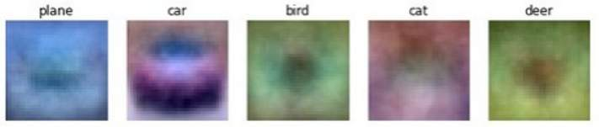
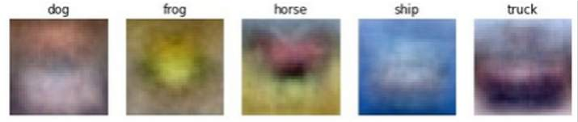
Neural Networks
(Before) Linear score function:
(Now) 2-layer Neural Network
Linear classifier: One template per class
x
h
Input: 3072
W₁
W₂
s
Output: 10
Hidden layer: 100
𝑥 ∈ ℝ^{𝐷}, 𝑊₁ ∈ ℝ^{𝐻×𝐷}, 𝑊₂ ∈ ℝ^{𝐶×𝐻}

Slide 23
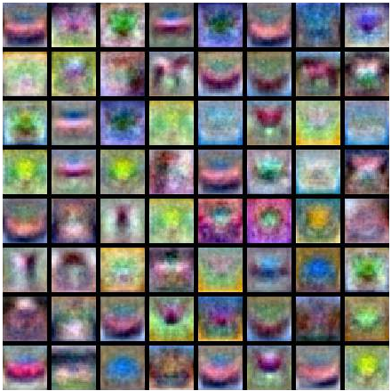
Neural Networks
Neural net: first layer is bank of templates; Second layer recombines templates
(Before) Linear score function: (Now) 2-layer Neural Network
x
h
Input: 3072
W₁
W₂
s
Output: 10
Hidden layer: 100
𝑥 ∈ ℝ^{𝐷}, 𝑊₁ ∈ ℝ^{𝐻×𝐷}, 𝑊₂ ∈ ℝ^{𝐶×𝐻}

Slide 24
Neural Networks
Can use different templates to cover multiple modes of a class!
(Before) Linear score function: (Now) 2-layer Neural Network
x
h
Input: 3072
W₁
W₂
s
Output: 10
Hidden layer: 100
𝑥 ∈ ℝ^{𝐷}, 𝑊₁ ∈ ℝ^{𝐻×𝐷}, 𝑊₂ ∈ ℝ^{𝐶×𝐻}

Slide 25
Deep Neural Networks
Depth = number of layers
h₁ | W₂ | h₂ | W₃ | h₃ | W₄ | h₄ | W₅ | h₅
x
Width: Size of each layer
W₁
W₆
s
Output: 10
Input:
3072
𝑠 = 𝑊₆ max 0, 𝑊₅ max 0, 𝑊₄ max 0, 𝑊₃ max 0, 𝑊₂ max 0, 𝑊₁𝑥

Slide 26
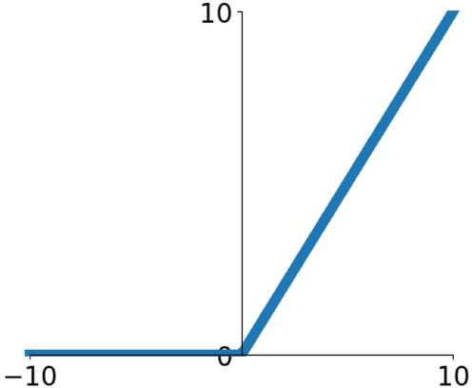
Activation Functions
2-layer Neural Network
𝑓 𝑥 = 𝑊₂
max 0,
𝑊₁𝑥 + 𝑏₁
+ 𝑏₂
The function 𝑅𝑒𝐿𝑈 𝑧 = max(0, 𝑧)
is called “Rectified Linear Unit”
This is called the activation function of the neural network

Slide 27
Activation Functions
2-layer Neural Network
𝑓 𝑥 = 𝑊₂
max 0,
𝑊₁𝑥 + 𝑏₁
+ 𝑏₂
The function 𝑅𝑒𝐿𝑈 𝑧 = max(0, 𝑧)
is called “Rectified Linear Unit”
This is called the activation function of the neural network
Q: What happens if we build a neural network with no activation function?
𝑓 𝑥 = 𝑊₂ 𝑊₁𝑥 + 𝑏₁ + 𝑏₂

Slide 28
Activation Functions
2-layer Neural Network
𝑓 𝑥 = 𝑊₂
max 0,
𝑊₁𝑥 + 𝑏₁
+ 𝑏₂
The function 𝑅𝑒𝐿𝑈 𝑧 = max(0, 𝑧)
is called “Rectified Linear Unit”
This is called the activation function of the neural network
Q: What happens if we build a neural network with no activation function?
𝑓 𝑥 = 𝑊₂ 𝑊₁𝑥 + 𝑏₁ + 𝑏₂
= 𝑊₁𝑊₂ 𝑥 + 𝑊₂𝑏₁ + 𝑏₂
A: We end up with a linear classifier!

Slide 29
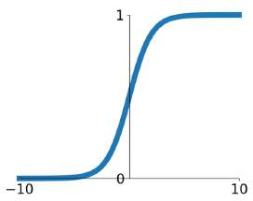
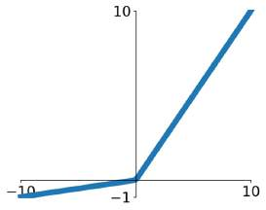
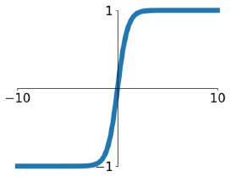
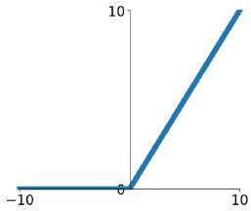
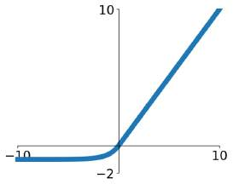
Activation Functions
Sigmoid
Leaky ReLU
max 0.2𝑥, 𝑥
1
𝜎 𝑥 =
1 + 𝑒^{−𝑥}
tanh
tanh 𝑥
Softplus
log 1 + exp 𝑥
𝑒^{2𝑥} − 1
⁼ 𝑒^{2𝑥} + 1
ReLU
max(0, 𝑥)
ELU
𝑓 𝑥
₌ ₇𝑥,
𝑥 > 0
𝑥 ≤ 0
𝛼 exp 𝑥 − 1 ,

Slide 30
Activation Functions
ReLU is a good default choice for most problems
Leaky ReLU
max 0.2𝑥, 𝑥
Sigmoid
1
𝜎 𝑥 =
1 + 𝑒^{−𝑥}
tanh
tanh 𝑥
Softplus
log 1 + exp 𝑥
𝑒^{2𝑥} − 1
⁼ 𝑒^{2𝑥} + 1
ReLU
max(0, 𝑥)
ELU
𝑓 𝑥
₌ ₇𝑥,
𝑥 > 0
𝑥 ≤ 0
𝛼 exp 𝑥 − 1 ,

Slide 31
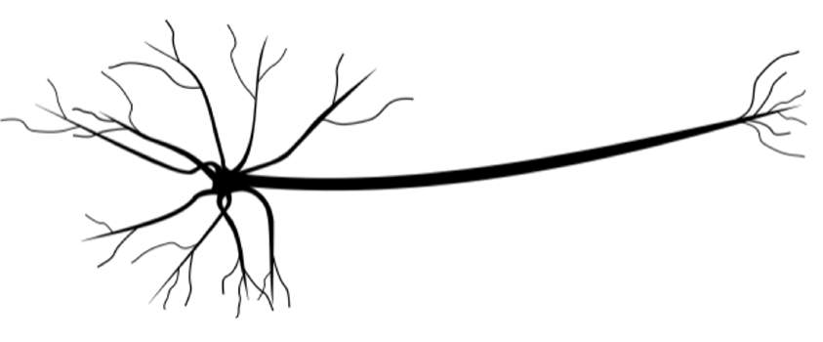
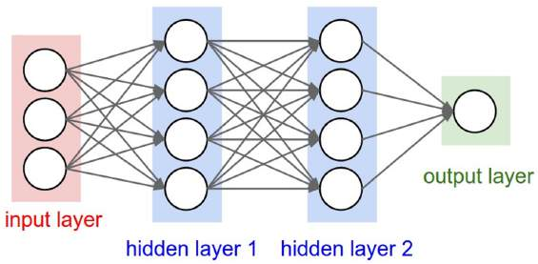
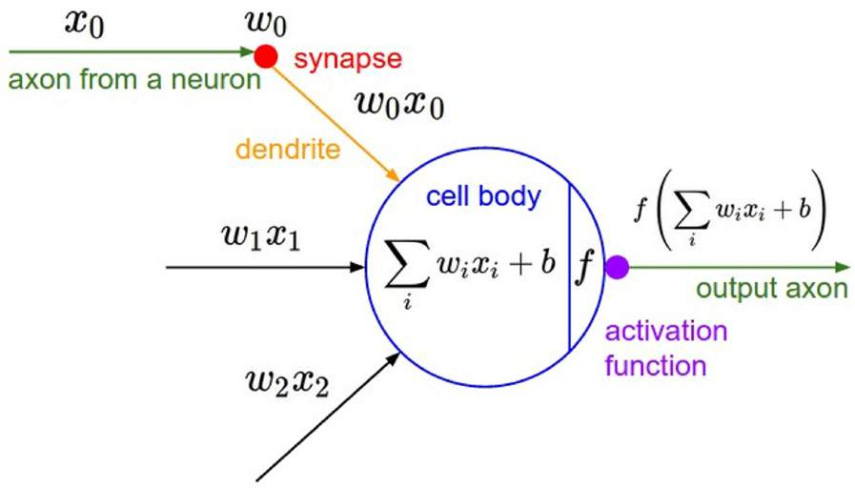
Biological Neuron
dendrite
presynaptic terminal
Artificial Neuron
axon
cell body
Neuron image by Felipe Perucho is licensed under CC-BY 3.0

Slide 32
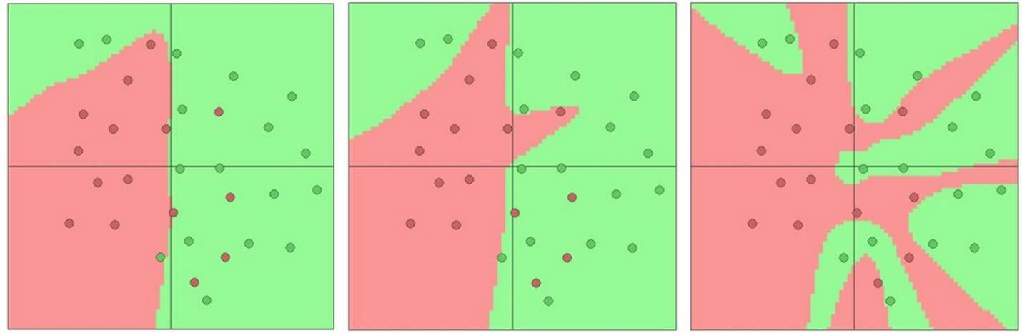
Setting the number of layers and their sizes
3 hidden units 6 hidden units 20 hidden units
More hidden units = more capacity

Slide 33
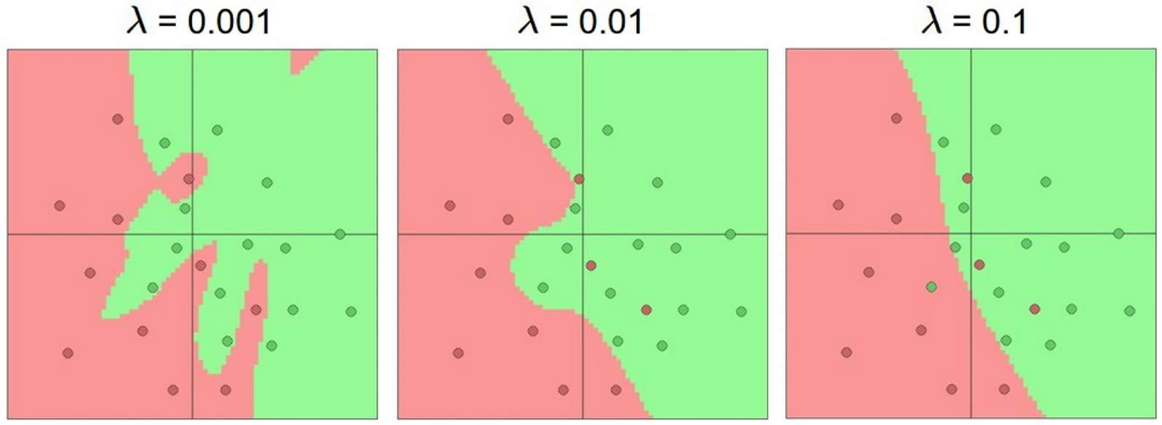
Don’t regularize with size; instead use stronger L2
(Web demo with ConvNetJS: http://cs.stanford.edu/people/karpathy/convnetjs/demo/classify2d.html)

Slide 34
Universal Approximation
A neural network with one hidden layer can approximate any function f: R^{N} -> R^{M} with arbitrary precision*
*Many technical conditions: Only holds on compact subsets of R^{N}; function must be continuous; need to define “arbitrary precision”; etc

Slide 35
Universal Approximation
Example: Approximating a function f: R -> R with a two-layer ReLU network
w₁
h₁
h₂
u₁
x
w₂
w₃
u₂
u₃
y
Output: y (1,)
Input: x (1,)
h₃
First layer weights: w (3,1) First layer bias: b (3,)
Second layer weights: u (1,3) First layer bias: p (1,)

Slide 36
Universal Approximation
Example: Approximating a function f: R -> R with a two-layer ReLU network
w₁
h₁
h₂
u₁
x
w₂
w₃
u₂
u₃
y
Output: y (1,)
Input: x (1,)
h₃
First layer weights: w (3,1) First layer bias: b (3,)
Second layer weights: u (1,3) First layer bias: p (1,)
h1 = max(0, w1 * x + b1) h2 = max(0, w2 * x + b2) h3 = max(0, w3 * x + b3)
y = u1 * h1 + u2 * h2 + u3 * h3 + p

Slide 37
Universal Approximation
Example: Approximating a function f: R -> R with a two-layer ReLU network
w₁
h₁
h₂
u₁
x
w₂
w₃
u₂
u₃
y
Output: y (1,)
Input: x (1,)
h₃
First layer weights: w (3,1) First layer bias: b (3,)
Second layer weights: u (1,3) First layer bias: p (1,)
h1 = max(0, w1 * x + b1) h2 = max(0, w2 * x + b2) h3 = max(0, w3 * x + b3)
y = u1 * h1 + u2 * h2 + u3 * h3 + p
y = u1 * max(0, w1 * x + b1)
+ u2 * max(0, w2 * x + b2)
+ u3 * max(0, w3 * x + b3)
+ p

Slide 38
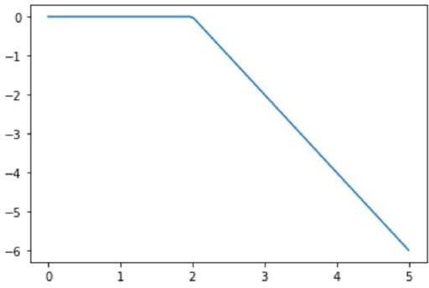
Universal Approximation
Example: Approximating a function f: R -> R with a two-layer ReLU network
w₁
h₁
h₂
u₁
Output is a sum of shifted, scaled ReLUs:
x
w₂
w₃
u₂
u₃
y
Output: y (1,)
Input: x (1,)
h₃
First layer weights: w (3,1) First layer bias: b (3,)
Second layer weights: u (1,3) First layer bias: p (1,)
h1 = max(0, w1 * x + b1) h2 = max(0, w2 * x + b2) h3 = max(0, w3 * x + b3)
y = u1 * h1 + u2 * h2 + u3 * h3 + p
y = u1 * max(0, w1 * x + b1)
+ u2 * max(0, w2 * x + b2)
+ u3 * max(0, w3 * x + b3)
+ p

Slide 39
Universal Approximation
Example: Approximating a function f: R -> R with a two-layer ReLU network
w₁
h₁
h₂
u₁
Output is a sum of shifted, scaled ReLUs:
x
w₂
u₂
u₃
y
Output: y (1,)
Input: x (1,)
Flip left / right based on sign of w_{i}
Slope is given by u_{i} * w_{i}
w
3
h₃
First layer weights: w (3,1) First layer bias: b (3,)
Second layer weights: u (1,3) First layer bias: p (1,)
Position of “bend” given by b_{i}
h1 = max(0, w1 * x + b1) h2 = max(0, w2 * x + b2) h3 = max(0, w3 * x + b3)
y = u1 * h1 + u2 * h2 + u3 * h3 + p
y = u1 * max(0, w1 * x + b1)
+ u2 * max(0, w2 * x + b2)
+ u3 * max(0, w3 * x + b3)
+ p

Slide 40
Universal Approximation
Example: Approximating a function f: R -> R with a two-layer ReLU network
We can build a “bump function” using four hidden units
w₁
h₁
h₂
u₁
y
t
x
w₂
w₃
u₂
u₃
y
Output: y (1,)
Input: x (1,)
h₃
x
First layer weights: w (3,1) First layer bias: b (3,)
Second layer weights: u (1,3) First layer bias: p (1,)
s₁ s₂ s₃ s₄
h1 = max(0, w1 * x + b1) h2 = max(0, w2 * x + b2) h3 = max(0, w3 * x + b3)
y = u1 * h1 + u2 * h2 + u3 * h3 + p
y = u1 * max(0, w1 * x + b1)
+ u2 * max(0, w2 * x + b2)
+ u3 * max(0, w3 * x + b3)
+ p

Slide 41
Universal Approximation
Example: Approximating a function f: R -> R with a two-layer ReLU network
We can build a “bump function” using four hidden units
w₁
h₁
h₂
u₁
y
t
x
w₂
w₃
u₂
u₃
y
Output: y (1,)
m₁ = t / (s₂ – s₁) m₂ = t / (s₄ – s₃)
Input: x (1,)
m₁
m₂
h₃
x
First layer weights: w (3,1) First layer bias: b (3,)
Second layer weights: u (1,3) First layer bias: p (1,)
s₁ s₂ s₃ s₄
h1 = max(0, w1 * x + b1) h2 = max(0, w2 * x + b2) h3 = max(0, w3 * x + b3)
y = u1 * h1 + u2 * h2 + u3 * h3 + p
y = u1 * max(0, w1 * x + b1)
+ u2 * max(0, w2 * x + b2)
+ u3 * max(0, w3 * x + b3)
+ p

Slide 42
Universal Approximation
Example: Approximating a function f: R -> R with a two-layer ReLU network
We can build a “bump function” using four hidden units
w₁
h₁
h₂
u₁
y
t
x
w₂
w₃
u₂
u₃
y
Output: y (1,)
m₁ = t / (s₂ – s₁) m₂ = t / (s₄ – s₃)
Input: x (1,)
m₁
m₂
h₃
x
First layer weights: w (3,1) First layer bias: b (3,)
Second layer weights: u (1,3) First layer bias: p (1,)
s₁ s₂ s₃
h1 = max(0, w1 * x + b1) h2 = max(0, w2 * x + b2) h3 = max(0, w3 * x + b3)
y = u1 * h1 + u2 * h2 + u3 * h3 + p
y = u1 * max(0, w1 * x + b1)
+ u2 * max(0, w2 * x + b2)
+ u3 * max(0, w3 * x + b3)
+ p
m₁ * max(0, x – s₁)

Slide 43
Universal Approximation
Example: Approximating a function f: R -> R with a two-layer ReLU network
We can build a “bump function” using four hidden units
w₁
h₁
h₂
u₁
y
t
x
w₂
w₃
u₂
u₃
y
Output: y (1,)
m₁ = t / (s₂ – s₁) m₂ = t / (s₄ – s₃)
Input: x (1,)
m₁
m₂
h₃
x
First layer weights: w (3,1) First layer bias: b (3,)
Second layer weights: u (1,3) First layer bias: p (1,)
s₁ s₂ s₃ s₄
h1 = max(0, w1 * x + b1) h2 = max(0, w2 * x + b2) h3 = max(0, w3 * x + b3)
y = u1 * h1 + u2 * h2 + u3 * h3 + p
y = u1 * max(0, w1 * x + b1)
+ u2 * max(0, w2 * x + b2)
+ u3 * max(0, w3 * x + b3)
+ p
m₁ * max(0, x – s₁)
-m₁ * max(0, x – s₂)

Slide 44
Universal Approximation
Example: Approximating a function f: R -> R with a two-layer ReLU network
We can build a “bump function” using four hidden units
w₁
h₁
h₂
u₁
y
t
x
w₂
w₃
u₂
u₃
y
Output: y (1,)
m₁ = t / (s₂ – s₁) m₂ = t / (s₄ – s₃)
Input: x (1,)
m₁
m₂
h₃
x
First layer weights: w (3,1) First layer bias: b (3,)
Second layer weights: u (1,3) First layer bias: p (1,)
s₁ s₂ s₃ s₄
h1 = max(0, w1 * x + b1) h2 = max(0, w2 * x + b2) h3 = max(0, w3 * x + b3)
y = u1 * h1 + u2 * h2 + u3 * h3 + p
y = u1 * max(0, w1 * x + b1)
+ u2 * max(0, w2 * x + b2)
+ u3 * max(0, w3 * x + b3)
+ p
m₁ * max(0, x – s₁)
-m₁ * max(0, x – s₂)
-m₂ * max(0, x – s₃)

Slide 45
Universal Approximation
Example: Approximating a function f: R -> R with a two-layer ReLU network
We can build a “bump function” using four hidden units
w₁
h₁
h₂
u₁
y
t
x
w₂
w₃
u₂
u₃
y
Output: y (1,)
m₁ = t / (s₂ – s₁) m₂ = t / (s₄ – s₃)
Input: x (1,)
m₁
m₂
h₃
x
First layer weights: w (3,1) First layer bias: b (3,)
Second layer weights: u (1,3) First layer bias: p (1,)
s₁ s₂ s₃ s₄
h1 = max(0, w1 * x + b1) h2 = max(0, w2 * x + b2) h3 = max(0, w3 * x + b3)
y = u1 * h1 + u2 * h2 + u3 * h3 + p
y = u1 * max(0, w1 * x + b1)
+ u2 * max(0, w2 * x + b2)
+ u3 * max(0, w3 * x + b3)
+ p
m₁ * max(0, x – s₁)
-m₁ * max(0, x – s₂)
-m₂ * max(0, x – s₃)
m₂ * max(0, x – s₄)

Slide 46
Universal Approximation
Example: Approximating a function f: R -> R with a two-layer ReLU network
We can build a “bump function” using four hidden units
w₁
h₁
h₂
u₁
y
t
x
w₂
w₃
u₂
u₃
y
Output: y (1,)
Input: x (1,)
h₃
x
First layer weights: w (3,1) First layer bias: b (3,)
Second layer weights: u (1,3) First layer bias: p (1,)
s₁ s₂ s₃ s₄
With 4K hidden units we can build a sum of K bumps
h1 = max(0, w1 * x + b1) h2 = max(0, w2 * x + b2) h3 = max(0, w3 * x + b3)
y = u1 * h1 + u2 * h2 + u3 * h3 + p
y = u1 * max(0, w1 * x + b1)
+ u2 * max(0, w2 * x + b2)
+ u3 * max(0, w3 * x + b3)
+ p
x

Slide 47

Universal Approximation
Example: Approximating a function f: R -> R with a two-layer ReLU network
We can build a “bump function” using four hidden units
w₁
h₁
h₂
u₁
y
t
x
w₂
w₃
u₂
u₃
y
Output: y (1,)
Input: x (1,)
h₃
x
First layer weights: w (3,1) First layer bias: b (3,)
Second layer weights: u (1,3) First layer bias: p (1,)
s₁ s₂ s₃ s₄
With 4K hidden units we can build a sum of K bumps
h1 = max(0, w1 * x + b1) h2 = max(0, w2 * x + b2) h3 = max(0, w3 * x + b3)
y = u1 * h1 + u2 * h2 + u3 * h3 + p
y = u1 * max(0, w1 * x + b1)
+ u2 * max(0, w2 * x + b2)
+ u3 * max(0, w3 * x + b3)
+ p
x
Approximate functions with bumps!

Slide 48
Universal Approximation
Example: Approximating a function f: R -> R with a two-layer ReLU network
w₁
h₁
h₂
u₁
What about…
Gaps between bumps?
Other nonlinearities?
Higher-dimensional functions?
x
w₂
w₃
u₂
u₃
y
Output: y (1,)
Input: x (1,)
h₃
First layer weights: w (3,1) First layer bias: b (3,)
Second layer weights: u (1,3) First layer bias: p (1,)
See Nielsen, Chapter 4
h1 = max(0, w1 * x + b1) h2 = max(0, w2 * x + b2)
y = u1 * max(0, w1 * x + b1)
+ u2 * max(0, w2 * x + b2)
h3 = max(0, w3 * x + b3)
y = u1 * h1 + u2 * h2 + u3 * h3 + p
+ u3 * max(0, w3 * x + b3)
+ p
x
Approximate functions with bumps!

Slide 49
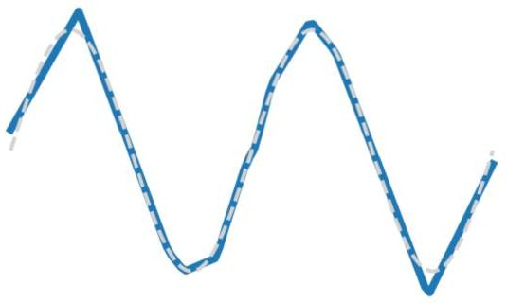
Universal Approximation
Example: Approximating a function f: R -> R with a two-layer ReLU network
h₁
h₂
u₁
Reality check: Networks don’t really learn bumps!
w₁
x
w₂
w₃
u₂
u₃
y
Output: y (1,)
Input: x (1,)
h₃
First layer weights: w (3,1) First layer bias: b (3,)
Second layer weights: u (1,3) First layer bias: p (1,)
h1 = max(0, w1 * x + b1) h2 = max(0, w2 * x + b2) h3 = max(0, w3 * x + b3)
y = u1 * h1 + u2 * h2 + u3 * h3 + p
y = u1 * max(0, w1 * x + b1)
+ u2 * max(0, w2 * x + b2)
+ u3 * max(0, w3 * x + b3)
+ p
x
Approximate functions with bumps!

Slide 50
Universal Approximation
Example: Approximating a function f: R -> R with a two-layer ReLU network
h₁
h₂ h₃
u₁
Reality check: Networks don’t really learn bumps!
w₁
x
w₂
w₃
u₂
u₃
y
Output: y (1,)
Input: x (1,)
Universal approximation tells us:
Neural nets can represent any function
Universal approximation DOES NOT tell us:
Whether we can actually learn any function with SGD
How much data we need to learn a function
x
Remember: kNN is also a universal approximator!
Approximate functions with bumps!

Slide 51

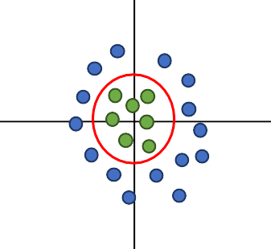
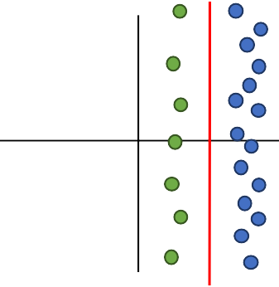



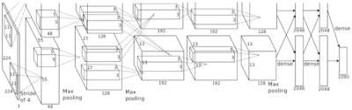
Summary
Feature transform + Linear classifier allows nonlinear decision boundaries
Neural Networks as learnable feature transforms
Original space
y
Feature space
θ
Feature Extraction
10 numbers giving scores for classes
r = (x² + y²)^{1/2} θ = tan⁻¹(y/x)
training
x
Feature transform
r
Krizhevsky, Sutskever, and Hinton, “Imagenet classification with deep convolutional neural networks”, NIPS 2012.
Figure copyright Krizhevsky, Sutskever, and Hinton, 2012. Reproduced with permission.
Nonlinear classifier in original space!
Linear classifier in feature space
10 numbers giving scores for classes
training
Lecture 3 - 97

Slide 52


Summary
Linear classifier: One template per class
From linear classifiers to fully-connected networks
𝑓 𝑥 = 𝑊₂ max 0, 𝑊₁𝑥 + 𝑏₁
+ 𝑏₂
Neural networks: Many reusable templates
x
h
Input: 3072
W₁
W₂
s
Output: 10
Hidden layer: 100

Slide 53
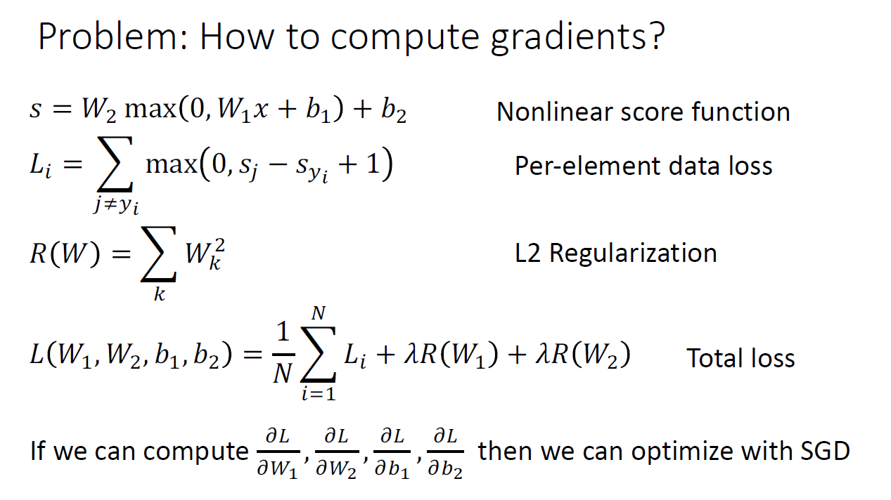

Slide 54
Backpropagation

Slide 55
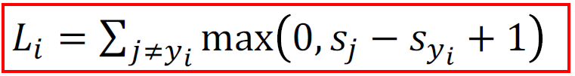
Better Idea: Computational Graphs
𝑠 = 𝑊𝑥
x
*
s (scores)
hinge loss
+
L
W
R
𝑅 𝑊

Slide 56
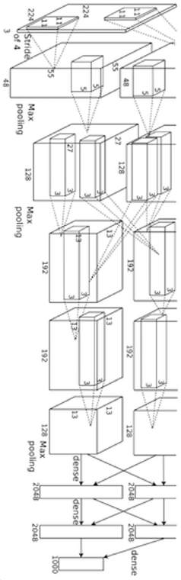
Deep Network (AlexNet)
input image
weights loss

Slide 57
f
𝑥
𝑧
𝜕𝐿
𝜕𝑧
Upstream gradient
𝑦

Slide 58
𝑧
𝑥
𝜕𝑧
𝜕𝑥
f
Local gradients
𝜕𝑧
𝜕𝐿
𝜕𝑦
𝑦
𝜕𝑧
Upstream gradient

Slide 59
𝑧
𝑥
𝜕𝐿
𝜕𝑧
𝜕𝑧 𝜕𝐿
𝜕𝑥 ⁼ 𝜕𝑥 𝜕𝑧
𝜕𝑥
f
Local gradients
Downstream gradients
𝜕𝑧
𝜕𝐿
𝜕𝑦
𝑦
𝜕𝑧
𝜕𝑧 𝜕𝐿
Upstream gradient
𝜕𝐿
𝜕𝑦 ⁼ 𝜕𝑦 𝜕𝑧

Slide 60
𝑧
𝑥
𝜕𝐿
𝜕𝑧
𝜕𝑧 𝜕𝐿
𝜕𝑥 ⁼ 𝜕𝑥 𝜕𝑧
𝜕𝑥
f
Local gradients
Downstream gradients
𝜕𝑧
𝜕𝐿
𝜕𝑦
𝑦
𝜕𝑧
𝜕𝑧 𝜕𝐿
Upstream gradient
𝜕𝐿
𝜕𝑦 ⁼ 𝜕𝑦 𝜕𝑧

Slide 61
Backpropagation: Another View
x₀
D₀
f₁ f₂
f₃
f₄
x₁
D₁
x₂
D₂
x₃
D₃
L
scalar
𝜕𝐿 ₌
𝜕𝑥₁
𝜕𝑥₂
𝜕𝑥₃
𝜕𝐿
Chain rule
𝜕𝑥₀
𝜕𝑥₀
𝜕𝑥₁
𝜕𝑥₂
𝜕𝑥₃

Slide 62






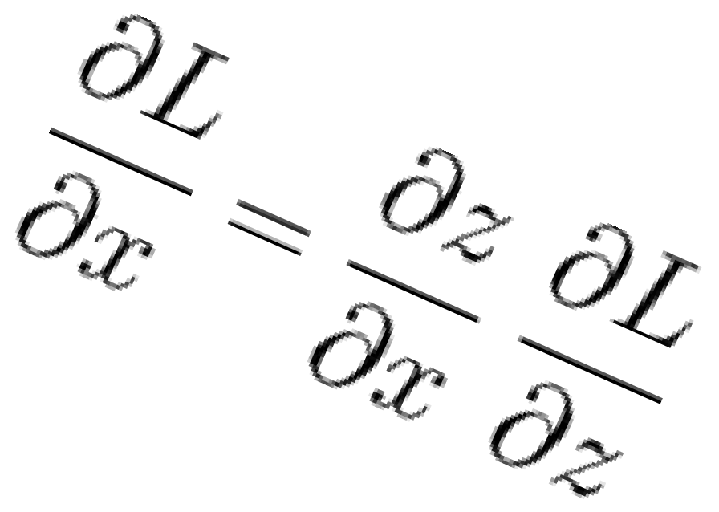








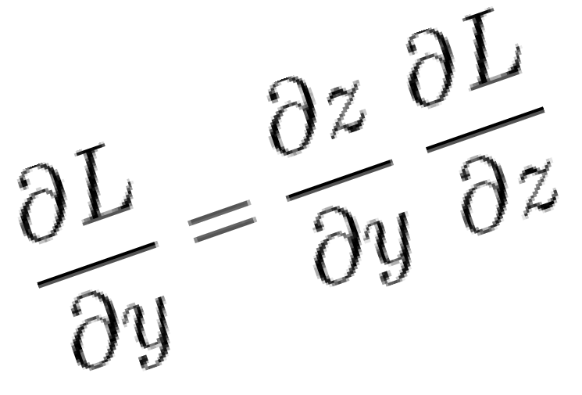

Summary
During the backward pass, each node in the graph receives upstream gradients and multiplies them by local gradients to compute downstream gradients
Represent complex expressions as computational graphs
x
*
s (scores)
hinge loss
L
+
W
R
Downstream gradients
f
Local gradients
Forward pass computes outputs
Upstream gradient
Backward pass computes gradients

