Slide 1
Lecture 2: Regularization + Optimization

Slide 2
Overfitting
Example: Linear classifier with 1D inputs, 2 classes, softmax loss
𝑠_{𝑖} = 𝑤_{𝑖}𝑥 + 𝑏_{𝑖}
A model is overfit when it performs too well on the training data, and has poor performance for unseen data
exp 𝑠_{𝑖}
𝑝 =
𝑖
exp 𝑠₁ + exp 𝑠₂
𝐿 = − log 𝑝_{𝑦}

Slide 3
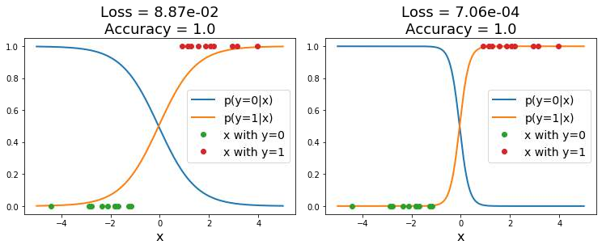
Overfitting
Example: Linear classifier with 1D inputs, 2 classes, softmax loss
𝑠_{𝑖} = 𝑤_{𝑖}𝑥 + 𝑏_{𝑖}
A model is overfit when it performs too well on the training data, and has poor performance for unseen data
exp 𝑠_{𝑖}
𝑝 =
𝑖
exp 𝑠₁ + exp 𝑠₂
𝐿 = − log 𝑝_{𝑦}
Both models have perfect accuracy on train data!

Slide 4
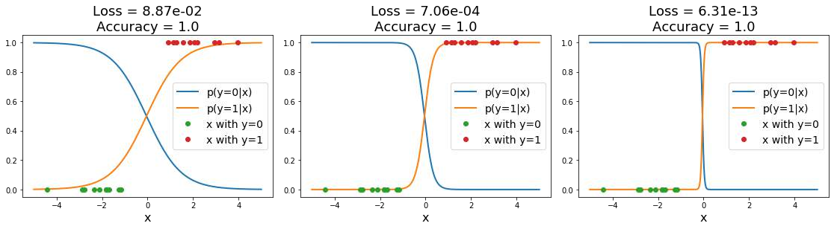
Overfitting
Example: Linear classifier with 1D inputs, 2 classes, softmax loss
𝑠_{𝑖} = 𝑤_{𝑖}𝑥 + 𝑏_{𝑖}
A model is overfit when it performs too well on the training data, and has poor performance for unseen data
exp 𝑠_{𝑖}
𝑝 =
𝑖
exp 𝑠₁ + exp 𝑠₂
𝐿 = − log 𝑝_{𝑦}
Both models have perfect accuracy on train data!
Low loss, but unnatural “cliff” between training points

Slide 5
Regularization: Beyond Training Error
𝑁
𝐿 𝑊 = ¹ & 𝐿 𝑓 𝑥 , 𝑊 , 𝑦
𝑖 𝑖
𝑁
𝑖
𝑖=1
Data loss: Model predictions should match training data

Slide 6
Regularization: Beyond Training Error
𝑁
𝐿 𝑊 = ¹ & 𝐿 𝑓 𝑥 , 𝑊 , 𝑦 + 𝜆𝑅 𝑊
𝑖 𝑖
𝜆 is a hyperparameter giving regularization strength
𝑁
𝑖
𝑖=1
Data loss: Model predictions should match training data
Regularization: Prevent the model from doing too well on training data

Slide 7
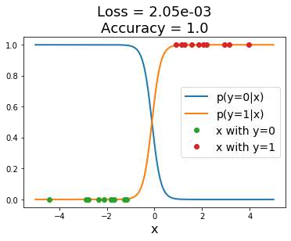
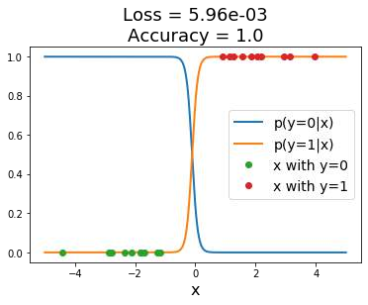
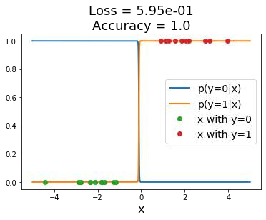
Regularization: Prefer Simpler Models
Example: Linear classifier with 1D inputs, 2 classes, softmax loss
exp 𝑠_{𝑖}
𝑠_{𝑖} = 𝑤_{𝑖}𝑥 + 𝑏_{𝑖} 𝑝_{𝑖} =
Regularization term causes loss to increase for model with sharp cliff
exp 𝑠₁ + exp 𝑠₂
𝐿 = − log 𝑝_{𝑦} + 𝝀 5 𝒘^{𝟐}
𝒊
𝒊

Slide 8
Regularization: Expressing Preferences
L2 Regularization
𝑥 = 1, 1, 1, 1
𝑅 𝑊 = $ 𝑊²
𝑘.𝑙
𝑤₁ = 1, 0, 0, 0
𝑘,𝑙
𝑤₂ = 0.25, 0.25, 0.25, 0.25
𝑤^{𝑇}𝑥 = 𝑤^{𝑇}𝑥 = 1
1 2
Same predictions, so data loss will always be the same

Slide 9
Regularization: Expressing Preferences
L2 Regularization
𝑥 = 1, 1, 1, 1
𝑅 𝑊 = $ 𝑊²
𝑘.𝑙
𝑤₁ = 1, 0, 0, 0
𝑘,𝑙
L2 regularization prefers weights to be “spread out”
𝑤₂ = 0.25, 0.25, 0.25, 0.25
𝑤^{𝑇}𝑥 = 𝑤^{𝑇}𝑥 = 1
1 2
Same predictions, so data loss will always be the same

Slide 10
Finding a good W
𝑁
𝐿 𝑊 = ¹ & 𝐿 𝑓 𝑥 , 𝑊 , 𝑦 + 𝜆𝑅 𝑊
𝑖 𝑖
𝑁
𝑖
𝑖=1
Loss function consists of data loss to fit the training data and regularization to prevent overfitting

Slide 11
𝑤∗ = arg min 𝐿 𝑤
Optimization
+

Slide 12

This image is CC0 1.0 public domain
Walking man image is CC0 1.0 public domain

Slide 13

This image is CC0 1.0 public domain
Walking man image is CC0 1.0 public domain

Slide 14
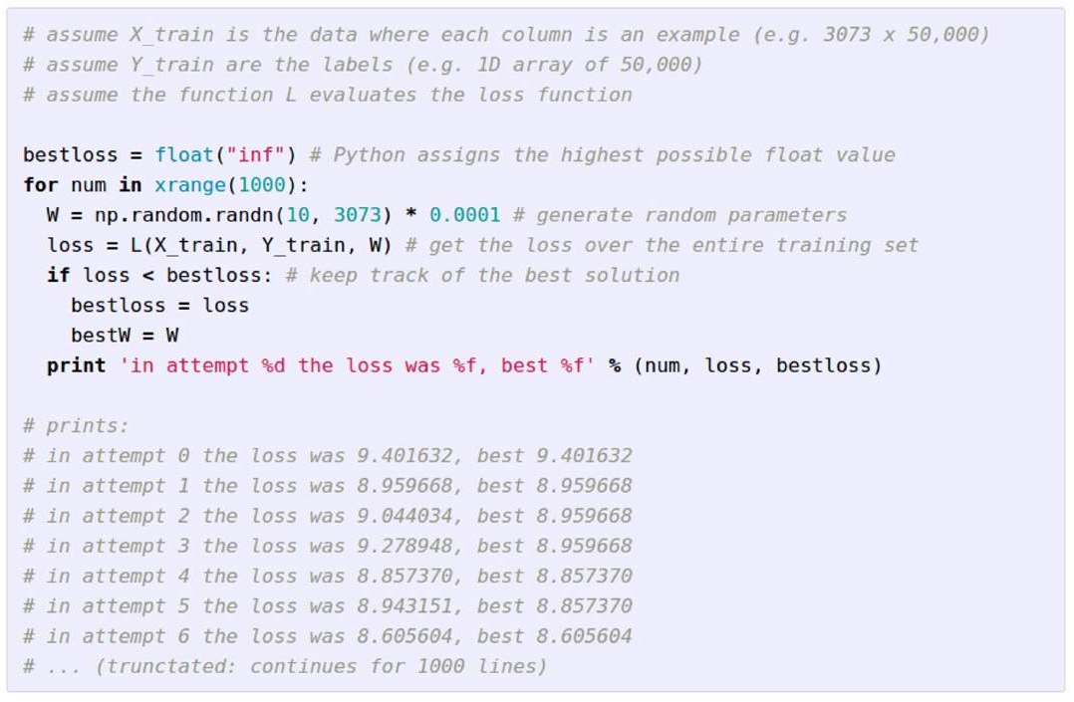
Idea #1: Random Search (bad idea!)

Slide 15
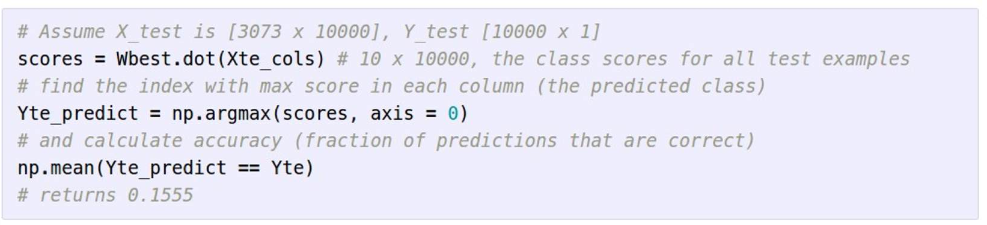
Idea #1: Random Search (bad idea!)
15.5% accuracy! not bad!

Slide 16
Idea #1: Random Search (bad idea!)
15.5% accuracy! not bad! (SOTA is ~95%)

Slide 17


Idea #2: Follow the slope

Slide 18
Idea #2: Follow the slope
In 1-dimension, the derivative of a function gives the slope:
𝑑𝑓 _{= lim} 𝑓 𝑥 + ℎ − 𝑓(𝑥)
𝑑𝑥 ℎ
ℎ→9
In multiple dimensions, the gradient is the vector of (partial derivatives) along each dimension
The slope in any direction is the dot product of the direction with the gradient The direction of steepest descent is the negative gradient

Slide 19
current W:
gradient dL/dW:
[0.34,
-1.11,
0.78,
0.12,
0.55,
2.81,
-3.1,
-1.5,
0.33,…]
loss 1.25347
[?,
?,
?,
?,
?,
?,
?,
?,
?,…]

Slide 20
current W:
W + h (first dim):
gradient dL/dW:
[0.34,
-1.11,
0.78,
0.12,
0.55,
2.81,
-3.1,
-1.5,
0.33,…]
loss 1.25347
[0.34 + 0.0001,
-1.11,
0.78,
0.12,
0.55,
2.81,
-3.1,
-1.5,
0.33,…]
loss 1.25322
[?,
?,
?,
?,
?,
?,
?,
?,
?,…]

Slide 21
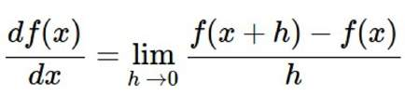
current W:
W + h (first dim):
gradient dL/dW:
[0.34,
-1.11,
0.78,
0.12,
0.55,
2.81,
-3.1,
-1.5,
0.33,…]
loss 1.25347
[0.34 + 0.0001,
-1.11,
0.78,
0.12,
0.55,
2.81,
-3.1,
-1.5,
0.33,…]
loss 1.25322
[-2.5,
?,
?,
(1.25322 - 1.25347)/0.0001
= -2.5
?,
?,…]

Slide 22
current W:
W + h (second dim):
gradient dL/dW:
[0.34,
-1.11,
0.78,
0.12,
0.55,
2.81,
-3.1,
-1.5,
0.33,…]
loss 1.25347
[0.34,
-1.11 + 0.0001,
0.78,
0.12,
0.55,
2.81,
-3.1,
-1.5,
0.33,…]
loss 1.25353
[-2.5,
?,
?,
?,
?,
?,
?,
?,
?,…]

Slide 23
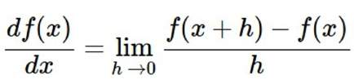
current W:
W + h (second dim):
gradient dL/dW:
[0.34,
-1.11,
0.78,
0.12,
0.55,
2.81,
-3.1,
-1.5,
0.33,…]
loss 1.25347
[0.34,
-1.11 + 0.0001,
0.78,
0.12,
0.55,
2.81,
-3.1,
-1.5,
0.33,…]
loss 1.25353
[-2.5,
0.6,
?,
?,
?,
?,
?,
?,
(1.25353 - 1.25347)/0.0001
= 0.6
?,…]

Slide 24
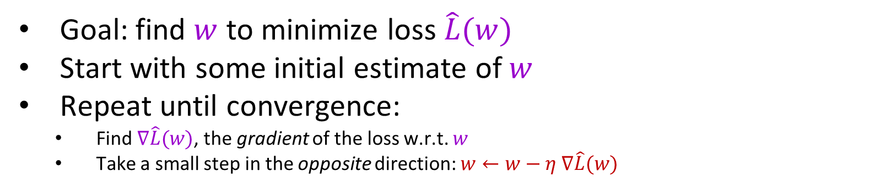
Gradient descent
Goal: find $w$ to minimize loss $\hat{L}(w)$
Start with some initial estimate of $w$
Repeat until convergence:
  Find $∇\hat{L}(w)$, the gradient of the loss w.r.t. $w$
  Take a small step in the opposite direction: $w←w−η ∇\hat{L}(w)$

Slide 25






The gradient vector
$$\hat{L}$$
$$\hat{L}(w)$$
Fastest rate of increase
$$w^{2}$$
$$∇\hat{L}(w)$$
$$w$$
$$w^{1}$$

Slide 26






The gradient vector
$$\hat{L}$$
$$\hat{L}(w)$$
Fastest rate of decrease
$$w^{2}$$
$$−∇\hat{L}(w)$$
$$w$$
$$w^{1}$$

Slide 27





Gradient descent
$$\hat{L}$$
$$\hat{L}(w−η∇\hat{L}(w))$$
$$w^{2}$$
$$w−η∇\hat{L}(w)$$
$$w^{1}$$

Slide 28
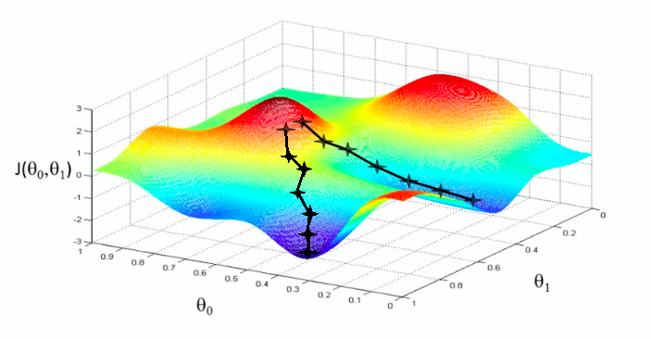
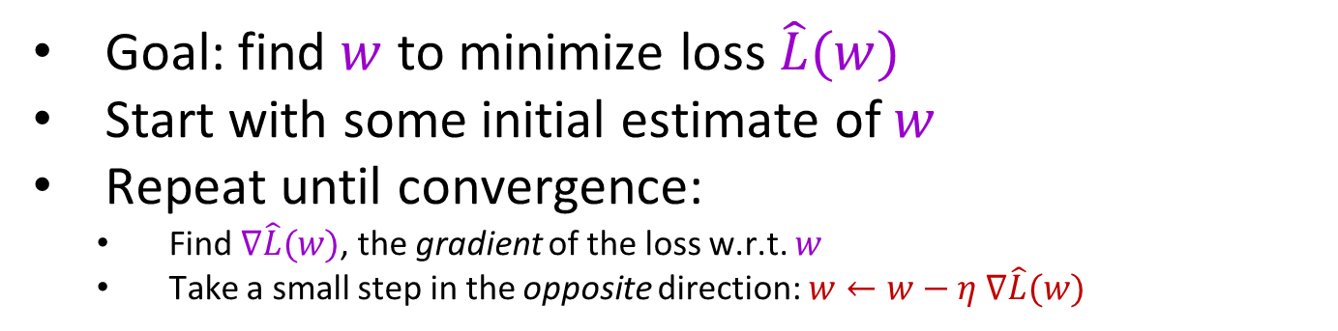



Gradient descent
Goal: find $w$ to minimize loss $\hat{L}(w)$
Start with some initial estimate of $w$
Repeat until convergence:
  Find $∇\hat{L}(w)$, the gradient of the loss w.r.t. $w$
  Take a small step in the opposite direction: $w←w−η ∇\hat{L}(w)$
$$\hat{L}$$
$$w^{2}$$
$$w^{1}$$

Slide 29
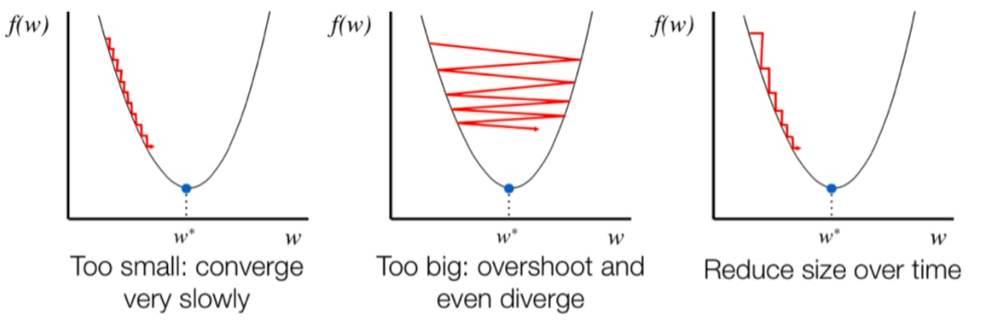
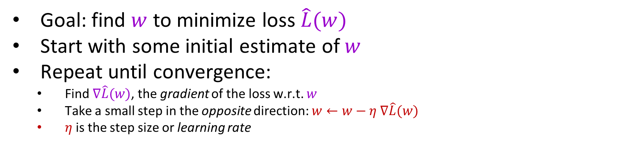
Gradient descent
Goal: find $w$ to minimize loss $\hat{L}(w)$
Start with some initial estimate of $w$
Repeat until convergence:
  Find $∇\hat{L}(w)$, the gradient of the loss w.r.t. $w$
  Take a small step in the opposite direction: $w←w−η ∇\hat{L}(w)$
  $η$is the step size or learning rate
Figure source

Slide 30
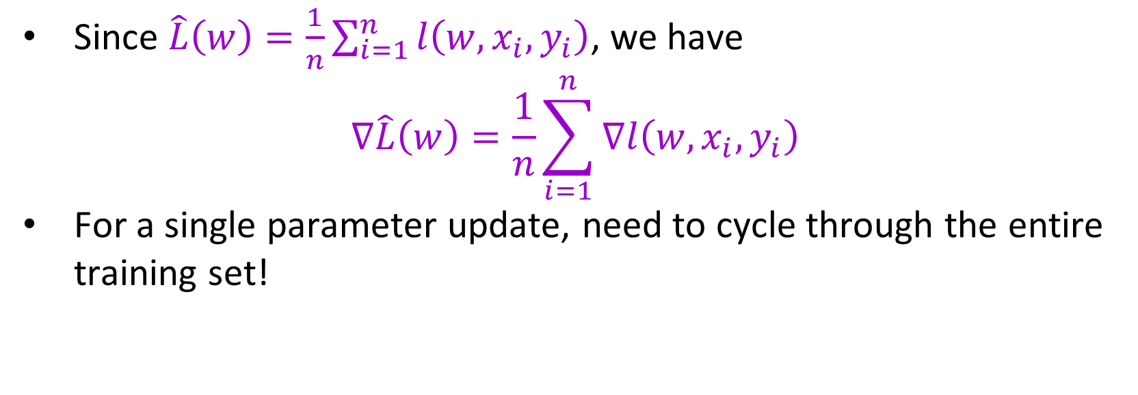
Full batch gradient descent
Since $\hat{L}\left(w\right)=\frac{1}{n}\sum_{i=1}^{n}{l\left(w,x_{i}, y_{i}\right)}$, we have
$$∇\hat{L}\left(w\right)=\frac{1}{n}\sum_{i=1}^{n}{∇l\left(w,x_{i}, y_{i}\right)}$$
For a single parameter update, need to cycle through the entire training set!

Slide 31
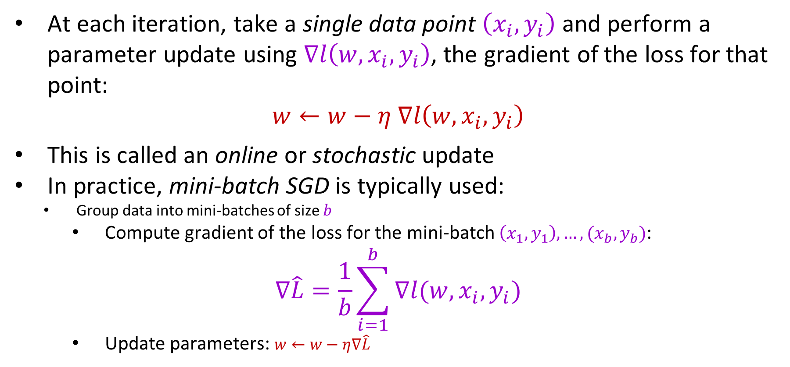
Stochastic gradient descent (SGD)
At each iteration, take a single data point $\left(x_{i},y_{i}\right)$ and perform a parameter update using $∇l\left(w,x_{i},y_{i}\right)$, the gradient of the loss for that point:
$$w←w−η ∇l\left(w,x_{i},y_{i}\right)$$
This is called an online or stochastic update
In practice, mini-batch SGD is typically used:
  Group data into mini-batches of size $b$
    Compute gradient of the loss for the mini-batch $\left(x_{1},y_{1}\right),…, {(x}_{b},y_{b})$:
$$∇\hat{L}=\frac{1}{b}\sum_{i=1}^{b}{∇l(w,x_{i},y_{i})}$$
    Update parameters: $w←w−η∇\hat{L}$

Slide 32
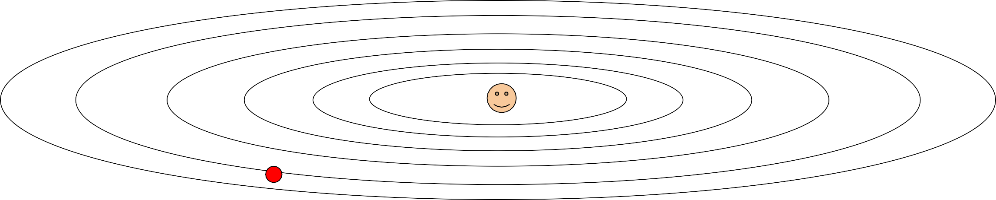
Problems with SGD
What if loss changes quickly in one direction and slowly in another? What does gradient descent do?
Loss function has high condition number: ratio of largest to smallest singular value of the Hessian matrix is large

Slide 33
Problems with SGD
What if loss changes quickly in one direction and slowly in another? What does gradient descent do?
Very slow progress along shallow dimension, jitter along steep direction
Loss function has high condition number: ratio of largest to smallest singular value of the Hessian matrix is large

Slide 34
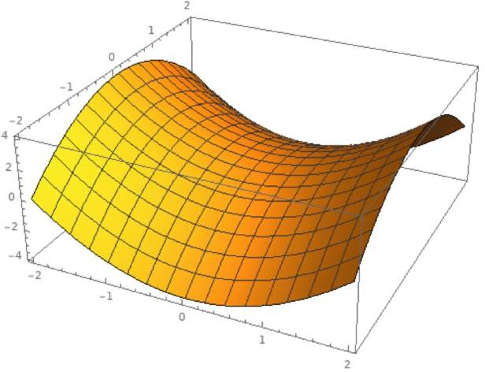
Problems with SGD
Local Minimum
What if the loss function has a local minimum or saddle point?
Saddle point

Slide 35

Problems with SGD
Local Minimum
What if the loss function has a local minimum or saddle point?
Saddle point
Zero gradient, gradient descent gets stuck

Slide 36
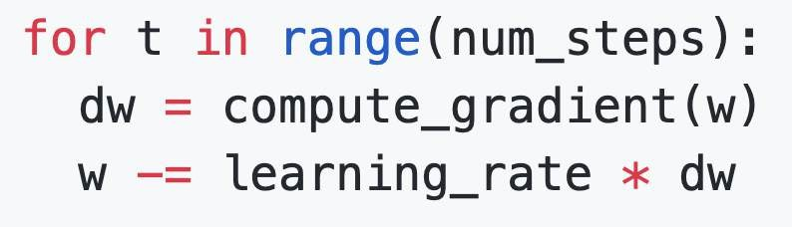
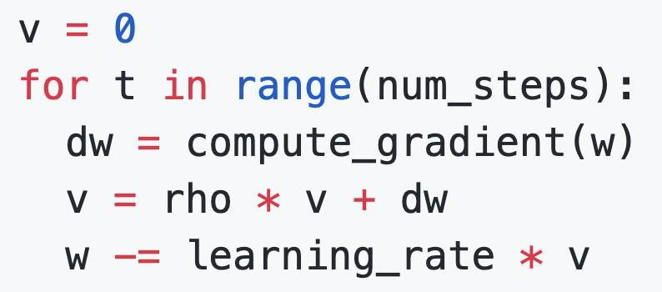
SGD + Momentum
SGD
𝑥_{𝑡+1} = 𝑥_{𝑡} − 𝛼∇𝑓 𝑥_{𝑡}
SGD+Momentum
𝑣_{𝑡+1} = 𝜌𝑣_{𝑡} + ∇𝑓 𝑥_{𝑡}
^{𝑥}𝑡+1 ^{= 𝑥}𝑡 ^{− 𝛼𝑣}𝑡+1
Build up “velocity” as a running mean of gradients
Rho gives “friction”; typically rho=0.9 or 0.99
Sutskever et al, “On the importance of initialization and momentum in deep learning”, ICML 2013

Slide 37

SGD + Momentum
Momentum update:
SGD+Momentum
𝑣_{𝑡+1} = 𝜌𝑣_{𝑡} + ∇𝑓 𝑥_{𝑡}
^{𝑥}𝑡+1 ^{= 𝑥}𝑡 ^{− 𝛼𝑣}𝑡+1
Velocity
actual step
Gradient Combine gradient at current
point with velocity to get step
- Build up “velocity” as a running mean of gradients
used to update weights
-
Rho gives “friction”; typically rho=0.9 or 0.99
Sutskever et al, “On the importance of initialization and momentum in deep learning”, ICML 2013

Slide 38
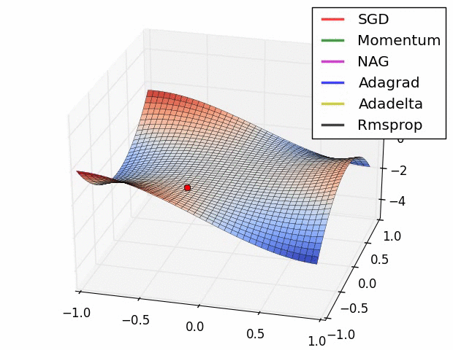
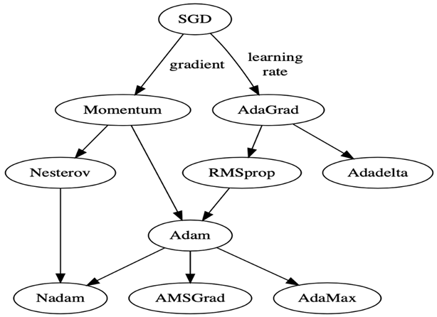

Slide 39
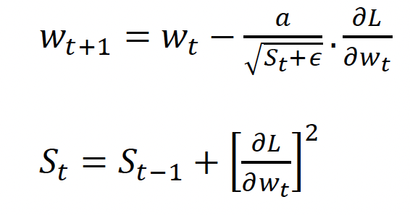
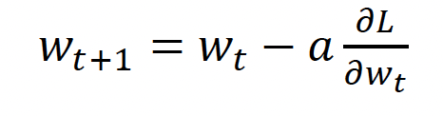
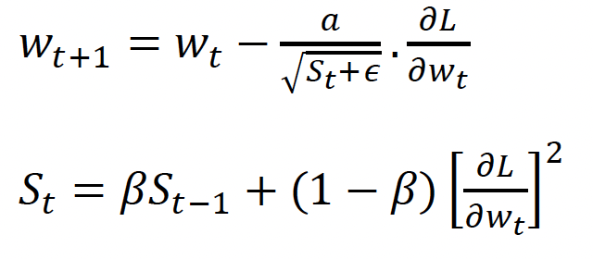
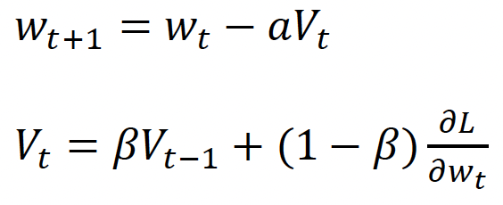
Adagrad
SGD
SGD + Momentum
RMSprop

Slide 40
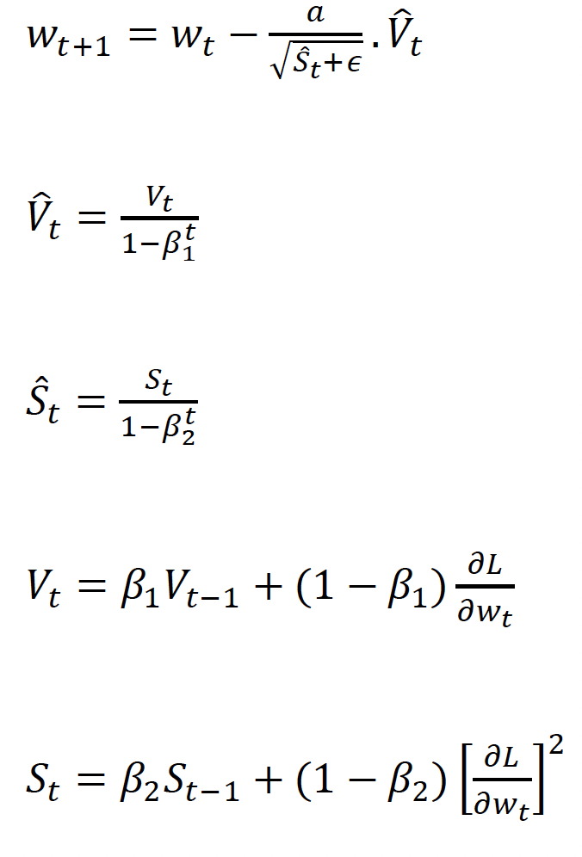
Adam

