Slide 1
Lecture 2: Linear Classifiers

Slide 2
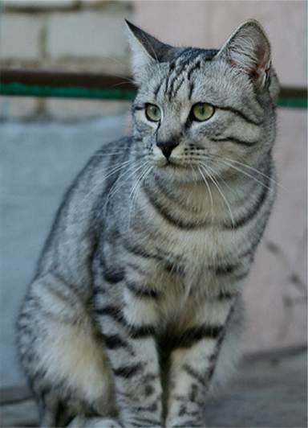
Last time: Image Classification
Input: image
Output: Assign image to one of a fixed set of categories
cat bird deer dog truck
This image by Nikita is licensed under CC-BY 2.0

Slide 3
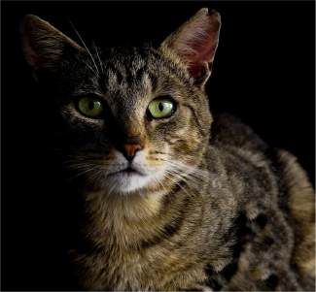

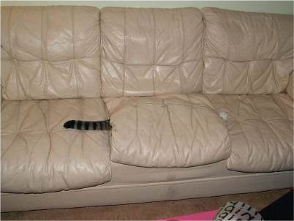
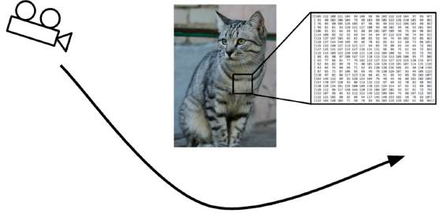
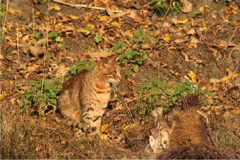
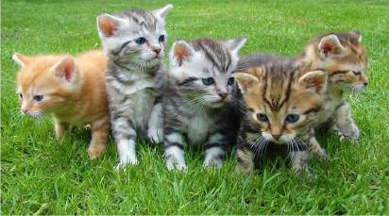
Last Time: Challenges of Recognition
Viewpoint
Illumination Deformation
Occlusion
This image is CC0 1.0 public domain
This image by Umberto Salvagnin is licensed under CC-BY 2.0
This image by jonsson is licensed under CC-BY 2.0
Clutter
Intraclass Variation
This image is CC0 1.0 public domain
This image is CC0 1.0 public domain

Slide 4
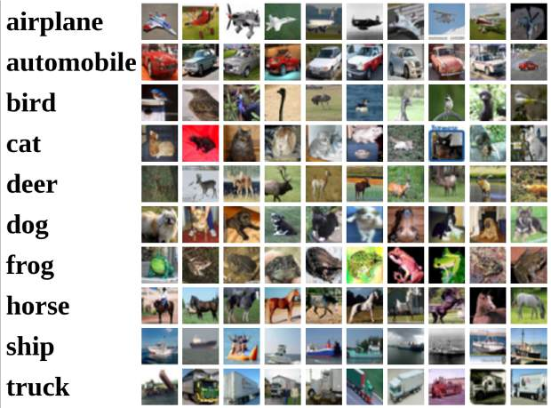
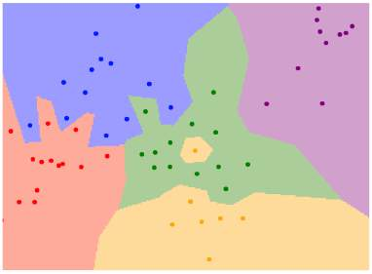
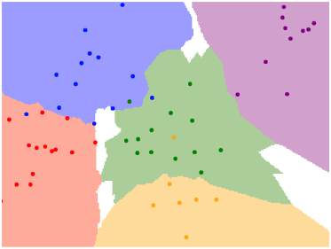
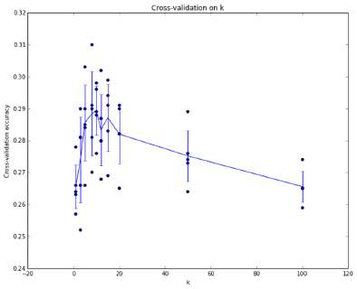
Last time: Data-Drive Approach, kNN
1-NN classifier
5-NN classifier
train
test
train | validation | test

Slide 5
Today: Linear Classifiers

Slide 6
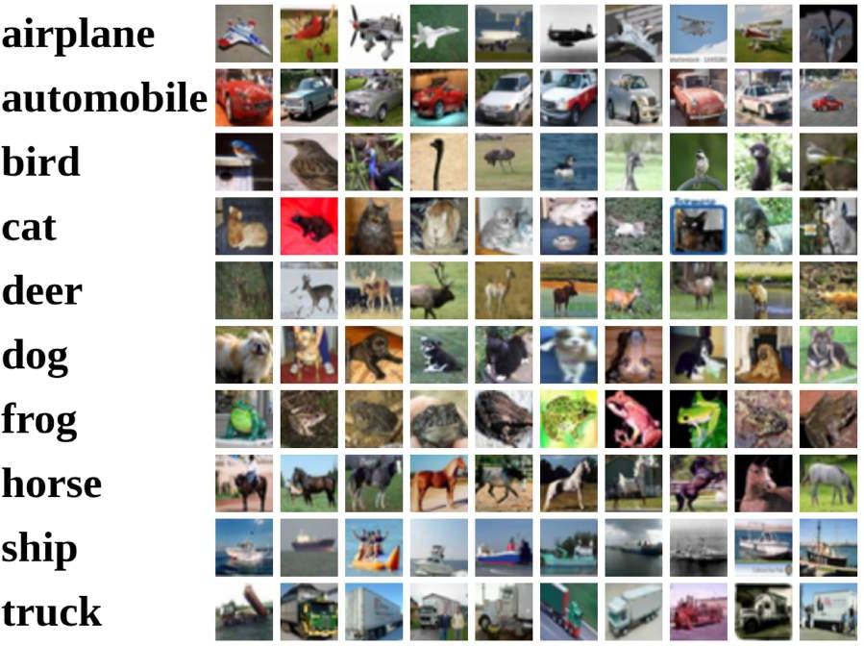
Recall CIFAR10
50,000 training images each image is 32x32x3
10,000 test images.

Slide 7
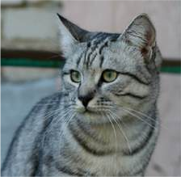
Parametric Approach
Image
10 numbers giving class scores
f(x,W)
Array of 32x32x3 numbers (3072 numbers total)
W
parameters or weights

Slide 8
f(x,W) = Wx
Parametric Approach: Linear Classifier
Image
10 numbers giving class scores
f(x,W)
Array of 32x32x3 numbers (3072 numbers total)
W
parameters or weights

Slide 9
Parametric Approach: Linear Classifier
(3072,)
f(x,W) = Wx
Image
(10,) (10, 3072)
f(x,W)
10 numbers giving class scores
Array of 32x32x3 numbers (3072 numbers total)
W
parameters or weights

Slide 10
Parametric Approach: Linear Classifier
(3072,)
f(x,W) = Wx + b
(10,)
Image
(10,) (10, 3072)
f(x,W)
10 numbers giving class scores
Array of 32x32x3 numbers (3072 numbers total)
W
parameters or weights

Slide 11
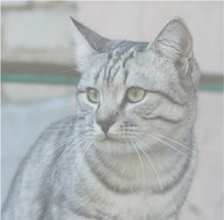
Example for 2x2 image, 3 classes (cat/dog/ship)
Stretch pixels into column
f(x,W) = Wx + b
56
231
24
2
56 | 231
24 | 2
Input image (2, 2)
(4,)

Slide 12
Example for 2x2 image, 3 classes (cat/dog/ship)
Stretch pixels into column
f(x,W) = Wx + b
56
231
24
2
0.2 | -0.5 | 0.1 | 2.0
1.5 | 1.3 | 2.1 | 0.0
0 | 0.25 | 0.2 | -0.3
1.1
3.2
-1.2
-96.8
437.9
61.95
56 | 231
24 | 2
+ =
Input image (2, 2)
W (3, 4)
b
(3,)
(3,)
(4,)

Slide 13

Interpreting a Linear Classifier
Algebraic Viewpoint f(x,W) = Wx + b
Stretch pixels into column
56
231
24
2
56 | 231
24 | 2
0.2 | -0.5 | 0.1 | 2.0
1.5 | 1.3 | 2.1 | 0.0
0 | 0.25 | 0.2 | -0.3
1.1
3.2
-1.2
-96.8
437.9
61.95
+ =
Input image (2, 2)
W (3, 4)
b
(3,)
(3,)
(4,)

Slide 14
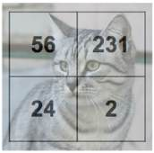
Interpreting a Linear Classifier
Instead of stretching pixels into columns, we can equivalently stretch rows of W into images!
Algebraic Viewpoint f(x,W) = Wx + b
Stretch pixels into column
0.2 | -0.5
0.1 | 2.0
1.5 | 1.3
2.1 | 0.0
0 | .25
0.2 | -0.3
56
231
24
2
W
+ =
56 | 231
24 | 2
0.2 | -0.5 | 0.1 | 2.0
1.5 | 1.3 | 2.1 | 0.0
0 | 0.25 | 0.2 | -0.3
1.1
3.2
-1.2
-96.8
437.9
61.95
Input image (2, 2)
W (3, 4)
b
1.1
3.2
-1.2
b
(3,)
(3,)
(4,)
-96.8
437.9
61.95

Slide 15
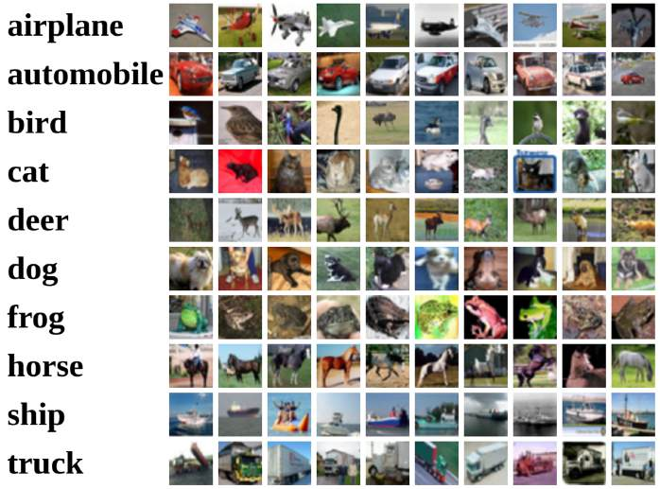

Interpreting an Linear Classifier
0.2 | -0.5
0.1 | 2.0
1.5 | 1.3
2.1 | 0.0
0 | .25
0.2 | -0.3
W
b
1.1 |  | 3.2 |  | -1.2
-96.8 |  | 437.9 |  | 61.95

Slide 16
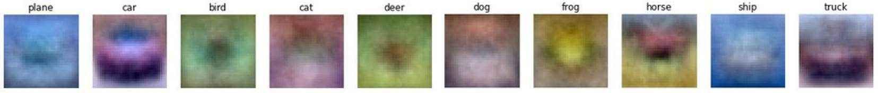
Interpreting an Linear Classifier: Visual Viewpoint
0.2 | -0.5
0.1 | 2.0
1.5 | 1.3
2.1 | 0.0
0 | .25
0.2 | -0.3
W
b
1.1 |  | 3.2 |  | -1.2
-96.8 |  | 437.9 |  | 61.95

Slide 17
Interpreting an Linear Classifier: Visual Viewpoint
Linear classifier has one “template” per category
W
b
0.2 | -0.5
0.1 | 2.0
1.5 | 1.3
2.1 | 0.0
0 | .25
0.2 | -0.3
1.1 |  | 3.2 |  | -1.2
-96.8 |  | 437.9 |  | 61.95

Slide 18
Interpreting an Linear Classifier: Visual Viewpoint
Linear classifier has one “template” per category
0.2 | -0.5
0.1 | 2.0
1.5 | 1.3
2.1 | 0.0
0 | .25
0.2 | -0.3
W
A single template cannot capture multiple modes of the data
b
e.g. horse template has 2 heads!
1.1 |  | 3.2 |  | -1.2
-96.8 |  | 437.9 |  | 61.95

Slide 19

Interpreting a Linear Classifier: Geometric Viewpoint
Airplane
Score
f(x,W) = Wx + b
Car Score
Cat Score
Classifier score
Array of 32x32x3 numbers (3072 numbers total)
Value of pixel (15, 8, 0)

Slide 20
Interpreting a Linear Classifier: Geometric Viewpoint
Decision Regions
Airplane
Score
Cat
Score
f(x,W) = Wx + b
Car Score
Classifier score
Array of 32x32x3 numbers (3072 numbers total)
Value of pixel (15, 8, 0)

Slide 21
Hard Cases for a Linear Classifier
Class 1:
First and third quadrants
Class 1:
1 <= L2 norm <= 2
Class 2: Everything else
Class 1: Three modes
Class 2: Everything else
Class 2:
Second and fourth quadrants

Slide 22
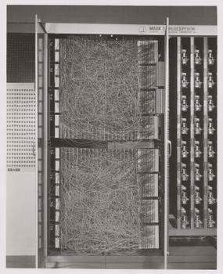
Recall: Perceptron couldn’t learn XOR
y
X | Y | F(x,y)
0 | 0 | 0
0 | 1 | 1
1 | 0 | 1
1 | 1 | 0
x

Slide 23
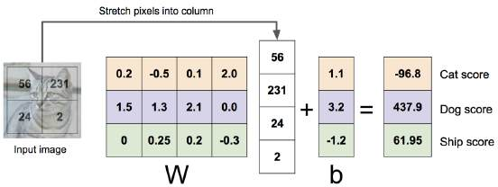
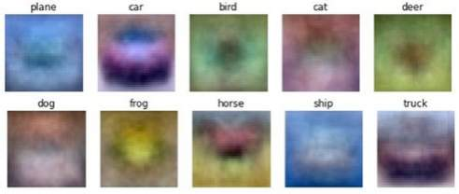
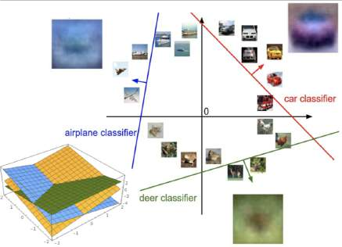
Linear Classifier: Three Viewpoints
Algebraic Viewpoint
Visual Viewpoint
Geometric Viewpoint
f(x,W) = Wx
One template per class
Hyperplanes cutting up space

Slide 24
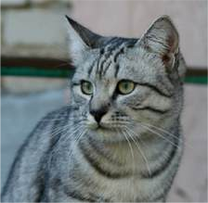
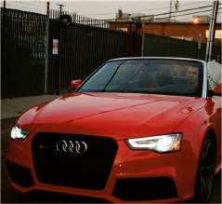
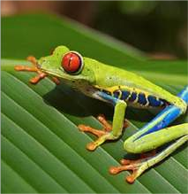
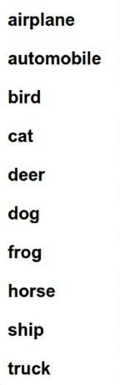
f(x,W) = Wx + b
So Far: Defined a linear score function
Given a W, we can compute class scores for an image x.
-3.45
-8.87
0.09
2.9
4.48
8.02
3.78
1.06
-0.36
-0.72
-0.51 | 3.42
6.04 | 4.64
5.31 | 2.65
-4.22 | 5.1
-4.19 | 2.64
3.58 | 5.55
4.49 | -4.34
-4.37 | -1.5
-2.09 | -4.79
-2.93 | 6.14
But how can we actually choose a good W?
Cat image by Nikita is licensed under CC-BY 2.0; Car image is CC0 1.0 public domain; Frog image is in the public domain

Slide 25
f(x,W) = Wx + b
Choosing a good W
TODO:
Use a loss function to quantify how good a value of W is
Find a W that minimizes the loss function (optimization)
-3.45
-8.87
0.09
2.9
4.48
8.02
3.78
1.06
-0.36
-0.72
-0.51 | 3.42
6.04 | 4.64
5.31 | 2.65
-4.22 | 5.1
-4.19 | 2.64
3.58 | 5.55
4.49 | -4.34
-4.37 | -1.5
-2.09 | -4.79
-2.93 | 6.14

Slide 26
Loss Function
A loss function tells how good our current classifier is
Low loss = good classifier High loss = bad classifier
(Also called: objective function; cost function)

Slide 27
Loss Function
A loss function tells how good our current classifier is
Low loss = good classifier High loss = bad classifier
(Also called: objective function; cost function)
Negative loss function sometimes called reward function, profit function, utility function, fitness function, etc

Slide 28
Loss Function
Given a dataset of examples
𝑁
𝑥_{𝑖}, 𝑦_{𝑖}
A loss function tells how good our current classifier is
𝑖=1
Where 𝑥_{𝑖} is image and
𝑦_{𝑖} is (integer) label
Low loss = good classifier High loss = bad classifier
(Also called: objective function; cost function)
Negative loss function sometimes called reward function, profit function, utility function, fitness function, etc

Slide 29
Loss Function
Given a dataset of examples
𝑁
𝑥_{𝑖}, 𝑦_{𝑖}
A loss function tells how good our current classifier is
Low loss = good classifier High loss = bad classifier
(Also called: objective function; cost function)
Negative loss function sometimes called reward function, profit function, utility function, fitness function, etc
𝑖=1
Where 𝑥_{𝑖} is image and
𝑦_{𝑖} is (integer) label
Loss for a single example is
𝐿_{𝑖} 𝑓 𝑥_{𝑖}, 𝑊 , 𝑦_{𝑖}

Slide 30
Loss Function
Given a dataset of examples
𝑁
𝑥_{𝑖}, 𝑦_{𝑖}
A loss function tells how good our current classifier is
Low loss = good classifier High loss = bad classifier
(Also called: objective function; cost function)
Negative loss function sometimes called reward function, profit function, utility function, fitness function, etc
𝑖=1
Where 𝑥_{𝑖} is image and
𝑦_{𝑖} is (integer) label
Loss for a single example is
𝐿_{𝑖} 𝑓 𝑥_{𝑖}, 𝑊 , 𝑦_{𝑖}
Loss for the dataset is average of per-example losses:
𝐿 = _{𝑁} * 𝐿_{𝑖} 𝑓 𝑥_{𝑖}, 𝑊 , 𝑦_{𝑖}
1
𝑖

Slide 31

Cross-Entropy Loss (Multinomial Logistic Regression)
Want to interpret raw classifier scores as probabilities
cat 3.2
car 5.1
frog -1.7

Slide 32
Cross-Entropy Loss (Multinomial Logistic Regression)
Want to interpret raw classifier scores as probabilities
𝑠 = 𝑓 𝑥_{𝑖}; 𝑊
exp 𝑠_{𝑘}
Softmax function
𝑃 𝑌 = 𝑘 | 𝑋 = 𝑥_{𝑖} =
∑_{j} exp 𝑠_{j}
cat 3.2
car 5.1
frog -1.7

Slide 33
Cross-Entropy Loss (Multinomial Logistic Regression)
Want to interpret raw classifier scores as probabilities
₌ exp 𝑠_{𝑘}
∑_{j} exp 𝑠_{j}
Softmax function
𝑠 = 𝑓 𝑥_{𝑖}; 𝑊
𝑃 𝑌 = 𝑘 | 𝑋 = 𝑥
𝑖
cat car frog
3.2
5.1
-1.7
Unnormalized log- probabilities / logits

Slide 34
Cross-Entropy Loss (Multinomial Logistic Regression)
Want to interpret raw classifier scores as probabilities
𝑠 = 𝑓 𝑥_{𝑖}; 𝑊
exp 𝑠_{𝑘}
Softmax function
𝑃 𝑌 = 𝑘 | 𝑋 = 𝑥_{𝑖} =
∑_{j} exp 𝑠_{j}
Probabilities must be >= 0
cat 3.2
car 5.1
frog -1.7
24.5
164.0
0.18
exp
Unnormalized log- probabilities / logits
unnormalized probabilities

Slide 35
Cross-Entropy Loss (Multinomial Logistic Regression)
Want to interpret raw classifier scores as probabilities
₌ exp 𝑠_{𝑘}
∑_{j} exp 𝑠_{j}
Softmax function
𝑠 = 𝑓 𝑥_{𝑖}; 𝑊
𝑃 𝑌 = 𝑘 | 𝑋 = 𝑥
𝑖
Probabilities must be >= 0
Probabilities must sum to 1
cat car frog
3.2
5.1
-1.7
24.5
164.0
0.18
0.13
0.87
0.00
exp
normalize
Unnormalized log- probabilities / logits
unnormalized probabilities
probabilities

Slide 36
Cross-Entropy Loss (Multinomial Logistic Regression)
Want to interpret raw classifier scores as probabilities
₌ exp 𝑠_{𝑘}
∑_{j} exp 𝑠_{j}
Softmax function
𝑠 = 𝑓 𝑥_{𝑖}; 𝑊
𝑃 𝑌 = 𝑘 | 𝑋 = 𝑥
𝑖
Probabilities must be >= 0
Probabilities must sum to 1
𝐿_{𝑖} = − log 𝑃 𝑌 = 𝑦_{𝑖} | 𝑋 = 𝑥_{𝑖}
cat car frog
3.2
5.1
-1.7
24.5
164.0
0.18
0.13
0.87
0.00
L_{i} = -log(0.13)
= 2.04
exp
normalize
Unnormalized log- probabilities / logits
unnormalized probabilities
probabilities

Slide 37
Cross-Entropy Loss (Multinomial Logistic Regression)
Want to interpret raw classifier scores as probabilities
₌ exp 𝑠_{𝑘}
∑_{j} exp 𝑠_{j}
Softmax function
𝑠 = 𝑓 𝑥_{𝑖}; 𝑊
𝑃 𝑌 = 𝑘 | 𝑋 = 𝑥
𝑖
Probabilities must be >= 0
Probabilities must sum to 1
𝐿_{𝑖} = − log 𝑃 𝑌 = 𝑦_{𝑖} | 𝑋 = 𝑥_{𝑖}
cat car frog
3.2
5.1
-1.7
24.5
164.0
0.18
0.13
0.87
0.00
Compare
1.00
0.00
0.00
exp
normalize
Unnormalized log- probabilities / logits
unnormalized probabilities
Correct probs
probabilities

Slide 38
Cross-Entropy Loss (Multinomial Logistic Regression)
Want to interpret raw classifier scores as probabilities
₌ exp 𝑠_{𝑘}
∑_{j} exp 𝑠_{j}
Softmax function
𝑠 = 𝑓 𝑥_{𝑖}; 𝑊
𝑃 𝑌 = 𝑘 | 𝑋 = 𝑥
𝑖
Maximize probability of correct class
Putting it all together:
cat 3.2
car 5.1
frog -1.7
𝐿_{𝑖} = − log 𝑃 𝑌 = 𝑦_{𝑖} | 𝑋 = 𝑥_{𝑖}
exp 𝑠_{𝑦𝑖}
𝐿_{𝑖} = − log
∑ exp 𝑠
j
j

Slide 39
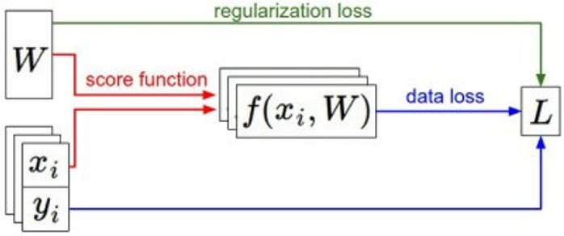
Recap: Loss Functions quantify preferences
We have some dataset of (x, y)
We have a score function:
We have a loss function:
𝑠 = 𝑓 𝑥; 𝑊, 𝑏 = 𝑊𝑥 + 𝑏
Linear classifier
exp 𝑠_{𝑦𝑖}
Softmax: 𝐿 = − log
𝑖
∑_{j} exp 𝑠_{j}

Slide 40
Recap: Loss Functions quantify preferences
Q: How do we find the best W, b?
𝑠 = 𝑓 𝑥; 𝑊, 𝑏 = 𝑊𝑥 + 𝑏
Linear classifier
We have some dataset of (x, y)
We have a score function:
We have a loss function:
exp 𝑠_{𝑦𝑖}
Softmax: 𝐿 = − log
𝑖
∑_{j} exp 𝑠_{j}

