Slide 1
CEN462 Introduction to Computer Vision
Lecture 1: Introduction

Slide 2
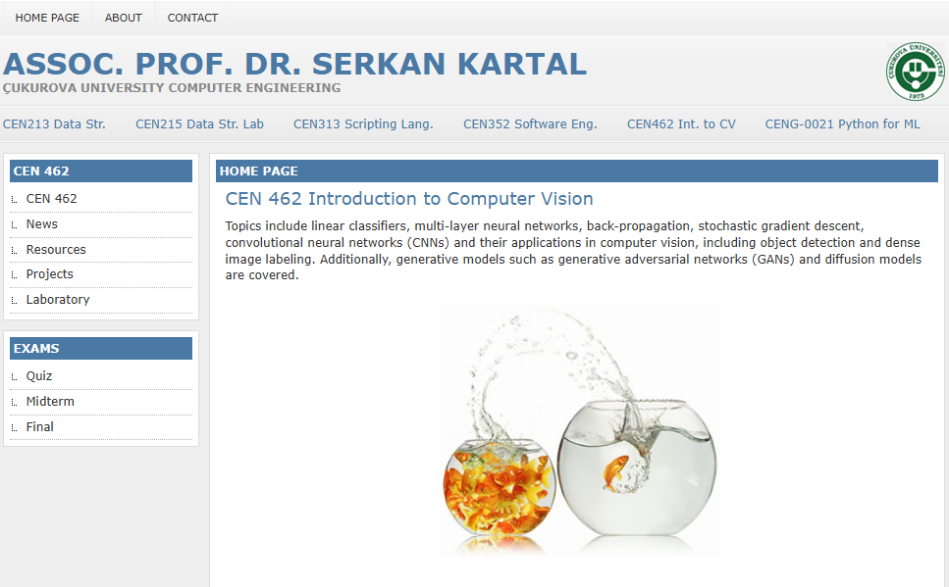
web address
https://ceng.cu.edu.tr/skartal/

Slide 3
Course Structure
Before Midterm: Fundamentals
  Details of how to implement and train different types of networks
  Fully-connected networks, convolutional networks, recurrent networks
  How to train and debug…
After Midterm: Applications and “Researchy” topics
  Object detection
  Image segmentation
  Generative models: GANs, VAEs
  Attention, Transformers

Slide 4
Course Content and Grading
Midterm Exam (20%)
Project (20%)
Final Exam (60%)

Slide 5
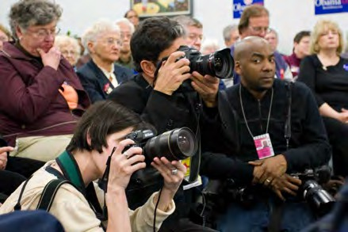
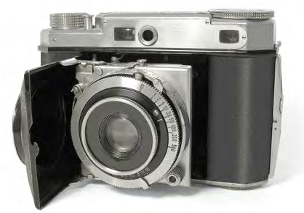
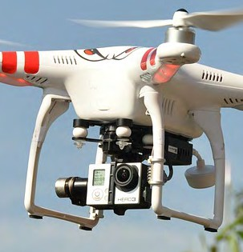
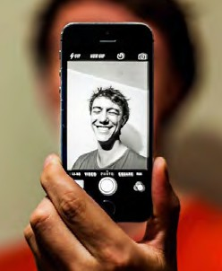
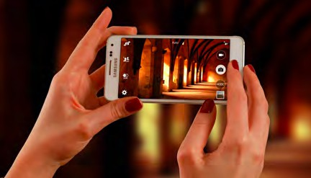
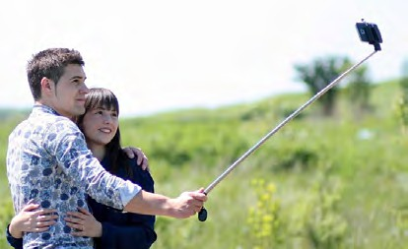
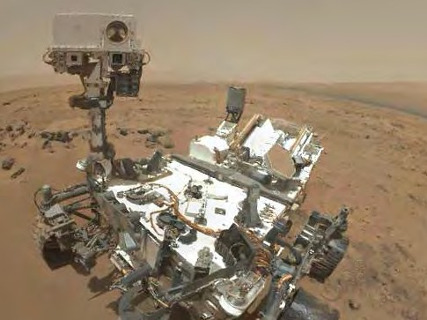
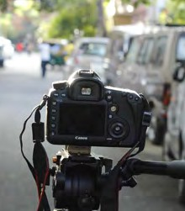
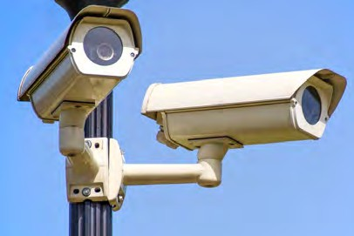
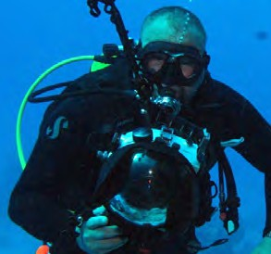
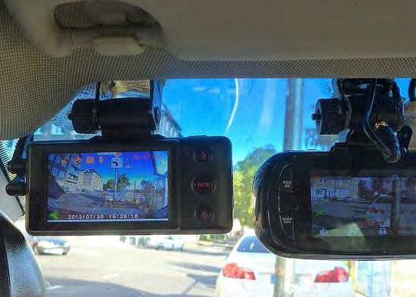
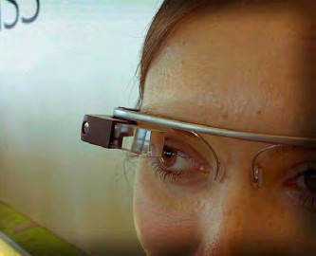
Computer Vision is everywhere!
Left to right:
Image by Roger H Goun is licensed under CC BY 2.0
Image is CC0 1.0 public domain Image is CC0 1.0 public domain Image is CC0 1.0 public domain
Left to right:
Image is free to use
Image is CC0 1.0 public domain Image by NASA is licensed under CC BY 2.0
Image is CC0 1.0 public domain
Bottom row, left to right Image is CC0 1.0 public domain Image by Derek Keats is
licensed under CC BY 2.0; changes made
Image is public domain
Image is licensed under CC-BY 2.0; changes made

Slide 6
Computer Vision
Building artificial systems that learn from data and experience

Slide 7
Today’s Agenda
A brief history of computer vision and deep learning
Course overview and logistics

Slide 8
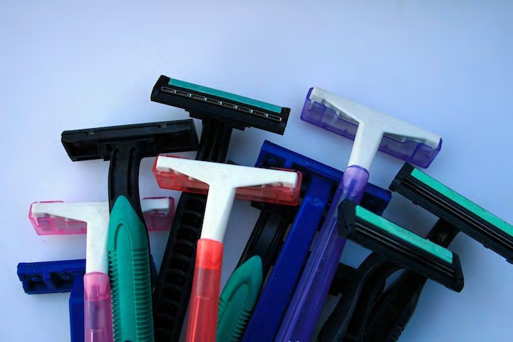
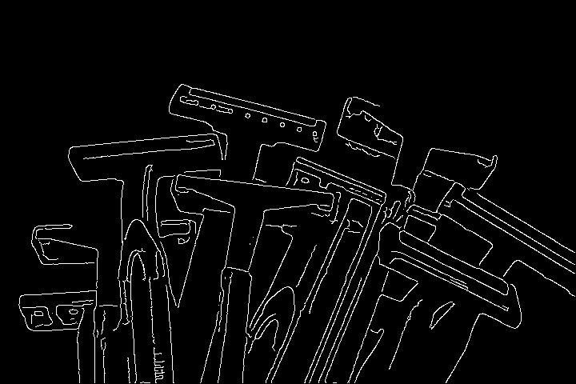
Recognition via Edge Detection (1980s)
1959
Hubel & Wiesel
1963
Roberts
1970s
David Marr
1979
Gen. Cylinders
1986
Canny
John Canny, 1986
David Lowe, 1987
Image is CC0 1.0 public domain

Slide 9
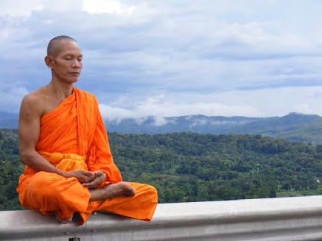
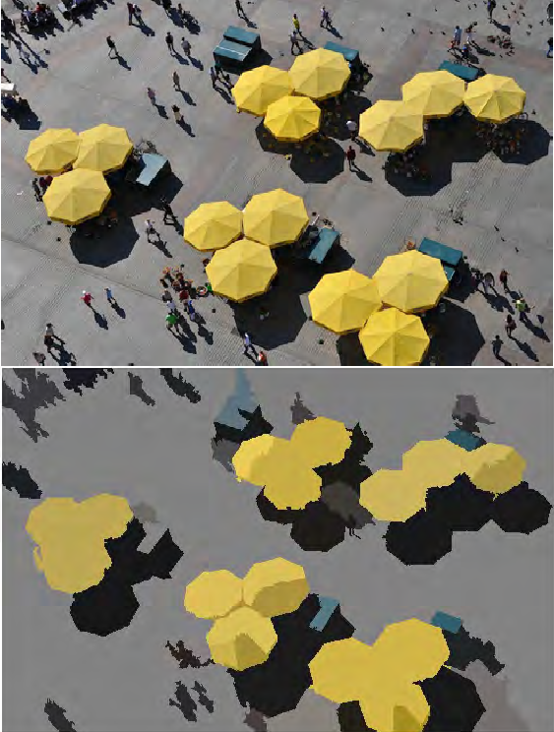
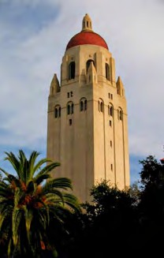
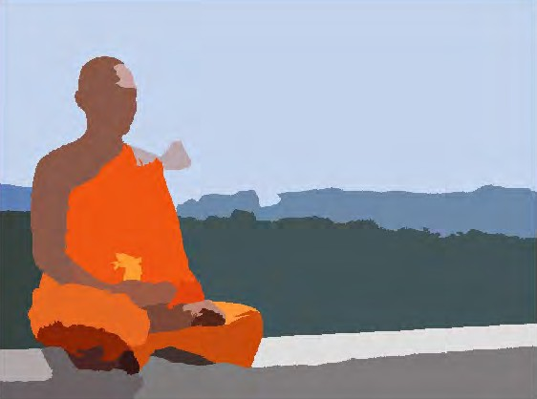
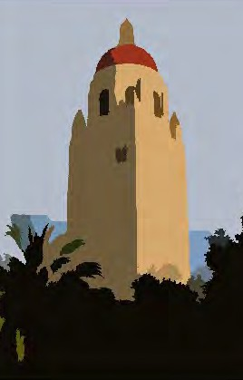
Recognition via Grouping (1990s)
1959
Hubel & Wiesel
1963
Roberts
1970s
David Marr
1979
Gen. Cylinders
1986
Canny
1997
Norm. Cuts
Normalized Cuts, Shi and Malik, 1997
AI Winter
Left Image is CC BY 3.0
Middl Image is public domain
Right Image is CC-BY 2.0; changes made

Slide 10
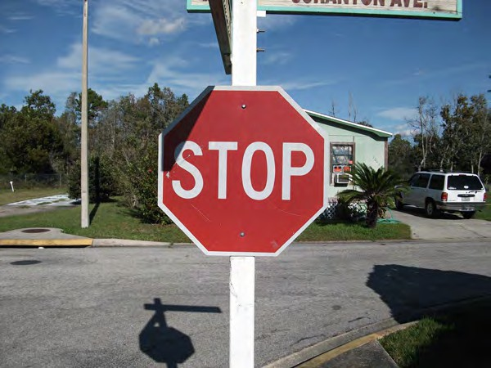

Recognition via Matching (2000s)
Image is public domain
Image is public domain
1959
Hubel & Wiesel
1963
Roberts
1970s
David Marr
1979
Gen. Cylinders
1986
Canny
1997
Norm. Cuts
1999
SIFT
SIFT, David Lowe, 1999
AI Winter

Slide 11
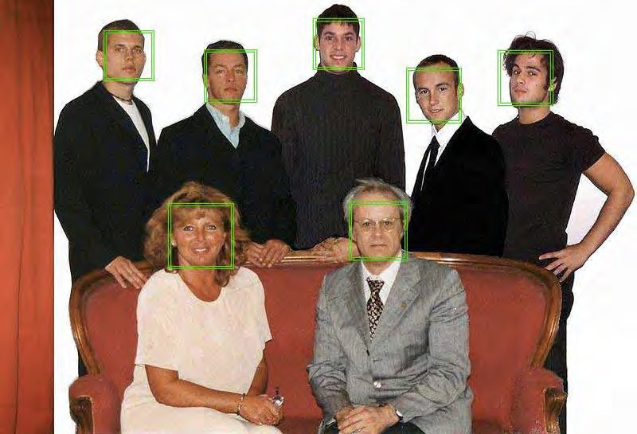
Face Detection
Viola and Jones, 2001
One of the first successful applications of machine learning to vision
1959
Hubel & Wiesel
1963
Roberts
1970s
David Marr
1979
Gen. Cylinders
1986
Canny
1997
Norm. Cuts
1999
SIFT
2001
V&J
AI Winter

Slide 12
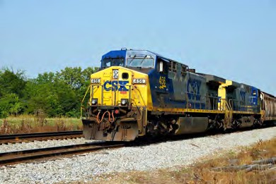
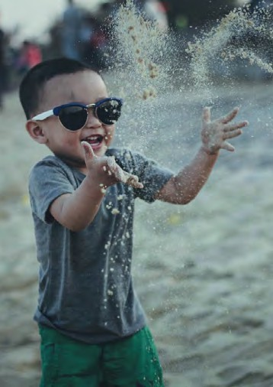
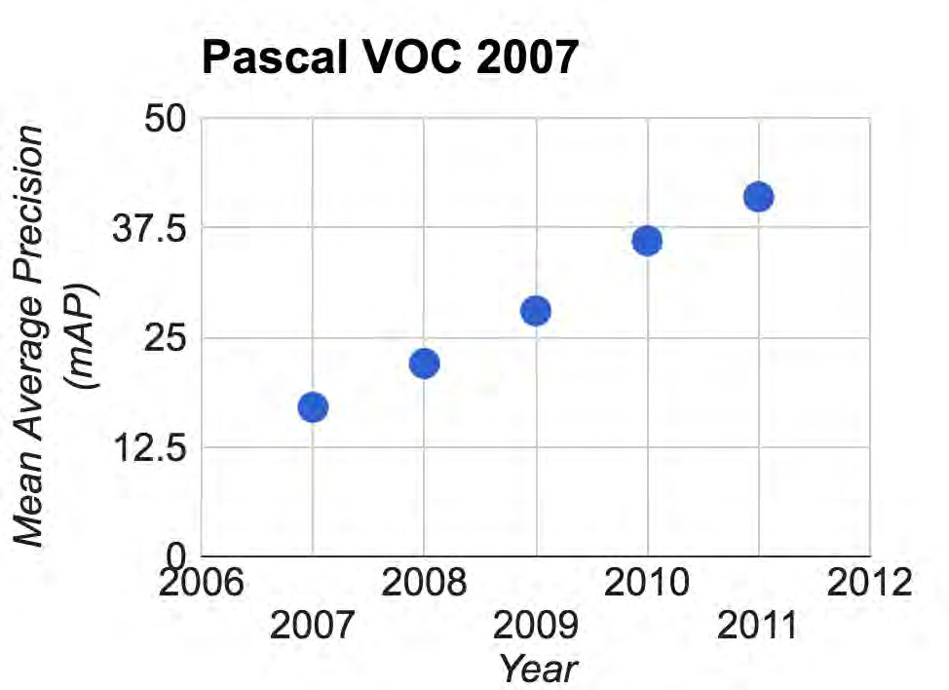
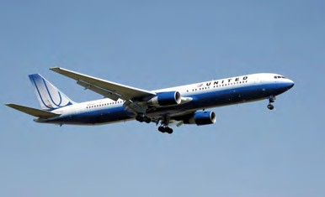
PASCAL Visual Object Challenge
Image is CC0 1.0 public domain
Train
Person
Airplane
Image is CC0 1.0 public domain
1959
Hubel & Wiesel
1963
Roberts
1970s
David Marr
1979
Gen. Cylinders
1986
Canny
1997
Norm. Cuts
1999
SIFT
2001
V&J
2007
PASCAL
AI Winter

Slide 13
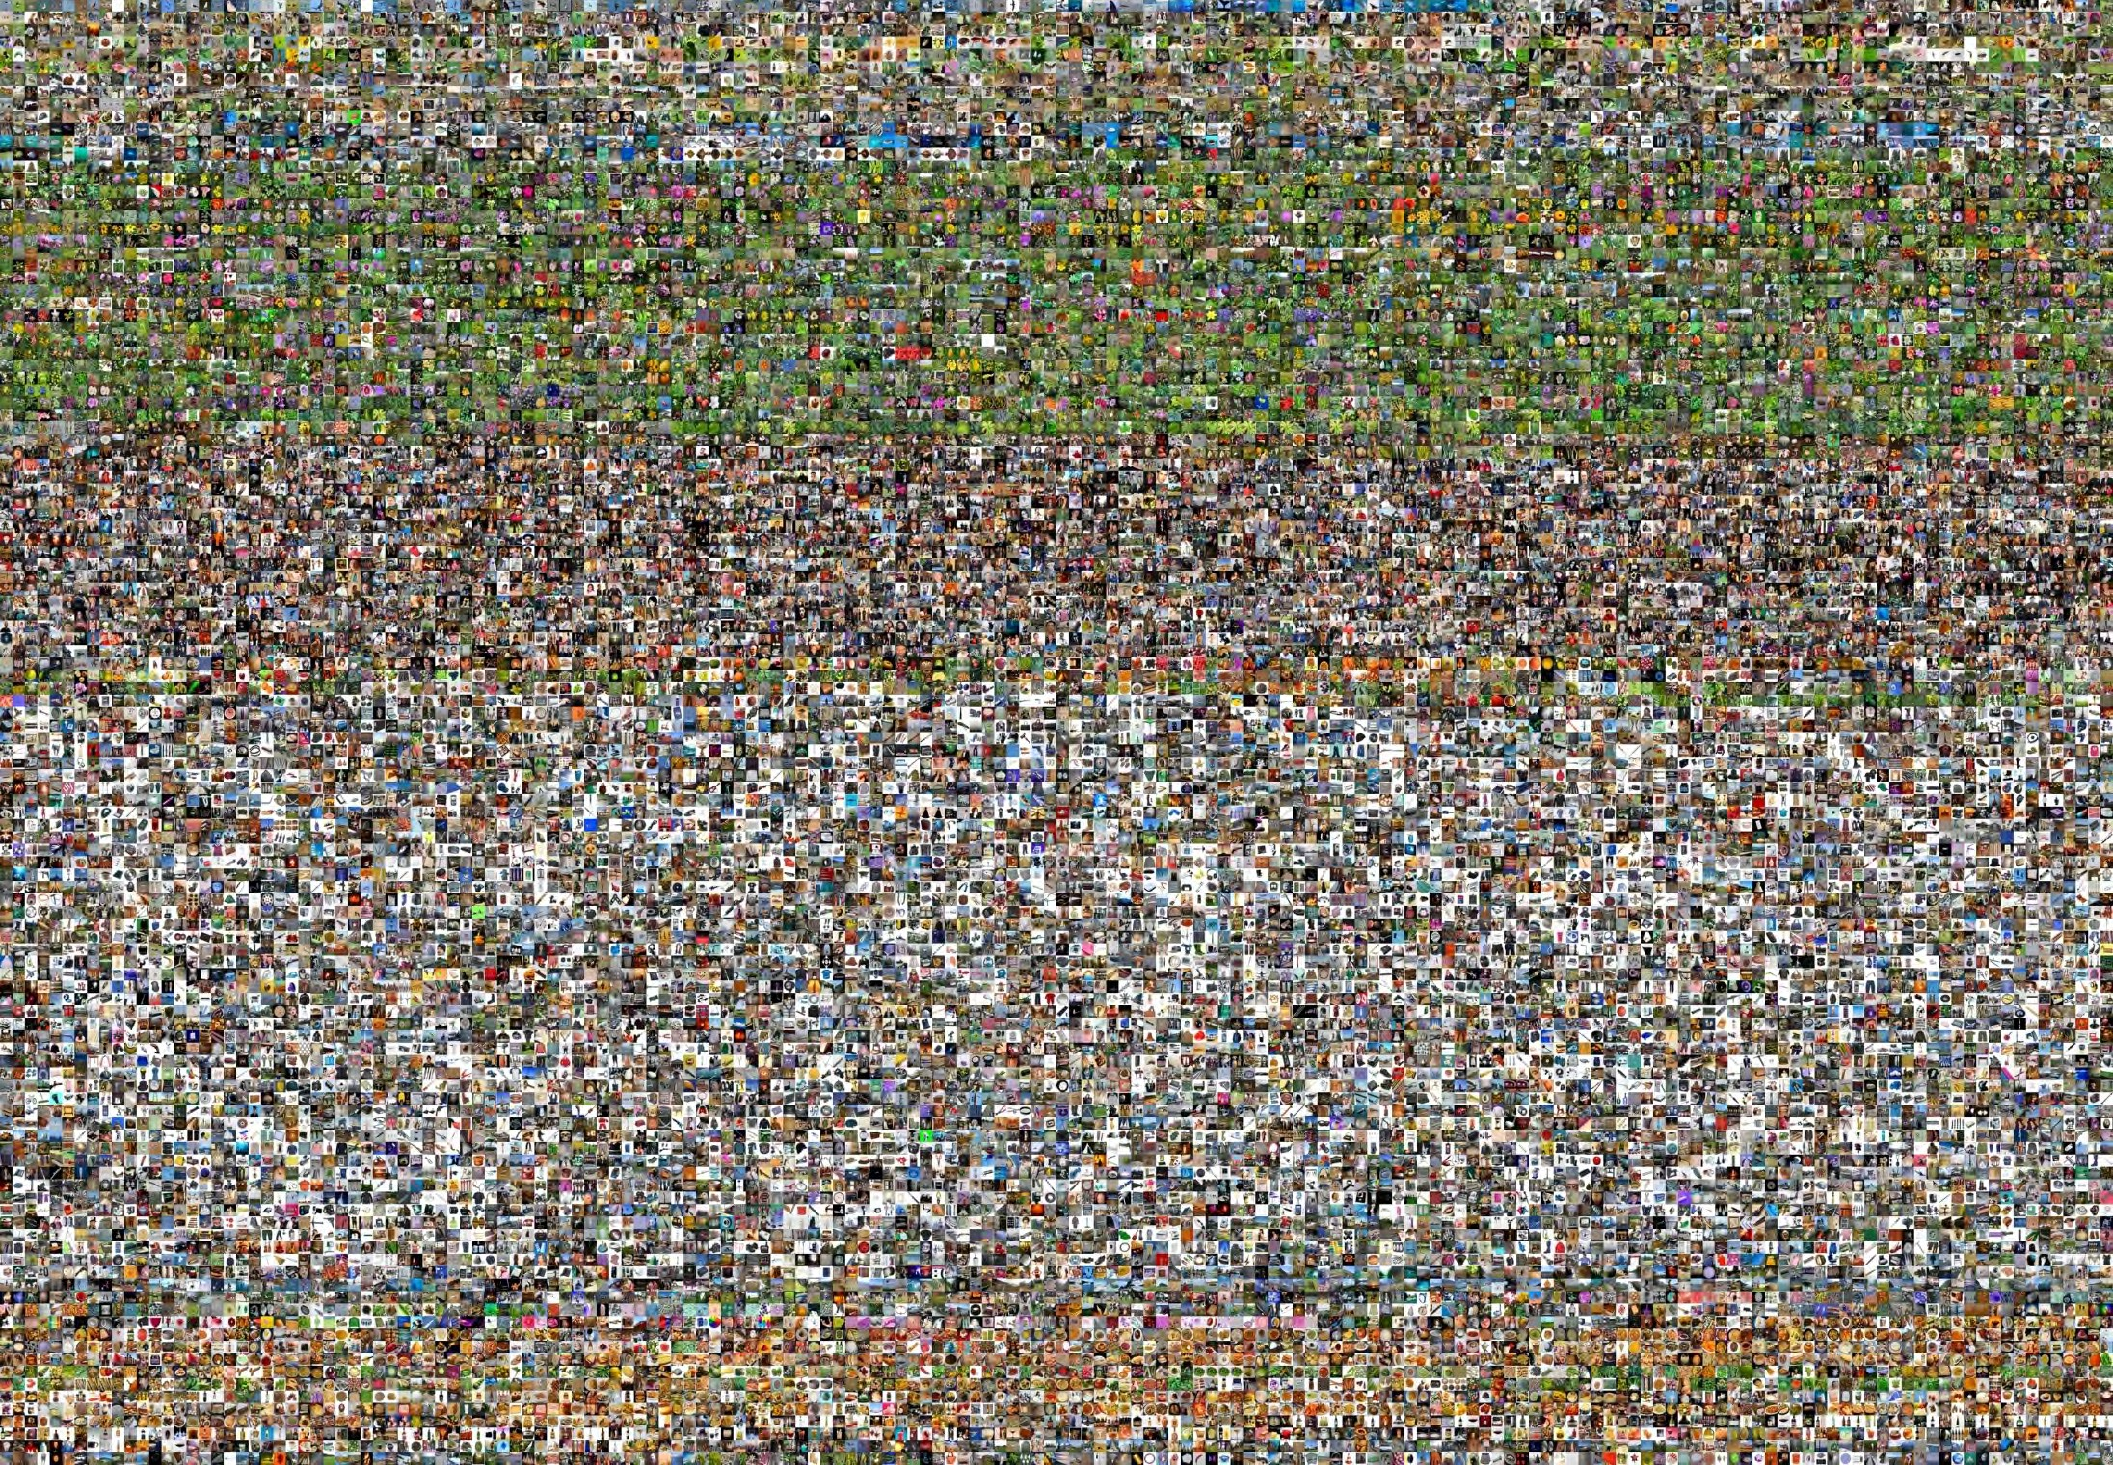
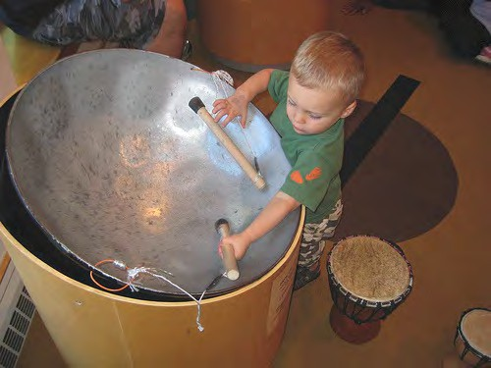
Output:
Scale T-shirt
Steel drum Drumstick Mud turtle
The Image Classification Challenge: 1,000 object classes
1,431,167 images
Deng et al, 2009 Russakovsky et al. IJCV 2015
1959
Hubel & Wiesel
1963
Roberts
1970s
David Marr
1979
Gen. Cylinders
1986
Canny
1997
Norm. Cuts
1999
SIFT
2001
V&J
2007
PASCAL
2009
ImageNet
AI Winter

Slide 14
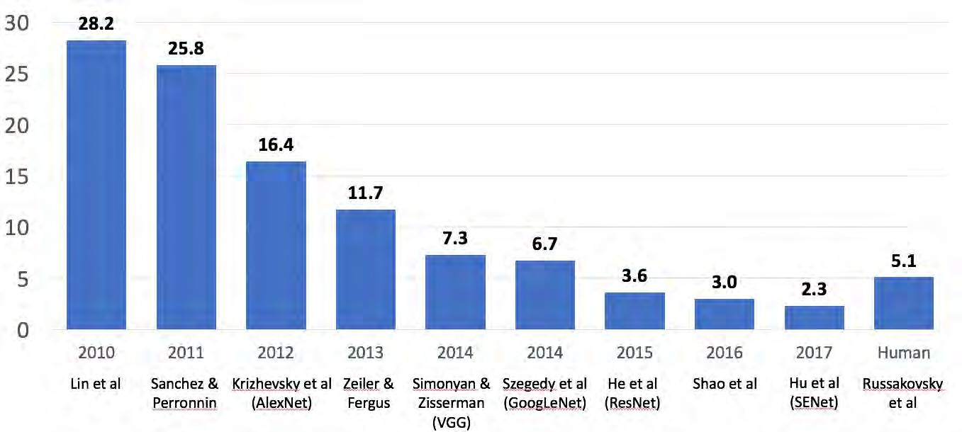
Enter Deep Learning
1959
Hubel & Wiesel
1963
Roberts
1970s
David Marr
1979
Gen. Cylinders
1986
Canny
1997
Norm. Cuts
1999
SIFT
2001
V&J
2007
PASCAL
2009
ImageNet
AI Winter
2012
AlexNet

Slide 15
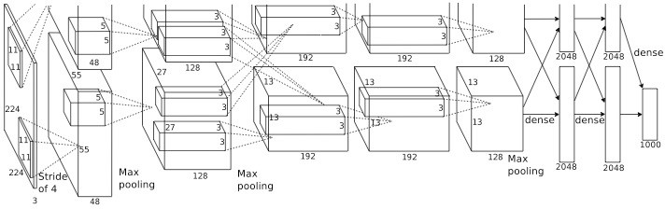
AlexNet: Deep Learning Goes Mainstream
Krizhevsky, Sutskever, and Hinton, NeurIPS 2012
1959
1963
1970s
1979
1986
1997
1999
2001
2007
2009
Hubel & Wiesel
Roberts
David Marr
Gen. Cylinders
Canny
Norm. Cuts
SIFT
V&J
PASCAL
ImageNet
AI Winter
2012
AlexNet

Slide 16
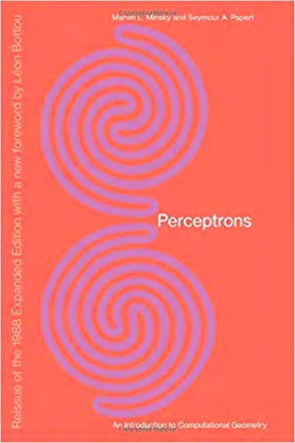
Minsky and Papert, 1969
X | Y | F(x,y)
0 | 0 | 0
0 | 1 | 1
1 | 0 | 1
1 | 1 | 0
y
x
Showed that Perceptrons could not learn the XOR function Caused a lot of disillusionment in the field
1959
Hubel & Wiesel
1963
Roberts
1970s
David Marr
1979
Gen. Cylinders
1986
Canny
1997
Norm. Cuts
1999
SIFT
2001
V&J
2007
PASCAL
2009
ImageNet
AI Winter
1958
Perceptron
1969
Minsky & Papert
2012
AlexNet
Lecture 1 - 31

Slide 17
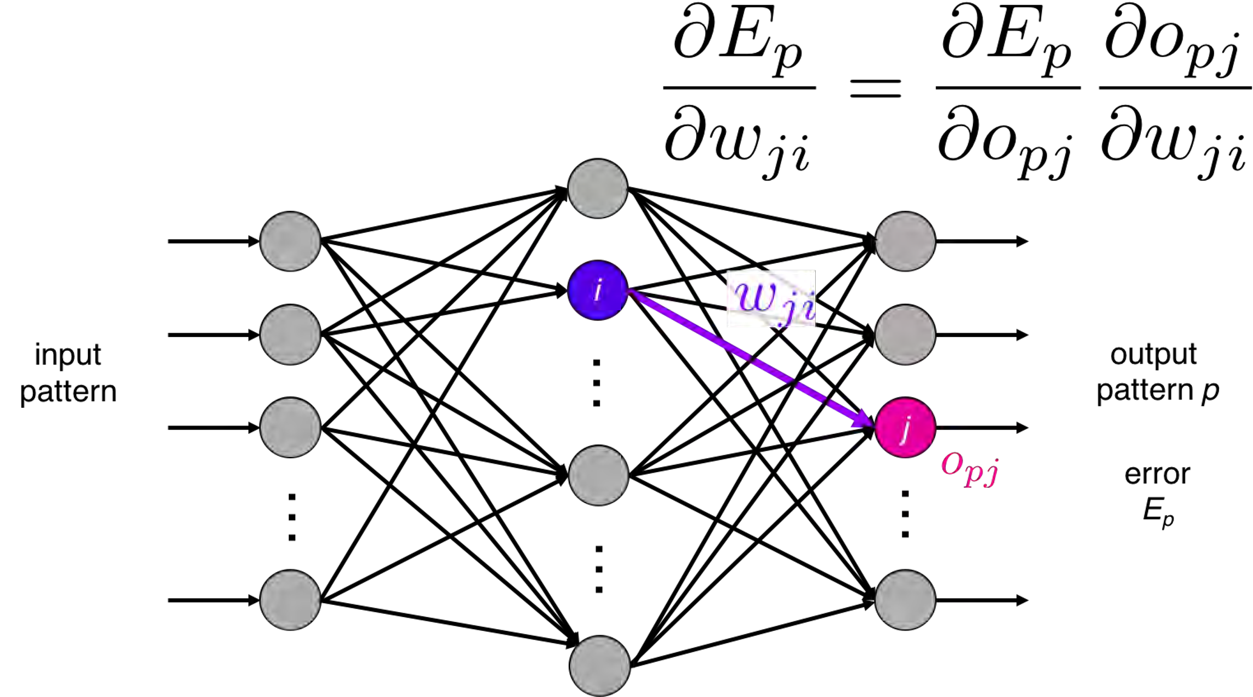
Backprop: Rumelhart, Hinton, and Williams, 1986
Introduced backpropagation for computing gradients in neural networks
recognizable math
Successfully trained perceptrons with multiple layers
Illustration of Rumelhart et al., 1986 by Lane McIntosh, copyright CS231n 2017
1959
Hubel & Wiesel
1963
Roberts
1970s
David Marr
1979
Gen. Cylinders
1986
Canny
1997
Norm. Cuts
1999
SIFT
2001
V&J
2007
PASCAL
2009
ImageNet
AI Winter
1958
Perceptron
1969
Minsky & Papert
1980
Neocognitron
1985
Backprop
Lecture 1 - 34
2012
AlexNet

Slide 18
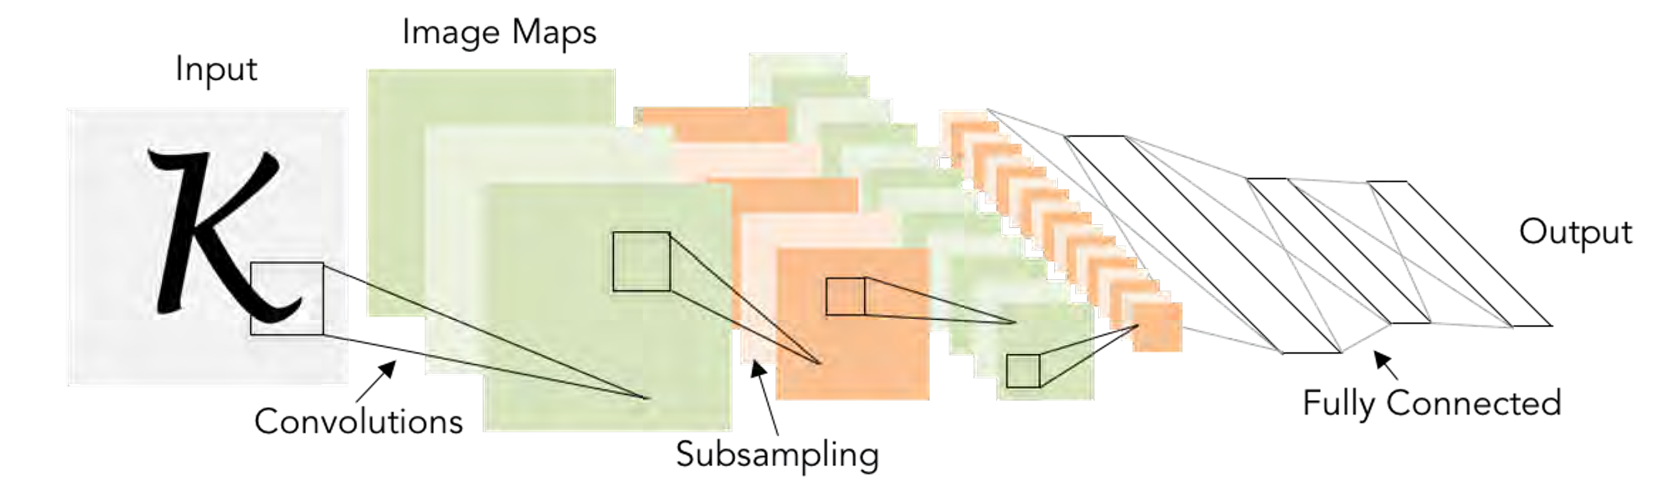
Convolutional Networks: LeCun et al, 1998
Applied backprop algorithm to a Neocognitron-like architecture Learned to recognize handwritten digits
Was deployed in a commercial system by NEC, processed handwritten checks Very similar to our modern convolutional networks!
1959
Hubel & Wiesel
1963
Roberts
1970s
David Marr
1979
Gen. Cylinders
1986
Canny
1997
Norm. Cuts
1999
SIFT
2001
V&J
2007
PASCAL
2009
ImageNet
AI Winter
1958
Perceptron
1969
Minsky & Papert
1980
Neocognitron
1985
Backprop
Lecture 1 - 35
1998
LeNet
2012
AlexNet

Slide 19
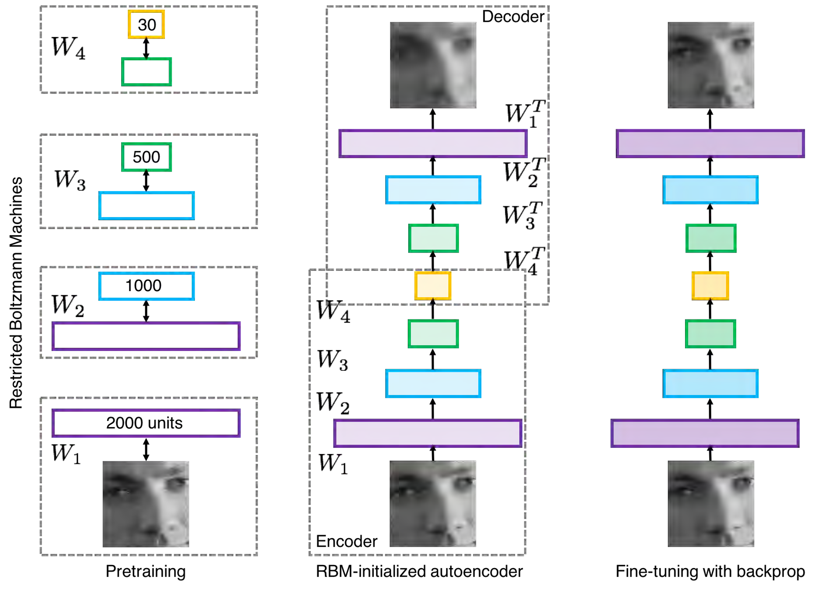
2000s: “Deep Learning”
People tried to train neural networks that were deeper and deeper
Not a mainstream research topic at this time
Hinton and Salakhutdinov, 2006 Bengio et al, 2007
Lee et al, 2009
Glorot and Bengio, 2010
1959
Hubel & Wiesel
1963
Roberts
1970s
David Marr
1979
Gen. Cylinders
1986
Canny
1997
Norm. Cuts
1999
SIFT
2001
V&J
2007
PASCAL
2009
ImageNet
AI Winter
1958
Perceptron
1969
Minsky & Papert
1980
Neocognitron
1985
Backprop
1998
LeNet
2006
Deep Learning
2012
AlexNet
Lecture 1 - 36

Slide 20
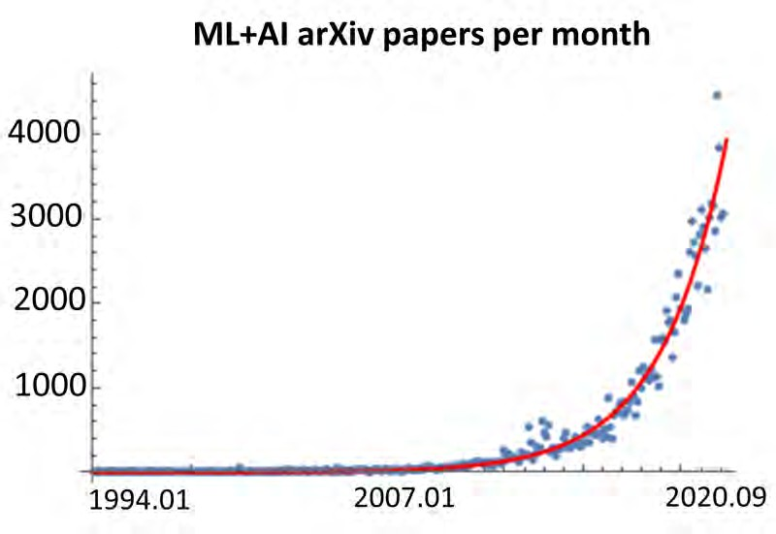
2012 to Present: Deep Learning Explosion
CVPR Papers
8000
7000
6000
5000
4000
3000
2000
1000
0
Submitted
Accepted
1985 1990 1995 2000 2005 2010 2015 2020
Publications at top Computer Vision conference
arXiv papers per month (source)
1959
Hubel & Wiesel
1963
Roberts
1970s
David Marr
1979
Gen. Cylinders
1986
Canny
1997
Norm. Cuts
1999
SIFT
2001
V&J
2007
PASCAL
2009
ImageNet
AI Winter
1958
Perceptron
1969
Minsky & Papert
1980
Neocognitron
1985
Backprop
1998
LeNet
2006
Deep Learning
2012
AlexNet

Slide 21
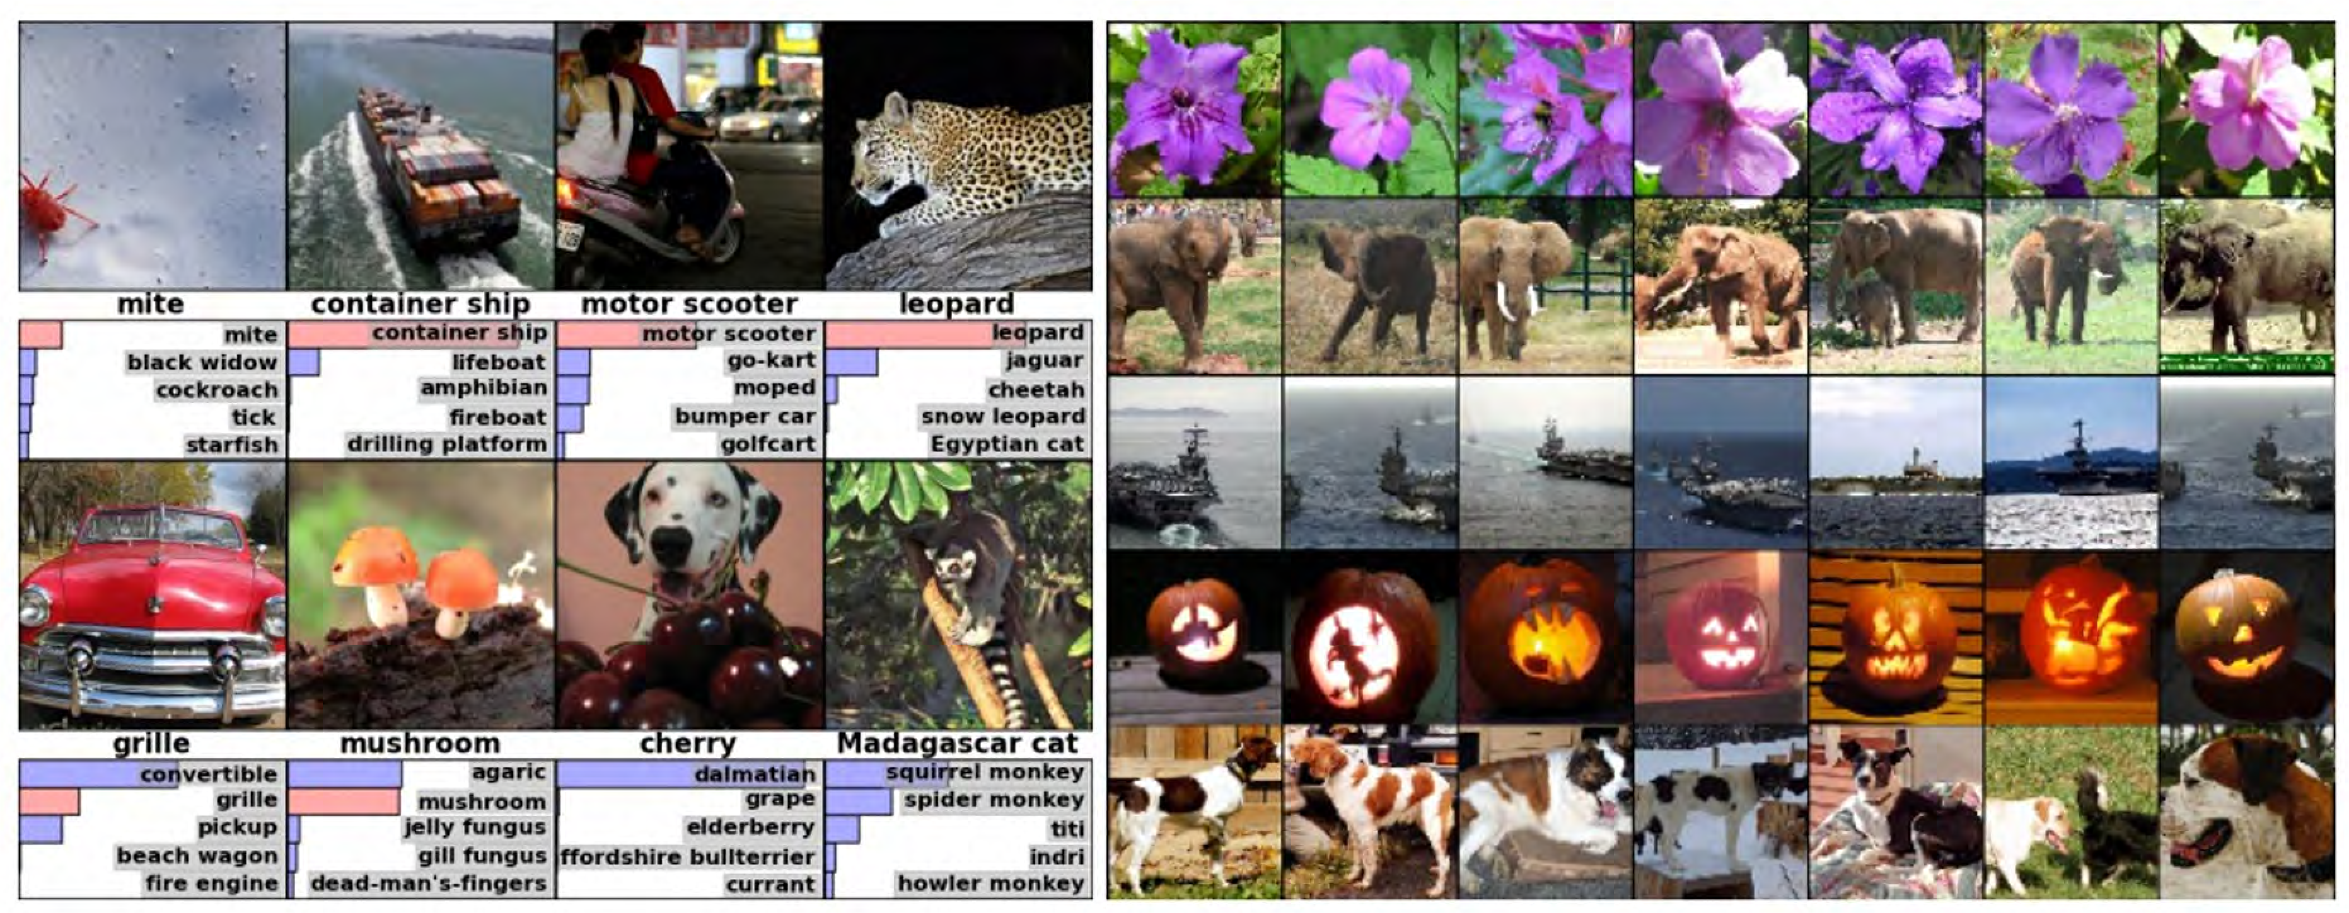
2012 to Present: Deep Learning is Everywhere
Image Classification Image Retrieval
Figures copyright Alex Krizhevsky, Ilya Sutskever, and Geoffrey Hinton, 2012. Reproduced with permission.

Slide 22
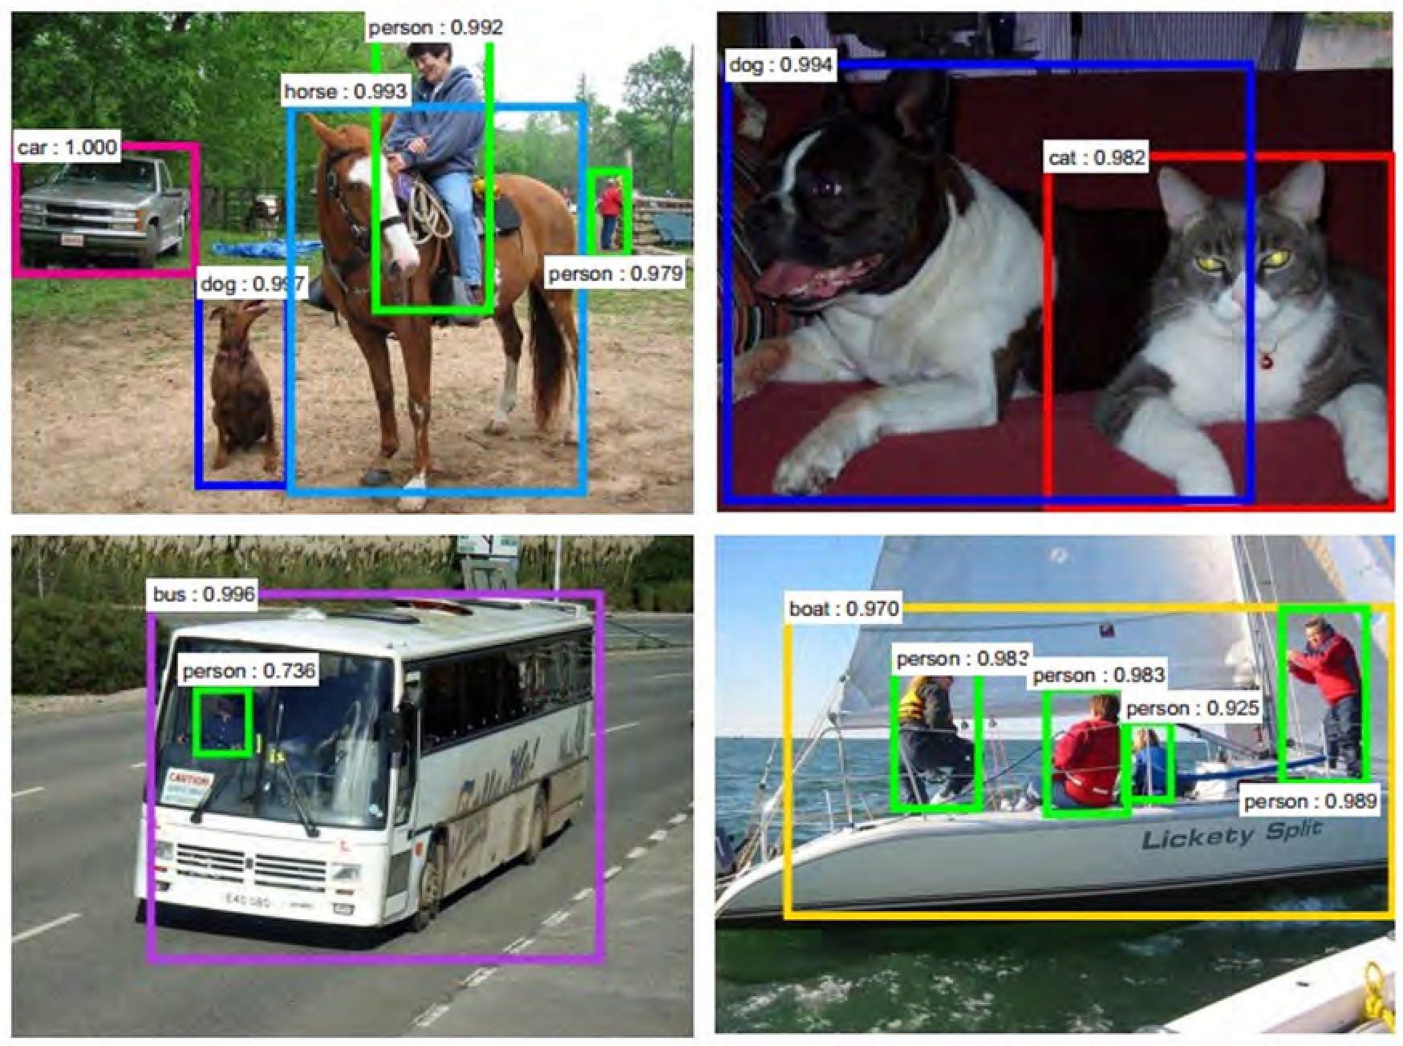
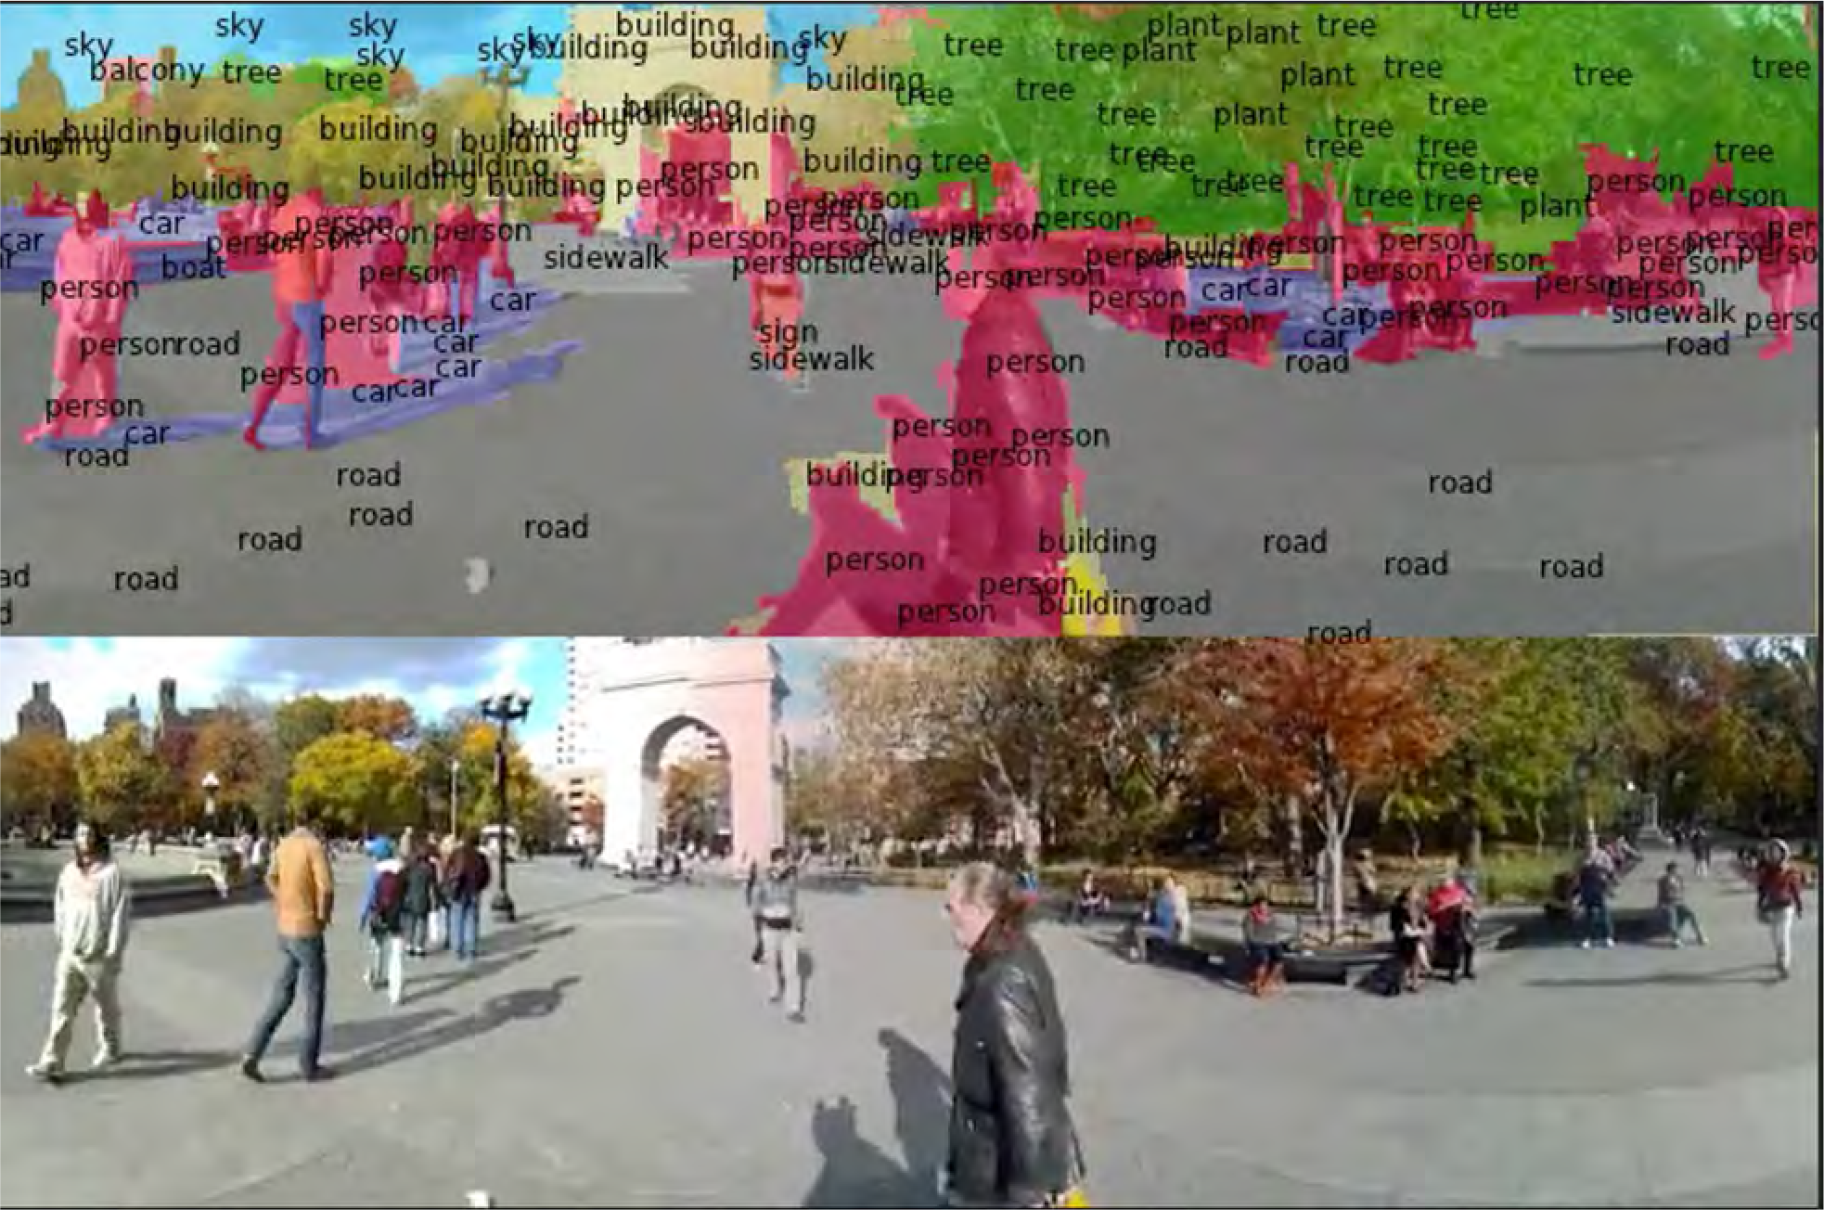
2012 to Present: Deep Learning is Everywhere
Object Detection Image Segmentation
Ren, He, Girshick, and Sun, 2015
Fabaret et al, 2012

Slide 23
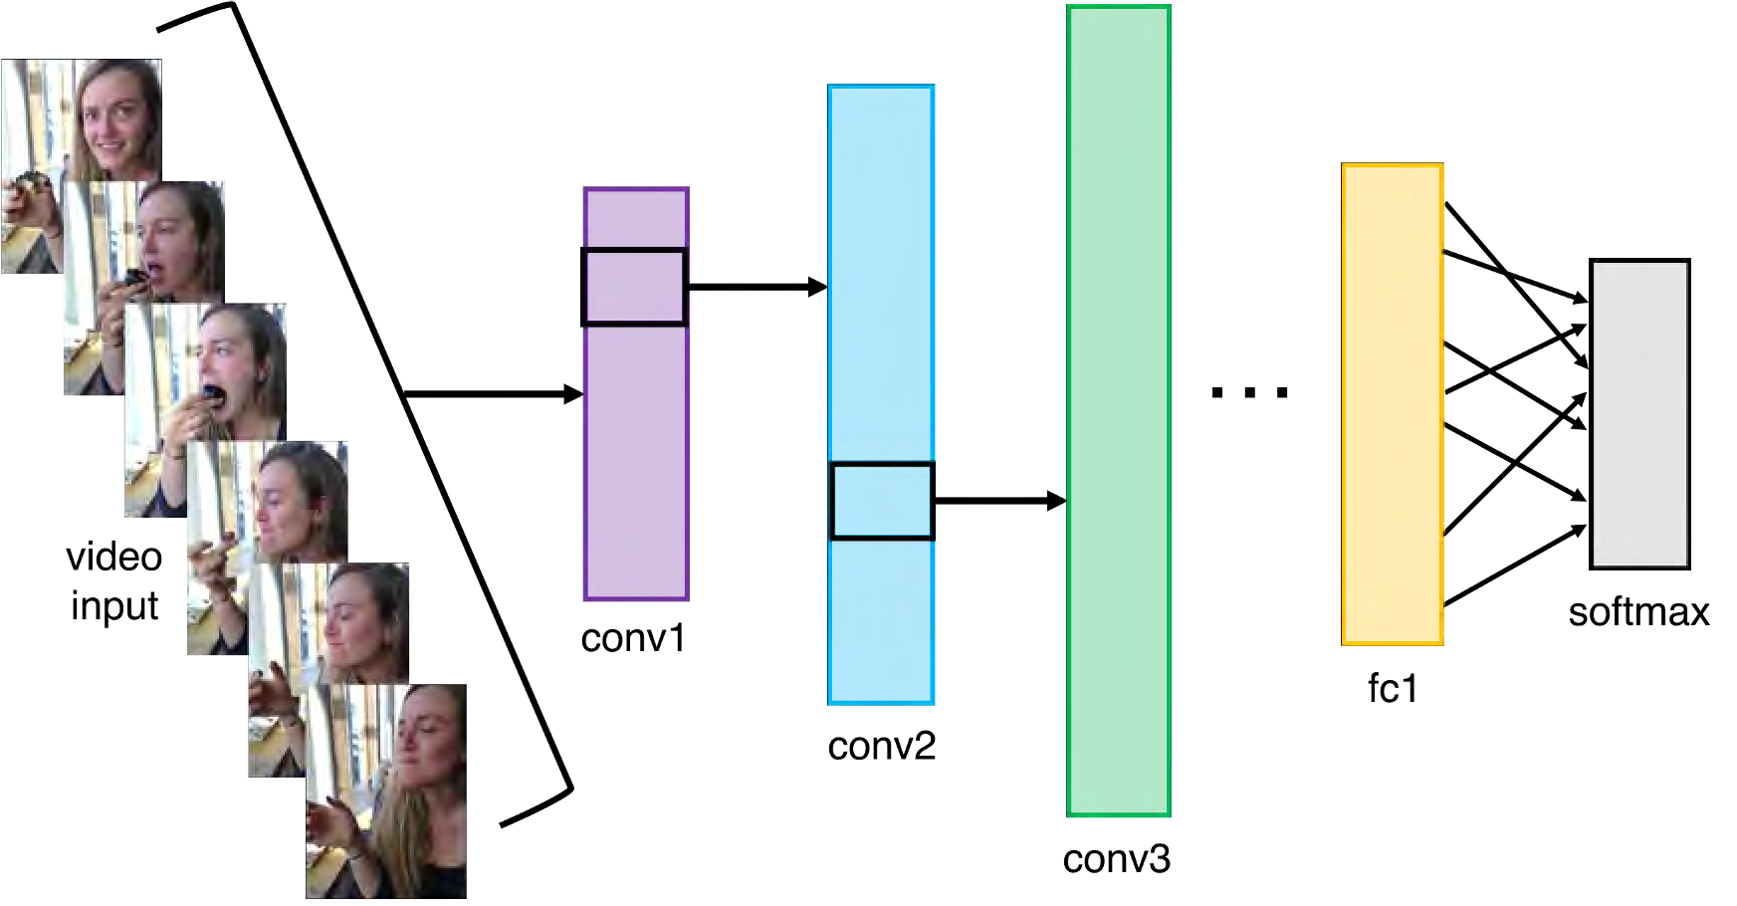
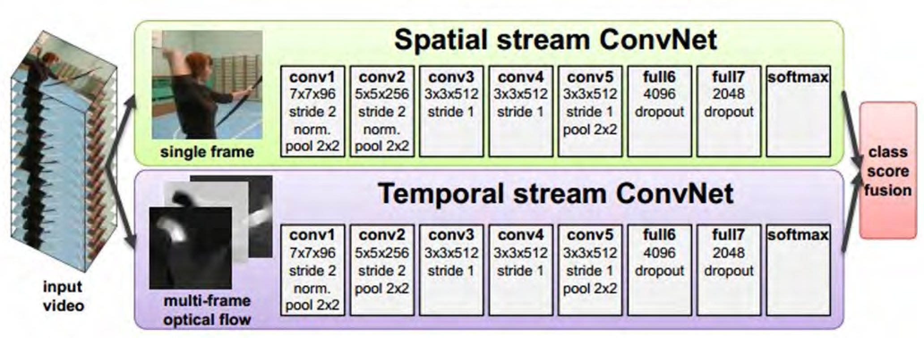
2012 to Present: Deep Learning is Everywhere
Video Classification
Activity Recognition
Simonyan et al, 2014

Slide 24
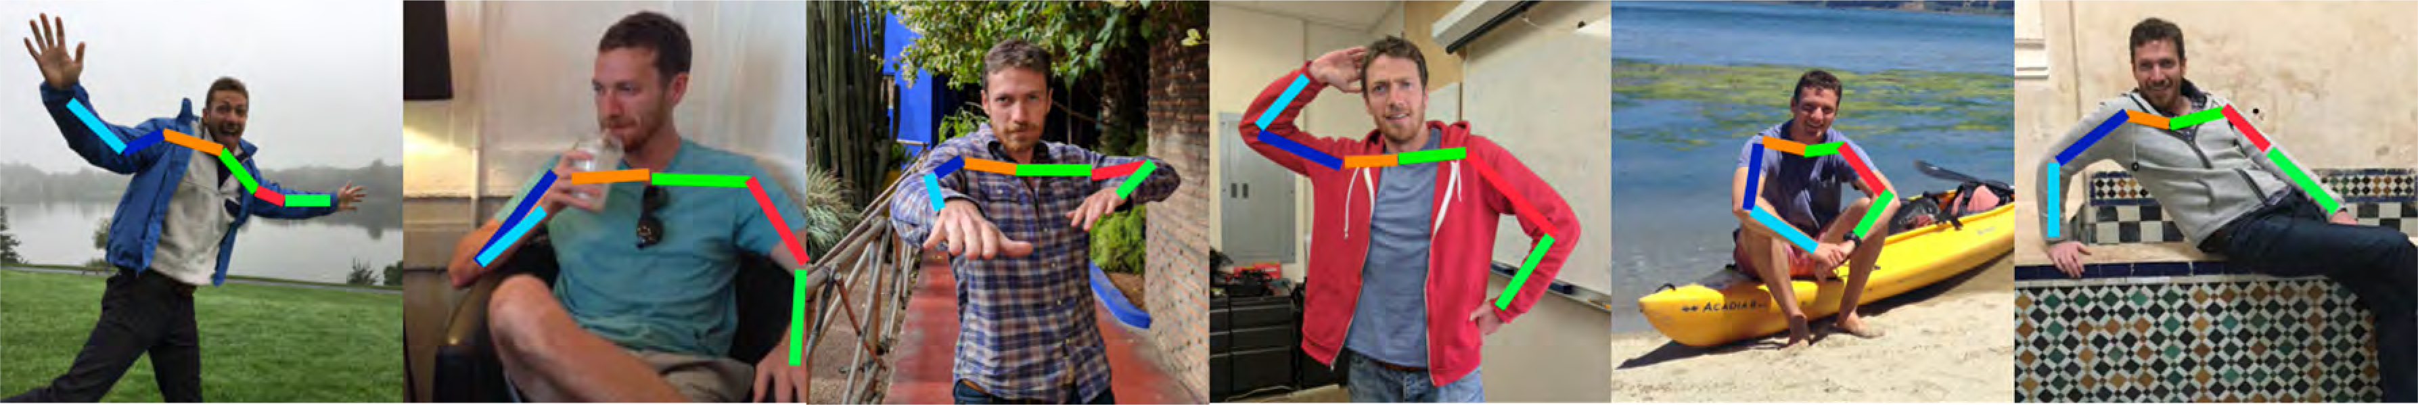
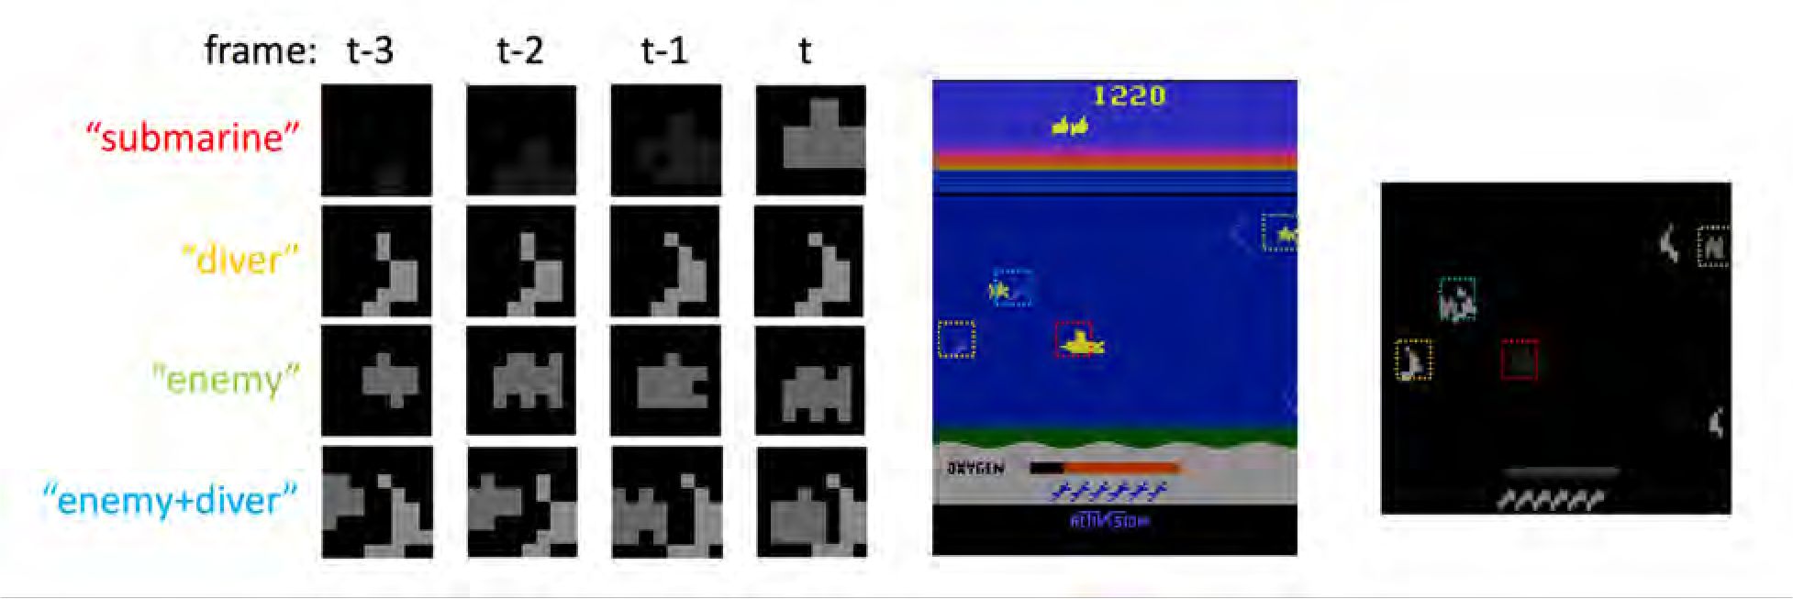
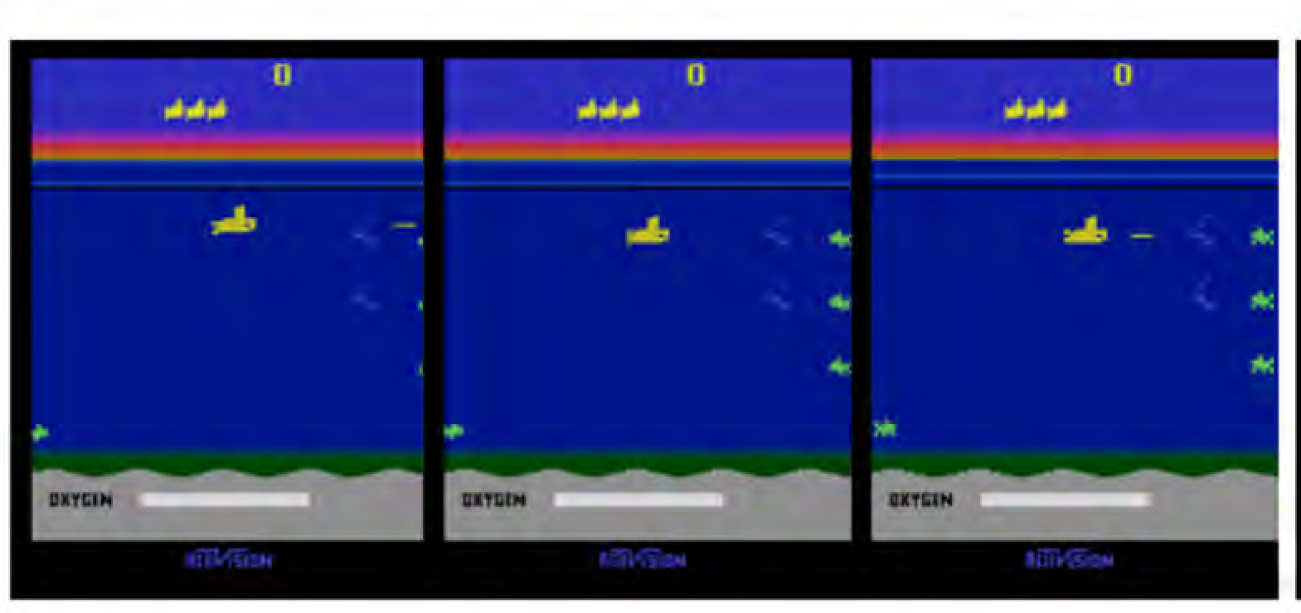
2012 to Present: Deep Learning is Everywhere
Pose Recognition (Toshev and Szegedy, 2014)
Playing Atari games (Guo et al, 2014)

Slide 25
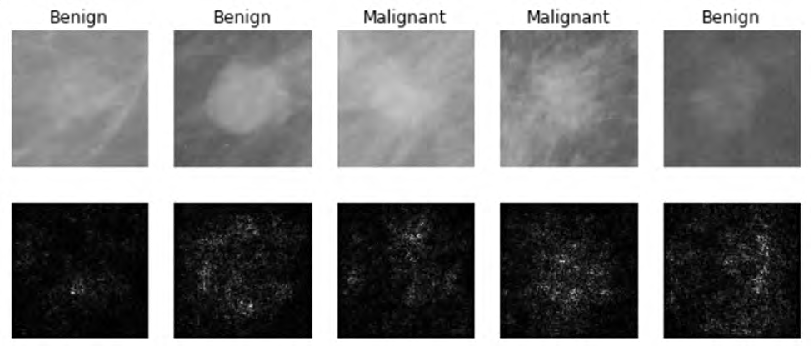
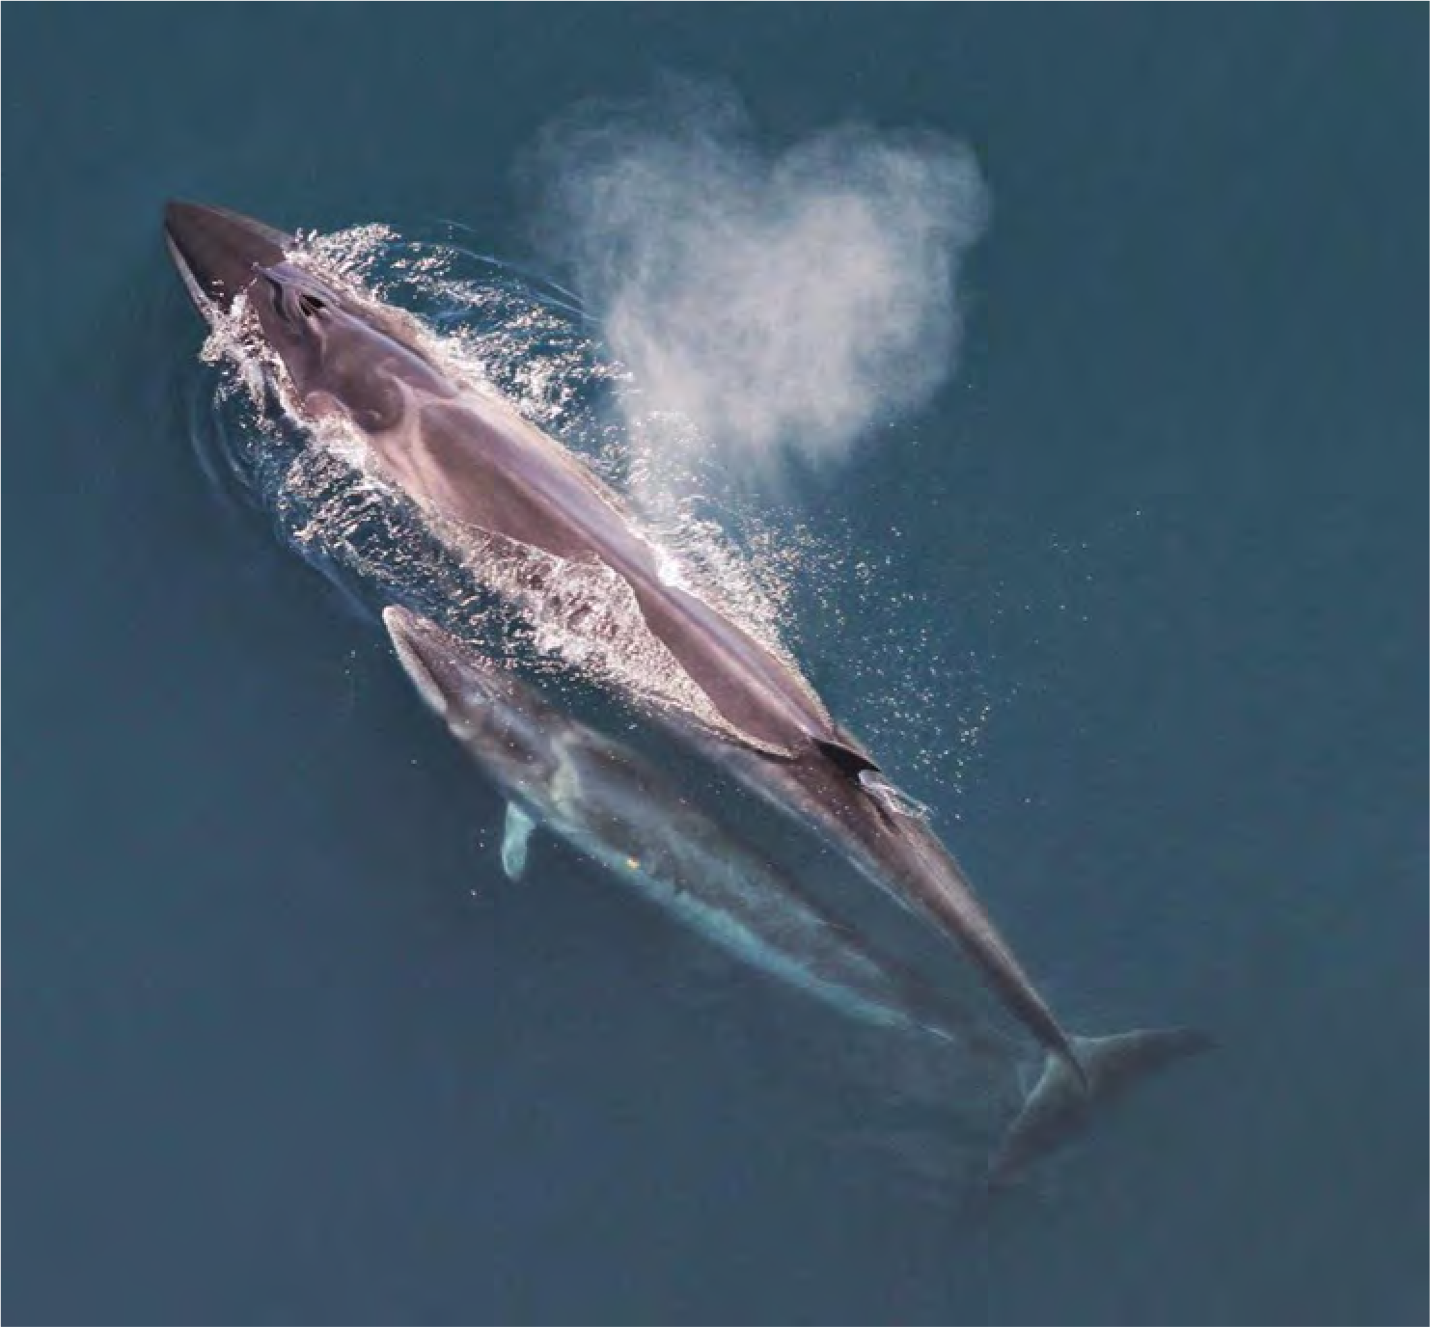
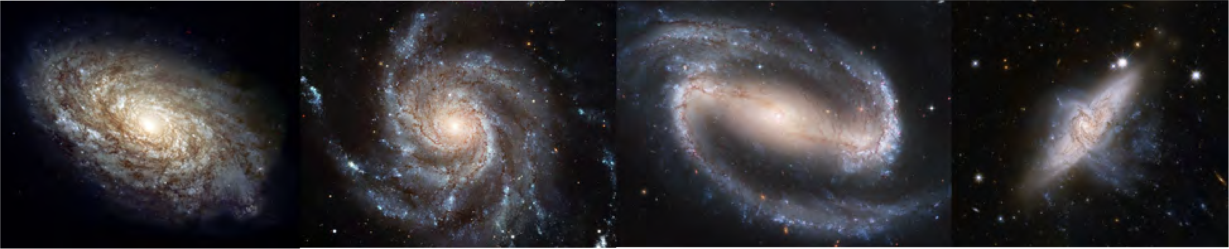
2012 to Present: Deep Learning is Everywhere
Medical Imaging
Whale recognition
Levy et al, 2016 Figure reproduced with permission
Galaxy Classification
Dieleman et al, 2014
From left to right: public domain by NASA, usage permitted by ESA/Hubble, public domain by NASA, and public domain.
Kaggle Challenge
This image by Christin Khan is in the public domain and originally came from the U.S. NOAA.

Slide 26
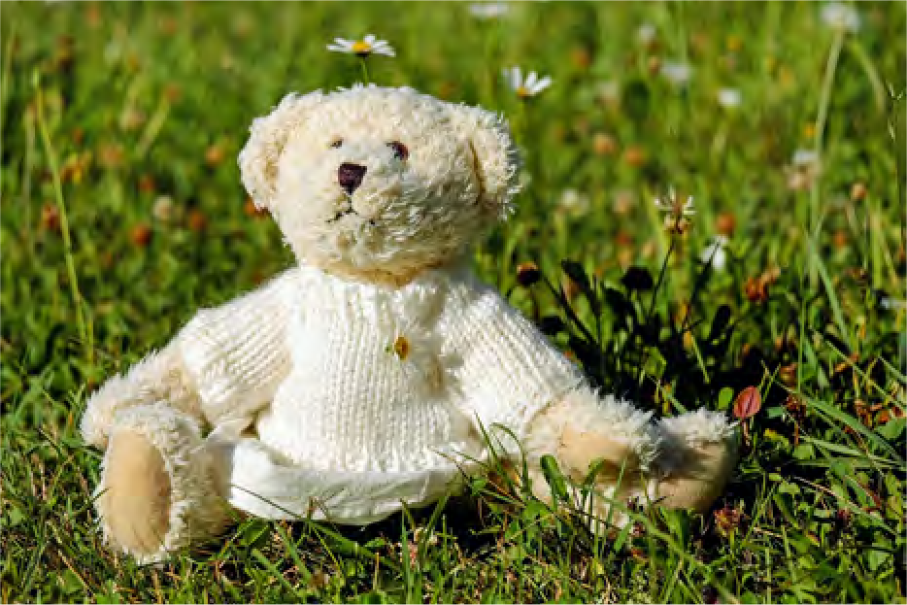
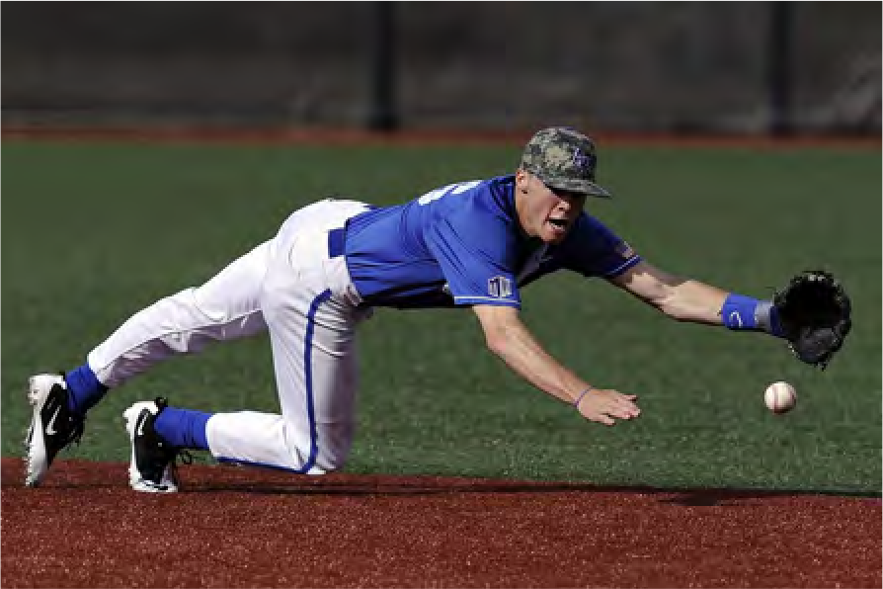
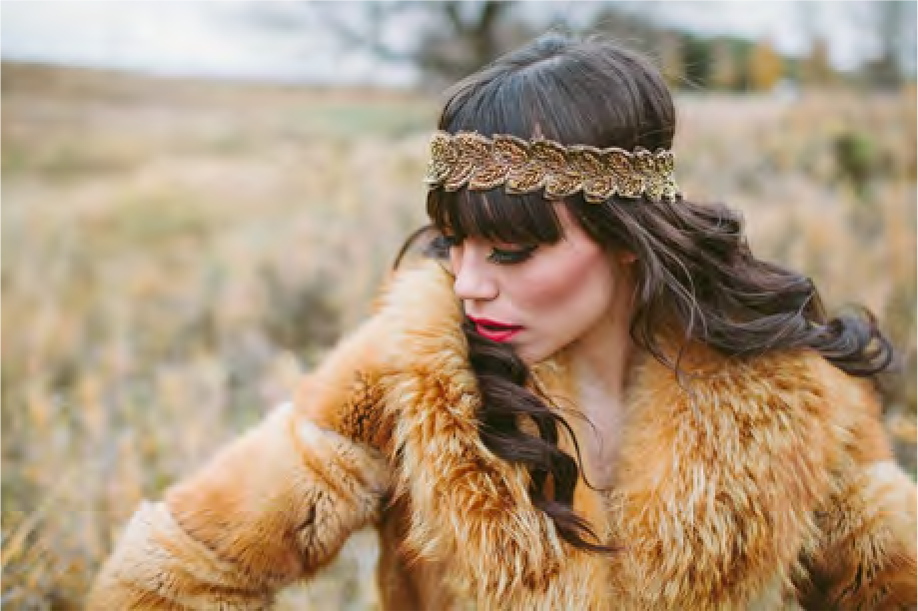
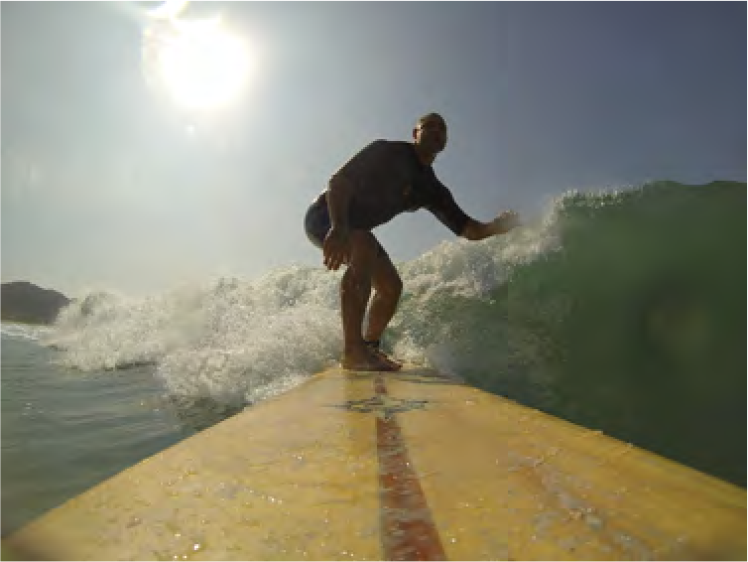


2012 to Present: Deep Learning is Everywhere
Image Captioning
Vinyals et al, 2015 Karpathy and Fei-Fei, 2015
A white teddy bear sitting in the grass
A man in a baseball uniform throwing a ball
A woman is holding a cat in her hand
All images are CC0 Public domain: https://pixabay.com/en/luggage-antique-cat-1643010/
https://pixabay.com/en/teddy-plush-bears-cute-teddy-bear-1623436/ https://pixabay.com/en/surf-wave-summer-sport-litoral-1668716/ https://pixabay.com/en/woman-female-model-portrait-adult-983967/
A man riding a wave on top of a surfboard
A cat sitting on a suitcase on the floor
A woman standing on a beach holding a surfboard
https://pixabay.com/en/handstand-lake-meditation-496008/ https://pixabay.com/en/baseball-player-shortstop-infield-1045263/
Captions generated by using Neuraltalk2

Slide 27






Original image is CC0 public domain
Starry Night and Tree Roots by Van Gogh are in the public domain
Bokeh image is in the public domain
Stylized images copyright , 2017; reproduced with permission
Mordvinsev et al, 2015 Gatys et al, 2016
Figures copyright , 2015. Reproduced with permission. Generated using the Inceptionism approach from a blog post by Google Research.

Slide 28

2012 to Present: Deep Learning is Everywhere
Ramesh et al, “DALL·E: Creating Images from Text”, 2021. https://openai.com/blog/dall-e/

Slide 29

2012 to Present: Deep Learning is Everywhere
Ramesh et al, “DALL·E: Creating Images from Text”, 2021. https://openai.com/blog/dall-e/

Slide 30


Slide 31




GFLOP per Dollar
CPU GPU (FP32)
45
40
35
30
25
20
15
10
5
0
RTX 3080
RTX 3090
Deep Learning Explosion
GTX 1080 Ti
RTX 2080 Ti
GeForce
GeForce
GTX 580
(AlexNet)
8800 GTX
Jan-04
Jul-05
Jan-07
Jul-08
Jan-10
Jul-11
Jan-13
Jul-14
Jan-16
Jul-17
Jan-19
Jul-20

Slide 32

GFLOP per Dollar
CPU GPU (FP32) GPU (Tensor Core)
180
160
140
120
100
80
60
40
20
0
Recent GPUs have
“Tensor Cores”:
Special hardware
for deep learning!
Jan-04
Jul-05
Jan-07
Jul-08
Jan-10
Jul-11
Jan-13
Jul-14
Jan-16
Jul-17
Jan-19
Jul-20

Slide 33



2018 Turing Award
Yoshua Bengio
Geoffrey Hinton
Yann LeCun
1959
Hubel & Wiesel
1963
Roberts
1970s
David Marr
1979
Gen. Cylinders
1986
Canny
1997
Norm. Cuts
1999
SIFT
2001
V&J
2007
PASCAL
2009
ImageNet
AI Winter
1958
Perceptron
1969
Minsky & Papert
1980
Neocognitron
1985
Backprop
1998
LeNet
2006
Deep Learning
2012
AlexNet
2018
Turing Award

Slide 34
Despite our success, computer vision still has a long way to go…

Slide 35

This image is copyright- free United States government work
Example credit: Andrej Karpathy

Slide 36










Computer Vision Technology Can Better Our Lives
Outside border images, clockwise, starting from top left:
Image by Pop Culture Geek is licensed under CC BY 2.0; changes made Image by the US Government is in the public domain
Image by the US Government is in the public domain
Image by Glogger is licensed under CC BY-SA 3.0; changes made Image by Sylenius is licensed under CC BY 3.0; changes made Image by US Government is in the public domain
Inside four images, clockwise, starting from top left:
Image is CC0 1.0 public domain
Image by Tucania is licensed under CC BY-SA 3.0; changes made
Image by Intuitive Surgical, Inc. is licensed under CC BY-SA 3.0; changes made Image by Oyundari Zorigtbaatar is licensed under CC BY-SA 4.0

Slide 37
Next time: Image Classification

