Slide 1


Problem
About 70% of ML Projects fail
Because the data is not cleaned, structured, or prepared properly.
Source: MIT Technology Review 2023, KDnuggets 2024
-
Pandas for Machine Learning
2

Slide 2

Before Pandas
The Old Work Flow
Manual Excel Cleaning
Complex SQL Queries
Inconsistent Formats
Missing Values Fixed by Hand
ISlow and Error-Prone Process
-
Data preparation used to take 60–80% of the total project time.
Source: Kelleher & Tierney (MIT Press, 2018); IBM Big Data Report (2015)
3

Slide 3
Modern Solution:
The magic of Pandas
Why Pandas Matters:
Fast and efficient data cleaning
Powerful transformations
Easy preprocessing for Machine Learning
Works perfectly with NumPy & Scikit-Learn
-
Hint: Turning messy, inconsistent raw data into clean, structured datasets.
4

Slide 4

What is Pandas?
A high-performance Python library for:
A fast, powerful data analysis library
Built on top of NumPy
Works with structured/tabular data
Provides Series & DataFrame
Essential for data cleaning and preprocessing.
Technical Definition: Pandas is built on top of NumPy and optimized for fast, flexible, and expressive data analysis.
-
5

Slide 5

Pandas Data Structures
Series → 1D labeled array
DataFrame → 2D labeled table
Adventages:
Flexible indexing
Built for fast operations
Foundation of all Pandas features
-
Pandas for Machine Learning
6

Slide 6
Series vs DataFrame
Series (1D)
One-dimensional labeled array
Holds any data type
Index + values
DataFrame (2D)
Table-like structure with rows/columns
Built from multiple Series
Perfect for tabular data
Index
Value
Name
Age
City
0
Ali
Ali
25
Ankara
1
Ayşe
2
Mehmet
Ayşe
30
İstanbul
-
Hint: The DataFrame is the structure you will use most often in data analysis.
You can think of it as a programmable version of an Excel table.
7

Slide 7
Creating a Pandas Series
Code (Python)
import pandas as pd
s = pd.Series([10, 20, 30], index=["A", "B", "C"])
print(s)
Expected Output:
A
10
B
20
C
30 dtype: int64
-
Key Insight: That’s it! We just created a clean Pandas Series from a simple Python dictionary.
8

Slide 8
Creating a Pandas DataFrame
Code (Python)
import pandas as pd # Import the Pandas library.
data = { # Create a Python dictionary to hold our sample data.
'Name': ['Ali', 'Ayşe', 'Mehmet'], # A column named "Name" storing three string values.
'Age': [25, 30, 35], # A column named "Age" storing integer values.
'City': ['Ankara', 'İstanbul', 'İzmir’] # A column named "City" storing city names.
}
df = pd.DataFrame(data) # Convert the dictionary into a Pandas DataFrame.
print(df) # Display the resulting DataFrame in a tabular format.
Expected Output:
Name
Age
City
0
Ali
25
Ankara
1
Ayşe
30
İstanbul
2
Mehmet
35
İzmir
-
Key Insight: That’s it! We just created a clean, professional data table from a simple Python dictionary.
9

Slide 9
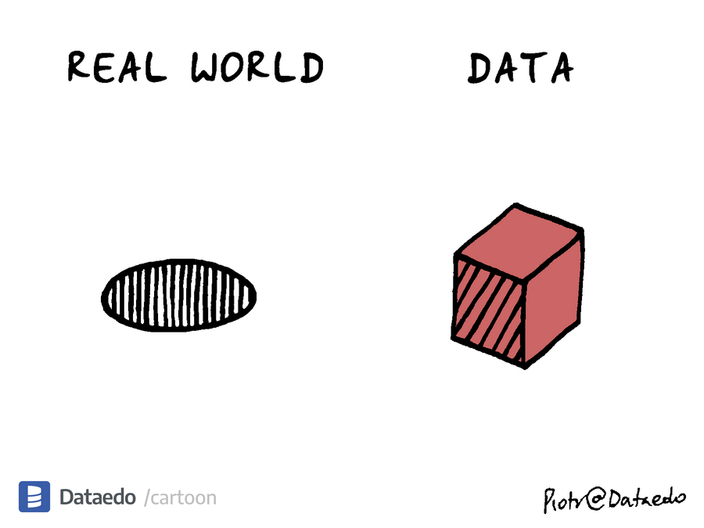
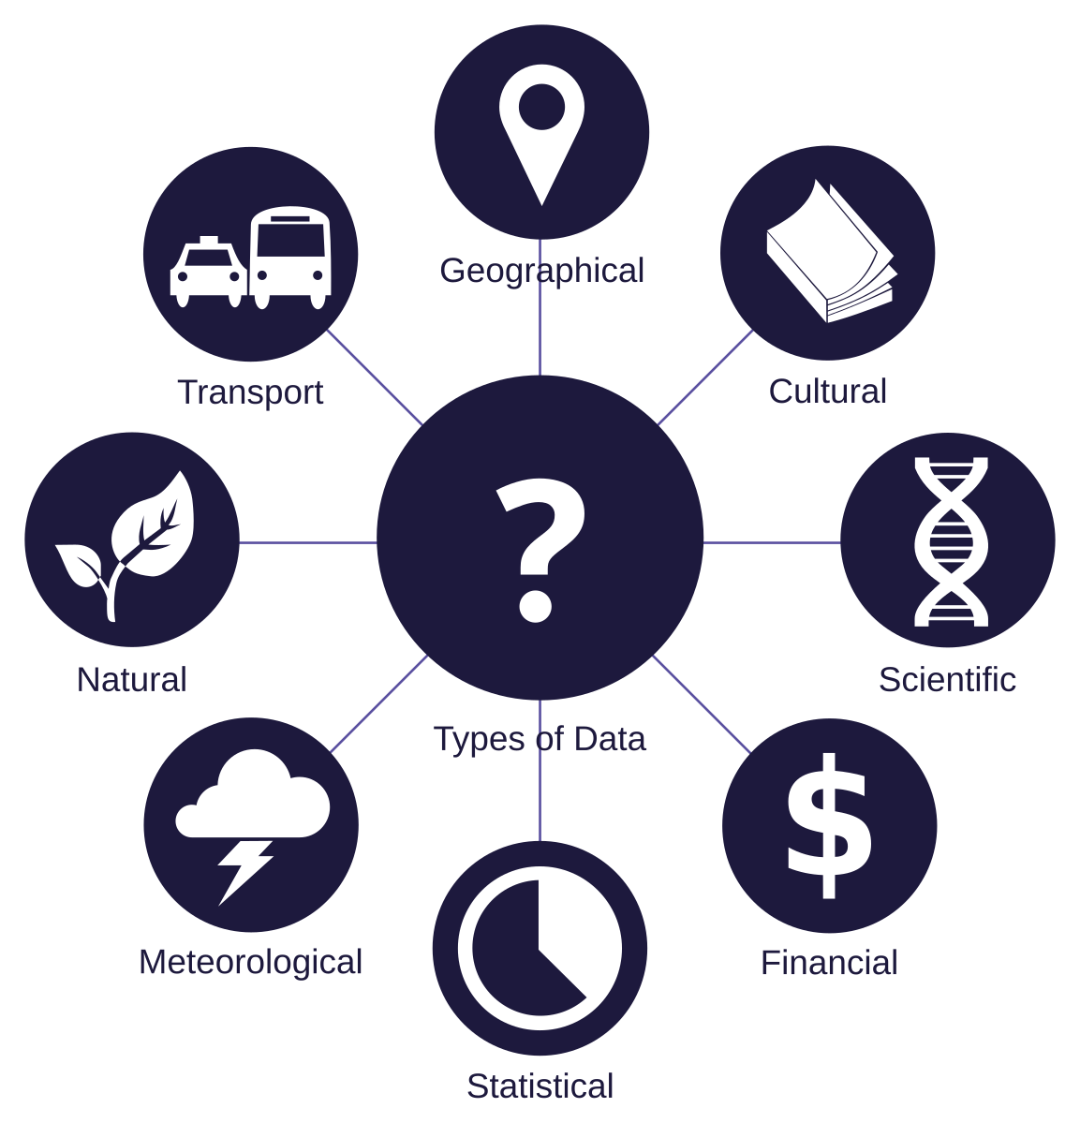
Understanding Data
in the Real World
Real-world data is rarely clean or structured:
Comes from different sources (CSV, Excel, JSON, SQL, APIs)
Has missing or inconsistent values
Contains noise, errors, or mixed types
Needs cleaning before any ML/analysis
-
Key Insight: Data is always a simplified, imperfect representation of the real world.
10

Slide 10
Working with Real-World Data
Supports 30+ File Formats
Pandas can read data from CSV, Excel, SQL, and many other formats.
This flexibility allows you to easily integrate data coming from different sources.
Examples of Data Reading:
df = pd.read_csv(‘file.csv’)
df = pd.read_excel(‘data.xlsx’)
df = pd.read_sql( 'SELECT * FROM customers', connection)
-
Key Insight: With Pandas, you can load data from dozens of formats using just one or two lines of code.
11

Slide 11




Exploring Your Data at a Glance
info()
head()
value_counts()
Shows data types, column counts, and mem. usage
Displays the first 5 rows of the dataset
Counts unique values in a categorical column
print(df.info())
print(df.head())
print(df.value_counts())
describe()
shape()
columns()
Provides statis[tical summary of numeric columns.
Shows number of rows and columns
Lists all column names
print(df.describe())
print(df.shape())
print(df.columns())
-
Key Insight: Before cleaning or modeling, gaining a quick overview of your dataset is essential. These functions give you an instant snapshot of structure, content, and statistical profile.
12

Slide 12
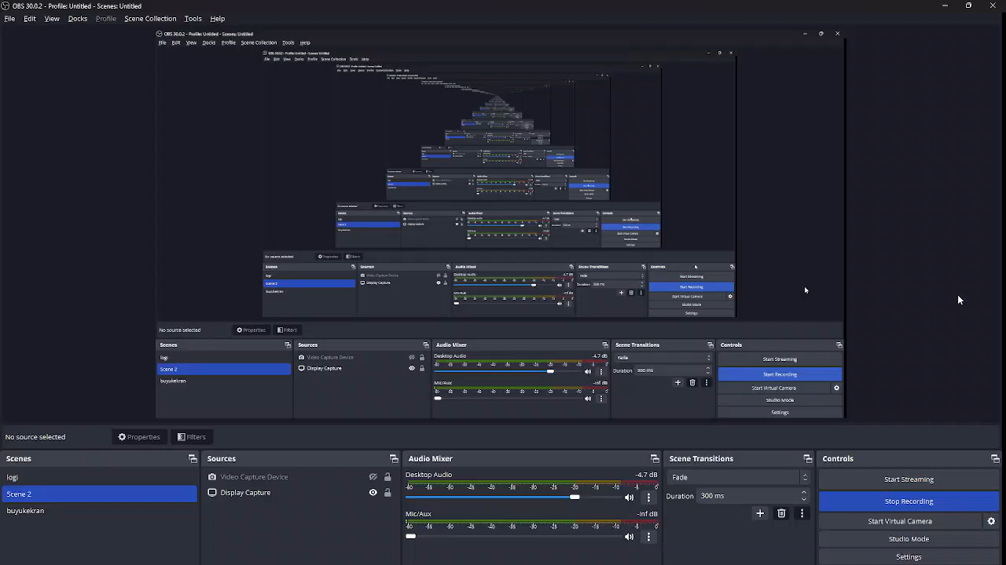

Slide 13

Data Selection: loc & iloc
loc → label-based selection
Uses row/column labels
Example: df.loc['row1', 'col1']
iloc → index-based selection
Uses integer positions
Example: df.iloc[0, 1]
Why Important?
Clean, intuitive row/column selection
Foundation for filtering & slicing
-
Pandas for Machine Learning
15

Slide 14
Quick Example for column
Code (Python)
import pandas as pd # Import the Pandas library.
data = { # Create a Python dictionary to hold our sample data.
'Name': ['Ali', 'Ayşe', 'Mehmet'], # A column named "Name" storing three string values.
'Age': [25, 30, 35], # A column named "Age" storing integer values.
'City': ['Ankara', 'İstanbul', 'İzmir’] # A column named "City" storing city names.
}
df = pd.DataFrame(data) # Convert the dictionary into a Pandas DataFrame.
print(df['City']) # Display the result.
Expected Output:
İndex
City
0
Ankara
1
İstanbul
2
İzmir
-
Key Insight: Using labels instead of numbers makes loc one of the safest and most readable ways to access data.
21

Slide 15
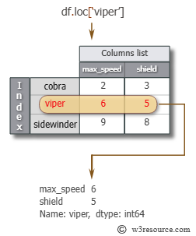
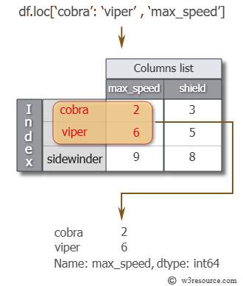
Data Selection: loc
loc → label-based selection
Uses row/column labels
Example: df.loc['row1', 'col1']
-
Pandas for Machine Learning
16

Slide 16
Quick Example 1 in Loc
Code (Python)
import pandas as pd # Import the Pandas library.
data = { # Create a Python dictionary to hold our sample data.
'Name': ['Ali', 'Ayşe', 'Mehmet'], # A column named "Name" storing three string values.
'Age': [25, 30, 35], # A column named "Age" storing integer values.
'City': ['Ankara', 'İstanbul', 'İzmir’] # A column named "City" storing city names.
}
df = pd.DataFrame(data) # Convert the dictionary into a Pandas DataFrame.
print(df.loc[1]) # Display the result.
Expected Output:
Name
Ayşe
Age
30
City
İstanbul
Name: 1, dtype: object
-
Key Insight: Using labels instead of numbers makes loc one of the safest and most readable ways to access data.
17

Slide 17
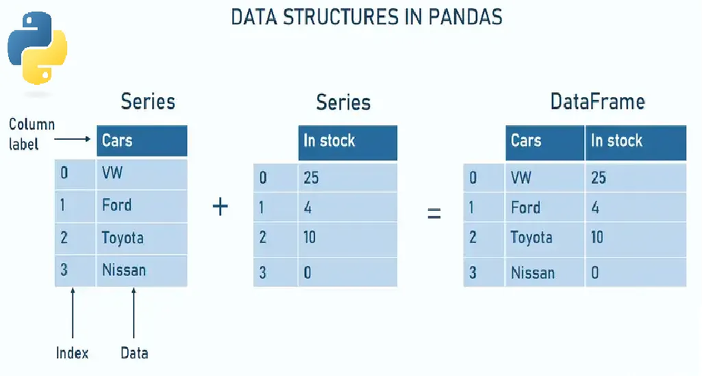
Filtering & Conditional Selection
Series → 1D labeled array
DataFrame → 2D labeled table
Adventages:
Flexible indexing
Built for fast operations
Foundation of all Pandas features
-
Pandas for Machine Learning
22

Slide 18
Quick Example 2 in Loc
Code (Python)
import pandas as pd # Import the Pandas library.
data = { # Create a Python dictionary to hold our sample data.
'Name': ['Ali', 'Ayşe', 'Mehmet'], # A column named "Name" storing three string values.
'Age': [25, 30, 35], # A column named "Age" storing integer values.
'City': ['Ankara', 'İstanbul', 'İzmir’] # A column named "City" storing city names.
}
df = pd.DataFrame(data) # Convert the dictionary into a Pandas DataFrame.
print(df.loc[0, 'City’]) # Display the result.
Expected Output:
Ankara
-
Key Insight: Before cleaning or modeling, gaining a quick overview of your dataset is essential. These functions give you an instant snapshot of structure, content, and statistical profile.
18

Slide 19
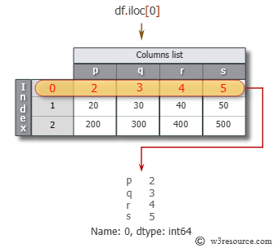
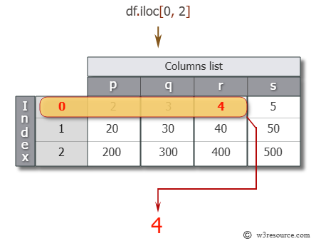
Data Selection: iloc
iloc → index-based selection
Uses integer positions
Example: df.iloc[0, 1]
-
Pandas for Machine Learning
19

Slide 20
Quick Example 1 in iloc
Code (Python)
import pandas as pd # Import the Pandas library.
data = { # Create a Python dictionary to hold our sample data.
'Name': ['Ali', 'Ayşe', 'Mehmet'], # A column named "Name" storing three string values.
'Age': [25, 30, 35], # A column named "Age" storing integer values.
'City': ['Ankara', 'İstanbul', 'İzmir’] # A column named "City" storing city names.
}
df = pd.DataFrame(data) # Convert the dictionary into a Pandas DataFrame.
print(df.iloc[0, 2]) # Display the result.
Expected Output:
Ankara
-
Key Insight: iloc enables powerful, position-based slicing—allowing advanced selection such as “last rows” or “last columns” using negative indices.
20

Slide 21
Quick Example 2 in iloc
Code (Python)
import pandas as pd # Import the Pandas library.
data = { # Create a Python dictionary to hold our sample data.
'Name': ['Ali', 'Ayşe', 'Mehmet'], # A column named "Name" storing three string values.
'Age': [25, 30, 35], # A column named "Age" storing integer values.
'City': ['Ankara', 'İstanbul', 'İzmir’] # A column named "City" storing city names.
}
df = pd.DataFrame(data) # Convert the dictionary into a Pandas DataFrame.
print(df.iloc[-2:, -2:]) # Display the result.
Expected Output:
Age
City
30
İstanbul
35
İzmir
-
Key Insight: Using labels instead of numbers makes loc one of the safest and most readable ways to access data.
21

Slide 22
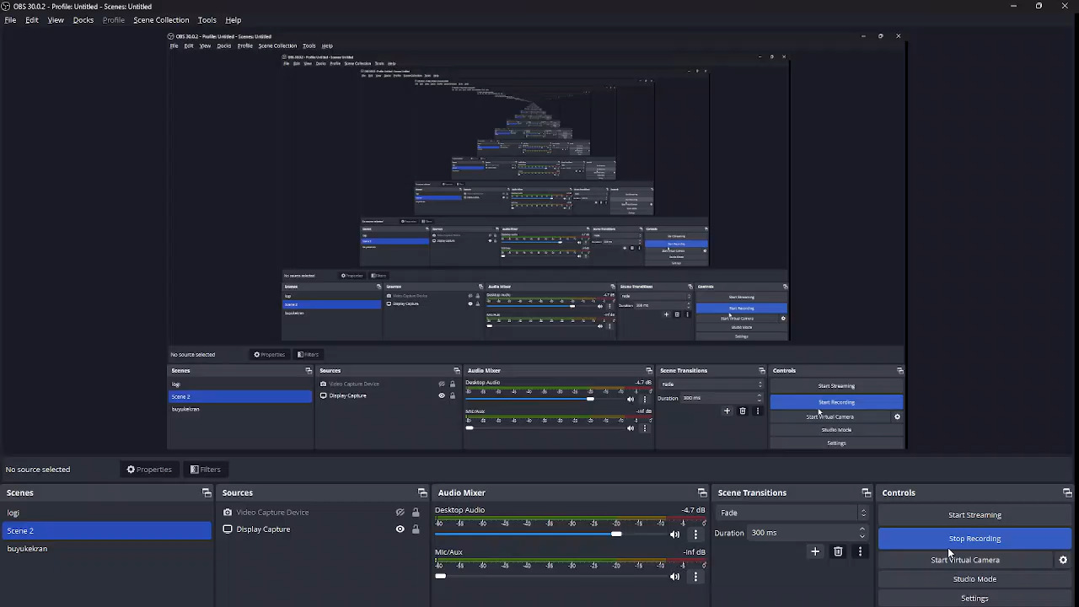

Slide 23

Cleaning Data
Reliable analysis starts with clean data. In this section, we explore the fundamental techniques for handling missing values, duplicates, and type inconsistencies in your dataset.
-
Key Insight: Clean data is the foundation of every successful machine learning pipeline — fixing missing values, duplicates, and incorrect data types prevents errors and improves model performance.
23

Slide 24
Cleaning Data
Detecting Missing Values
df.isnull().sum()
isnull() / isna()
This function quickly shows how many missing values exist in each column and helps you decide which areas should be prioritized during cleaning.
Identifies missing entries across rows and columns and gives you a complete map of gaps in your dataset.
-
Key Insight: Missing values are inevitable in real-world data — detecting them correctly is the first step toward a reliable dataset.
24

Slide 25
Cleaning Data
Removing Missing Values
df.dropna(inplace=True)
dropna()
This method is ideal when missing data could negatively affect your analysis. However, it should be used carefully to avoid losing too much information.
Removes rows or columns containing missing values and creates a cleaner, more consistent dataset.
-
Key Insight: This method is ideal when missing data could negatively affect your analysis. However, it should be used carefully to avoid losing too much information.
25

Slide 26
Cleaning Data
Filling Missing
Values
df['Age'].fillna(df['Age'].median(), inplace=True)
fillna()
Using statistical measures such as the median, mean, or mode helps fill missing values while minimizing data loss and maintaining consistent analysis.
Replaces missing values with constants or statistical measures, ensuring data completeness and stability.
-
Key Insight: Filling missing values with statistical measures maintains data integrity and prevents unnecessary row/column removal—leading to more reliable machine learning pipelines.
26

Slide 27

Data Quality:
Cleanliness and Consistency
After addressing missing values, the next step is to remove duplicates and resolve type inconsistencies in your dataset. These actions improve the accuracy and reliability of your analyses.
-
Key Insight: Clean and consistent data prevents misleading results and forms the foundation of trustworthy machine learning models.
27

Slide 28




Core Transformation Functions
apply()
map()
Runs custom logic on rows or columns. Useful for creating new features such as age groups.
Performs value mapping for 1D Series. Ideal for dictionary-based transformations.
df["AgeGroup"] = df["Age"].apply(lambda x: "Young" if x < 30 else "Adult")
df["GenderCode"] = df["Gender"].map({"Male": 1, "Female": 0})
replace()
astype()
Fixes inconsistent or incorrect values—commonly used for cleaning categorical labels.
Converts data types. Ensures numeric, text, or boolean consistency.
df["City"] = df["City"].replace({"ist": "Istanbul"})
df["Fiyat"] = df["Fiyat"].astype(float)
-
Key Insights: Transformation functions allow you to standardize, clean, and reshape your data—making it ready for reliable machine learning workflows.
28

Slide 29
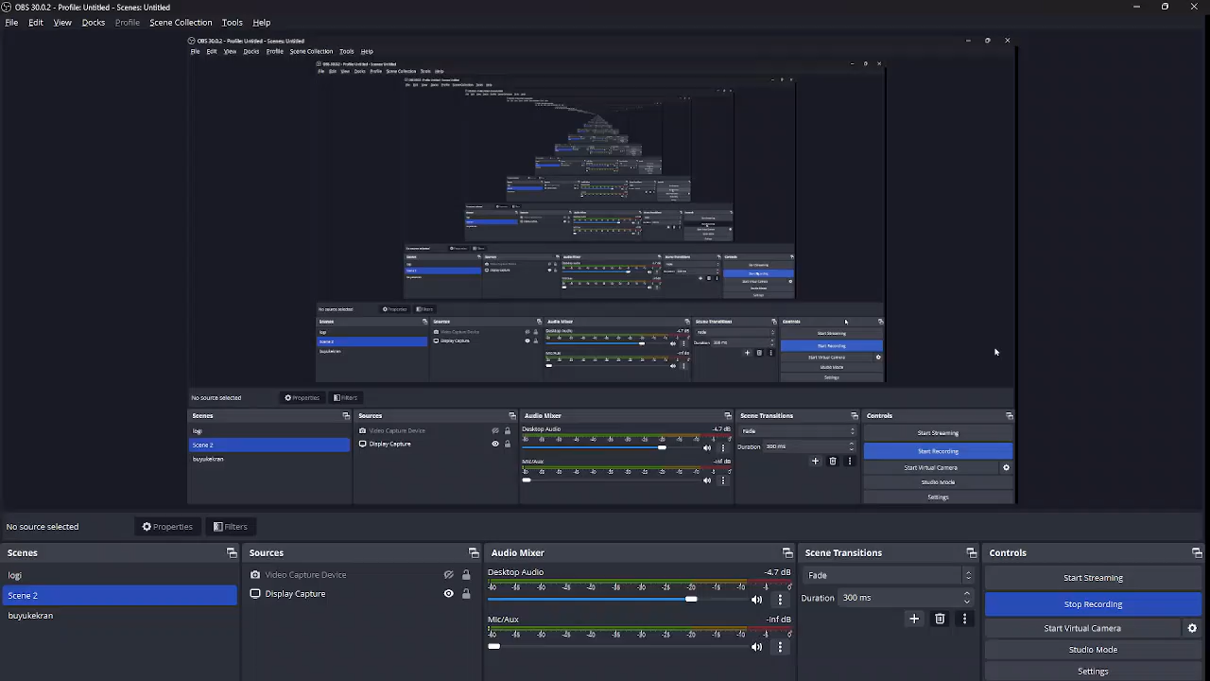

Slide 30
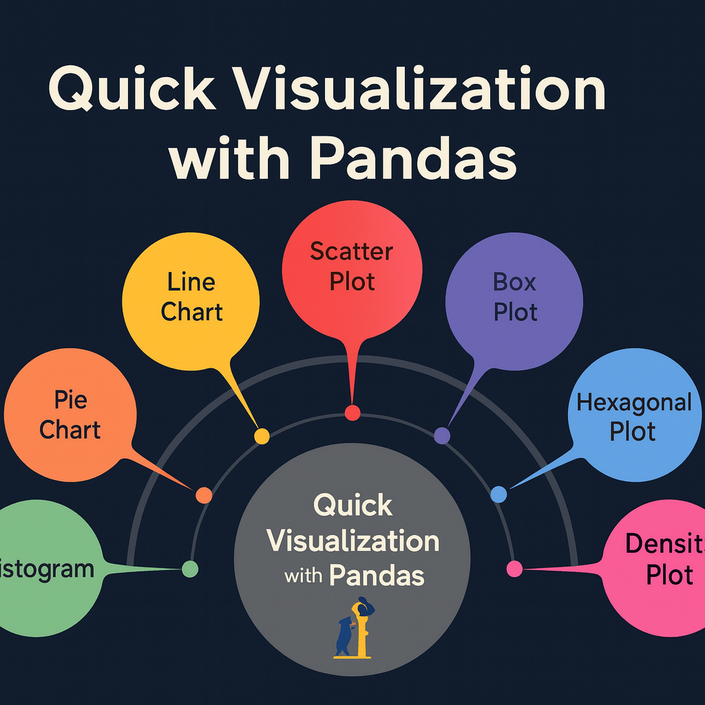
Quick Visualization with Pandas
Why It Matters:
Pandas integrates directly with Matplotlib, allowing quick visual checks.
Perfect for exploratory data analysis (EDA).
Helps spot patterns, outliers, trends in seconds.
-
Key Insight: Pandas' built-in plotting functions allow you to generate immediate visual insights without switching to full visualization libraries—ideal for fast EDA.
31

Slide 31
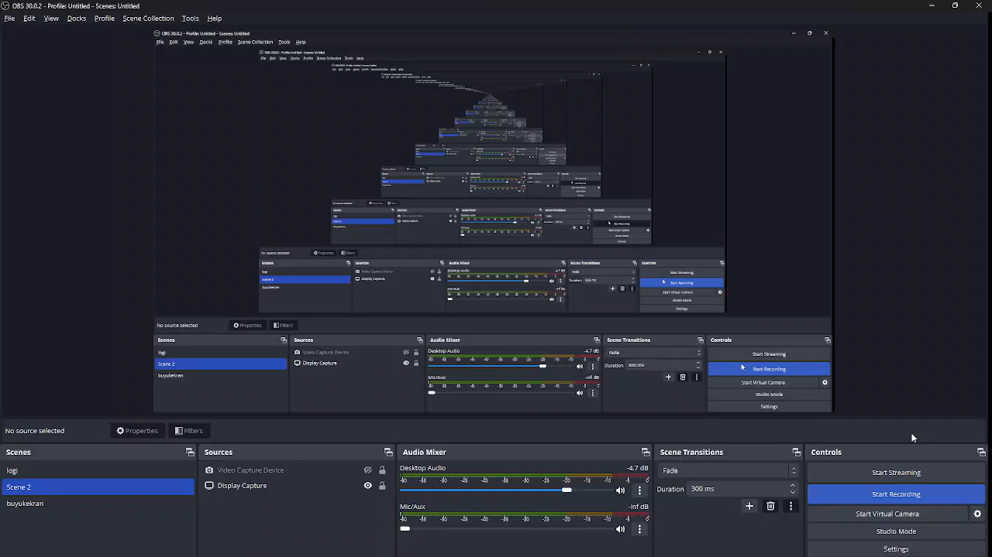

Slide 32
Exercise
two data files are used i.e. ‘titles.csv’ and ‘cast.csv’. The ‘titles.csv’ file contains the list of movies with the releasing year; whereas ‘cast.csv’ file has five columns which store the title of movie, releasing year, star-casts, type(actor/actress), characters and ratings for actors
Find the top 10 years with the highest number of films
Find the top 10 characters with the highest score

