Slide 1
Numpy creating and manipulating numerical data

Slide 2
Overview
What are NumPy and NumPy arrays?
Creating arrays
Basic data types
Basic visualization
Indexing and slicing
Copies and views
Fancy indexing

Slide 3
What are NumPy and NumPy arrays?
Python objects
high-level number objects: integers, floating point
containers: lists, dictionaries (fast lookup)
NumPy provides
extension package to Python for multi-dimensional arrays
closer to hardware (efficiency)
designed for scientific computation (convenience)

Slide 4
Why do we need NumPy
Why it is useful: Memory-efficient container that provides fast numerical operations
Python does numerical computations slowly.
1000 x 1000 matrix multiply
Python triple loop takes > 10 min.
Numpy takes ~0.03 seconds

Slide 5
Arrays
Structured lists of numbers.
Vectors
Matrices
Images
Tensors
ConvNets

Slide 6
Arrays
Structured lists of numbers.
Vectors
Matrices
Images
Tensors
ConvNets
$$\left[\begin{matrix}p_{x} \\ p_{y} \\ p_{z}\end{matrix}\right]$$
$$\left[\begin{matrix}a_{11} & ⋯ & a_{1n} \\ ⋮ & ⋱ & ⋮ \\ a_{m1} & ⋯ & a_{mn}\end{matrix}\right]$$

Slide 7
Arrays
Structured lists of numbers.
Vectors
Matrices
Images
Tensors
ConvNets

Slide 8
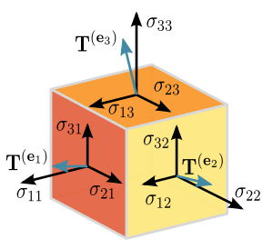
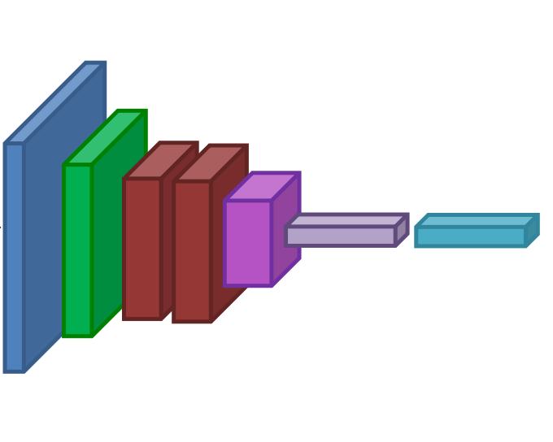
Arrays
Structured lists of numbers.
Vectors
Matrices
Images
Tensors
ConvNets

Slide 9
Arrays, Basic Properties
import numpy as np
a = np.array([[1,2,3],[4,5,6]],dtype=np.float32)
print a.ndim, a.shape, a.dtype
Arrays can have any number of dimensions, including zero (a scalar).
Arrays are typed: np.uint8, np.int64, np.float32, np.float64
Arrays are dense. Each element of the array exists and has the same type.

Slide 10
Creating arrays
Manual construction of arrays
1-D
2-D
>>> import numpy as np
>>> a = np.array([0, 1, 2, 3])
>>> a
array([0, 1, 2, 3])
>>> a.ndim
1
>>> a.shape
(4,)
>>> len(a)
4
>>> b = np.array([[0, 1, 2], [3, 4, 5]]) # 2 x 3 array
>>> b
array([[0, 1, 2],
[3, 4, 5]])
>>> b.ndim
2
>>> b.shape
(2, 3)
>>> len(b) # returns the size of the first dimension
2
>>> c = np.array( [ [ [ 1 ], [ 2 ] ], [ [ 3 ], [ 4 ] ] ] )
>>> c
array([[[1],
[2]],
[[3],
[4]]])
>>> c.shape
(2, 2, 1)

Slide 11
Functions for creating arrays
Tip: In practice, we rarely enter items one by one. . .
Evenly spaced:
or by number of points:
>>> a = np.arange(10) # 0 .. n-1 (!)
>>> a
array([0, 1, 2, 3, 4, 5, 6, 7, 8, 9])
>>> b = np.arange(1, 9, 2) # start, end (exclusive), step
>>> b
array([1, 3, 5, 7])
>>> c = np.linspace(0, 1, 6) # start, end, num-points
>>> c
array([0. , 0.2, 0.4, 0.6, 0.8, 1. ])
>>> d = np.linspace(0, 1, 5, endpoint=False)
>>> d
array([0. , 0.2, 0.4, 0.6, 0.8])

Slide 12
Common arrays:
np.random: random numbers
>>> a = np.random.rand(4) # uniform in [0, 1]
>>> a
array([ 0.95799151, 0.14222247, 0.08777354, 0.51887998])
>>> b = np.random.randn(4) # Gaussian
>>> b
array([ 0.37544699, -0.11425369, -0.47616538, 1.79664113])
>>> np.random.seed(1234) # Setting the random seed

Slide 13
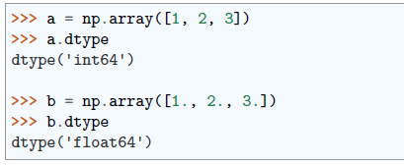
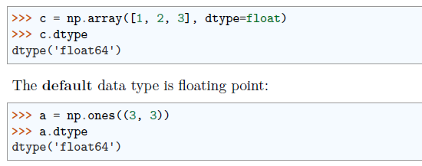
Basic data types
You may have noticed that, in some instances, array elements are displayed with a trailing dot (e.g. 2. vs 2). This is due to a difference in the data-type used:
NumPy auto-detects the data-type from the input.
But, you can explicitly specify which data-type you want:

Slide 14
There are also other types:
Bool
Strings
Much more
int32, int64, uint32, uint64

Slide 15
Indexing and slicing
The items of an array can be accessed and assigned to the same way as other Python sequences (e.g. lists):
Slicing: Arrays, like other Python sequences can also be sliced:
Note that the last index is not included! :

Slide 17
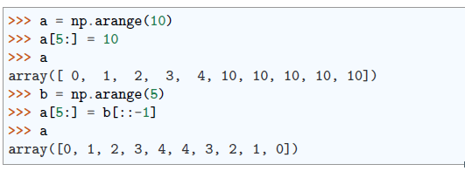
You can also combine assignment and slicing:

Slide 18
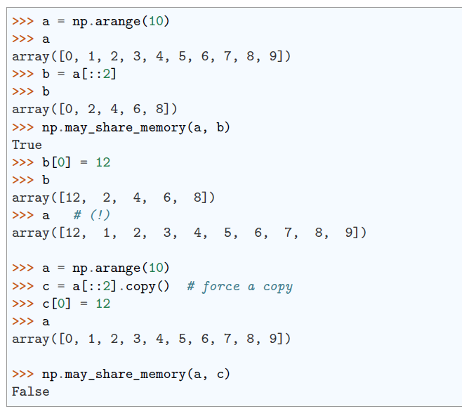
Copies and views
A slicing operation creates a view on the original array, which is just a way of accessing array data. When modifying the view, the original array is modified as well:

Slide 19
Fancy indexing
NumPy arrays can be indexed with slices, but also with boolean or integer arrays (masks).
It creates copies not views.
Using boolean masks

Slide 20
Indexing with a mask can be very useful to assign a new value to a sub-array:
Indexing with an array of integers
Indexing can be done with an array of integers, where the same index is repeated several time:
New values can be assigned with this kind of indexing:

Slide 21
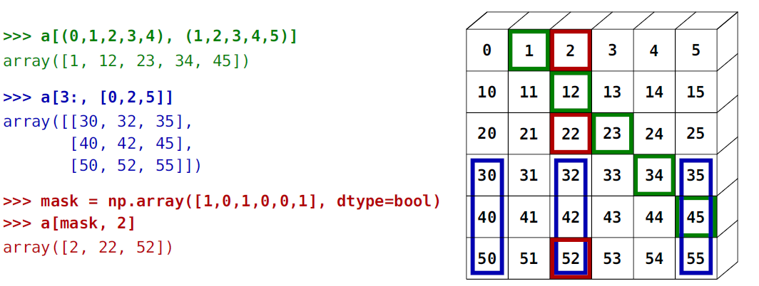
The image below illustrates various fancy indexing applications

Slide 22
Numerical operations on arrays
Elementwise operations
Basic reductions
Broadcasting
Array shape manipulation
Sorting data

Slide 23
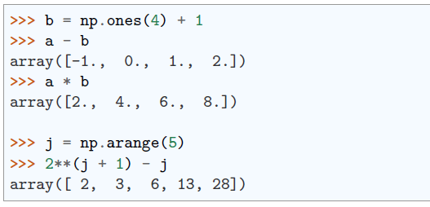
Elementwise operations
With scalars:
All arithmetic operates elementwise:

Slide 24
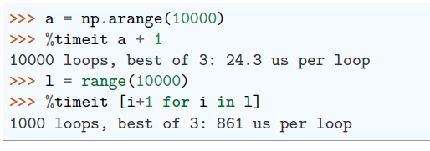
These operations are of course much faster than if you did them in pure python:

Slide 25
Warning: Array multiplication is not matrix multiplication:
Note: Matrix multiplication:

Slide 26
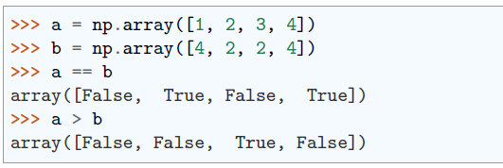
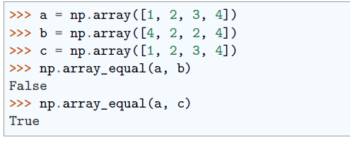
Other operations
Comparisons:
Array-wise comparisons:

Slide 27
Logical operations:
Transcendental functions:

Slide 28
Shape mismatches

Slide 29
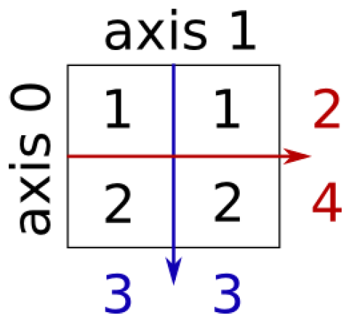
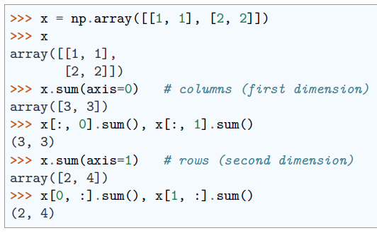
Basic reductions
Computing sums
Sum by rows and by columns:

Slide 30
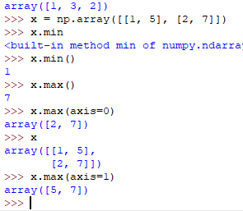
Other reductions
works the same way (and take axis=)

Slide 31
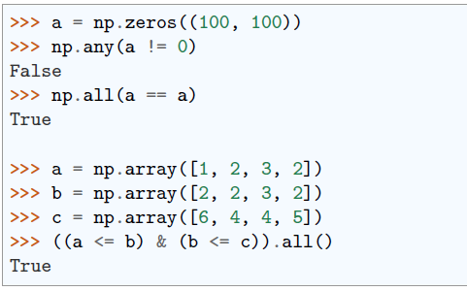
Logical operations:
Note: Can be used for array comparisons:

Slide 32
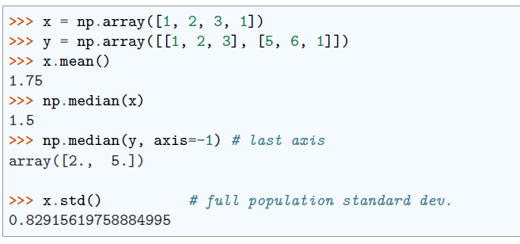
Statistics:

Slide 33
Coding
Prepare a dataset containing the movies watched by movie viewers and their durations over one month. Perform the following operations on the dataset using the NumPy library.
Step 1: Create the Data Set
# Sample movie viewer statistics
movie_names = np.array(["Movie1", "Movie2", "Movie3", "Movie4", "Movie5"])
watch_durations = np.array([120, 90, 150, 75, 180])
Step 2: Perform Basic Statistical Calculations
Calculate the total watch duration.
Calculate the average watch duration.
Find the longest and shortest watched movies.
Step 3: Array Manipulations
Convert movie watch durations to hours.
Filter movies with durations below a certain threshold (e.g., below 2 hours).
Step 4: Print Results
Print the results, Movie Names & watch_durations_hours

Slide 34
Broadcasting
Basic operations on numpy arrays (addition, etc.) are elementwise
This works on arrays of the same size.
Nevertheless, It’s also possible to do operations on arrays of different sizes if NumPy can transform these arrays so that they all have the same size: this conversion is called broadcasting. Example:

Slide 35
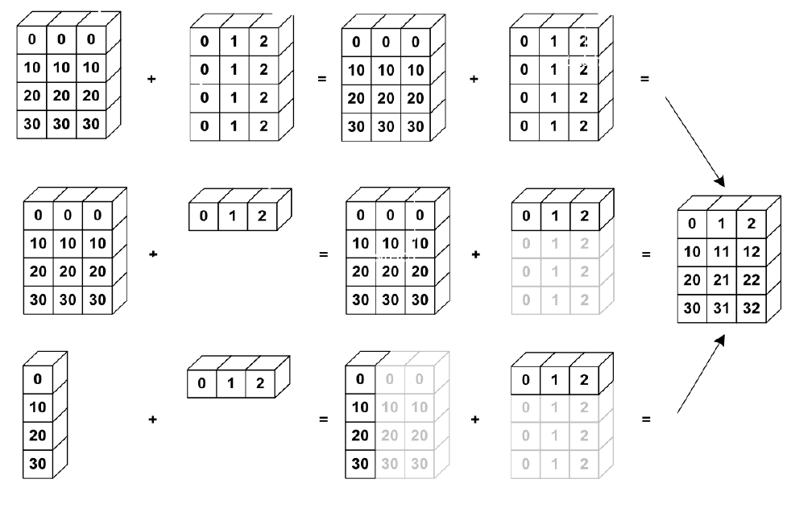
Broadcasting Example:

Slide 36
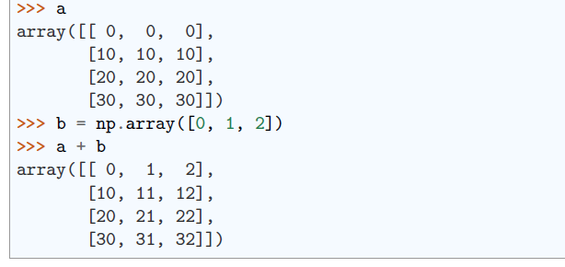
Let’s verify:
We have already used broadcasting without knowing it!:

Slide 37
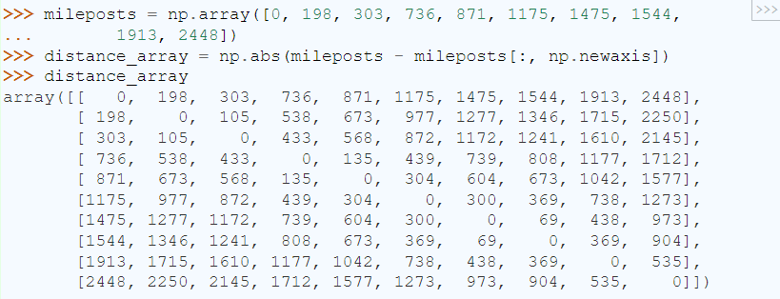
Worked Example: Broadcasting
Let’s construct an array of distances (in miles) between cities of Route 66: Chicago, Springfield, Saint-Louis, Tulsa, Oklahoma City, Amarillo, Santa Fe, Albuquerque, Flagstaff and Los Angeles.

Slide 39
A lot of grid-based or network-based problems can also use broadcasting. For instance, if we want to compute the distance from the origin of points on on a 5x5 grid, we can do.

Slide 40
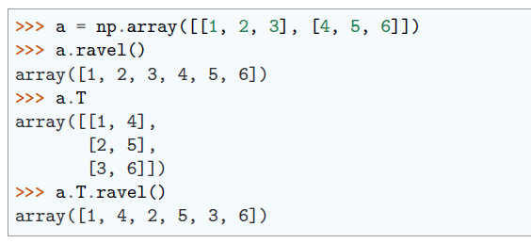
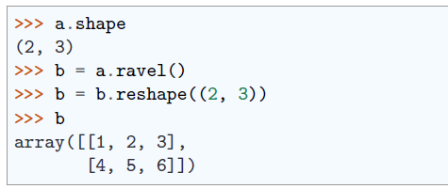
Array shape manipulation
Flattening
Reshaping - The inverse operation to flattening:

Slide 41
Adding a dimension

Slide 42
Resizing
Size of an array can be changed with ndarray.resize:
However, it must not be referred to somewhere else:

Slide 43
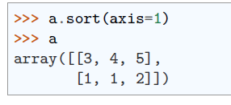
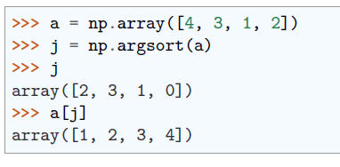
Sorting data
Sorting along an axis:
In-place sort: Sorting with fancy indexing:

Slide 44
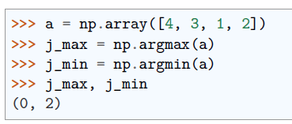
Finding minima and maxima:

Slide 45
More data types
Just as in Python and Java, the result of a math operator is cast to the more general or precise datatype.
uint64 + uint16 => uint64
float32 / int32 => float32
Assignment never changes the type!
Forced casts:

Slide 46
Rounding:

Slide 47
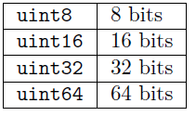
Different data type sizes
Integers (signed):
Unsigned integers:

Slide 48
Floating-point numbers:

Slide 50
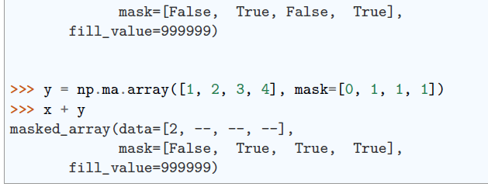
maskedarray
dealing with (propagation of) missing data
For floats one could use NaN’s, but masks work for all types:

Slide 51
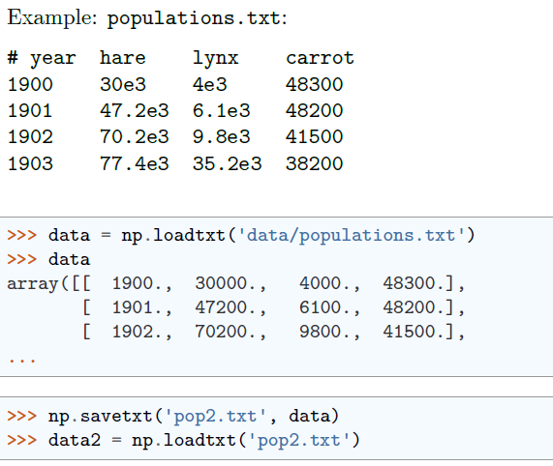
Loading data files
Text files

