Slide 1
Section 6
Inner Workings of Python Objects – Part 2

Slide 2
Classes and Encapsulation
One of the primary roles of a class is to encapsulate data and internal implementation details of an object.
However, a class also defines a public interface that the outside world is supposed to use to manipulate the object.
This distinction between implementation details and the public interface is important.

Slide 3
A Problem
In Python, almost everything about classes and objects is open.
  You can easily inspect object internals.
  You can change things at will.
  There is no strong notion of access-control (i.e., private class members)
That is an issue when you are trying to isolate details of the internal implementation.
Python Encapsulation
Python relies on programming conventions to indicate the intended use of something.
These conventions are based on naming.
There is a general attitude that it is up to the programmer to observe the rules as opposed to having the language enforce them

Slide 4
Private/Protected Attributes
Any attribute name with leading “_” is considered to be private.
  class Person(object):
  def __init__(self, name):
  self._name = 0
However, this is only a programming style.
You can still access and change it.
  >>> p = Person('Guido')
  >>> p._name
  'Guido'
  >>> p._name = 'Dave'
  >>>

Slide 5
Private Attributes
Variant : Attribute names with two leading _
  class Person(object):
    def __init__(self, name):
      self.__name = name
This kind of attribute is "more private"
  >>> p = Person('Guido')
  >>> p.__name
  AttributeError: 'Person' object has no attribute '__name'
  >>>
This is actually just a name mangling trick
  >>> p = Person('Guido')
  >>> p._Person__name
  'Guido'
  >>>

Slide 6
Private Attributes
Discussion: What style to use?
Most experienced Python programmers seem to use a single underscore
Many consider the use of double underscores to cause more problems than they solve
Example: getattr(), setattr() don't work right
You mileage might vary...

Slide 7
Problem: Simple Attributes
Consider the following class
  class Stock:
  def __init__(self, name, shares, price):
  self.name = name
  self.shares = shares
  self.price = price
A surprising feature is that you can set the attributes to any value at all:
  >>> s = Stock('IBM', 50, 91.1)
  >>> s.shares = 100
  >>> s.shares = "hundred"
  >>> s.shares = [1, 0, 0]
  >>>
Suppose you later wanted to add validation
  s.shares = '50' # Raise a TypeError, this is a string
How would you do it?

Slide 8
Managed Attributes
One approach: introduce accessor methods.
  class Stock:
  def __init__(self, name, shares, price):
  self.name = name
  self.set_shares(shares)
  self.price = price
  # Function that layers the "get" operation
  def get_shares(self):
  return self._shares
  # Function that layers the "set" operation
  def set_shares(self, value):
  if not isinstance(value, int):
  raise TypeError('Expected an int')
  self._shares = value
Too bad that this breaks all of our existing code.
  s.shares = 50 s.set_shares(50)

Slide 9
Properties
There is an alternative approach to the previous pattern.
  class Stock:
  def __init__(self, name, shares, price):
  self.name = name
  self.shares = shares
  self.price = price
  @property
  def shares(self):
  return self._shares
  @shares.setter
  def shares(self, value):
  if not isinstance(value, int):
  raise TypeError('Expected int')
  self._shares = value
The syntax is a little jarring at first

Slide 10
Properties
Normal attribute access now triggers the getter and setter methods under @property and @shares.setter.
  class Stock:
  def __init__(self, name, shares, price):
  self.name = name
  self.shares = shares
  self.price = price
  @property
  def shares(self):
  return self._shares
  @shares.setter
  def shares(self, value):
  if not isinstance(value, int):
  raise TypeError('Expected int')
  self._shares = value
No changes needed to other source code
>>> s = Stock(...)
>>> s.shares
100
>>> s.shares = 50
>>>
get
set

Slide 11
Properties
You don't change existing attribute access
  class Stock:
  def __init__(self, name, shares, price):
  ...
  # This assignment calls the setter below
  self.shares = shares
  ...
  ...
  @shares.setter
  def shares(self, value):
  if not isinstance(value, int):
  raise TypeError('Expected int')
  self._shares = value
Common confusion: property vs private name
assignment
calls the setter

Slide 12
Properties
Properties are also useful if you are creating objects where you want to have a very consistent user interface
Example : Computed data attributes
  class Circle(object):
    def __init__(self, radius):
      self.radius = radius
    @property
    def area(self):
      return math.pi * (self.radius ** 2)
    @property
    def perimeter(self):
      return 2 * math.pi * self.radius

Slide 13
Properties
Example use:
  >>> c = Circle(4)
  >>> c.radius
  4
  >>> c.area
  50.26548245743669
  >>> c.perimeter
  25.132741228718345
Commentary : Notice how there is no obvious difference between the attributes as seen by the user of the object
Instance Variable
Computed Properties

Slide 14
Uniform Access
The last example shows how to put a more uniform interface on an object. If you don't do this, an object might be confusing to use:
  >>> c = Circle(4.0)
  >>> a = c.area() # Method
  >>> r = c.radius # Data attribute
  >>>
Why is the () required for the cost, but not for the shares? A property can fix this.

Slide 15
__slots__ Attribute
You can restrict the set of attributes names.
  class Stock:
  __slots__ = ('name','_shares','price')
  def __init__(self, name, shares, price):
  self.name = name
  ...
It will raise an error for other attributes.
  >>> s = Stock('GOOG', 100, 490.1)
  >>> s.price = 385.15
  >>> s.prices = 410.2
  Traceback (most recent call last):
  File "<stdin>", line 1, in ?
  AttributeError: 'Stock' object has no attribute 'prices'
Although this prevents errors and restricts usage of objects, it's actually used for performance and makes Python use memory more efficiently.

Slide 16
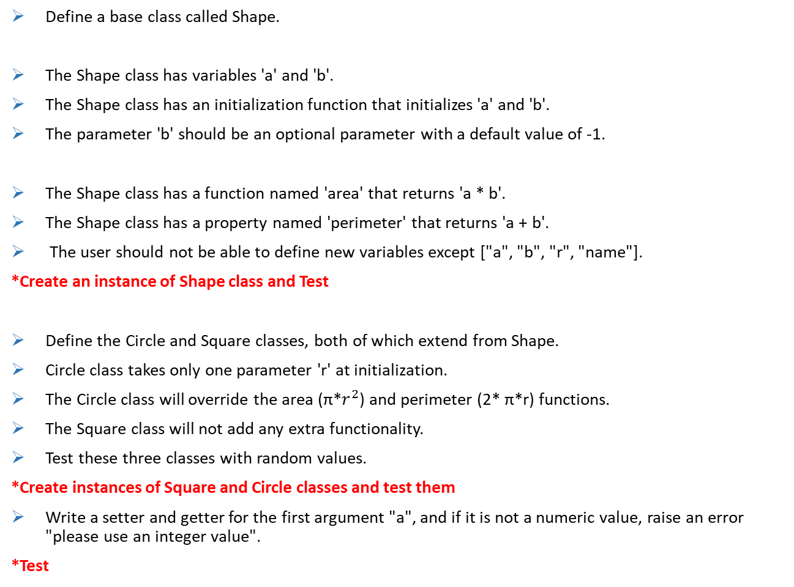
Let's code:
Define a base class called Shape.
The Shape class has variables 'a' and 'b'.
The Shape class has an initialization function that initializes 'a' and 'b'.
The parameter 'b' should be an optional parameter with a default value of -1.
The Shape class has a function named 'area' that returns 'a * b'.
The Shape class has a property named 'perimeter' that returns 'a + b'.
The user should not be able to define new variables except ["a", "b", "r", "name"].
*Create an instance of Shape class and Test
Define the Circle and Square classes, both of which extend from Shape.
Circle class takes only one parameter 'r' at initialization.
The Circle class will override the area (π*$r^{2}$) and perimeter (2* π*r) functions.
The Square class will not add any extra functionality.
Test these three classes with random values.
*Create instances of Square and Circle classes and test them
Write a setter and getter for the first argument "a", and if it is not a numeric value, raise an error "please use an integer value".
*Test

Slide 17
Final Comments on Encapsulation
Don't go overboard with private attributes, properties, slots, etc.
They serve a specific purpose and you may see them when reading other Python code.
However, they are not necessary for most day-to-day coding.

