Slide 1
Section 6 Inner Workings of Python Objects

Slide 2
Overview
A few more details about how objects work
How objects are represented
Details of attribute access
Data encapsulation

Slide 3
Dictionaries Revisited
Dictionary is a collection of named values.
stock = {
'name' : 'GOOG',
'shares' : 100,
'price' : 490.1
}
Dictionaries are commonly used for simple data structures.
However, they are used for critical parts of the interpreter and may be the most important type of data in Python.

Slide 4
Dicts and Modules
Within a module, a dictionary holds all of the global variables and functions.
# foo.py
x = 42
def bar():
...
def spam():
...
If you inspect foo.__dict__ or globals(), you'll see the dictionary.
{
'x' : 42,
'bar' : <function bar>,
'spam' : <function spam>
}

Slide 5
Dicts and Objects
User defined objects also use dictionaries for both;
Instance data
Classes
In fact, the entire object system is mostly an extra layer that's put on top of dictionaries.
Let's take a look...

Slide 6
Dicts and Instances
A dictionary holds the instance data (__dict__)
>>> s = Stock('GOOG', 100, 490.1)
>>> s.__dict__
{'name' : 'GOOG', 'shares' : 100, 'price': 490.1 }
You populate this dict (and instance) when assigning to self.
class Stock:
def __init__(self, name, shares, price):
self.name = name
self.shares = shares
self.price = price
self.__dict__
{
'name': 'GOOG',
'shares': 100,
'price': 490.1
}

Slide 7
Dicts and Instances
Critical point : Each instance gets its own private dictionary
s = Stock('GOOG', 100, 490.1)
t = Stock('AAPL', 50, 123.45)
{
'name' : 'GOOG',
'shares' : 100,
'price' : 490.10
}
{
'name’ : AAPL',
'shares’ : 50,
'price’ : 123.45
}
So, If you created 100 instances of some class, there are 100 dictionaries sitting around holding data.

Slide 8
Dicts and Classes
A separate dictionary also holds the methods.
class Stock:
def __init__(self, name, shares, price):
self.name = name
self.shares = shares
self.price = price
def cost(self):
return self.shares * self.price
def sell(self, nshares):
self.shares -= nshares
Stock.__dict__
{
'cost': <function>,
'sell': <function>,
'__init__': <function>
}

Slide 9
Instances and Classes
Instances and classes are linked together.
__class__ attribute refers back to the class.
>>> s = Stock('GOOG', 100, 490.1)
>>> s.__dict__
{ 'name': 'GOOG', 'shares': 100, 'price': 490.1 }
>>> s.__class__
<class '__main__.Stock'>
>>>
The instance dictionary holds data unique to each instance, whereas the class dictionary holds data collectively shared by all instances.

Slide 10
Instances and Classes

Slide 11
Attribute Access
When you work with objects, you access data and methods using the (.) operator
x = obj.name # Getting
obj.name = value # Setting
del obj.name # Deleting
These operations are directly tied to the dictionaries sitting underneath the covers.

Slide 12
Modifying Instances
Operations that modify an object update the underlying dictionary.
>>> s = Stock('GOOG', 100, 490.1)
>>> s.__dict__
{ 'name':'GOOG', 'shares': 100, 'price': 490.1 }
>>> s.shares = 50 # Setting
>>> s.date = '6/7/2007’ # Setting
>>> s.__dict__
{ 'name': 'GOOG', 'shares': 50, 'price': 490.1, 'date': '6/7/2007’ }
>>> del s.shares # Deleting
>>> s.__dict__
{ 'name': 'GOOG', 'price': 490.1, 'date': '6/7/2007' }
>>>

Slide 13
Modifying Instances
It may be surprising that instances can be extended after creation
You can freely change attributes at any time
>>> s = Stock('GOOG',100,490.10)
>>> s.blah = "some new attribute"
>>> del s.name
>>>
Again, you're just manipulating a dictionary
Very different from C++/Java where the structure of an object is rigidly fixed

Slide 14
Reading Attributes
Suppose you read an attribute on an instance.
x = obj.name
The attribute may exist in two places:
Local instance dictionary.
Class dictionary.
So, both dictionaries must be checked.

Slide 15
Reading Attributes
First, check in local __dict__.
If not found, look in __dict__ of class through __class__.
>>> s = Stock(...)
>>> s.name
'GOOG'
>>> s.cost()
49010.0
>>>
This lookup scheme is how the members of a class get shared by all instances.
s
.__dict__
.__class__
{'name': 'GOOG',
'shares': 100 }
1
Stock
.__dict__
{'cost': <func>,
'sell':<func>,
'__init__':..}
2

Slide 16
How inheritance works
Classes may inherit from other classes.
class A(B, C):
...
The base classes are stored in a tuple in each class.
>>> A.__bases__
(<class '__main__.B'>, <class '__main__.C'>)
>>>
This provides a link to parent classes.
This link simply extends the search process used to find attributes

Slide 17
Reading Attributes
First, check in local __dict__.
If not found, look in __dict__ of class through __class__.
If not found in class, look in base classes
>>> s = Stock(...)
>>> s.name
'GOOG'
>>> s.cost()
49010.0
>>>
This lookup scheme is how the members of a class get shared by all instances.
s
.__dict__
.__class__
{'name': 'GOOG',
'shares': 100 }
1
Stock
.__dict__
{'cost': <func>,
'sell':<func>,
'__init__':..}
2
3
look in __bases__

Slide 18
Single Inheritance
In inheritance hierarchies, attributes are found by walking up the inheritance tree
class A: pass
class B(A): pass
class C(A): pass
class D(B): pass
class E(D): pass
With single inheritance, there is single path to the top.
You stop with the first match.

Slide 19
Method Resolution Order or MRO
Python precomputes an inheritance chain and stores it in the MRO attribute on the class. You can view it.
>>> E.__mro__
(<class '__main__.E'>, <class '__main__.D'>,
<class '__main__.B'>, <class '__main__.A'>,
<type 'object'>)
>>>
This chain is called the Method Resolution Order.
To find an attribute, Python walks the MRO in order.
The first match wins.

Slide 20
MRO in Multiple Inheritance
With multiple inheritance, there is no single path to the top. Let's take a look at an example.
class A: pass
class B: pass
class C(A, B): pass
class D(B): pass
class E(C, D): pass
What happens when you access an attribute?
e = E()
e.attr
An attribute search process is carried out, but what is the order? That's a problem.

Slide 21
Multiple Inheritance
Python uses cooperative multiple inheritance which obeys some rules about class ordering.
Big picture: Child classes can arrange their parents to cooperate with each other
But there are some rules...
Rule 1: Children before parents
Rule 2: Parents go in order

Slide 22
Multiple Inheritance
class C(A, B):
...
Head explosion: Python might check other classes in-between. This is allowed by the rules.
Rule 1: Children before parents
Rule 2: Parents go in order
some other class
(injected into the chain)

Slide 23
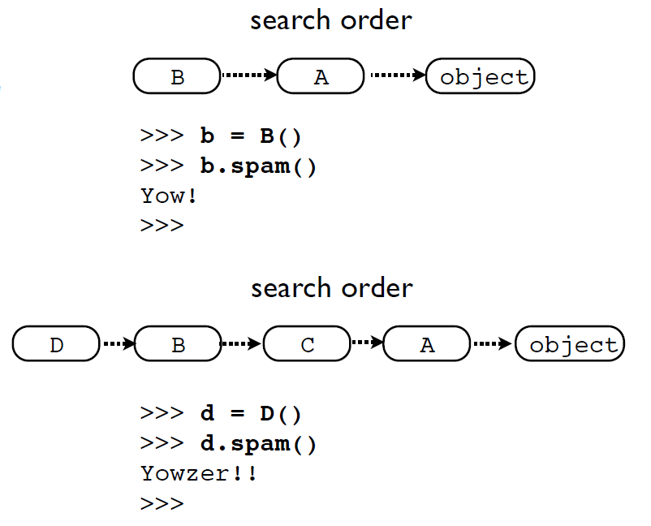
Multiple Inheritance
class A(object):
def yow(self):
print 'Yow!'
class B(A):
def spam(self):
self.yow()
Now consider
class C(A):
def yow(self):
print 'Yowzer!!'
class D(B,C):
Pass
Why? The rules

Slide 24
Multiple Inheritance
Python flattens the inheritance hierarchy
>>> D.__mro__
(<class '__main__.D'>, <class '__main__.B'>,
<class '__main__.C'>, <class '__main__.A'>,
<type 'object'>)
>>>
Calculated using the C3 Linearization algorithm
Merge of parent MROs according to the "rules"
Attributes found by walking the MRO as before

Slide 25
Why super()
Always use super() when overriding methods.
class B(A):
def foo(self):
...
return super(B,self).foo()
super() delegates to the next class on the MRO
Tricky bit: You don't know what it is

Slide 26
Some Cautions
Multiple inheritance is a powerful tool
With power comes responsibility
Frameworks/libraries sometimes use it for advanced features involving composition of components
More details in an advanced course

