Slide 1
CEN 427 Python Programming
Serkan KARTAL
Department of Computer Engineering
Cukurova University

Slide 2
Formatted Output
When working with data, you often want to produce structured output (tables, etc.).
Name Shares Price
---------- ---------- -----------
AA 100 32.20
IBM 50 91.10
CAT 150 83.44
MSFT 200 51.23
GE 95 40.37
MSFT 50 65.10
IBM 100 70.44

Slide 3
String Formatting
One way to format string in Python 3.6+ is with f-strings.
>>> name = 'IBM'
>>> shares = 100
>>> price = 91.1
>>> f'{name:>10s} {shares:>10d} {price:>10.2f}'
' IBM 100 91.10'
Format codes
d Decimal integer
b Binary integer
x Hexadecimal integer
f Float as [-]m.dddddd
e Float as [-]m.dddddde+-xx
g Float, but selective use of E notation
s String
c Character (from integer
:>10d Int. right aligned in 10-character field
:<10d Int. left aligned in 10-character field
:^10d Int. centered in 10-character field
:0.2f Float with 2 digit precision

Slide 4
format() Function
format() that can apply formatting to arguments or keyword arguments.
>>> '{name:>10s} {shares:10d} {price:10.2f}'.format(name='IBM', shares=100, price=91.1)
' IBM 100 91.10'
>>> '{:10s} {:10d} {:10.2f}'.format('IBM', 100, 91.1)
' IBM 100 91.10’
C-Style Formatting
Formatting operator (%)
>>> 'The value is %d' % 3
'The value is 3'
>>> '%5d %-5d %10d' % (3,4,5)
' 3 4 5'
>>> '%0.2f' % (3.1415926,)
'3.14'

Slide 5
Working with Sequences
Python has three «sequence» datatypes.
a = 'Hello’ # String
b = [1, 4, 5] # List
c = ('GOOG', 100, 490.1) # Tuple
Sequences are ordered : s[n]
a[0] # 'H'
b[-1] # 5
c[1] # 100
Sequences have a length : len(s)
len(a) # 5
len(b) # 3
len(c) # 3

Slide 6
Working with Sequences
Sequences can be replicated: s * n.
>>> a = 'Hello'
>>> a * 3
'HelloHelloHello'
>>> b = [1, 2, 3]
>>> b * 2
[1, 2, 3, 1, 2, 3]
Sequences of the same type can be concatenated: s + t.
>>> a = (1, 2, 3)
>>> b = (4, 5)
>>> a + b
(1, 2, 3, 4, 5)
>>>
>>> c = [1, 5]
>>> a + c
Traceback (most recent call last):
File "<stdin>", line 1, in <module>
TypeError: can only concatenate tuple (not "list") to tuple

Slide 7
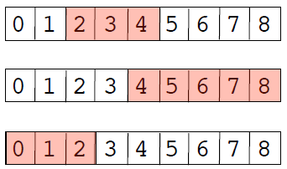
Sequence Slicing
Slicing operator : s[start:end]
a = [0,1,2,3,4,5,6,7,8]
a[2:5] # [2,3,4]
a[-5:] # [4,5,6,7,8]
a[:3] # [0,1,2]
Indices must be integers.
Slices do not include the end value
If indices are omitted, they default to the beginning or end of the list.
# Reassignment
a = [0,1,2,3,4,5,6,7,8]
a[2:4] = [10,11,12] # [0,1,10,11,12,4,5,6,7,8]
# Deletion
a = [0,1,2,3,4,5,6,7,8]
del a[2:4] # [0,1,4,5,6,7,8]

Slide 8
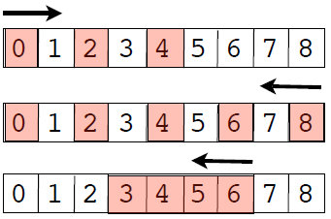
Extended Slices
Extended slicing: s[start:end:step]
a = [0,1,2,3,4,5,6,7,8]
a[0:5:2] # [0,2,4]
a[::-2] # [8,6,4,2,0]
a[6:2:-1] # [6,5,4,3]
step indicates stride and direction
end index is not included in result
Go easy on it for code clarity

Slide 9
Sequence Reductions
sum(s)
>>> s = [1, 2, 3, 4]
>>> sum(s)
10
>>>
min(s), max(s)
>>> min(s)
1
>>> max(s)
4
>>> max(t)
'World'
>>>

Slide 10
Iteration over a sequence
The for-loop iterates over sequence data.
>>> s = [1, 4, 9, 16]
>>> for i in s:
... print(i)
...
1
4
9
16
>>>
On each iteration of the loop, you get new item of data to work with.

Slide 11
break
continue
Breaking out of a loop (exiting)
for name in namelist:
if name == 'Jake':
break
...
...
Statements
Only applies to the inner-most loop
Skipping to the next iteration
for line in lines:
if line == '\n': # Skip blank lines
continue
# More statements
...
Useful if the current item isn't of interest or needs to be ignored in processing

Slide 12
Looping over integers
range() creates a list of integers
for i in range(100):
# i = 0,1,...,99
range([start,] end [,step])
x = range(100) # x = [0, 1,..., 99]
y = range(10, 20) # y = [10, 11,..., 19]
z = range(10, 50, 2) # z = [10, 12,..., 48]

Slide 13
enumerate() function
enumerate(sequence [, start = 0])
Provides a loop counter value
names = ['Elwood', 'Jake', 'Curtis']
for i, name in enumerate(names):
# Loops with i = 0, name = 'Elwood'
# i = 1, name = 'Jake'
# i = 2, name = 'Curtis’
Example: Keeping a line number
with open(filename) as f:
for lineno, line in enumerate(f, start=1):
...

Slide 14
enumerate() Function
enumerate() is a nice shortcut
for i,x in enumerate(names):
Statements
Compare to:
i = 0
for x in names:
statements
i += 1
Less typing and enumerate() runs slightly faster

Slide 15
for and tuples
Looping with multiple iteration variables
points = [
(1, 4),(10, 40),(23, 14),(5, 6),(7, 8)
]
for x, y in points:
# Loops with x = 1, y = 4
# x = 10, y = 40
# x = 23, y = 14
# ...
Here, each tuple is unpacked into a set of iteration variables.

Slide 16
zip() function
Combines multiple sequences into tuples
columns = ['name', 'shares', 'price']
values = ['GOOG', 100, 490.1 ]
pairs = zip(columns, values)
# ('name','GOOG'), ('shares',100), ('price',490.1)
One use, looping over two sequences
for column, value in pairs:
...
Another use: making dictionaries
d = dict(zip(columns, values))

Slide 17
List Comprehensions
A list comprehension creates a new list by applying an operation to each element of a sequence.
>>> a = [1, 2, 3, 4, 5]
>>> b = [2*x for x in a ]
>>> b
[2, 4, 6, 8, 10]
>>>
Another example:
>>> names = ['Elwood', 'Jake']
>>> a = [name.lower() for name in names]
>>> a
['elwood', 'jake']
>>>

Slide 18
List Comp: Examples
List comprehensions are hugely useful
Collecting the values of a specific field
stocknames = [s['name'] for s in stocks]
Performing database-like queries
a = [s for s in stocks if s['price'] > 100 and s['shares'] > 50 ]
Data reductions over sequences
cost = sum([s['shares']*s['price'] for s in stocks])

Slide 19
List Comprehensions
General syntax
[expression for names in sequence if condition]
What it means
result = []
for names in sequence:
if condition:
result.append(expression)

Slide 20
Historical Digression
List comprehensions come from math
a = [x*x for x in s if x > 0] # Python
a = { $x^{2}$ | x ∈ s, x > 0 } # Math
Implemented in several other languages
But most Python programmers would probably just view this as a "cool shortcut"

Slide 21
More details on objects
So far: a tour of the most common types
Have skipped some critical details
Memory management
Copying
Type checking

Slide 22
The Issue with Assignment
Many operations in Python are related to assigning or storing values.
a = value # Assignment to a variable
s[n] = value # Assignment to a list
s.append(value) # Appending to a list
d['key'] = value # Adding to a dictionary
A caution : assignment operations never make a copy of the value being assigned
All assignments are merely reference copies (or pointer copies if you prefer)

Slide 23
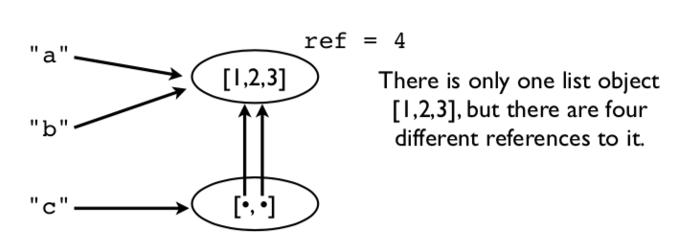
Assignment example
Consider this code fragment.
a = [1,2,3]
b = a
c = [a,b]
picture of the underlying memory

Slide 24
Assignment Example
Modifying a value affects all references
>>> a.append(999)
>>> a
[1,2,3,999]
>>> b
[1,2,3,999]
>>> c
[[1,2,3,999], [1,2,3,999]]
Notice how a change in the original list shows up everywhere else.
This is because no copies were ever made. Everything is pointing to the same thing.

Slide 25
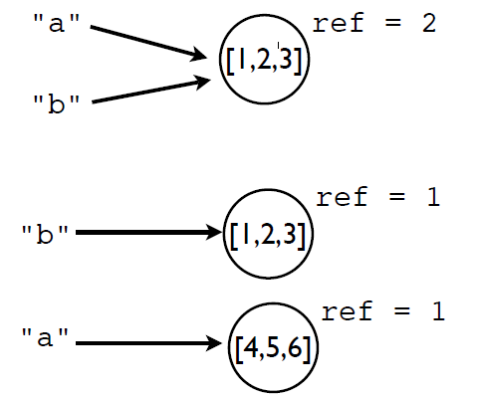
Reassigning values
Reassigning a value never overwrites the memory used by the previous value.
a = [1,2,3]
b = a
a = [4,5,6]
Remember: Variables are names, not memory locations.

Slide 26
Some Dangers
If you don't know about this sharing, you will shoot yourself in the foot at some point
Typical scenario : You modify some data thinking that it's your own private copy and it accidentally corrupts some data in some other part of the program
Comment: This is one of the reasons why the primitive data types (int, float, string) are immutable (read-only)

Slide 27
Identity and References
Use the is operator to check if two values are exactly the same object.
>>> a = [1,2,3]
>>> b = a
>>> a is b
True
is compares the object identity (an integer).
>>> id(a)
3588944
>>> id(b)
3588944
>>>

Slide 28
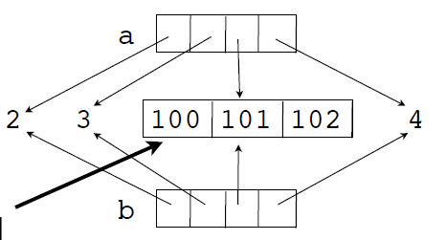
Shallow Copies
Lists and dicts have methods for copying.
>>> a = [2,3,[100,101],4]
>>> b = list(a) # Make a copy
>>> a is b
False
It's a new list, but the list items are shared.
>>> a[2].append(102)
>>> b[2]
[100,101,102]
>>>
>>> a[2] is b[2]
True
>>>
This inner list is
still being shared

Slide 29
Deep Copying
Sometimes you need to make a copy of an object and all the objects contained within it.
Use the copy module for this:
>>> a = [2,3,[100,101],4]
>>> import copy
>>> b = copy.deepcopy(a)
>>> a[2].append(102)
>>> b[2]
[100,101]
>>> a[2] is b[2]
False
This is the only safe way to copy something

Slide 30
Names, Values, Types
Variable names do not have a type. It's only a name.
However, values do have an underlying type.
>>> a = 42
>>> b = 'Hello World'
>>> type(a)
<type 'int'>
>>> type(b)
<type 'str'>
type() will tell you what it is.
The type name is usually used as a function that creates or converts a value to that type.

Slide 31
Type Checking
How to tell if an object is a specific type.
if isinstance(a, list):
print('a is a list’)
Checking for one of many possible types.
if isinstance(a, (list,tuple)):
print('a is a list or tuple’)
*Caution: Don't go overboard with type checking. It can lead to excessive code complexity.

Slide 32
Summary
Have looked at basic principles of working with data in Python programs
Brief look at part of the object-model
A big part of understanding most Python programs.

