Slide 1
Section 9 Pandas

Slide 2
What is Pandas?
High-performance, easy-to-use data structures and data analysis tools
Built for the Python programming language.
Working with Pandas is fast, easy and more expressive than other tools.
Provides fast data processing as Numpy along with flexible data manipulation techniques as spreadsheets and relational databases.
Pandas are built on the top of Numpy.
Lastly, pandas integrates well with matplotlib library, which makes it very handy tool for analyzing the data.

Slide 3
Data structures
Pandas provides two very useful data structures to process
Series
The Series is a one-dimensional array that can store various data types,
The row labels in a Series are called the index.
Any list, tuple and dictionary can be converted in to Series using ‘series’ method
DataFrame
Series are used to work with one dimensional array, whereas DataFrame can be used with two dimensional arrays.
DataFrame has two different index i.e. column-index and row-index.

Slide 4
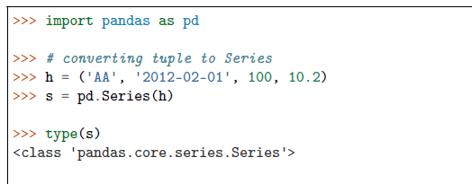
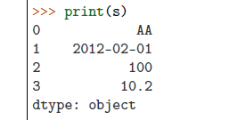
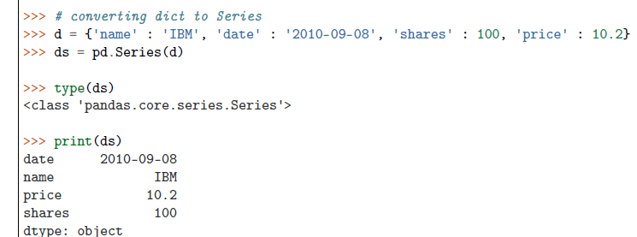
Series

Slide 5
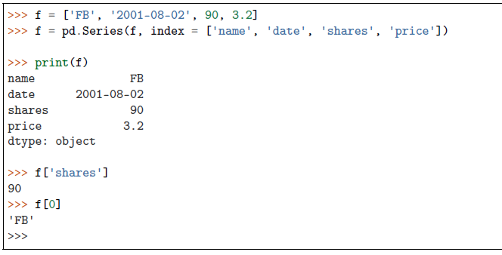
Series
Note that in the tuple-conversion, the index are set to ‘0, 1, 2 and 3’. We can provide custom index names as follows.
Elements of the Series can be accessed using index name e.g. f[‘shares’] or f[0]

Slide 6
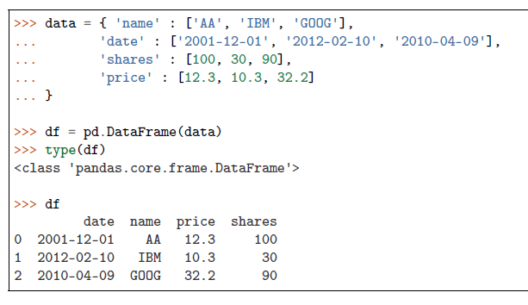
DataFrame
The most common way to create a DataFrame is by using the dictionary of equal-length list as shown below.
Further, all the spreadsheets and text files are read as DataFrame, therefore it is very important data structure of pandas.

Slide 7
DataFrame
Additional columns can be added after defining a DataFrame as below,
Currently, the row index are set to 0, 1 and 2. These can be changed using ‘index’ attribute as below,

Slide 8
Data can be accessed in two ways i.e. using row and column index,
>>> df['shares’]
one 100
two 30
three 90
Name: shares, dtype: int64
>>>df.loc['one’]
name AA
date 2001-12-01
shares 100
price 12.3
owner Unknown
Name: one, dtype: object
>>>df.iloc[0]
name AA
date 2001-12-01
shares 100
price 12.3
owner Unknown
Name: one, dtype: object

Slide 9
More on DataFrame indexing
In [855]: data = np.arange(9).reshape(3,-1)
In [856]: data
Out[856]:
array([[0, 1, 2],
[3, 4, 5],
[6, 7, 8]])
In [871]: frame[['c1', 'c3']]
Out[871]:
c1 c3
r1 0 2
r2 3 5
r3 6 8
In [870]: frame['c1']
Out[870]:
r1 0
r2 3
r3 6
Name: c1, dtype: int32
In [878]: frame.loc['r1']
Out[878]:
c1 0
c2 1
c3 2
Name: r1, dtype: int32
In [879]: frame.loc[['r1','r3']]
Out[879]:
c1 c2 c3
r1 0 1 2
r3 6 7 8
In [868]: frame = DataFrame(data, index=['r1', 'r2', 'r3'], columns=['c1', 'c2', 'c3'])
In [869]: frame
Out[869]:
c1 c2 c3
r1 0 1 2
r2 3 4 5
r3 6 7 8
In [885]: frame.iloc[:2]
Out[885]:
c1 c2 c3
r1 0 1 2
r2 3 4 5
In [952]: frame['c1']['r1']
Out[952]: 0
Row slices

Slide 10
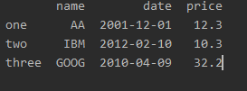
# access all rows for a column
>>> df.loc[:,“shares"]
one 100
two 30
three 90
Name: shares, dtype: int64
Any column can be deleted using ‘del’ or ‘drop’ commands,
>>> del df['owner']
>>> df.drop('shares',axis=1)

Slide 11
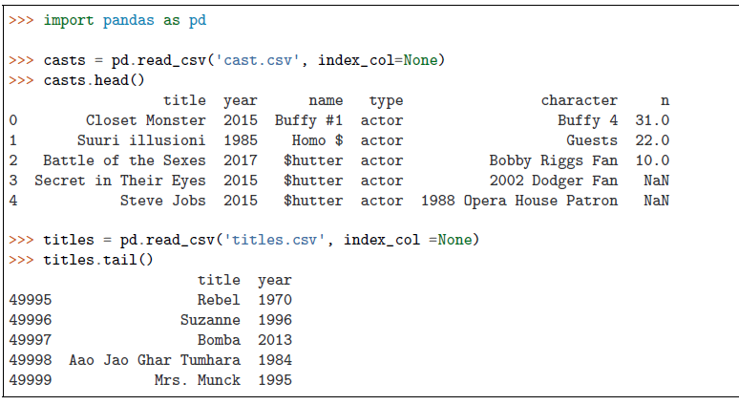
Reading files
two data files are used i.e. ‘titles.csv’ and ‘cast.csv’. The ‘titles.csv’ file contains the list of movies with the releasing year; whereas ‘cast.csv’ file has five columns which store the title of movie, releasing year, star-casts, type(actor/actress), characters and ratings for actors
• read_csv : read the data from the csv file.
• index_col = None : there is no index i.e. first column is data
• head() : show only first five elements of the DataFrame
• tail() : show only last five elements of the DataFrame

Slide 12
If there is some error while reading the file due to encoding, then try for following option as well,
len : ‘len’ commmand can be used to see the total number of rows in the file,
head() and tail() commands show the first and last 5 lines respectively

Slide 13
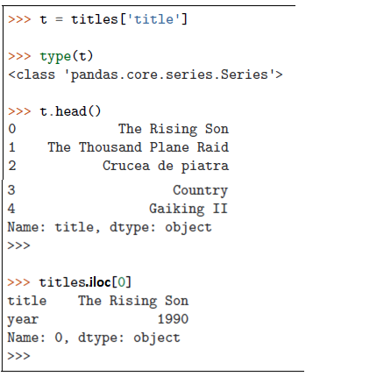
Data operations
Row and column selection
Any row or column of the DataFrame can be selected by passing the name of the column or rows. After selecting
one from DataFrame, it becomes one-dimensional therefore it is considered as Series.
iloc : use ‘iloc’ command to select a row from the DataFrame.

Slide 14
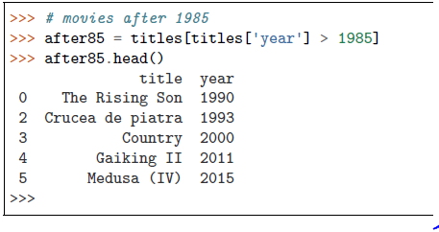
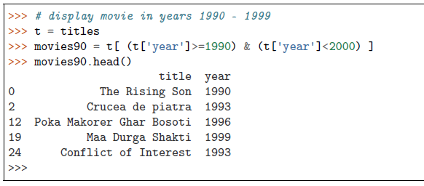
Filter Data
Data can be filtered by providing some boolean expression in DataFrame.
For example, movies which released after 1985 are filtered

Slide 15
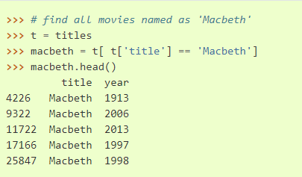
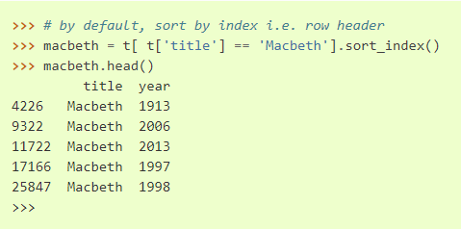
Sorting
Sorting can be performed using ‘sort_index’ or ‘sort_values’ keywords,
Note that in above filtering operation, the data is sorted by index i.e. by default ‘sort_index’ operation is used as shown below,

Slide 16
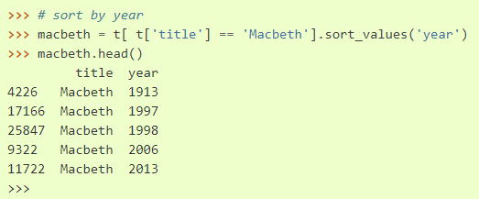
To sort the data by values, the ‘sort_value’ option can be used. In below code, data is sorted by year now,

Slide 17
Null values
Note that, various columns may contains no values, which are usually filled as NaN.
For example, rows 3-4 of casts are NaN
These null values can be easily selected, unselected or contents can be replaced by any other values e.g. empty strings or 0 etc.

Slide 18
To display the rows with null values, the condition must be passed in the DataFrame,
NaN values can be fill by using fillna

Slide 19
String operations
search for the movie “Maa”
all the movies which starts with ‘Maa’.

Slide 20
Count Values
Total number of occurrences can be counted using ‘value_counts()’

Slide 21
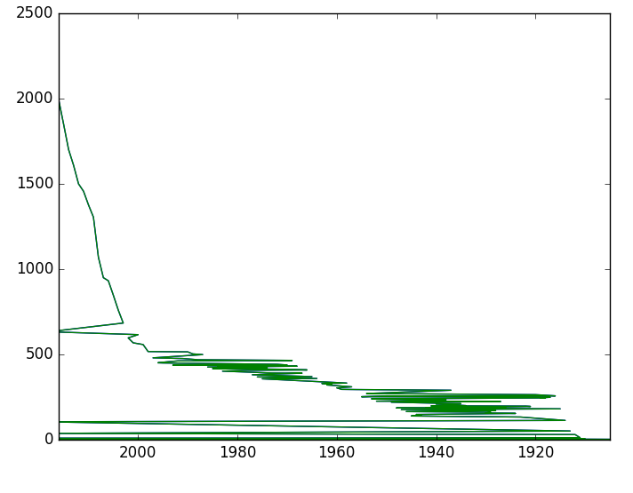
Plots
Pandas supports the matplotlib library and can be used to plot the data as well.
Following plot will be generated from above code, which does not provide any useful information

Slide 22
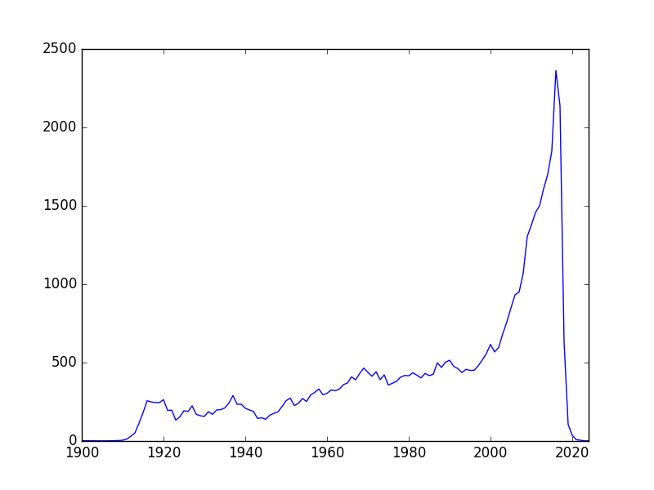
It’s better to sort the years (i.e. index) first and then plot the data as below
Now, the graph provide some useful information i.e. number of movies are increasing each year.

Slide 23
Groupby
Data can be grouped by columns-headers.
Groupby with column-names:
In Section Count Values, the value of movies/year were counted using ‘count_values()’ method. Same can be achieve by ‘groupby’ method as well. The ‘groupby’ command return an object, and we need to an additional functionality to it to get some results. For example,

Slide 24
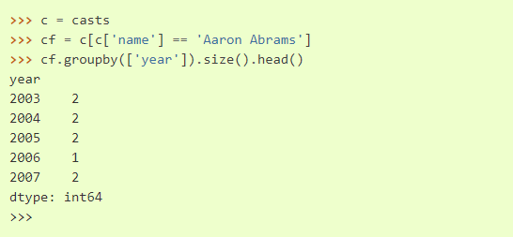
Further, groupby option can take multiple parameters for grouping. For example, we want to group the movies of the actor ‘Aaron Abrams’ based on year,
Above list shows that year-2003 is found in two rows with name-entry as ‘Aaron Abrams’. In the other word, he did 2 movies in 2003

Slide 25
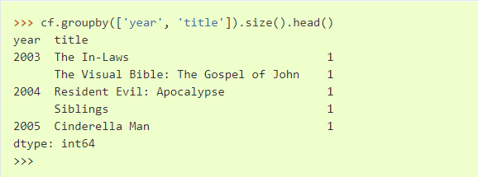
In above code, the groupby operation is performed on the ‘year’ first and then on ‘title’. In the other word, first all the movies are grouped by year.
After that, the result of this groupby is again grouped based on titles. Note that, first group command arranged the year in order i.e. 2003, 2004 and 2005 etc.; then next group command arranged the title in alphabetical order

Slide 26
Next, we want to do grouping based on maximum ratings in a year; i.e. we want to group the items by year and see the maximum rating in those years,
Above results show that the maximum rating in year 1912 is 6 for Aaron Abrams.

Slide 27
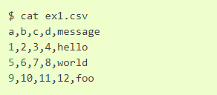
File operations
Reading files:
Pandas supports various types of file format e.g. csv, text, excel and different database etc.
Files are often stored in different formats as well e.g. files may or may not contain header, footer and comments etc.
Following are the contents of ‘ex1.csv’ file,

Slide 28
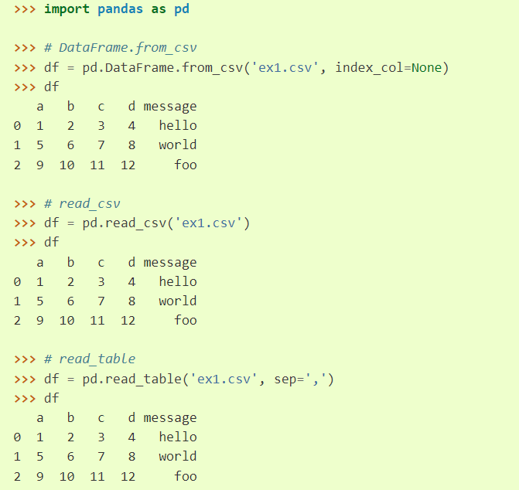
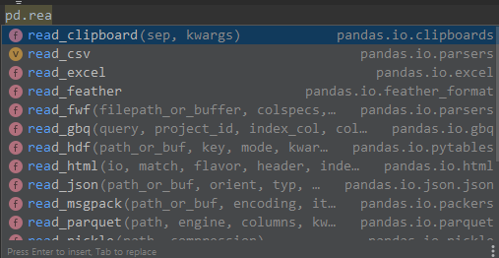
Below are the outputs of different file reading methods. ‘read_csv’ is general purpose method for reading the files, hence this method is used for rest of the tutorial,

Slide 29
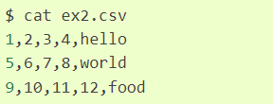
Note that, in above outputs, the headers are added from the file; but not all the files contain header. In this case, we need to explicitly define the header as below,
Since header is not present in above file, therefore we need to provide the “header” argument explicitly.

Slide 30
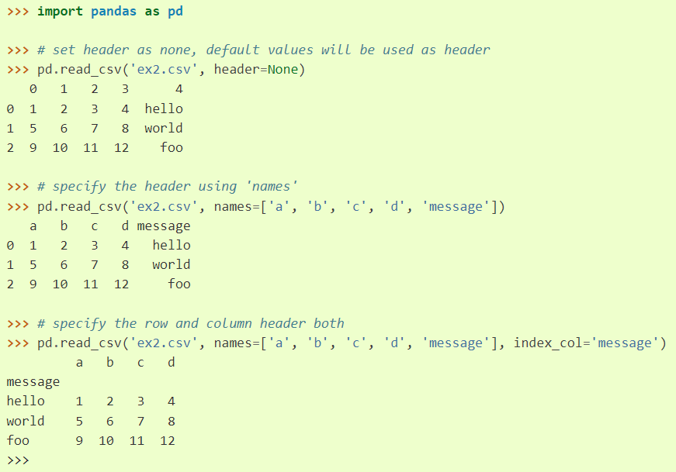

Slide 31
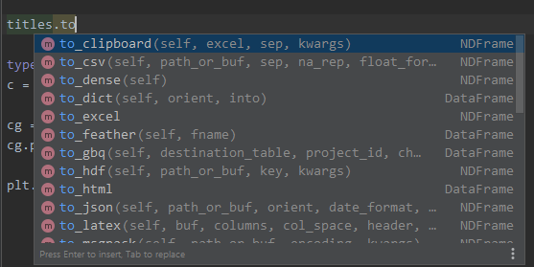
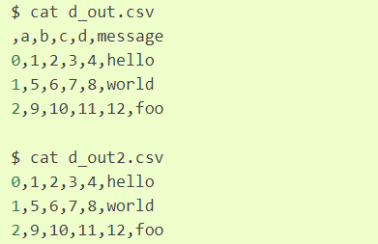
Writing data to a file
The ‘to_csv’ command is used to save the file.
Contents of above two files are:

Slide 32
Exercise
Find the top 10 years with the highest number of films
Find the top 10 characters with the highest score

Slide 33
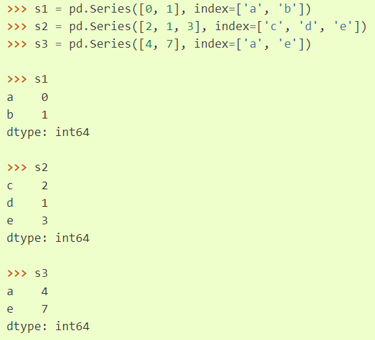
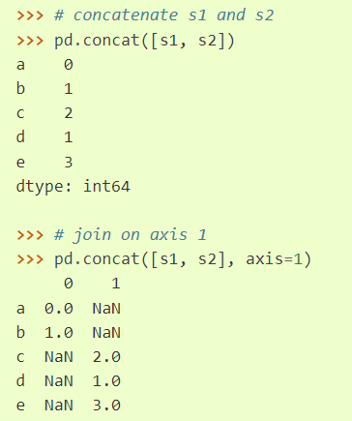
Concatenating the data

Slide 34
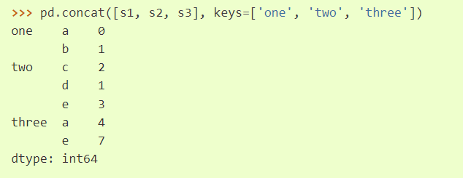
it is difficult to identify the different pieces of concatenate operation. We can provide ‘keys’ to make the operation identifiable,

Slide 35
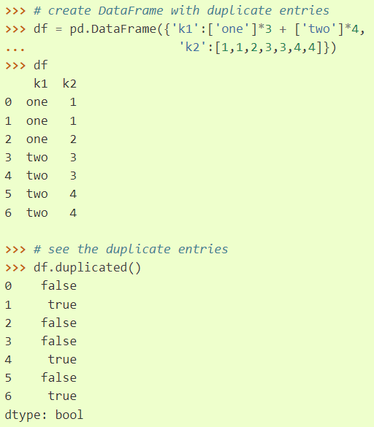
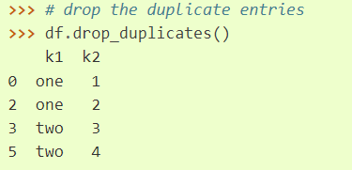
Data transformation
Removing duplicates:
Removing duplicate entries are quite easy with ‘drop_duplicates’ command

Slide 36
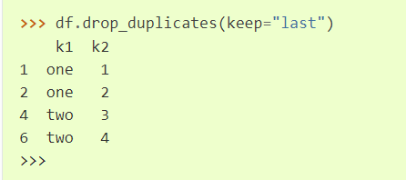
Currently, last entry is removed by drop_duplicates commnad. If we want to keep the last entry, then ‘keep’ keyword can be used,

Slide 37
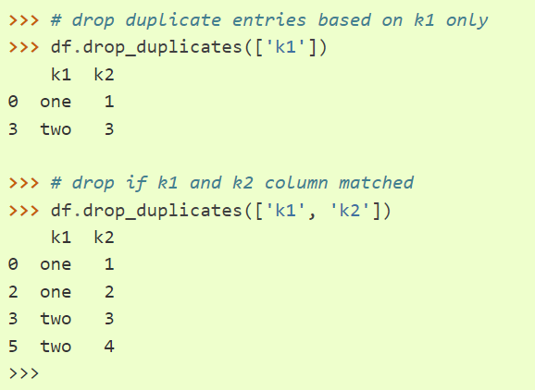
We can drop all the duplicate values from based on the specific columns as well,

Slide 38
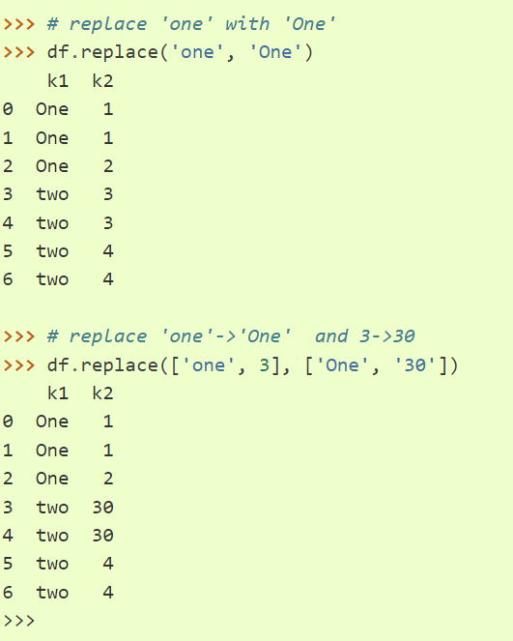
Replacing values
Replacing value is very easy using pandas as below

Slide 39
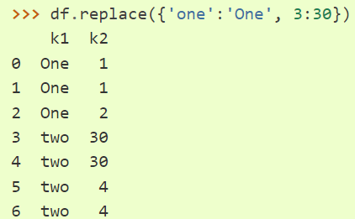
Arguments can be passed as dictionary as well,

Slide 40
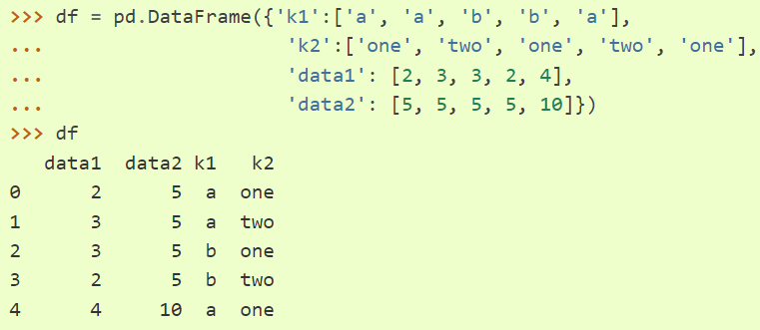
Groupby and data aggregation
Some more features of groupby operation
Let’s create a DataFrame first,

Slide 41
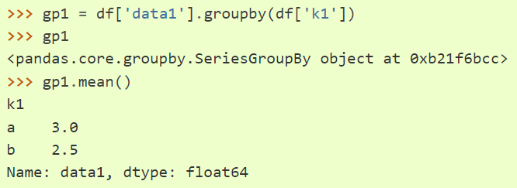
Now, create a group based on ‘k1’ and find the mean value as below. In the following code, rows (0, 1, 4) and (2, 3) are grouped together. Therefore mean values are 3 and 2.5.

Slide 42
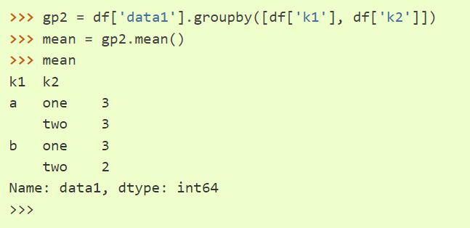
We can pass multiple parameters for grouping as well,

