Slide 1
Section 6
Inner Workings of Python Objects

Slide 2
Overview
A few more details about how objects work
How objects are represented
Details of attribute access
Data encapsulation

Slide 3
Dictionaries Revisited
Dictionary is a collection of named values.
  stock = {
  'name' : 'GOOG',
  'shares' : 100,
  'price' : 490.1
  }
Dictionaries are commonly used for simple data structures.
However, they are used for critical parts of the interpreter and may be the most important type of data in Python.

Slide 4
Dicts and Modules
Within a module, a dictionary holds all of the global variables and functions.
  # foo.py
  x = 42
  def bar():
  ...
  def spam():
  ...
If you inspect foo.__dict__ or globals(), you'll see the dictionary.
    {
    'x' : 42,
    'bar' : <function bar>,
    'spam' : <function spam>
    }

Slide 5
Dicts and Objects
User defined objects also use dictionaries for both;
  Instance data
  Classes
In fact, the entire object system is mostly an extra layer that's put on top of dictionaries.
Let's take a look...

Slide 6
Dicts and Instances
A dictionary holds the instance data (__dict__)
  >>> s = Stock('GOOG', 100, 490.1)
  >>> s.__dict__
  {'name' : 'GOOG', 'shares' : 100, 'price': 490.1 }
You populate this dict (and instance) when assigning to self.
  class Stock:
  def __init__(self, name, shares, price):
  self.name = name
  self.shares = shares
  self.price = price
  self.__dict__
{
'name': 'GOOG',
'shares': 100,
'price': 490.1
}

Slide 7
Dicts and Instances
Critical point : Each instance gets its own private dictionary
s = Stock('GOOG', 100, 490.1)
t = Stock('AAPL', 50, 123.45)
{
  'name' : 'GOOG',
  'shares' : 100,
  'price' : 490.10
}
{
  'name’ : AAPL',
  'shares’ : 50,
  'price’ : 123.45
}
So, If you created 100 instances of some class, there are 100 dictionaries sitting around holding data.

Slide 8
Dicts and Classes
A separate dictionary also holds the methods.
  class Stock:
  def __init__(self, name, shares, price):
  self.name = name
  self.shares = shares
  self.price = price
  def cost(self):
  return self.shares * self.price
  def sell(self, nshares):
  self.shares -= nshares
Stock.__dict__
{
'cost': <function>,
'sell': <function>,
'__init__': <function>
}

Slide 9
Instances and Classes
Instances and classes are linked together.
__class__ attribute refers back to the class.
  >>> s = Stock('GOOG', 100, 490.1)
  >>> s.__dict__
  { 'name': 'GOOG', 'shares': 100, 'price': 490.1 }
  >>> s.__class__
  <class '__main__.Stock'>
  >>>
The instance dictionary holds data unique to each instance, whereas the class dictionary holds data collectively shared by all instances.

Slide 10
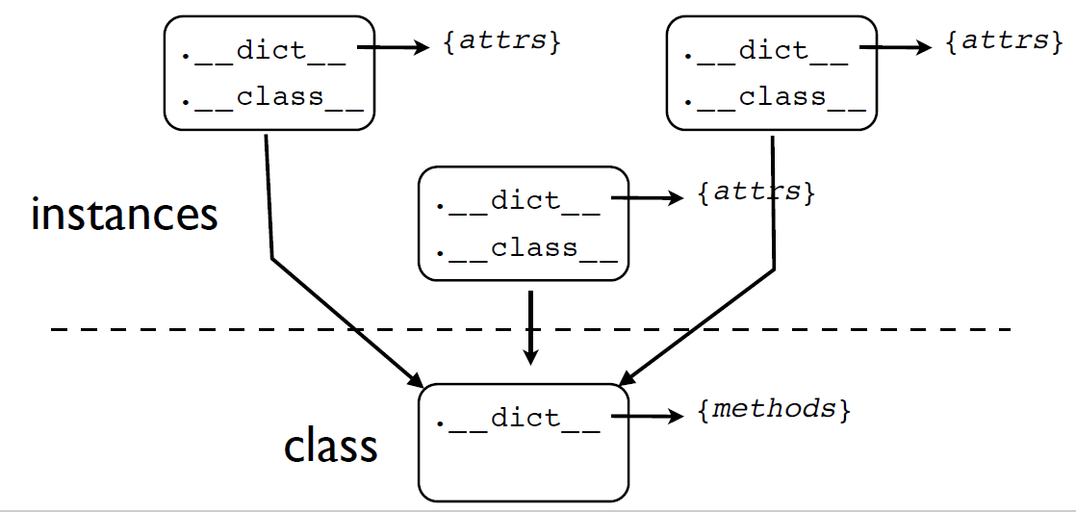
Instances and Classes

Slide 11
Attribute Access
When you work with objects, you access data and methods using the (.) operator
  x = obj.name # Getting
  obj.name = value # Setting
  del obj.name # Deleting
These operations are directly tied to the dictionaries sitting underneath the covers.

Slide 12
Modifying Instances
Operations that modify an object update the underlying dictionary.
  >>> s = Stock('GOOG', 100, 490.1)
  >>> s.__dict__
  { 'name':'GOOG', 'shares': 100, 'price': 490.1 }
  >>> s.shares = 50 # Setting
  >>> s.date = '6/7/2007’ # Setting
  >>> s.__dict__
  { 'name': 'GOOG', 'shares': 50, 'price': 490.1, 'date': '6/7/2007’ }
  >>> del s.shares # Deleting
  >>> s.__dict__
  { 'name': 'GOOG', 'price': 490.1, 'date': '6/7/2007' }
  >>>

Slide 13
Modifying Instances
It may be surprising that instances can be extended after creation
You can freely change attributes at any time
  >>> s = Stock('GOOG',100,490.10)
  >>> s.blah = "some new attribute"
  >>> del s.name
  >>>
Again, you're just manipulating a dictionary
Very different from C++/Java where the structure of an object is rigidly fixed

Slide 14
Reading Attributes
Suppose you read an attribute on an instance.
  x = obj.name
The attribute may exist in two places:
  Local instance dictionary.
  Class dictionary.
So, both dictionaries must be checked.

Slide 15
Reading Attributes
First, check in local __dict__.
If not found, look in __dict__ of class through __class__.
  >>> s = Stock(...)
  >>> s.name
  'GOOG'
  >>> s.cost()
  49010.0
  >>>
This lookup scheme is how the members of a class get shared by all instances.
s
.__dict__
.__class__
{'name': 'GOOG',
'shares': 100 }
1
Stock
.__dict__
{'cost': <func>,
'sell':<func>,
'__init__':..}
2

Slide 16
How inheritance works
Classes may inherit from other classes.
  class A(B, C):
  ...
The base classes are stored in a tuple in each class.
  >>> A.__bases__
  (<class '__main__.B'>, <class '__main__.C'>)
  >>>
This provides a link to parent classes.
This link simply extends the search process used to find attributes

Slide 17
Reading Attributes
First, check in local __dict__.
If not found, look in __dict__ of class through __class__.
If not found in class, look in base classes
  >>> s = Stock(...)
  >>> s.name
  'GOOG'
  >>> s.cost()
  49010.0
  >>>
This lookup scheme is how the members of a class get shared by all instances.
s
.__dict__
.__class__
{'name': 'GOOG',
'shares': 100 }
1
Stock
.__dict__
{'cost': <func>,
'sell':<func>,
'__init__':..}
2
3
look in __bases__

Slide 18
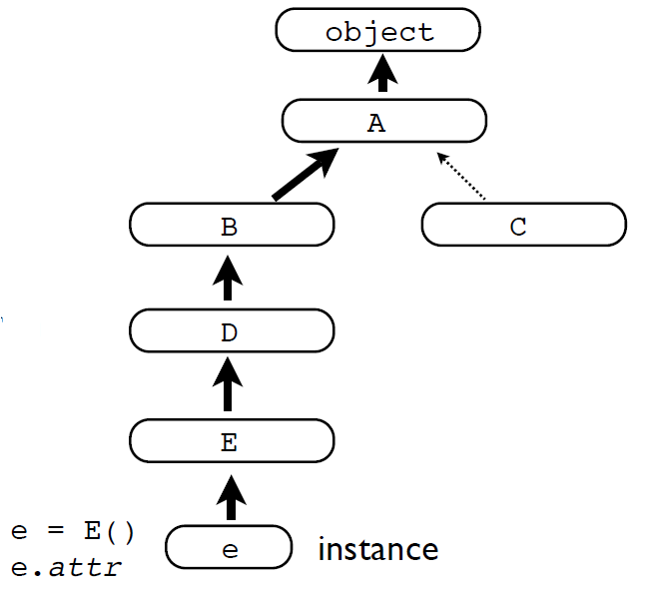
Single Inheritance
In inheritance hierarchies, attributes are found by walking up the inheritance tree
  class A: pass
  class B(A): pass
  class C(A): pass
  class D(B): pass
  class E(D): pass
With single inheritance, there is single path to the top.
You stop with the first match.

Slide 19
Method Resolution Order or MRO
Python precomputes an inheritance chain and stores it in the MRO attribute on the class. You can view it.
  >>> E.__mro__
  (<class '__main__.E'>, <class '__main__.D'>,
  <class '__main__.B'>, <class '__main__.A'>,
  <type 'object'>)
  >>>
This chain is called the Method Resolution Order.
To find an attribute, Python walks the MRO in order.
The first match wins.

Slide 20
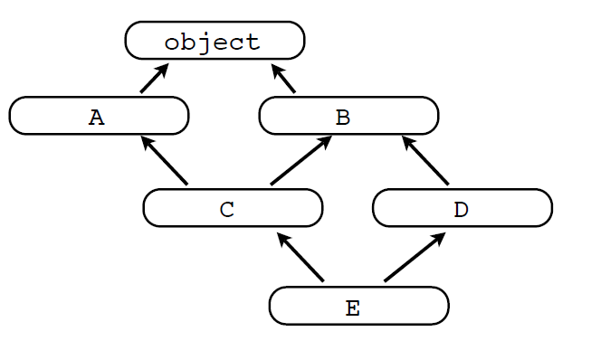
MRO in Multiple Inheritance
With multiple inheritance, there is no single path to the top. Let's take a look at an example.
  class A: pass
  class B: pass
  class C(A, B): pass
  class D(B): pass
  class E(C, D): pass
What happens when you access an attribute?
  e = E()
  e.attr
An attribute search process is carried out, but what is the order? That's a problem.

Slide 21
Multiple Inheritance
Python uses cooperative multiple inheritance which obeys some rules about class ordering.
Big picture: Child classes can arrange their parents to cooperate with each other
But there are some rules...
Rule 1: Children before parents
Rule 2: Parents go in order

Slide 22


Multiple Inheritance
class C(A, B):
  ...
Head explosion: Python might check other classes in-between. This is allowed by the rules.
Rule 1: Children before parents
Rule 2: Parents go in order
some other class
(injected into the chain)

Slide 23
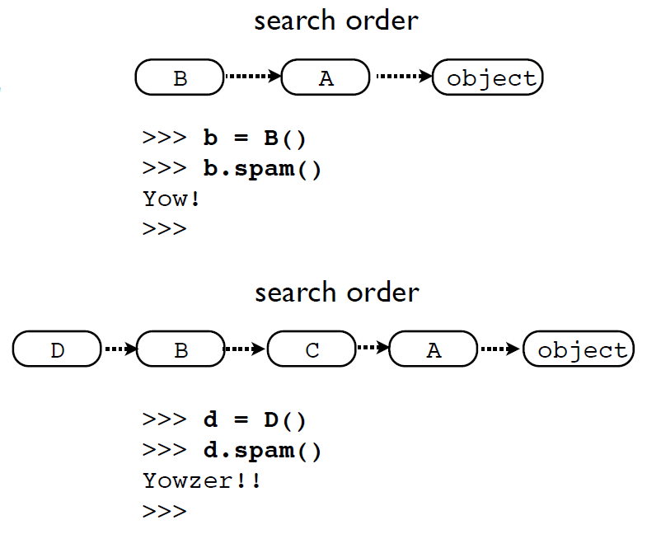
Multiple Inheritance
class A(object):
  def yow(self):
    print 'Yow!'
class B(A):
  def spam(self):
    self.yow()
Now consider
class C(A):
  def yow(self):
    print 'Yowzer!!'
class D(B,C):
  Pass
Why? The rules

Slide 24
Multiple Inheritance
Python flattens the inheritance hierarchy
  >>> D.__mro__
  (<class '__main__.D'>, <class '__main__.B'>,
  <class '__main__.C'>, <class '__main__.A'>,
  <type 'object'>)
  >>>
Calculated using the C3 Linearization algorithm
Merge of parent MROs according to the "rules"
Attributes found by walking the MRO as before

Slide 25
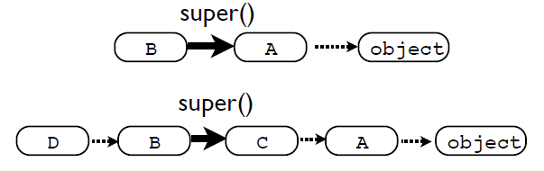
Why super()
Always use super() when overriding methods.
  class B(A):
    def foo(self):
      ...
      return super(B,self).foo()
super() delegates to the next class on the MRO
Tricky bit: You don't know what it is

Slide 26
Some Cautions
Multiple inheritance is a powerful tool
With power comes responsibility
Frameworks/libraries sometimes use it for advanced features involving composition of components
More details in an advanced course

Slide 27
Classes and Encapsulation
One of the primary roles of a class is to encapsulate data and internal implementation details of an object.
However, a class also defines a public interface that the outside world is supposed to use to manipulate the object.
This distinction between implementation details and the public interface is important.

Slide 28
A Problem
In Python, almost everything about classes and objects is open.
  You can easily inspect object internals.
  You can change things at will.
  There is no strong notion of access-control (i.e., private class members)
That is an issue when you are trying to isolate details of the internal implementation.
Python Encapsulation
Python relies on programming conventions to indicate the intended use of something.
These conventions are based on naming.
There is a general attitude that it is up to the programmer to observe the rules as opposed to having the language enforce them

Slide 29
Private/Protected Attributes
Any attribute name with leading “_” is considered to be private.
  class Person(object):
  def __init__(self, name):
  self._name = 0
However, this is only a programming style.
You can still access and change it.
  >>> p = Person('Guido')
  >>> p._name
  'Guido'
  >>> p._name = 'Dave'
  >>>

Slide 30
Private Attributes
Variant : Attribute names with two leading _
  class Person(object):
    def __init__(self, name):
      self.__name = name
This kind of attribute is "more private"
  >>> p = Person('Guido')
  >>> p.__name
  AttributeError: 'Person' object has no attribute '__name'
  >>>
This is actually just a name mangling trick
  >>> p = Person('Guido')
  >>> p._Person__name
  'Guido'
  >>>

Slide 31
Private Attributes
Discussion: What style to use?
Most experienced Python programmers seem to use a single underscore
Many consider the use of double underscores to cause more problems than they solve
Example: getattr(), setattr() don't work right
You mileage might vary...

Slide 32
Problem: Simple Attributes
Consider the following class
  class Stock:
  def __init__(self, name, shares, price):
  self.name = name
  self.shares = shares
  self.price = price
A surprising feature is that you can set the attributes to any value at all:
  >>> s = Stock('IBM', 50, 91.1)
  >>> s.shares = 100
  >>> s.shares = "hundred"
  >>> s.shares = [1, 0, 0]
  >>>
Suppose you later wanted to add validation
  s.shares = '50' # Raise a TypeError, this is a string
How would you do it?

Slide 33
Managed Attributes
One approach: introduce accessor methods.
  class Stock:
  def __init__(self, name, shares, price):
  self.name = name
  self.set_shares(shares)
  self.price = price
  # Function that layers the "get" operation
  def get_shares(self):
  return self._shares
  # Function that layers the "set" operation
  def set_shares(self, value):
  if not isinstance(value, int):
  raise TypeError('Expected an int')
  self._shares = value
Too bad that this breaks all of our existing code.
  s.shares = 50 s.set_shares(50)

Slide 34
Properties
There is an alternative approach to the previous pattern.
  class Stock:
  def __init__(self, name, shares, price):
  self.name = name
  self.shares = shares
  self.price = price
  @property
  def shares(self):
  return self._shares
  @shares.setter
  def shares(self, value):
  if not isinstance(value, int):
  raise TypeError('Expected int')
  self._shares = value
The syntax is a little jarring at first

Slide 35
Properties
Normal attribute access now triggers the getter and setter methods under @property and @shares.setter.
  class Stock:
  def __init__(self, name, shares, price):
  self.name = name
  self.shares = shares
  self.price = price
  @property
  def shares(self):
  return self._shares
  @shares.setter
  def shares(self, value):
  if not isinstance(value, int):
  raise TypeError('Expected int')
  self._shares = value
No changes needed to other source code
>>> s = Stock(...)
>>> s.shares
100
>>> s.shares = 50
>>>
get
set

Slide 36
Properties
You don't change existing attribute access
  class Stock:
  def __init__(self, name, shares, price):
  ...
  # This assignment calls the setter below
  self.shares = shares
  ...
  ...
  @shares.setter
  def shares(self, value):
  if not isinstance(value, int):
  raise TypeError('Expected int')
  self._shares = value
Common confusion: property vs private name
assignment
calls the setter

Slide 37
Properties
Properties are also useful if you are creating objects where you want to have a very consistent user interface
Example : Computed data attributes
  class Circle(object):
    def __init__(self, radius):
      self.radius = radius
    @property
    def area(self):
      return math.pi * (self.radius ** 2)
    @property
    def perimeter(self):
      return 2 * math.pi * self.radius

Slide 38
Properties
Example use:
  >>> c = Circle(4)
  >>> c.radius
  4
  >>> c.area
  50.26548245743669
  >>> c.perimeter
  25.132741228718345
Commentary : Notice how there is no obvious difference between the attributes as seen by the user of the object
Instance Variable
Computed Properties

Slide 39
Uniform Access
The last example shows how to put a more uniform interface on an object. If you don't do this, an object might be confusing to use:
  >>> c = Circle(4.0)
  >>> a = c.area() # Method
  >>> r = c.radius # Data attribute
  >>>
Why is the () required for the cost, but not for the shares? A property can fix this.

Slide 40
__slots__ Attribute
You can restrict the set of attributes names.
  class Stock:
  __slots__ = ('name','_shares','price')
  def __init__(self, name, shares, price):
  self.name = name
  ...
It will raise an error for other attributes.
  >>> s = Stock('GOOG', 100, 490.1)
  >>> s.price = 385.15
  >>> s.prices = 410.2
  Traceback (most recent call last):
  File "<stdin>", line 1, in ?
  AttributeError: 'Stock' object has no attribute 'prices'
Although this prevents errors and restricts usage of objects, it's actually used for performance and makes Python use memory more efficiently.

Slide 41
Final Comments on Encapsulation
Don't go overboard with private attributes, properties, slots, etc.
They serve a specific purpose and you may see them when reading other Python code.
However, they are not necessary for most day-to-day coding.

